Slide 1
Set Theory 2

Slide 2
Cartesian Product
Cartesian product of A and B, denoted A × B, is the set whose members are all possible ordered pairs (a,b) where a is a member of A and b is a member of B.
The cartesian product of {1, 2, 3 } and {red, white} is {(1, red), (1, white), (2, red), (2, white), (3, red), (3, white)}.
Is A x B = B x A? No, the ordered pair (1,red) is not the same as (red, 1).

Slide 3
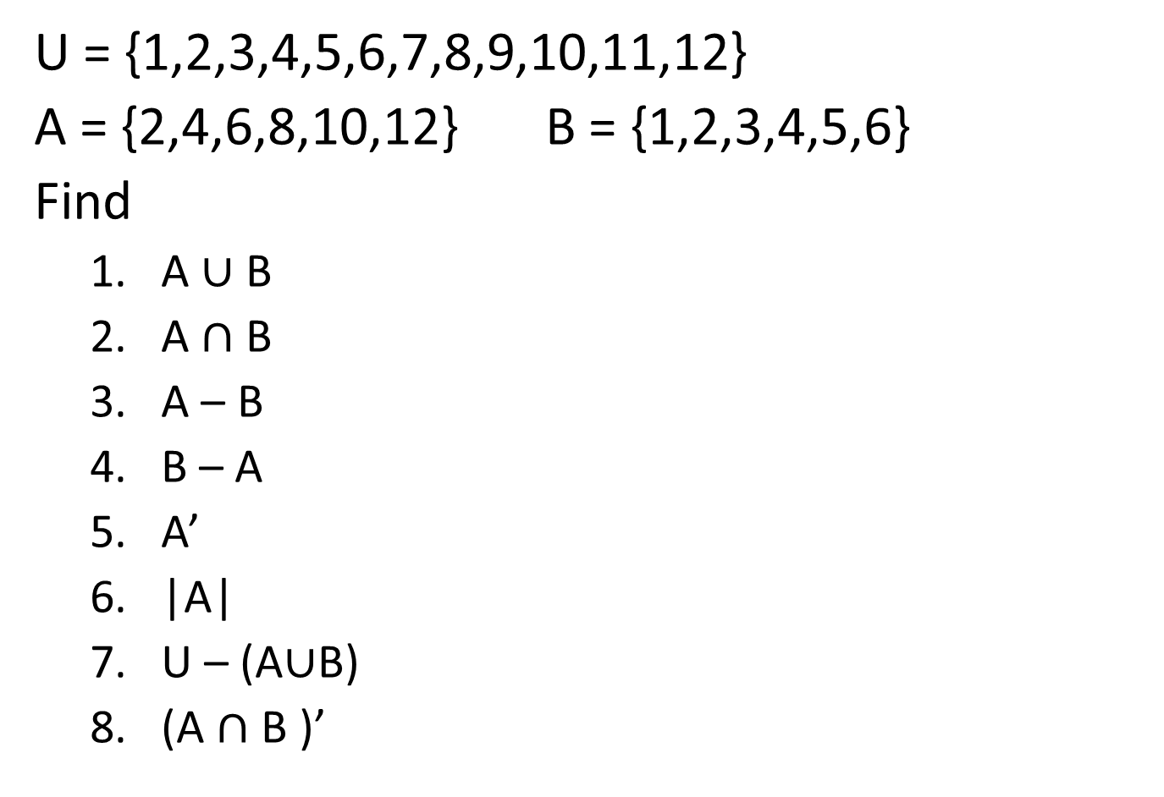
Question
U = {1,2,3,4,5,6,7,8,9,10,11,12}
A = {2,4,6,8,10,12} B = {1,2,3,4,5,6}
Find
A $∪$ B
A $∩$ B
A – B
B – A
A’
|A|
U – (A$∪$B)
(A $∩$ B )’

Slide 4
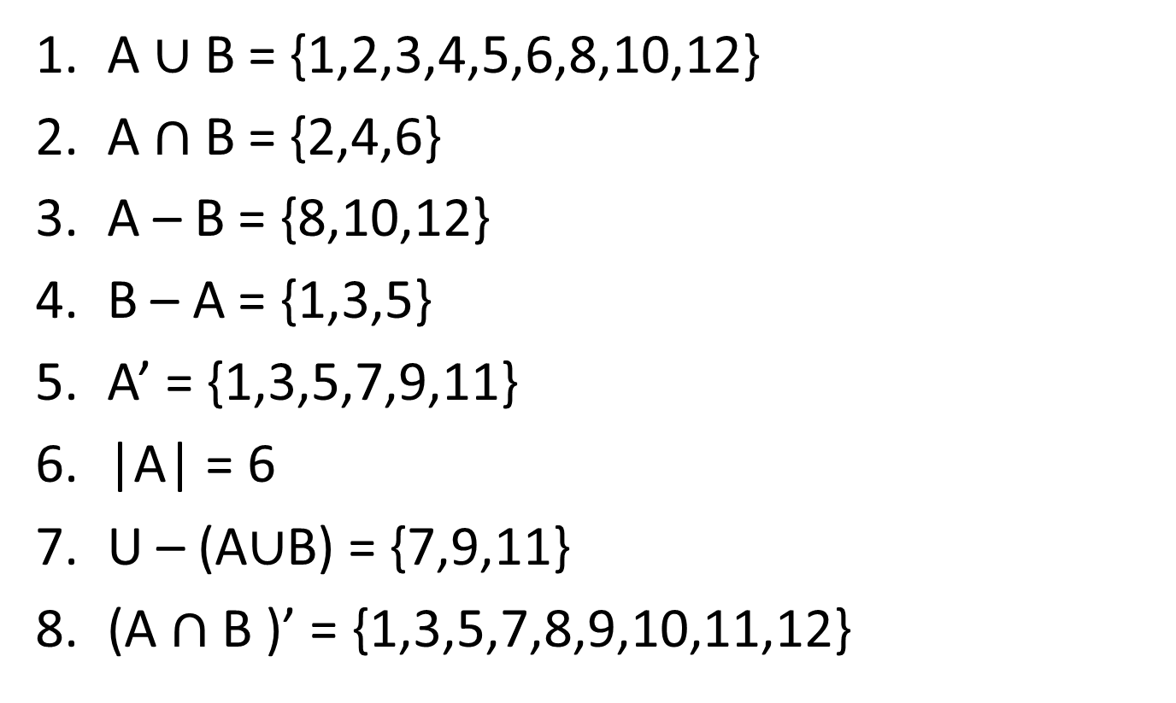
Solution
A $∪$ B = {1,2,3,4,5,6,8,10,12}
A $∩$ B = {2,4,6}
A – B = {8,10,12}
B – A = {1,3,5}
A’ = {1,3,5,7,9,11}
|A| = 6
U – (A$∪$B) = {7,9,11}
(A $∩$ B )’ = {1,3,5,7,8,9,10,11,12}

Slide 5
Venn Diagram
U
A
B
8
2
1
6
10
4
3
9
12
5
7
11

Slide 6

U – (A$∪$B) shaded on Venn diagram
U
A
B

Slide 7

(A $∩$ B )’ shaded on Venn diagram
U
A
B

Slide 8

Cardinal Number Formula
|A $∪$ B| = |A| + |B| - |A $∩$ B|
A
B

Slide 9
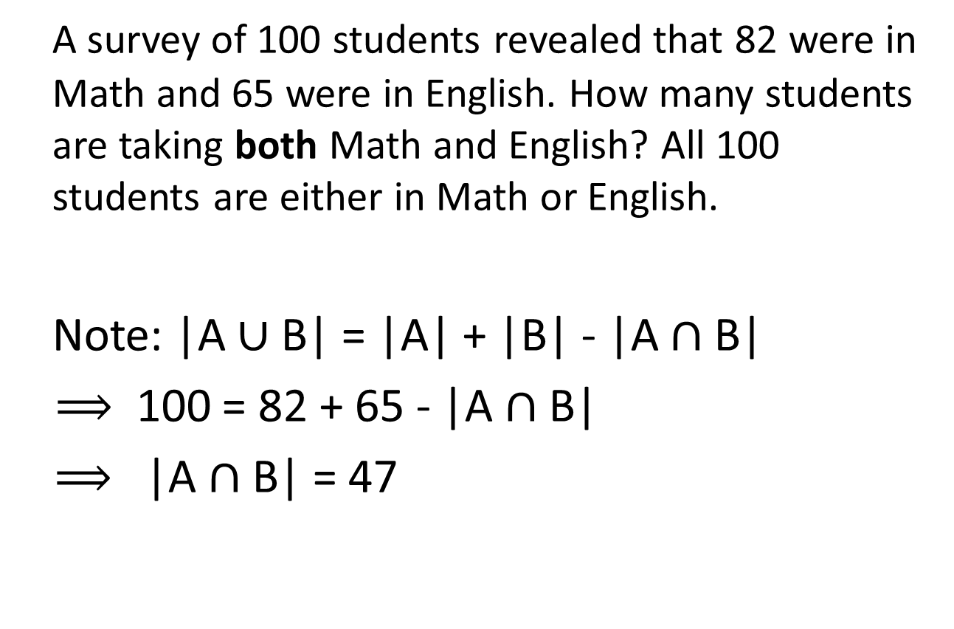
Logic and Venn diagrams - example
A survey of 100 students revealed that 82 were in Math and 65 were in English. How many students are taking both Math and English? All 100 students are either in Math or English.
Note: |A $∪$ B| = |A| + |B| - |A $∩$ B|
$⟹$ 100 = 82 + 65 - |A $∩$ B|
$⟹$ |A $∩$ B| = 47

Slide 10
U
Math
English

Slide 11
Solution
82 + 65 = 147 82 – 47 = 35
147 – 100 = 47 65 – 47 = 18
U
Math
English
35
47
18

Slide 12
Venn Diagrams - Three Sets
A
B
2
1
3
5
4
6
7
C

Slide 13

A
B
2
1
3
5
4
6
7
C
Region 1: In A but not in B or C
Region 1: A-(B $∪C)$

Slide 14

A
B
2
1
3
5
4
6
7
C
Region 2: In A and B but not in C
Region 2: (A $∩B)$-$C$

Slide 15

A
B
2
1
3
5
4
6
7
C
Region 3: In B but not in A or C
Region 3: B-(A $∪C)$

Slide 16
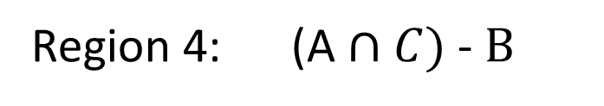
A
B
2
1
3
5
4
6
7
C
Region 4: In A and C but not in B
Region 4: (A $∩C)$-$B$

Slide 17

A
B
2
1
3
5
4
6
7
C
Region 5: In A and B and C
Region 5: A $∩$ B $∩C$

Slide 18
Region 1: In A but not in B or C
Region 2: In A and B but not in C
Region 3: In B but not in A or C
Region 4: In A and C but not in B
Region 5: In A and B and C
Region 6: In B and C but not in A
Region 7: In C but not in A or B

Slide 19

Exam Question - Summer 2019
Q5 (a) On separate Venn diagrams shade the area to represent the following:
(i) A – (B – C) (ii) A $∩$ (B $∪$ C) (iii) A – (B $∩$ C)
Solution on next slide

Slide 20
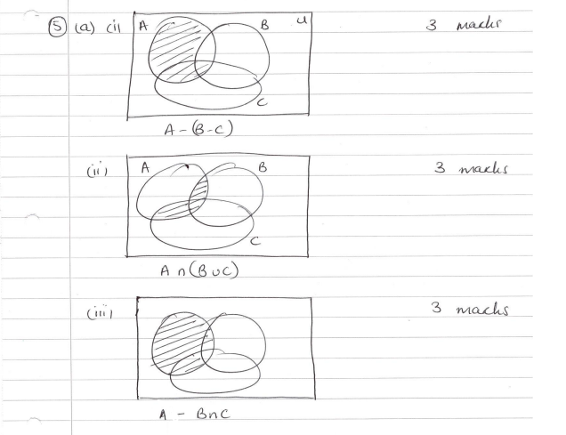

Slide 21
Logic and Venn diagrams -example with three sets
Example 1 This term, a survey of 100 students at De Anza college finds that 50 take math, 40 take English, and 30 take history. Of these 15 take English and math, 10 take English and history, 10 take math and history, and 5 take all three subjects. Draw a Venn diagram and determine the following.
The number of students taking math but not the other two subjects.
The number of students taking English or math but not history.
The number of students taking none of these subjects.

Slide 22
Solution
U =100 students
M
E
5
H

Slide 23
Solution
U =100 students
M
E
10
5
5
5
H

Slide 24
Solution
U =100 students
M
E
30
10
20
5
5
5
15
10
H

Slide 25
Answers
The number of students taking math but not the other two subjects……. 30
The number of students taking English or math but not history……..60
The number of students taking none of these subjects………10

Slide 26

Formula for the Cardinal Number of the Union of Three Sets
|A $∪$ B $∪$ C|
= |A| + |B| + |C|
- |A $∩$ B| - |A $∩$ C| - |B $∩$ C| + |A $∩$ B $∩$ C|

Slide 27
Example 2 :
A group of 40 students were surveyed about the languages they have chosen: E = English, F = French, S = Spanish.
2 students did not study any of the languages above.
8 study English and French
10 study English and Spanish
6 study French and Spanish
13 students study French
28 students study English
19 students study Spanish

Slide 28
How many students study all three languages?
How many students study French and Spanish but not English?
How many students study one language only?

Slide 29
Formula for the Cardinal Number of the Union of Three Sets
|A $∪$ B $∪$ C|
= |A| + |B| + |C|
- |A $∩$ B| - |A $∩$ C| - |B $∩$ C| + |A $∩$ B $∩$ C|

Slide 30
Example 3: In a class of 32 pupils:
17 pupils eat school dinners
16 pupils live in town
13 pupils travel by bus
8 pupils live in town, travel to school by bus
9 pupils do not live in town, do not travel to school by bus and do not eat school dinners
11 pupils live in town and have school dinners
9 pupils travel by bus and eat school dinners
How many students live in town, travel by bus and eat school dinners?

Slide 31
Example 4 From a group of 100 students surveyed we obtain the following:
12 play tennis and basketball
11 play tennis and volleyball
13 play basketball and volleyball
40 play tennis
40 play basketball
30 play volleyball
18 play none of the three

Slide 32
Draw the Venn diagram and answer the following:
How many students play all three sports?
How many play exactly two sports?
How many play tennis but not volleyball?

