Slide 1
Coordinate Geometry
Additional Notes

Slide 2
Coordinate Geometry Formulae
We need to be able to use the following formulae:
Distance between two points (x₁, y₁) and (x₂, y₂)
Midpoint, M, between two points (x₁, y₁) and (x₂, y₂)

Slide 3
Coordinate Geometry Formulae
Slope, m, of line containing two points (x₁, y₁) and (x₂, y₂)
Equation of a line with slope m and point (x₁,y₁)

Slide 4
General equation of line y=mx+c
The equation of a line is represented in general form as y = mx + c where the m represents the slope of the line and the c is the y-intercept (where line cuts the y-axis.
The line y = 3x + 5 has a slope of 3 and cuts the y-axis at 5, ie. at point (0,5).
A positive slope means the line slopes upwards from left to right.

Slide 5
The line y = -2x + 6 has a slope of -2 and cuts the y-axis at 6 ie. at point (0,6).
A line with a negative slope slopes downwards from left to right.
Positive sloping line
Negative sloping line
Line with slope of 0

Slide 6
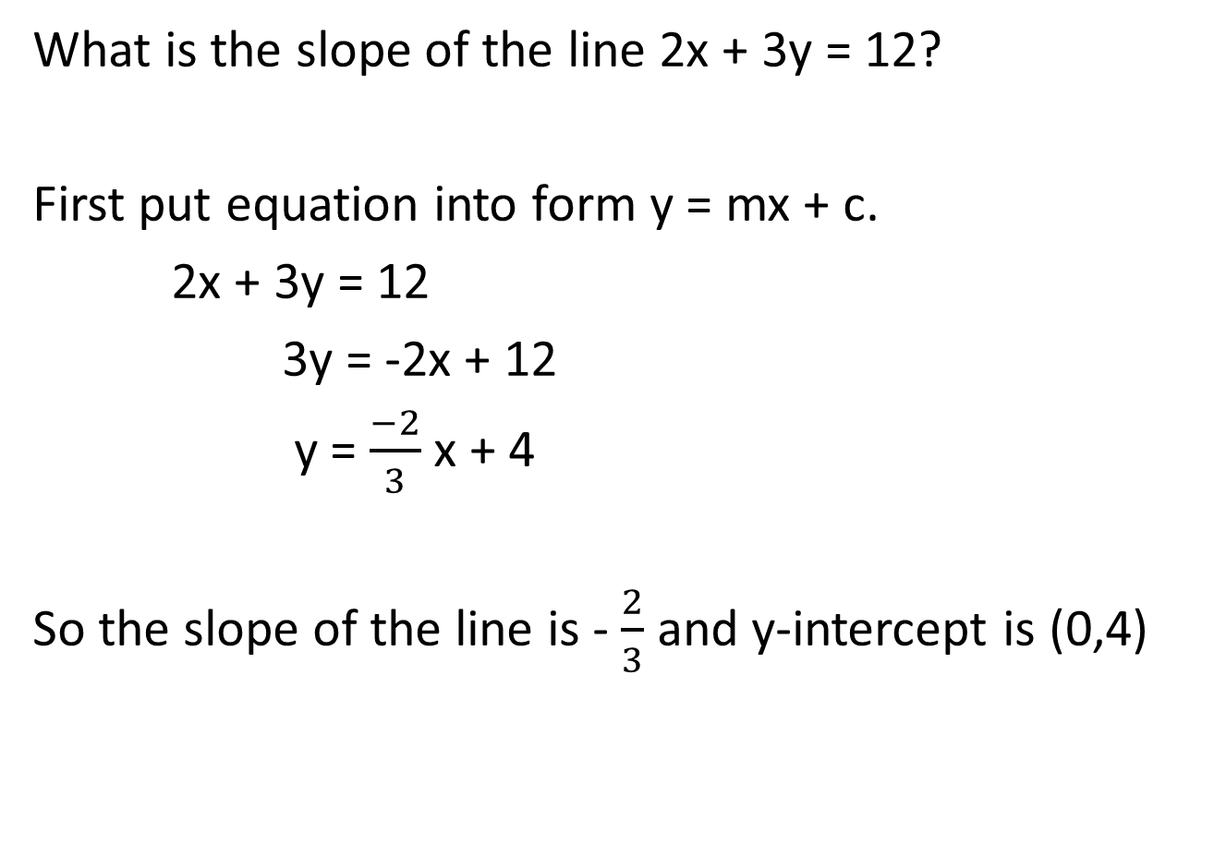
What is the slope of the line 2x + 3y = 12?
First put equation into form y = mx + c.
2x + 3y = 12
3y = -2x + 12
y = $\frac{−2}{3}$ x + 4
So the slope of the line is - $\frac{2}{3}$ and y-intercept is (0,4)

Slide 7

Parallel lines
Parallel lines have equal slopes. So L: y = 3x + 7 and M: y = 3x – 5 are both parallel.
We say L $∥$ M.

Slide 8
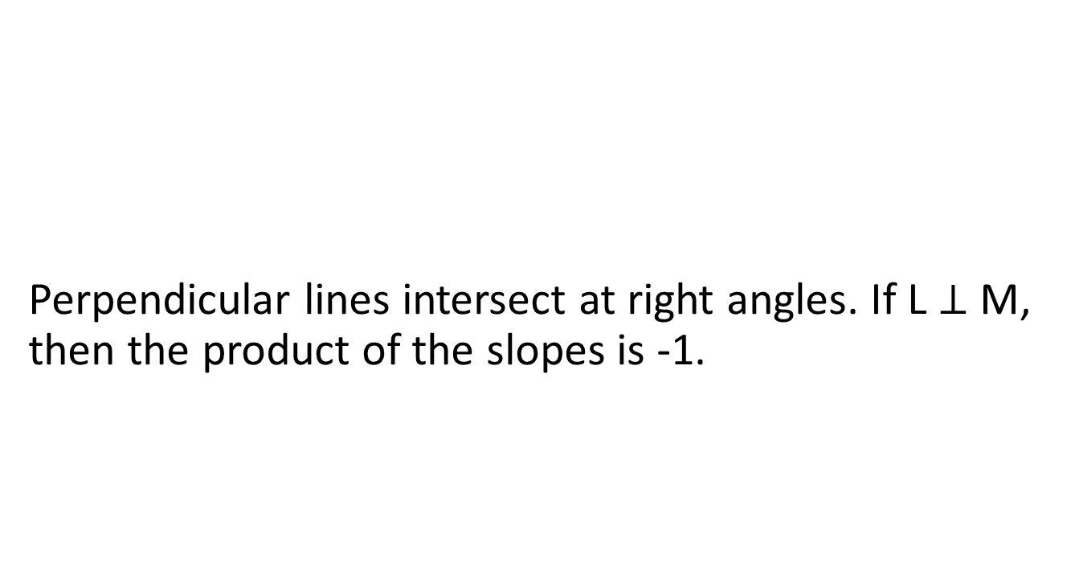
Perpendicular lines
Perpendicular lines intersect at right angles. If L $⊥$ M, then the product of the slopes is -1.

Slide 9
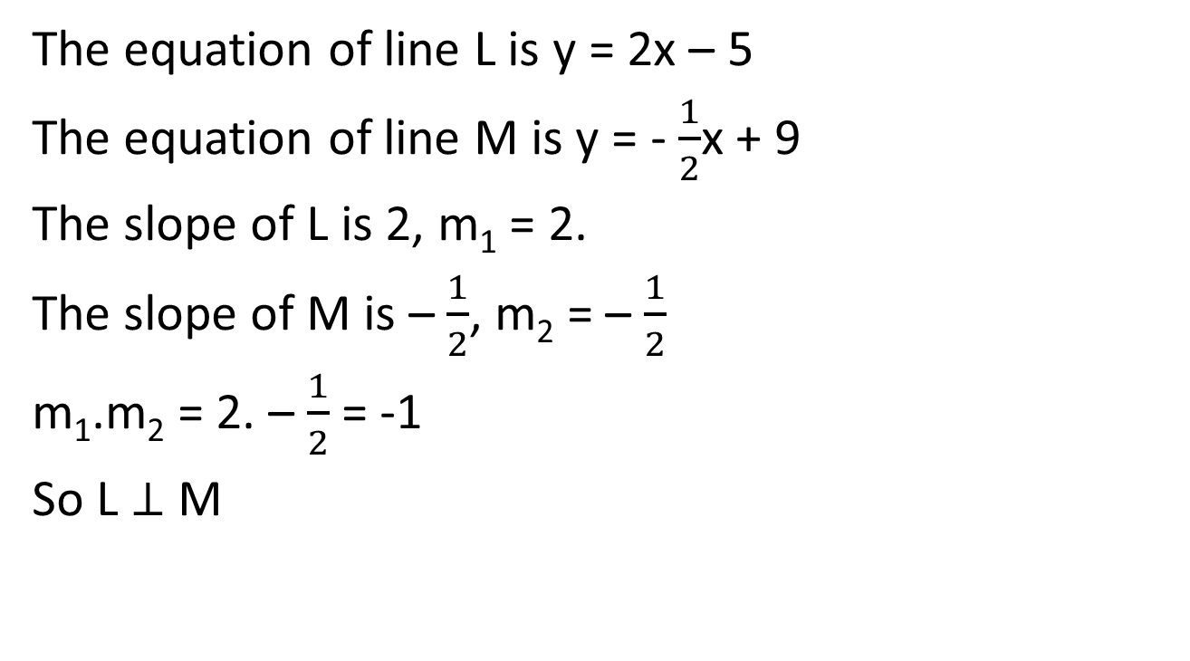
Perpendicular lines
The equation of line L is y = 2x – 5
The equation of line M is y = - $\frac{1}{2}$x + 9
The slope of L is 2, m₁ = 2.
The slope of M is – $\frac{1}{2}$, m₂ = – $\frac{1}{2}$
m₁.m₂ = 2. – $\frac{1}{2}$ = -1
So L $⊥$ M

Slide 10
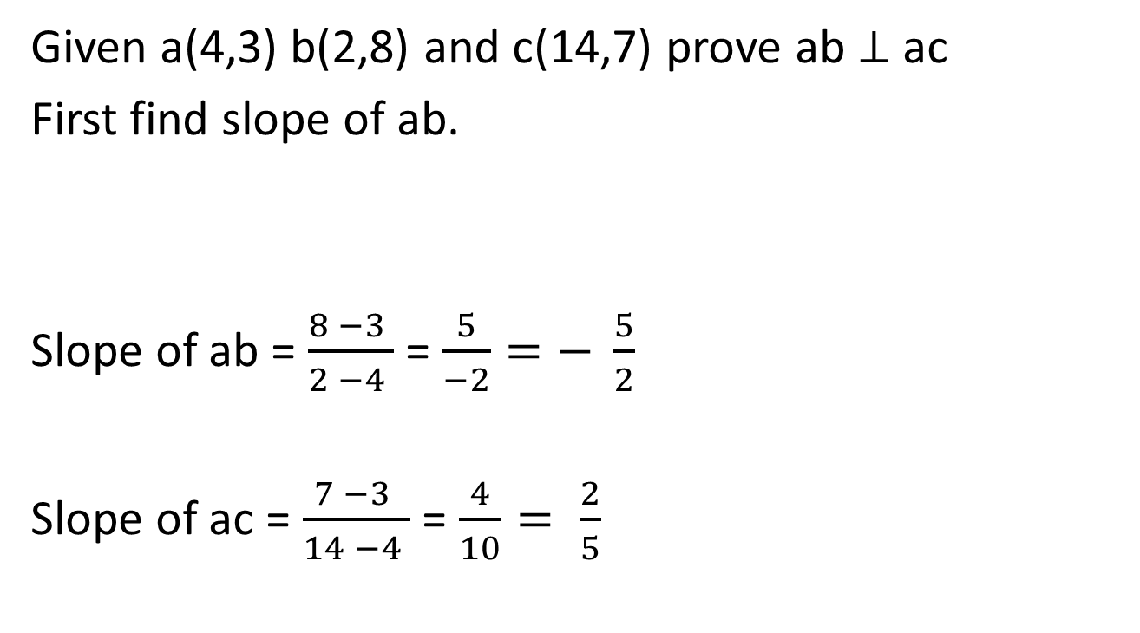
Perpendicular lines
Given a(4,3) b(2,8) and c(14,7) prove ab $⊥$ ac
First find slope of ab.
Slope of ab = $\frac{8 −3 }{2 −4 }$ = $\frac{5}{−2}=− \frac{5}{2}$
Slope of ac = $\frac{7 −3 }{14 −4 }$ = $\frac{4}{10}= \frac{2}{5}$

Slide 11

$− \frac{5}{2}$ . $\frac{2}{5}$ = - $\frac{10}{10}$ = -1
So ab $⊥$ ac

Slide 12
Intersection of two lines
Two lines intersect at a single point (x₁,y₁). To find the point of intersection we use simultaneous equations. See three examples on the following slides.

Slide 13
Simultaneous equations-example 1
Solve y = 2x + 3
y = 7 – 2x
In first equation y = 2x + 3 and in second equation y = 7 -2x, so
2x + 3 = 7 - 2x
Solving for x
2x + 2x = 7 – 3
4x = 4
x = 1

Slide 14
Now substitute in x = 1 to either original equation to find y.
y = 2x + 3
y = 2(1) + 3 = 5
So solution x = 1 and y = 5
So point of intersection is (1,5)

Slide 15
Simultaneous equations-example 2
Solve 4x + 2y = 32
3x – y = 19
To solve here we need to cancel the x or the y. To cancel a variable we need same number and opposite signs in front of the variable.
We will cancel the y terms. Why?
4x + 2y = 32
(x 2) 3x – y = 19

Slide 16
4x + 2y = 32
6x – 2y = 38
4x + 2y = 32
6x – 2y = 38
10x = 70
x = 7
Substitute x = 7 into one of the original equations:
4x + 2y = 32
4(7) + 2y = 32
28 + 2y = 32
2y = 4 ……..so y =2
So point of intersection is (7,2)

Slide 17
Simultaneous equations-example 3
Solve 5x + 4 y = 26
2x + 3y = 16
To solve here we need to cancel the x or the y. To cancel a variable we need same number and opposite signs in front of the variable.
We will cancel the y terms. Why?
(3) 5x + 4 y = 26
(-4) 2x + 3y = 16

Slide 18
15x + 12y = 78
-8x - 12y = -64
7x = 14
so x = 2 x = 2
Substitute x = 2 into one of the original equations.
5x + 4 y = 26
5(2) + 4y = 26
10 + 4y = 26
4y = 26 - 10 = 16
y = 16/4 y = 4
So point of intersection is (2,4)

Slide 19
Drawing a line on the cartesian plane (the x – y axis)
To draw any line we need two points. Suppose we wish to draw the line 2x + 3y = 12.
Find two points on the line…..where line cuts x-axis and y-axis.
Line cuts x-axis at y=0…so let y=0 and solve for x.
2x + 3y = 12
2x + 3(0) = 12
2x = 12……so x = 6
line cuts x-axis at (6,0)

Slide 20
Line cuts y-axis at x=0…so let x=0 and solve for y.
2x + 3y = 12
2(0) + 3y = 12
3y = 12……so y = 4
line cuts y-axis at (0,4)
Plot the two points and draw a line through the two points. See next slide.

