Slide 1
The Proxy WARFARE: Unmasking Russian and Chinese Externalized Cyber Capabilities

Slide 2

WHO I AM?
ALIXIA RUTAYISIRE
Geopolitical Analyst at QuoIntelligence
Previous role as intelligence analyst at the French MoD
Assessment of political and security situations
Providing strategic insights combining geopolitics and CTI

Slide 3
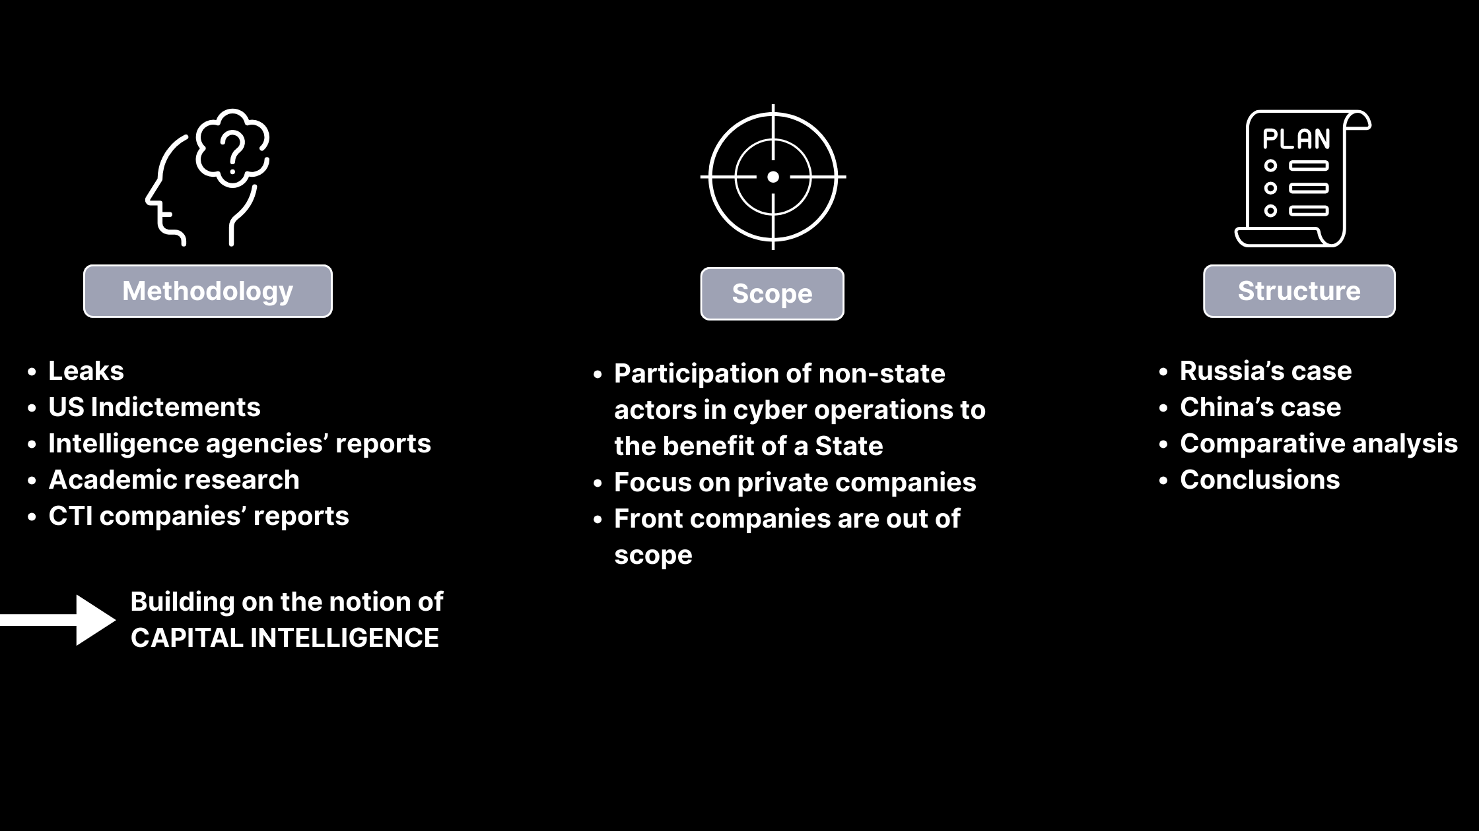
SETTING THE STAGE: Methodology, Scope, Structure
METODOLOGY
SCOPE
STRUCTURE
Leaks
US Indictments
Intelligence agencies’ reports
Academic research
CTI companies’ reports
Participation of non-state actors in cyber operations to the benefit of a State
Focus on private companies
Front companies are out of scope
Russia’s case
China’s case
Comparative analysis
Conclusions

Slide 4

RUSSIA: Cybercrime network historical development

Slide 5
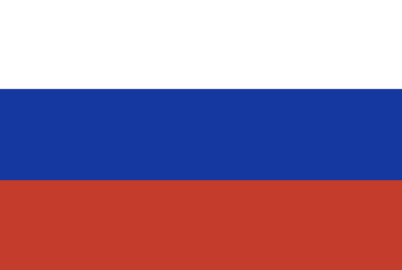
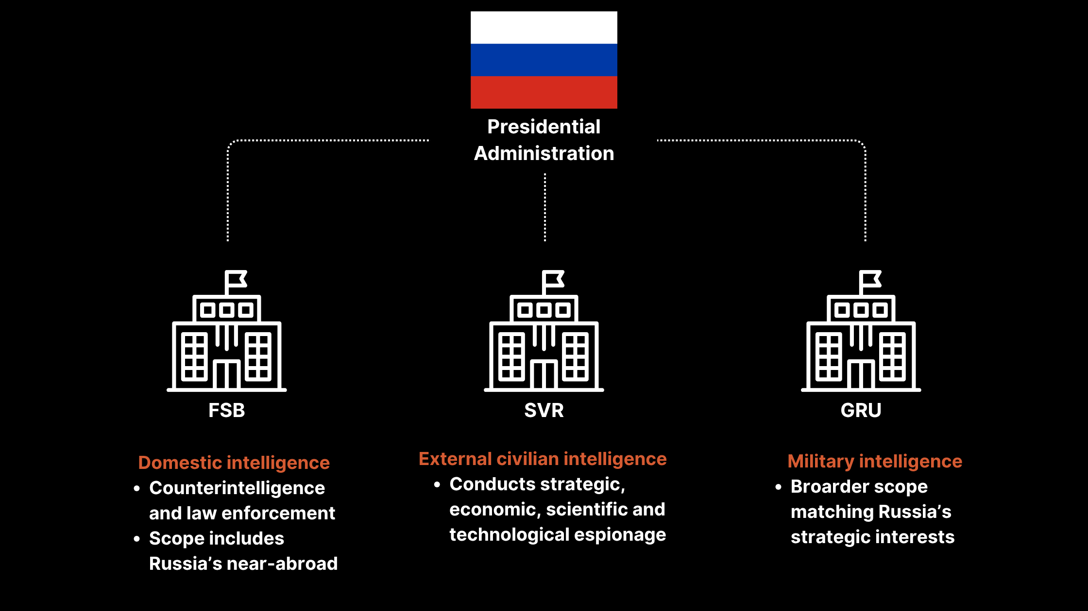
RUSSIA: Intelligence agencies
PRESINDENTIAL
ADMINISTRATION
Domestic intelligence
Counterintelligence and law enforcement
Scope includes Russia’s near-abroad
External civilian intelligence
Conducts strategic, economic, scientific and technological espionage
Military intelligence
Broader scope matching Russia’s strategic interests

Slide 6
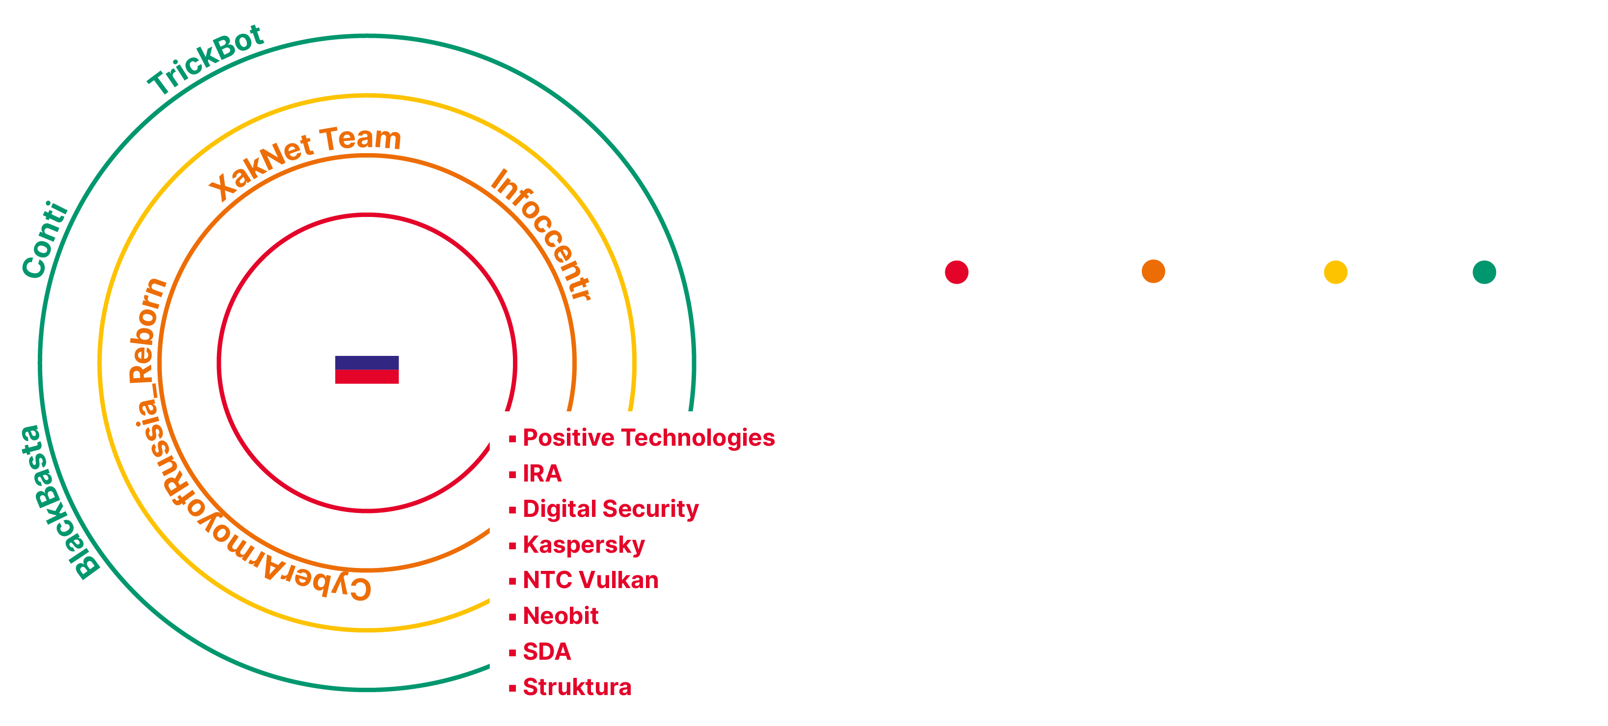
RUSSIA: The outsourcing ecosystem
Layers of outsourcing:

Slide 7

RUSSIA: Proxy services offering
Vulnerability Identification
Tools &
Solutions
Recruiting
Training
Information Operation

Slide 8

RUSSIA: Outsourcing risk-benefit calculus
RISKS
BENEFITS
Lack of control
Risky behavior
Uncertain mobilization
Reduced costs
Unparalleled Flexibility
Plausible deniability

Slide 9
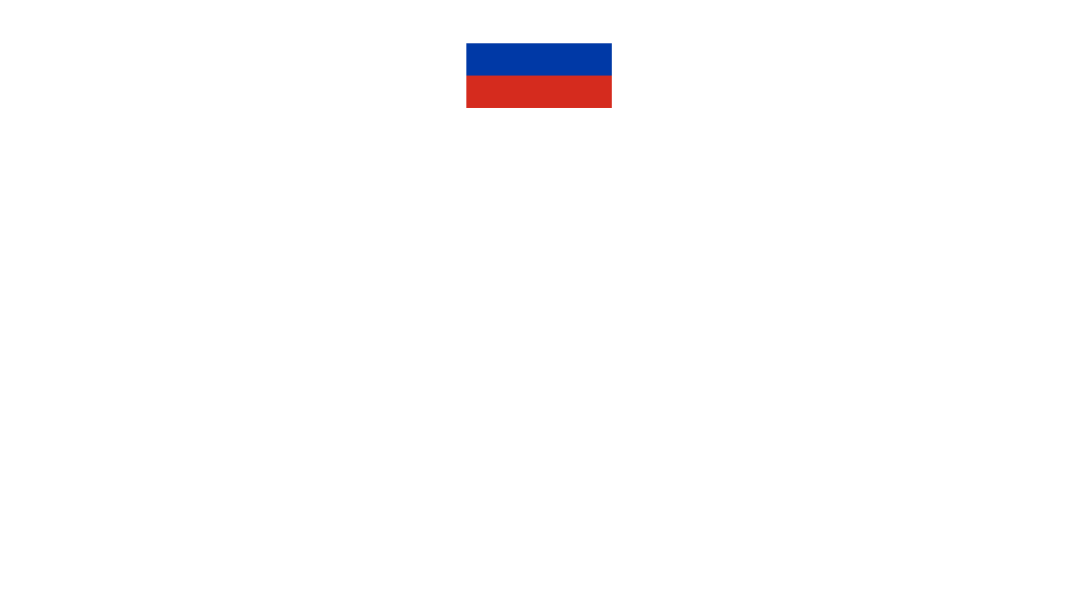
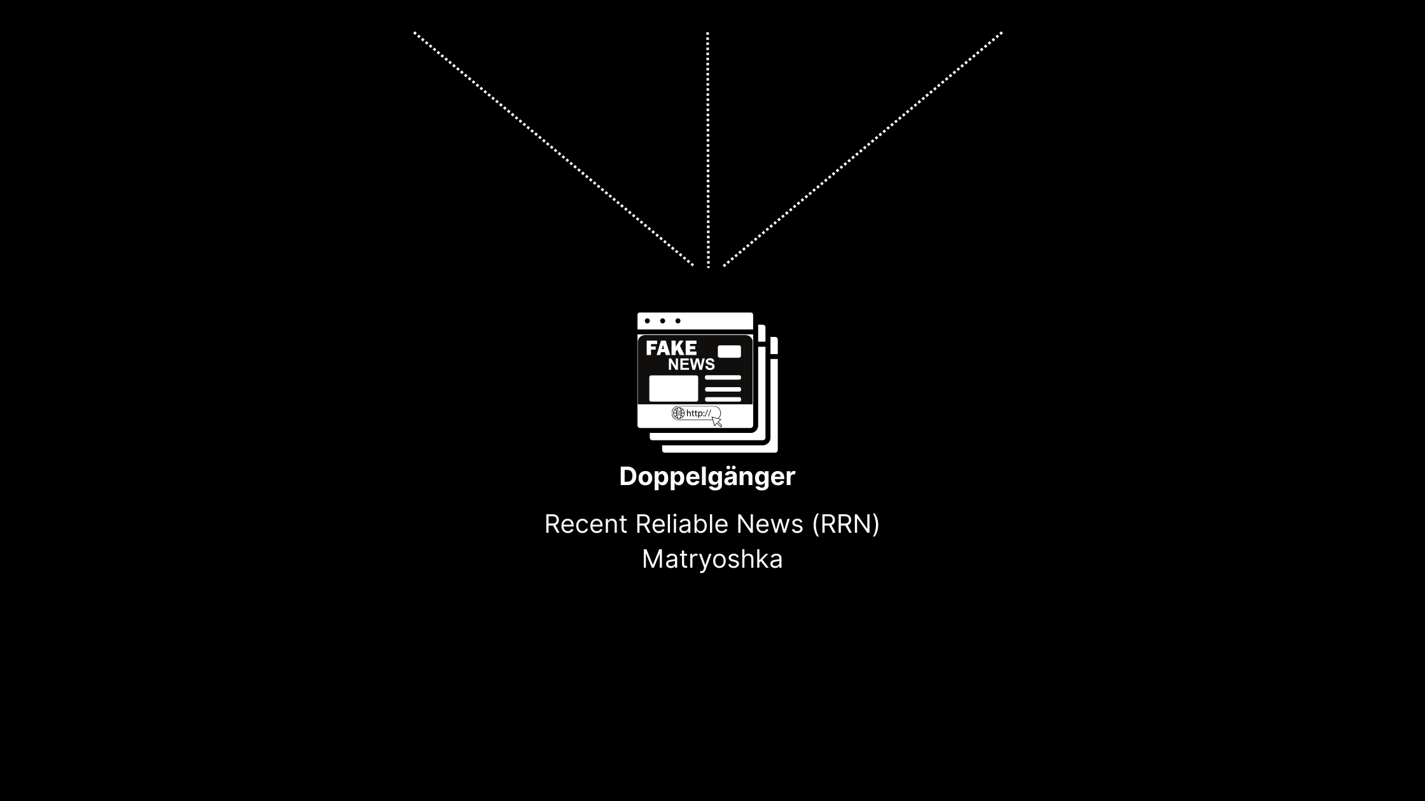
RUSSIA: The IO network

Slide 10


CHINA: Cyber sphere historical development
1994
1997-2010
2003
2010s
China accesses internet
Creation of Red Hacker groups
PLA starts recruiting hackers
MSS takeover recruiting of hackers

Slide 11









CHINA: From patriotic hackers to state contractors
Wu Haibo
Member of the Green Army and 0x557
I-Soon
Cai Jingjing
Member of Green Army, Xfocus, 0x557
Integrity Tech
Tan Dailin
Founder of NCPH
Hacking Group
PLA
Arrested by the MPS
MSS
Founder of cybersecurity firms

Slide 12
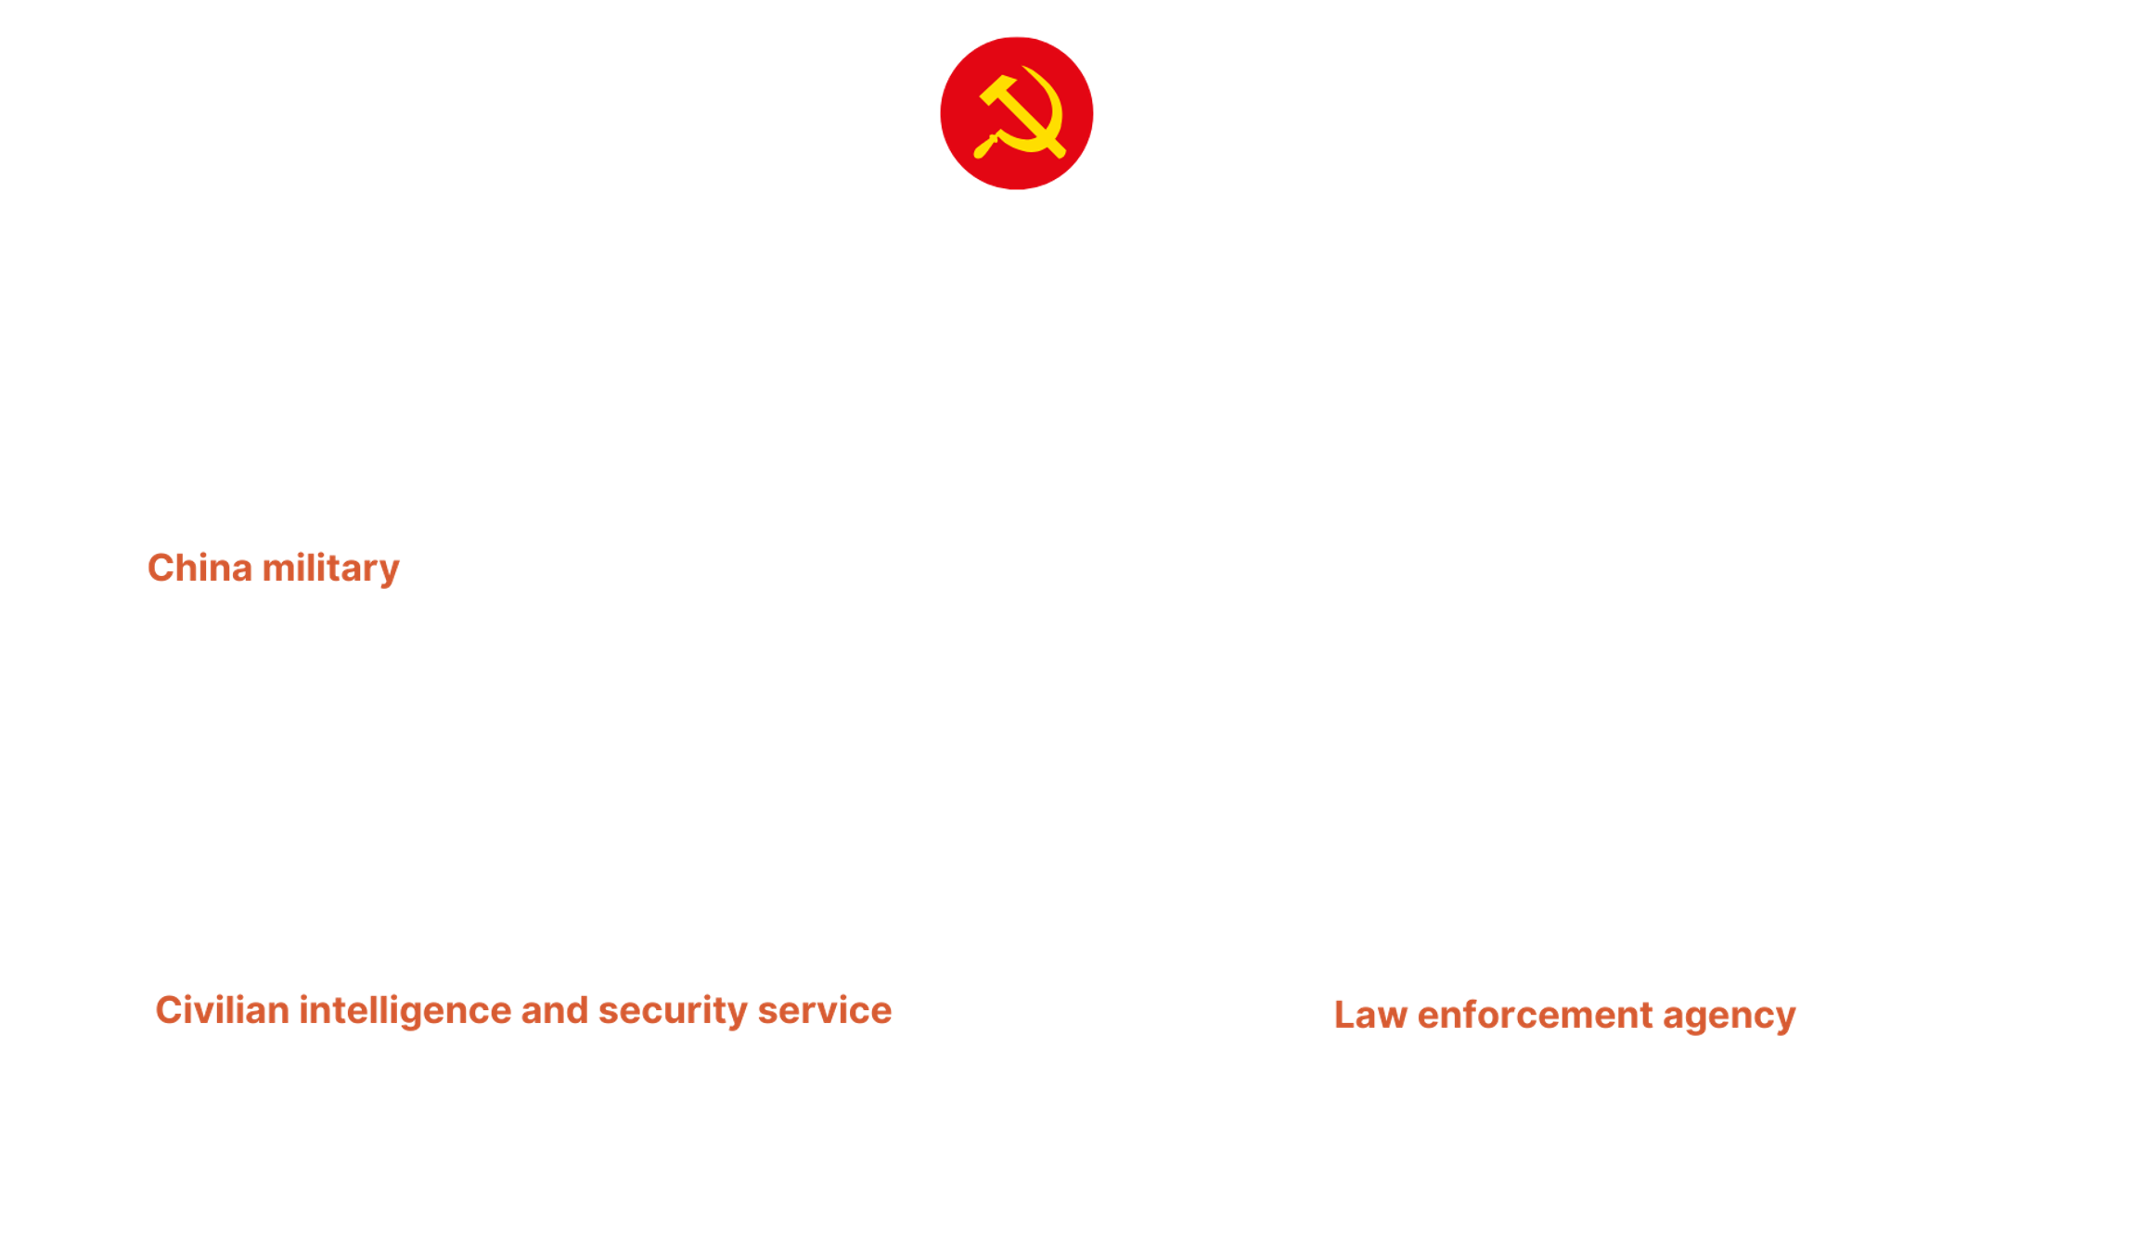
CHINA: Institutional architecture of state cyber capabilities

Slide 13

CHINA: The outsourcing ecosystem
Key Characteristics:
Comprehensive national strategy
Public bids
IT leaders and SMEs
Subcontracting
Competitive environment
Links based guanxi
High degree of autonomy
Qihoo 360, Beijing Topsec, Integrity Technology Group
Tsinghua Tongfang Co, Shanghai Firetech, Shanghai Powerock
I-Soon, Chengdu404, NSFocus, QiAnXin
Sichuan Juxinhe Network Technology Co, Sichuan Zhixin Ruijie Network Technology Co
Beijing Huanyu Tiangiong Information Technology Co, Shanghai Heiying Information Technology Co

Slide 14
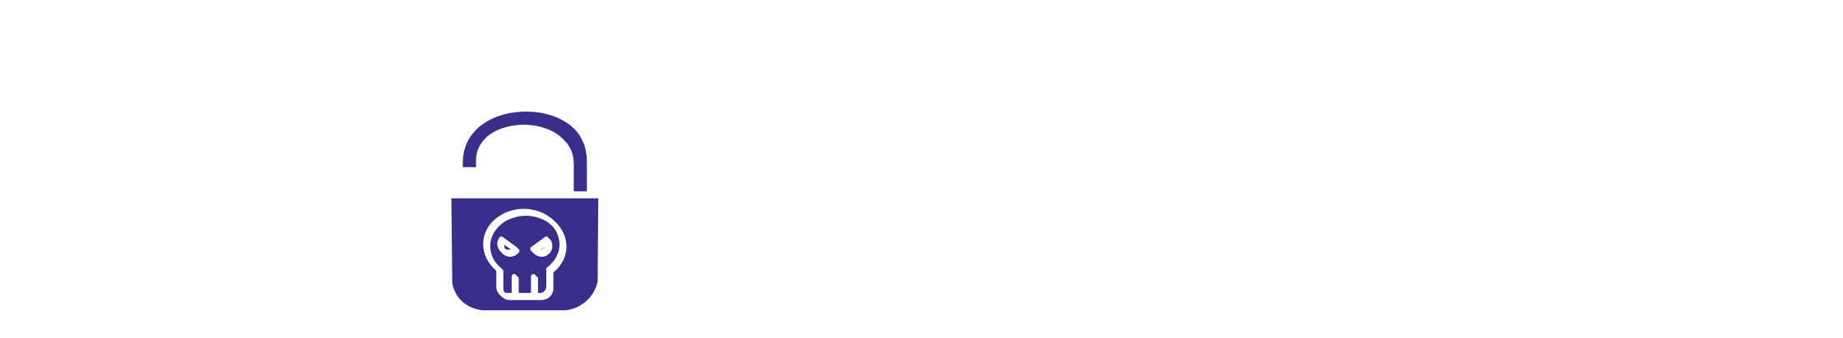
CHINA: Proxy services offering
Vulnerability Identification
Hacking-for-hire
Tools & Solutions
Recruiting
Information Operation

Slide 15
CHINA: Outsourcing risk-benefit calculus
RISKS
BENEFITS
Reduced costs
Flexibility
Efficiency
Innovation
Plausible deniability
Companies or employees re-selling data
Corruption and bid rigging
Risky behavior

Slide 16

CHINA: Vulnerability identification and exploitation strategy

Slide 17

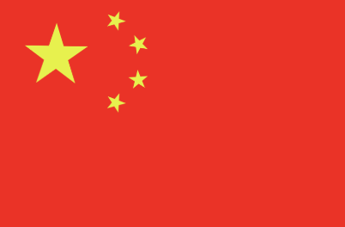
RUSSIA – CHINA: A comparative analysis
Proxy Characteristics/Countries
Private companies | Yes | Yes
Degree of autonomy of private companies | Medium-Low | High
Full outsourcing to private companies | No | Yes
Hacktivist groups | Yes | Unclear
Independent hackers | Yes | No
eCrime groups | Likely | No
Information operations | FOREIGN | Domestic

Slide 18
THE PROXY WARFARE: Takeaways and Conclusions
Functional and Effective Model
Best for Authoritarian Regimes
Increasingly Complex Threat Landscape
Challenging Attribution

Slide 19
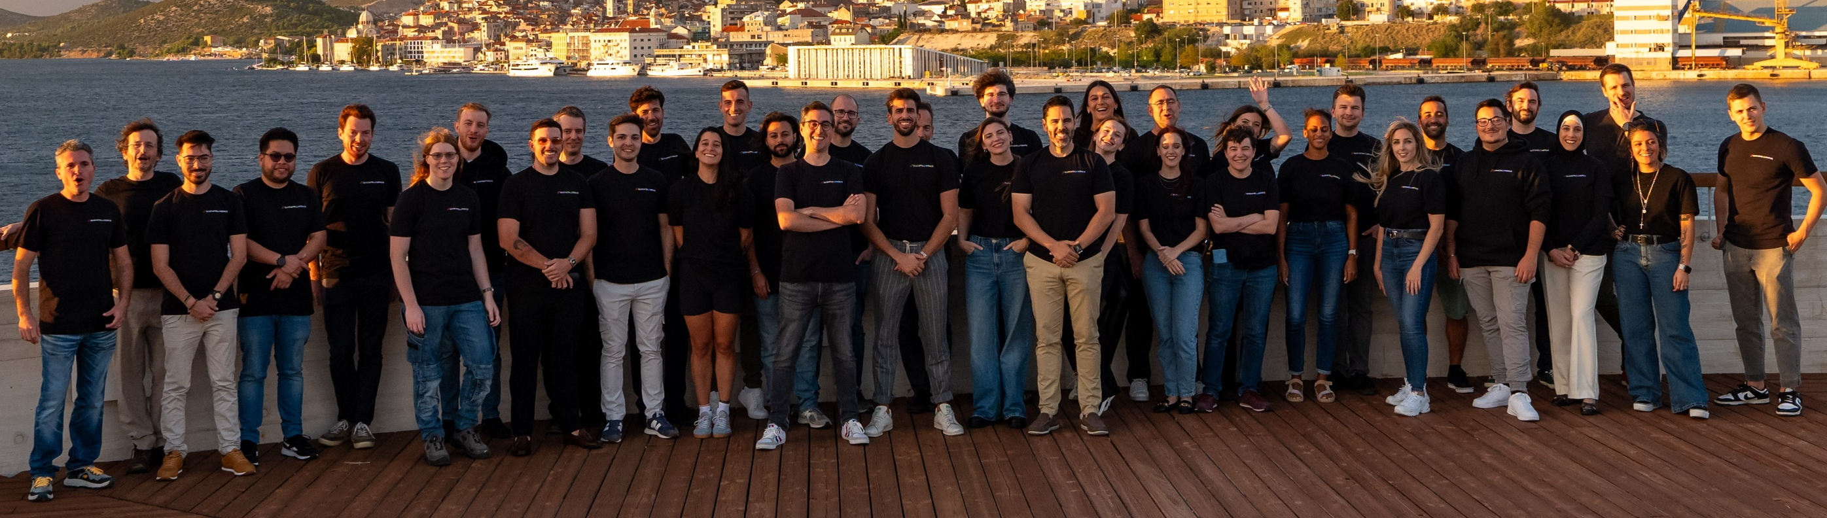



FOLLOW US
QuoIntelligence
Alixia RUTAYISIRE
curious@quointelligence.eu
/alixia-r
quointelligence.eu

