Slide 1

Seasonal Agriculture Performance Analysis Aman Kumar Chandigarh University
AICTE STU ID : STU6a641a16ab1121784945174

Slide 2

PROBLEM STATEMENT
(Agricultural activities are influenced by seasonal variations in environmental conditions, farming practices, resource availability and market conditions. As a result, agricultural performance may differ from one season to another. However, raw agricultural data does not clearly explain how agricultural performance changes across seasons or what patterns can be observed in different seasonal conditions. The problem is to analyze the given agricultural dataset and investigate seasonal differences in agricultural performance by identifying meaningful patterns, trends, relationships and variations within the available data.

Slide 3
Project Description Seasonal Agriculture Performance Analysis is a data analysis project that examines agricultural performance across different seasons, crops, states, environmental conditions, farming practices, resource usage, and economic factors. The project uses data cleaning, exploratory data analysis, statistical techniques, and visualization to identify seasonal patterns, compare agricultural performance, analyze relationships between environmental factors and yield, and evaluate profitability and resource efficiency. The findings are used to generate data-driven insights and recommendations for better seasonal agricultural planning and decision-making.

Slide 4

WHO ARE THE END USERS?
Farmers and agricultural planners — for seasonal crop and resource planning.
Agricultural departments and policymakers — for evidence-based regional planning.
Agribusinesses and resource managers — for understanding production and profitability patterns.
Researchers and analysts — for further study of seasonal agricultural performance.

Slide 5

Technology Used
Python — core programming and analysis
Pandas & NumPy — data cleaning and numerical analysis
Matplotlib & Seaborn — data visualization
SciPy — statistical testing and ANOVA

Slide 6
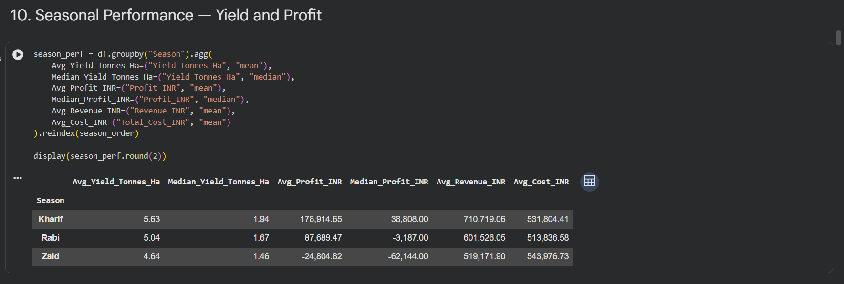
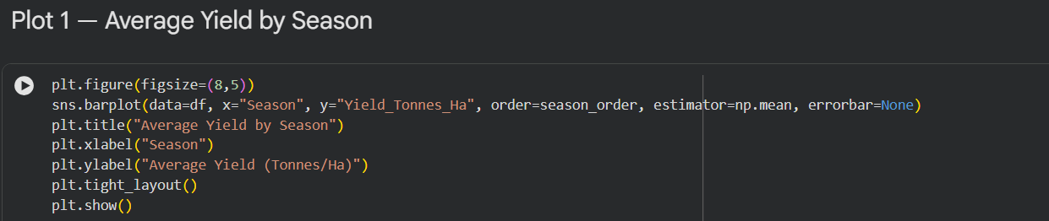
RESULTS

Slide 7
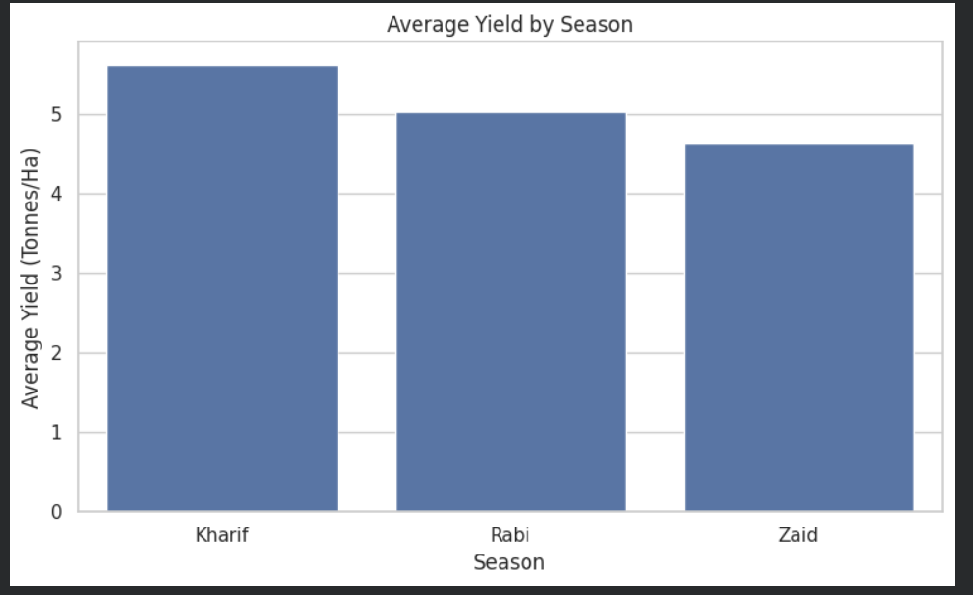
RESULTS

Slide 8
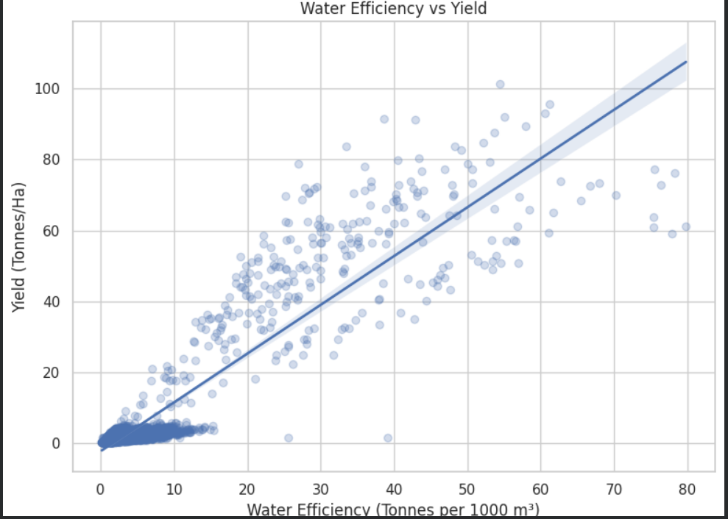
RESULTS

Slide 9
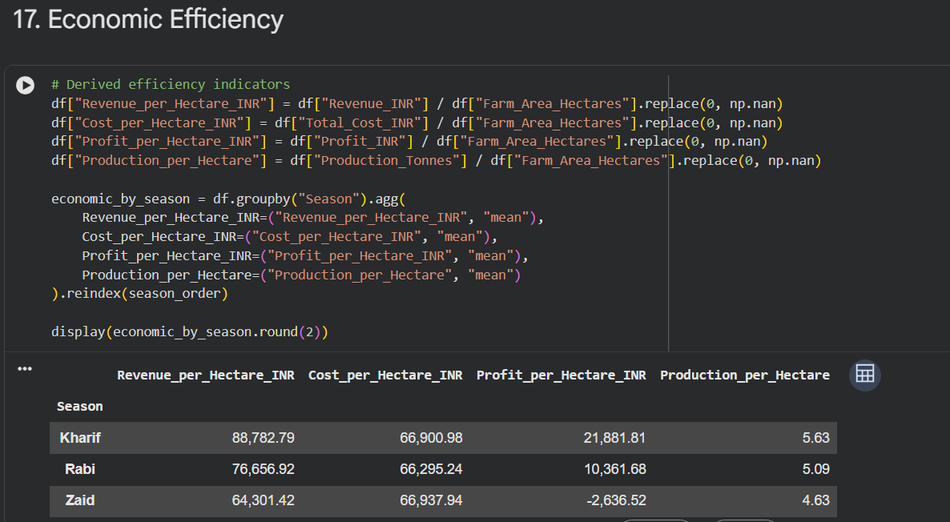
RESULTS

Slide 10
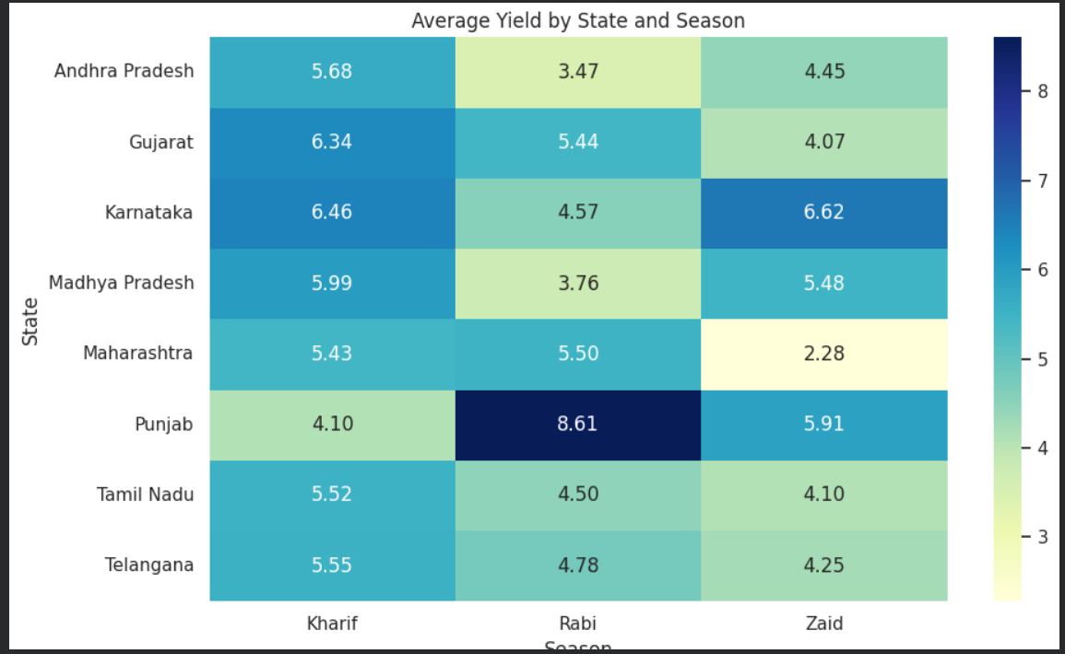
RESULTS

Slide 11
Future scope
• Build predictive models for crop yield and profitability.
• Add multi-year weather and historical market-price data.
• Develop interactive dashboards for farmers and decision-makers.
• Use more detailed district-level and crop-specific analysis.
• Explore causal and advanced statistical methods with richer datasets.

Slide 12
GitHub Link
https://github.com/realamvn/AICTE_Seasonal_Agriculture_Performance_Analysis

Slide 13

VOIS Course completion certificate - Course name- Data Visualization

Slide 14
Thank you
.
.
Aman Kumar Chandigarh University

