Slide 1
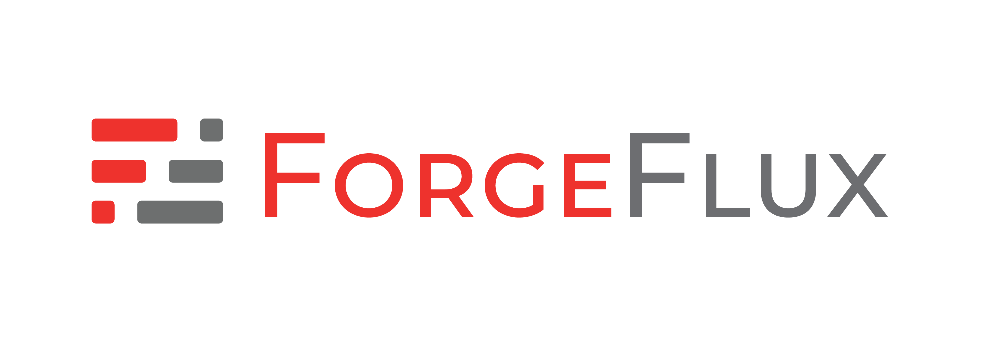
ForgeFlux
External Federation for Software Forges
Aravinth Manivannan | @realaravinth

Slide 2
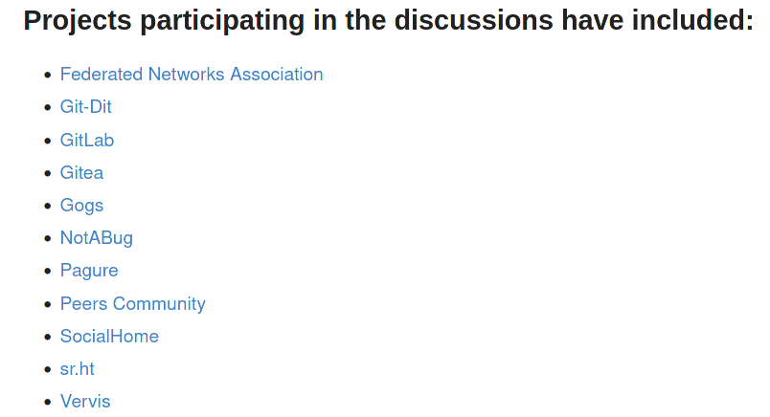
Federated Ecosystem: a pipe dream?
Federation is six times harder then centralized designs
Lack of participation from major vendors
Source: https://notabug.org/peers/forgefed/

Slide 3
ForgeFlux Approach: External federation, native UX
Zero modifications to forge source code: using forge APIs
Same workflow as contributing to native projects
Forge developers can adapt to run as internal service(with minimal changes)

Slide 4
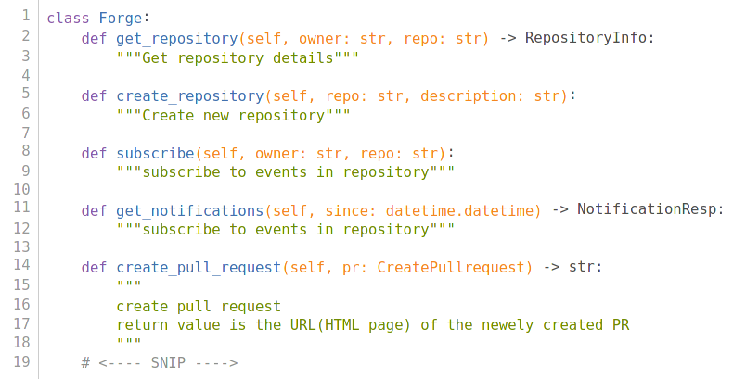
ForgeFlux Approach: Maximum Flexibility
Implement forge-specific behavior and get federation via Activity Pub for free!

Slide 5
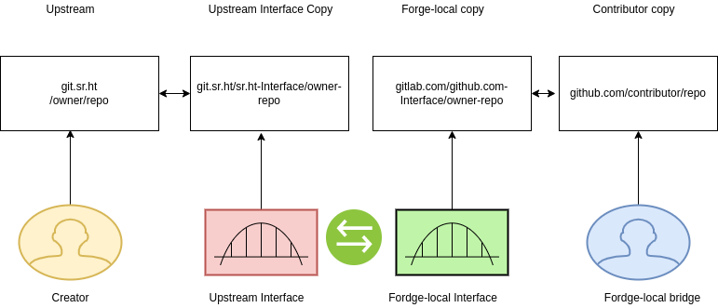
ForgeFlux Approach: Federation through replication
Activity
Pub

Slide 6
Project Scope
Official support for:
  Gitea
  Source Hut
  GitLab
  GitHub
Stepping stone for native federation
Forge Federation standardization: forking peers/ForgeFed

