Slide 1
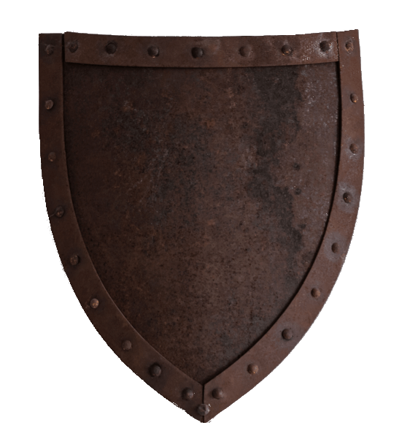
Introducing mCaptcha
No-nonsense, privacy-focused CAPTCHA system with seamless UX
Aravinth Manivannan | @realaravinth
mcaptcha.org
mCaptcha

Slide 2
Overview
How does it work?
1.1) Proof of work based rate limiting
1.2) Variable difficulty Proof of work
1.2) Performance and Protection Scope
Accessibility
Privacy
Reasons for not choosing mCaptcha
mCaptcha

Slide 3
How does it work?
mCaptcha

Slide 4
PoW based rate limiting
Make the user do more work to send the request than the work the server needs to do to serve the request
Generating proof^{[1]}: 50,000 x hash()
Verifying proof: 1 x hash()
Fully transparant process:
i. mCaptcha sends PoW^{[2]} challenge to user
ii. user generates PoW with challenge and sends PoW to mCaptcha
iii. mCaptcha verifies proof; if valid: send access token else: deny access
iv. Access token is send to client server(ex: codeberg.org)
v. client server verifies authenticity of access token with mCaptcha
[1]: 50,000 hashes is an approximation, reality might be significantly higher.
[2]: Pow is short for Proof of Work
mCaptcha

Slide 5
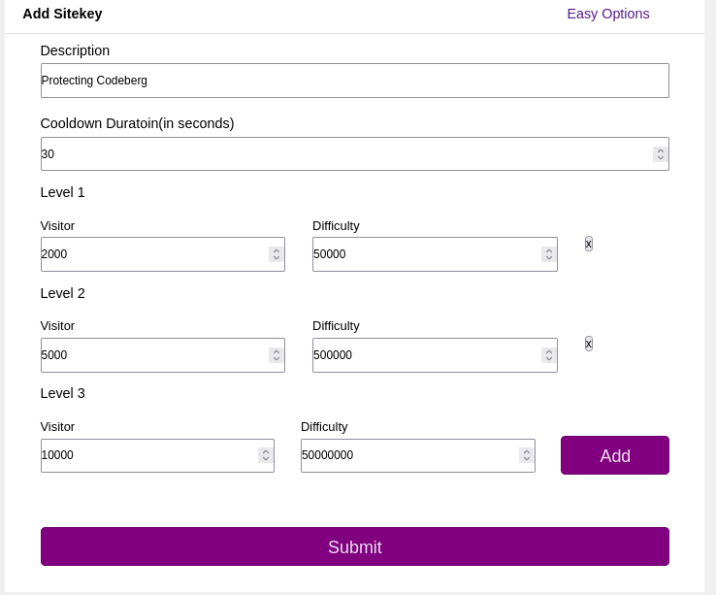
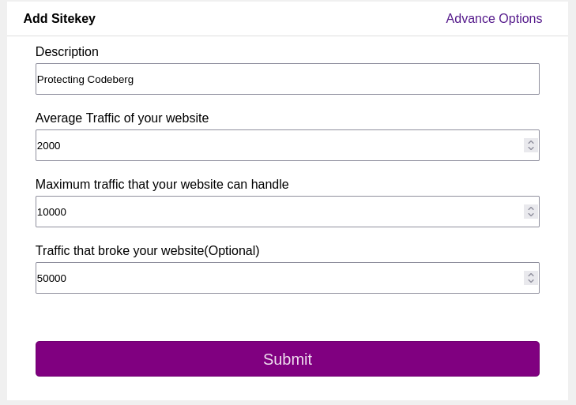
Variable difficulty Proof of work
(or how mCaptcha ups the ante when under attack)
Difficulty factor increases when under attack, i.e, when number of requests increases in given time
Difficulty factor is configured based on a website statistics in easy and advance modes.
mCaptcha

Slide 6
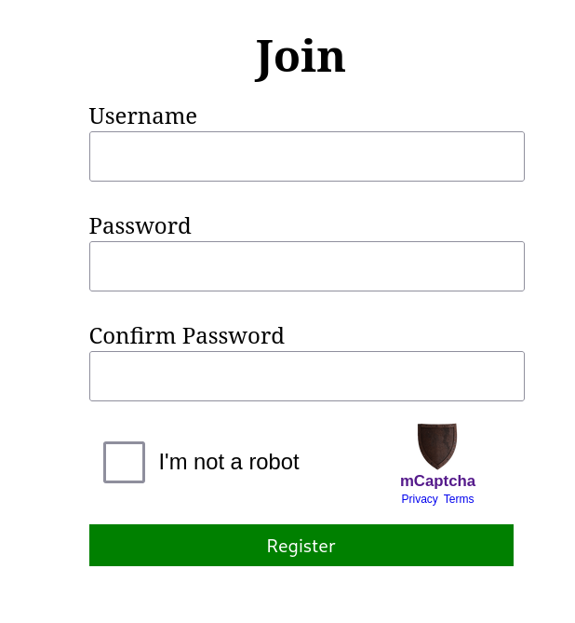
Performance and Protection Scope
Effective against DDoS attacks
Doesn’t detect spam: advertisements on comments/issues isn't covered
mCaptcha

Slide 7
Performance and Protection Scope: Benchmark
demo-server is a demo implementation with two endpoints that do the exact same thing: process and register a user but differ in the fact the one of them(/protected) is protected by mCaptcha.
DDoS Benchmarks source code is available at: https://github.com/mCaptcha/dos
mCaptcha

Slide 8
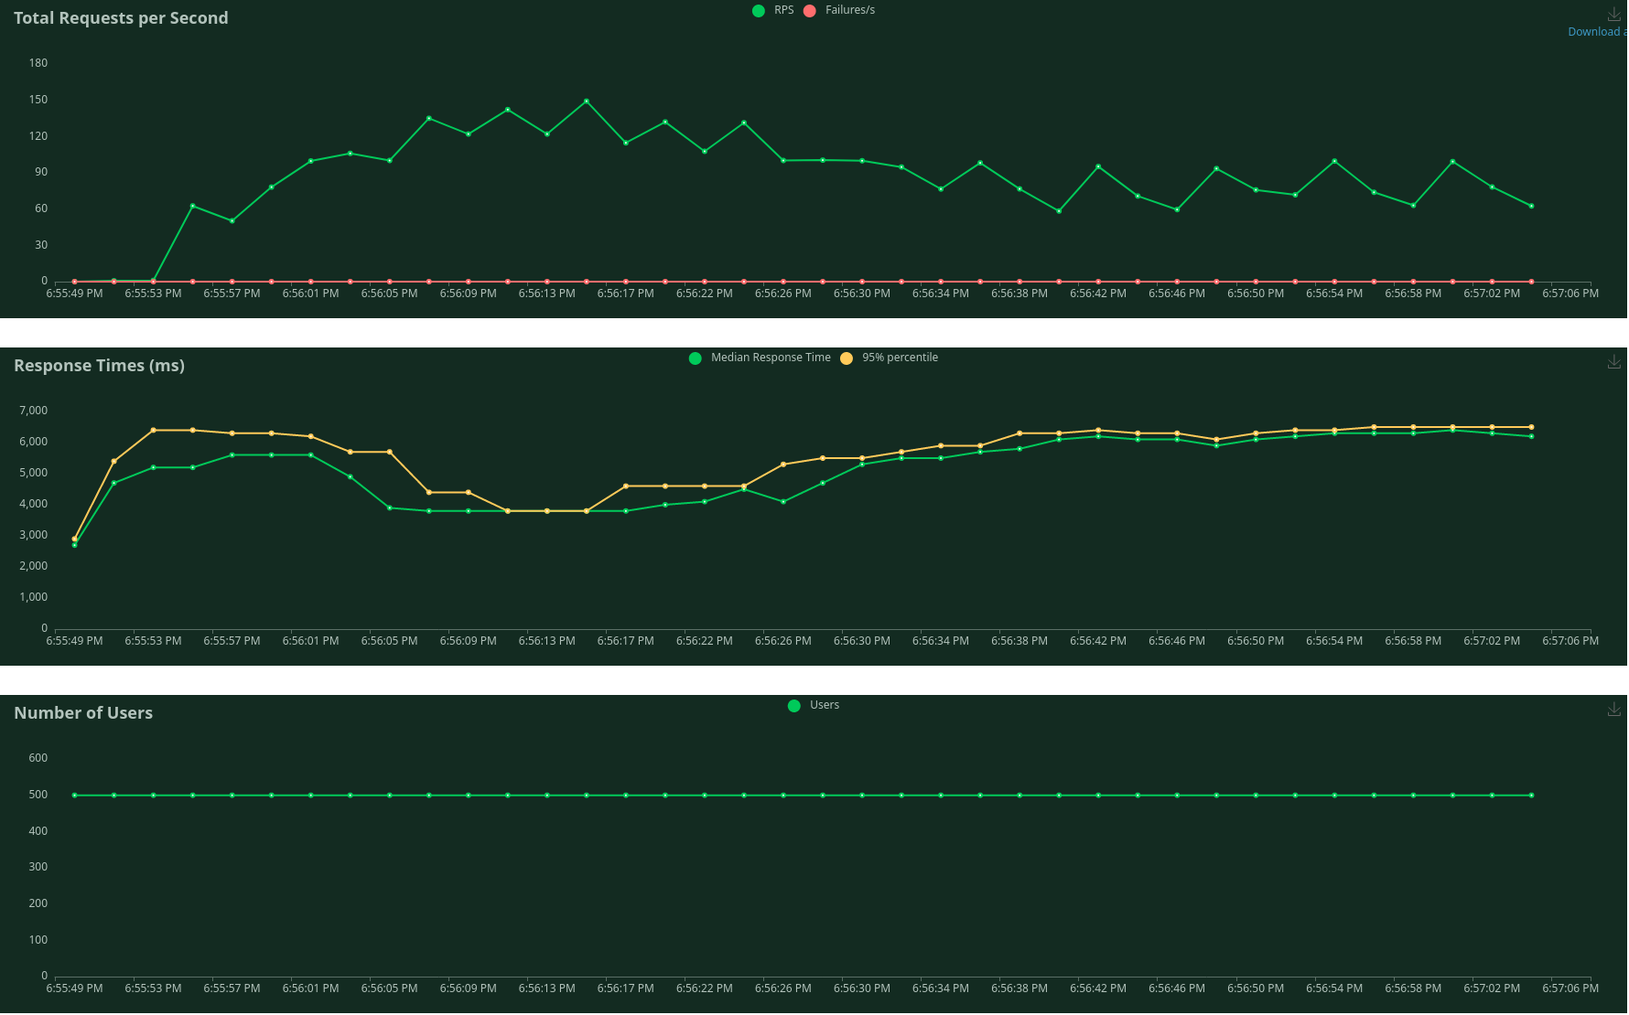
Benchmark: unprotected endpoint stats
mCaptcha

Slide 9
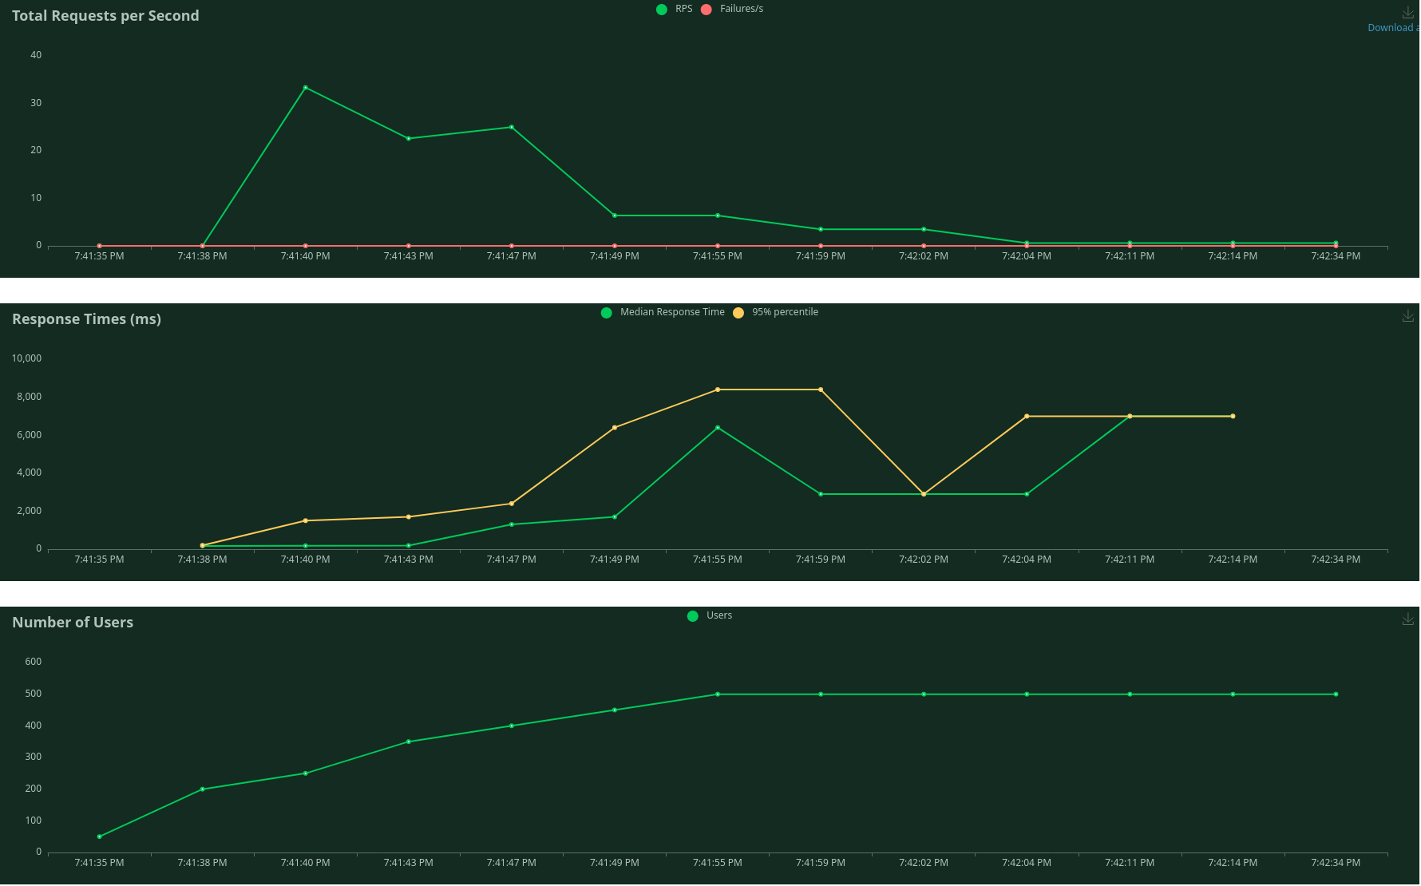
Benchmark: protected endpoint stats
mCaptcha

Slide 10
Accessibility
PROS
All validation happens at the a click of a button. No images, no text and no audio.
CONS
Hasn’t been audited for accessibility
Older, slow devices may fail validation. Can be mitigated by expert configuration but might still happen. survey.mcaptcha.org is WIP, should help admins when data is available.
mCaptcha

Slide 11
Privacy
No cookies
IP is not logged; IP rate-limiting
Works in Tor
All JavaScript executed(and full project) is Free Software
mCaptcha

Slide 12
Reasons for not choosing mCaptcha
Single-person project
Hasn’t been audited
Doesn’t protect against spam
mCaptcha

Slide 13
Resources
Homepage: https://mcaptcha.org
Source code: https://github.com/mCaptcha
Matrix space: https://matrix.to/#/#mcaptcha:matrix.batsense.net
Fediverse: @mCaptcha@batsense.net
mCaptcha

