Slide 1
Production-grade VMs Deployment
Using KVM/QEMU, Libvirt, Terraform, Ansible and Testinfra
Aravinth Manivannan
realaravinth@batsense.net

Slide 2
Overview
Why virtualization?
Deploy VMs with Terraform
Configure with Ansible
Test configuration with Testinfra
Increase and decrease scale quickly

Slide 3
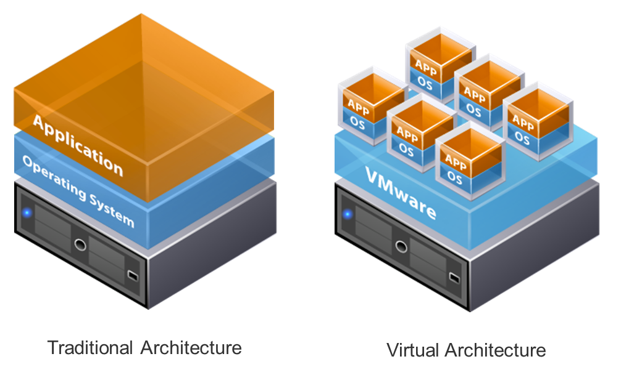
Why virtualization?
Dependency isolation
Compute resource efficiency
Reduced operational costs
Reduce energy footprint
Reproducible environments

Slide 4
Dependencies
GNU/Linux host machine
KVM
QEMU
Libvirt
Terraform
Python 3
Ansible
Testinfra
Debian 11 Bullseye qcow2 bootable

Slide 5
Deploy VMs with terraform

Slide 6
Deploy load-balanced web application with Ansible

Slide 7
Test Deployment

Slide 8
Scale up and scale down web application

Slide 9
Resources
Libvirt: https://libvirt.org
Terraform: https://terraform.io
Ansible: https://ansible.com
Testinfra: https://testinfra.readthedocs.io/en/latest/
Debian 11 “Bullseye” bootable: https://testinfra.readthedocs.io/en/latest/
Source code: https://git.batsense.net/realaravinth/libreddit-loadbalance-demo

