Slide 1

ForgeFlux
External Federation for Software Forges
https://forgeflux.org
Aravinth Manivannan | @realaravinth

Slide 2
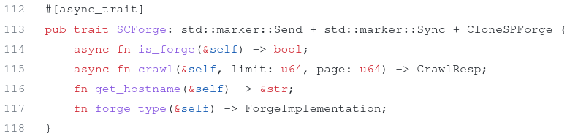
Starchart: Maximum Flexibility
To implement Starchart for $FORGE

Slide 3
Starchart: Using existing standards
A feasibility evaluation was taken up on Murmurations for Starchart.
@6543 referred to publiccode.yml as a plausible medium for a file storage format.
A proposal was sent to publiccode.yml to support a subset of mandatory fields mentioned in the issue.

Slide 4
Starchart: Open Spider
Spiders in general don’t publish their data, but Starchart does!
The data can be synced between various instances of Starchart via git pull.

