Slide 1

"Exploring Global Health and Socio-Economic Trends:
A Comparative Analysis from 2000 to 2015“
Group V
Abhishek,Arun,Christy,Gokul,Merlin.

Slide 2
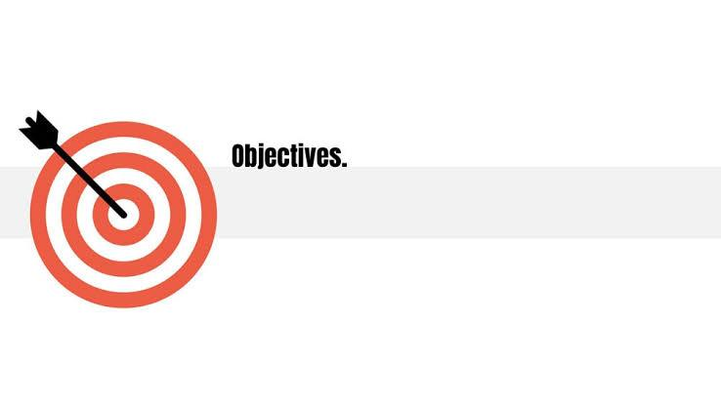
Today, we will delve into a comprehensive Excel dataset (life_exp) containing vital indicators from 133 different countries. This dataset offers valuable insights into factors influencing life expectancy.
The purpose of our analysis is to identify trends, correlations, and disparities across different nations over the 15 years.
By examining these data, we aim to improve our global health outcomes and socio-economic development.

Slide 3

Factors Influencing Life Expectancy:
Genetics
Lifestyle Choices: Diet, Exercise, Smoking, Alcohol Consumption:
Socioeconomic Status: Access to healthcare, Education, Income
Environmental Factors: Pollution, Climate
Healthcare: Quality of healthcare, Access to healthcare
Social Support: Relationships, Community Engagement:
Behavioural Factors: Stress Management, Risky Behaviours:

Slide 4
Data Creation & Analysis…
Database creation:
create database project;
use project;
CREATE TABLE life_expectancy ( Country VARCHAR(50),
Year INT,
Status VARCHAR(20),
Life_expectancy FLOAT,
Adult_Mortality INT,
Infant_deaths INT,
Alcohol FLOAT,
Percentage_expenditure FLOAT,
Hepatitis_B INT, Measles INT,
BMI FLOAT,
Under_five_deaths INT,
Polio INT,
Total_expenditure FLOAT,
Diphtheria INT,
HIV_AIDS FLOAT,
GDP FLOAT,
Population BIGINT, Income_composition_of_resources FLOAT,
Schooling FLOAT);

Slide 5

Data Preview:
select * from life_exp;
Name and Count of unique countries:
select count(distinct(country)) as countries from life_exp;
select distinct(country) from life_exp;

Slide 6
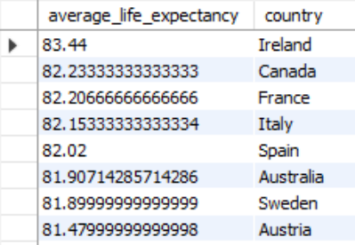
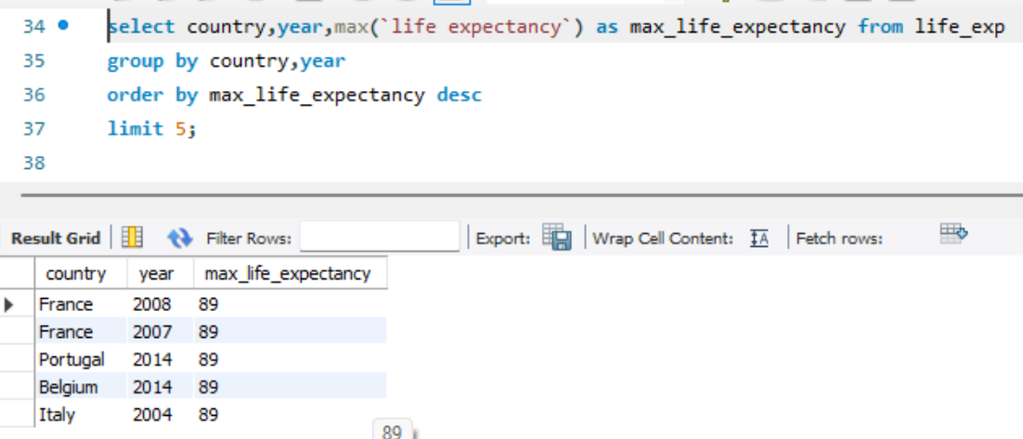
Life Expectancy:-
Average life expectancy of each country:
select AVG(`Life expectancy`) AS average_life_expectancy, country
FROM life_exp
group by country
order by average_life_expectancy desc;
Maximum Life expectancy :
select country,year,max(`life expectancy`) as max_life_expectancy
from life_exp
group by country, year
order by max_life_expectancy desc
limit 5;

Slide 7
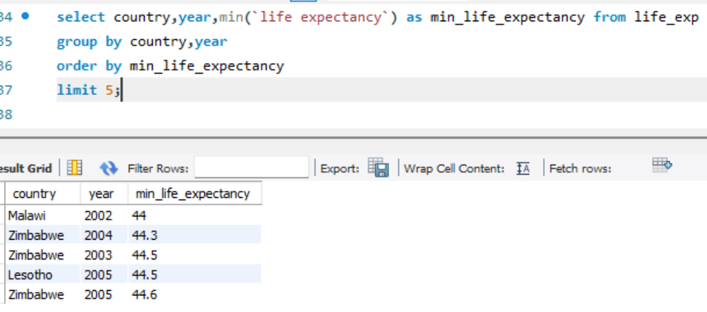
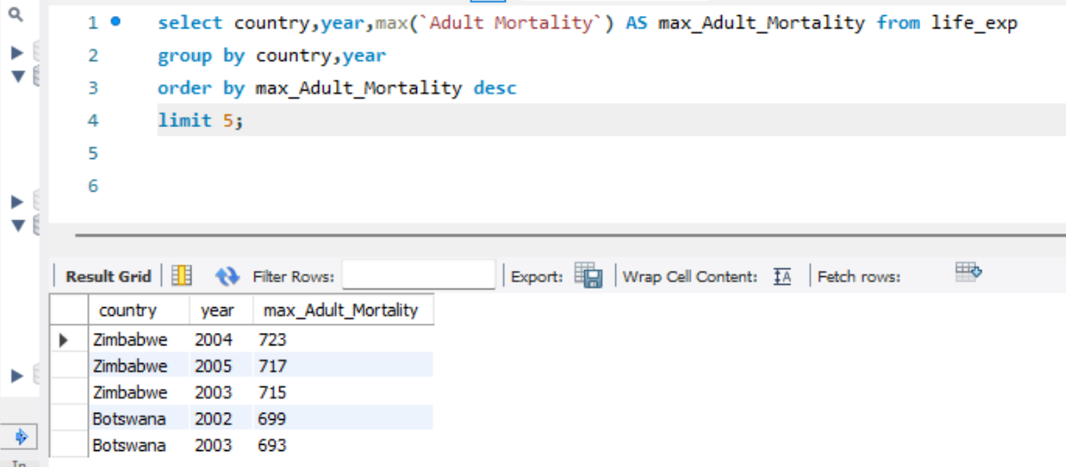
Minimum Life expectancy :
select country,year,min(`life expectancy`) as min_life_expectancy
from life_exp
group by country, year
order by min_life_expectancy
limit 5;
Adult Mortality:-
Maximum Adult Mortality:
select country,year,max(`Adult Mortality`) AS max_Adult_Mortality
from life_exp
group by country,year
order by max_Adult_Mortality desc
limit 5;

Slide 8
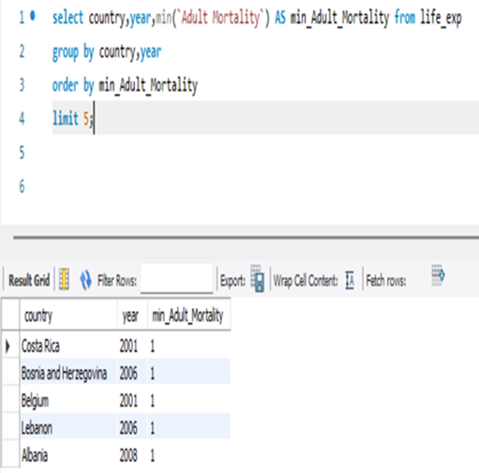
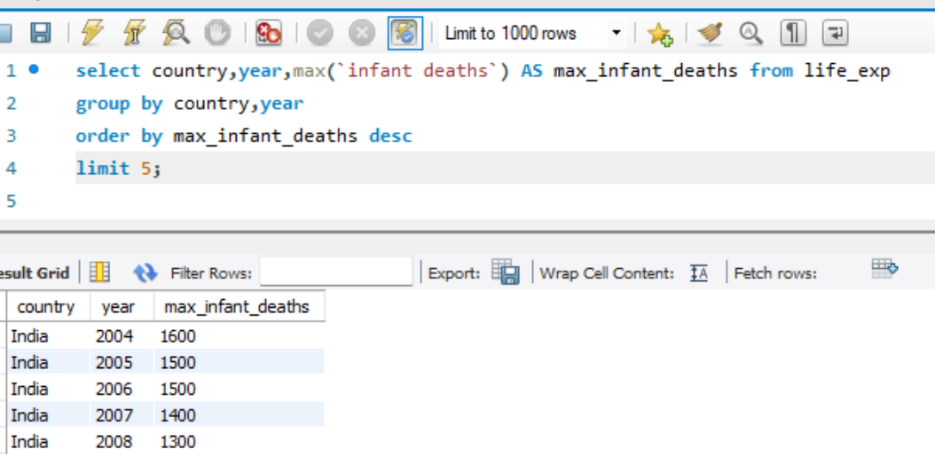
Minimum Adult Mortality:
select country,year,min(`Adult Mortality`) as min_Adult_Mortality from life_exp
group by country,year
order by min_Adult_Mortality
limit 5;
Infant deaths:-
Maximum Infant deaths :
select year,country, max(`infant deaths`) as max_infant_deaths
from life_exp
group by country
order by average_infant_deaths desc
limit 1;

Slide 9
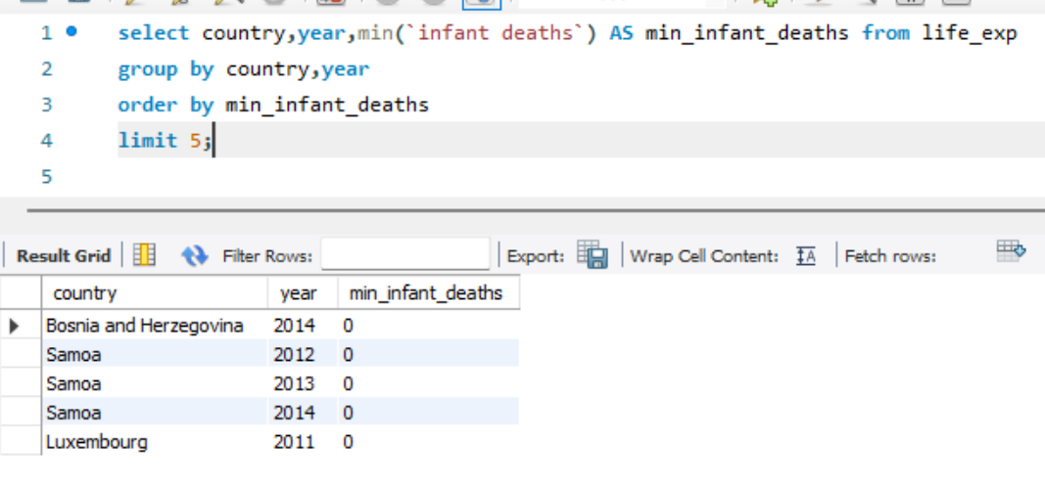
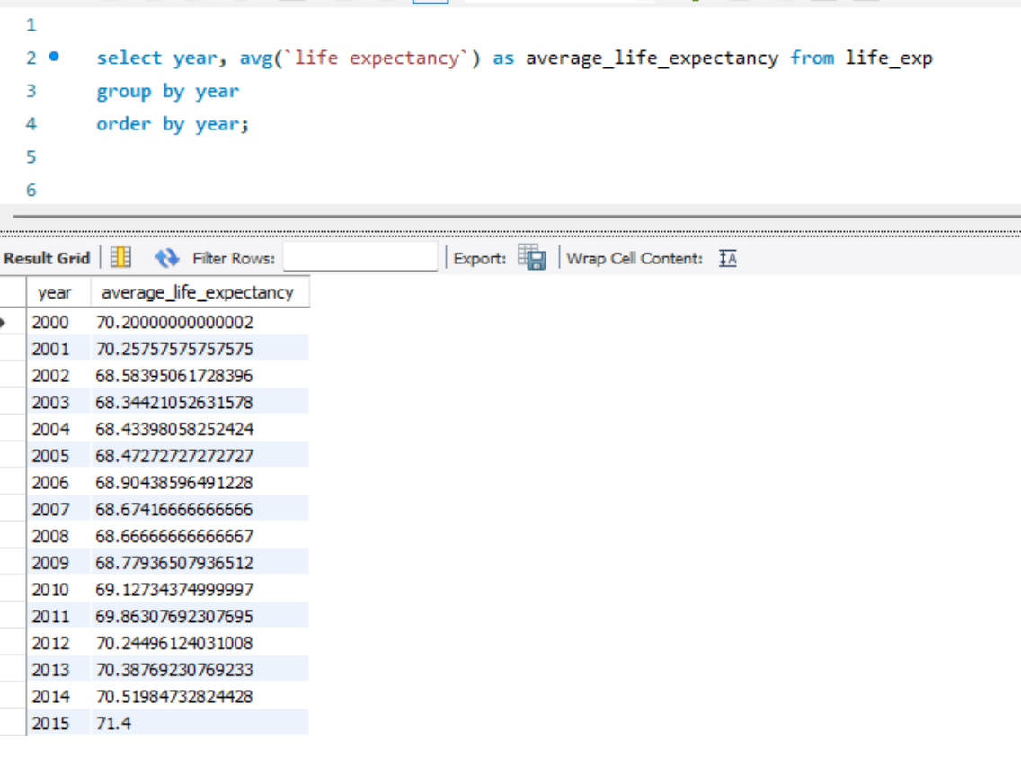
Minimum Infant deaths :
select year,country, min(`infant deaths`) as min_infant_deaths
from life_exp
group by country
order by min_infant_deaths
limit 1;
Trends Over Time:
How has life expectancy changed over the years globally and in specific countries?
select year, avg(life expectancy) as average_life_expectancy from life_exp
group by year
order by year;

Slide 10
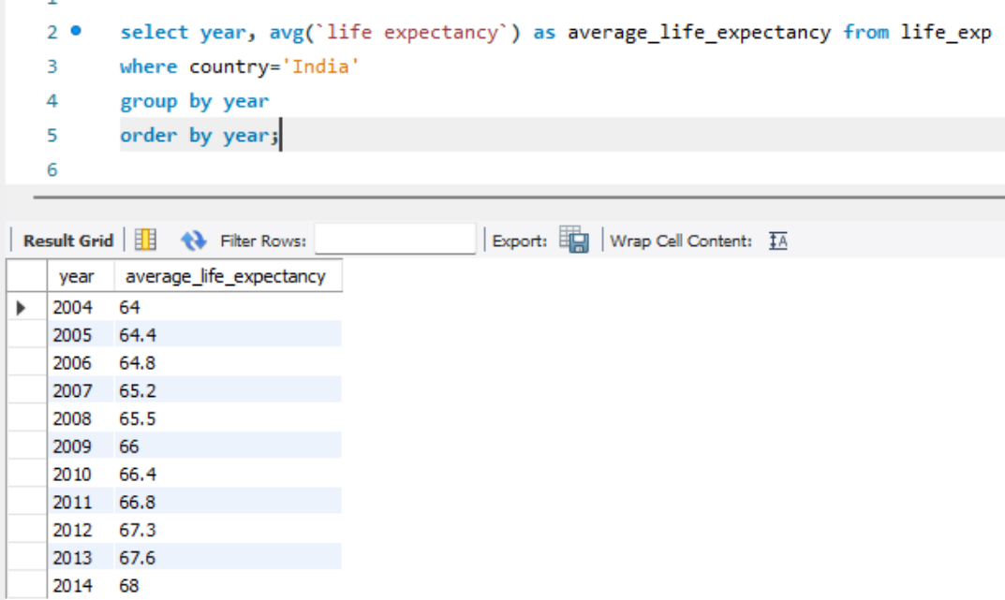
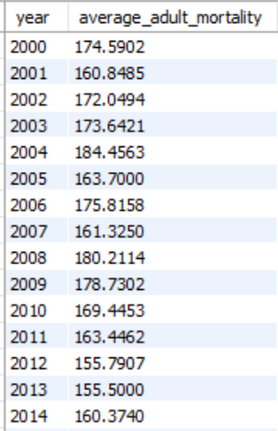
# for a specific country –
select year, avg(life expectancy) as average life_expectancy from life_exp
where country = ‘India’
group by year
order by year;
2. Are there any trends in adult mortality rates over time?
select year, avg(adult mortality) as average adult mortality
from life_exp
group by year
order by year;

Slide 11
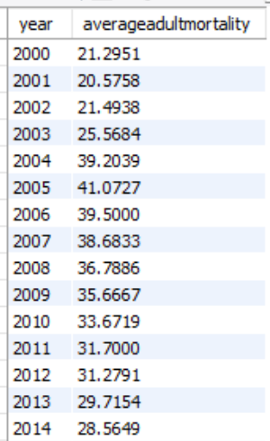
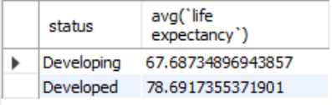
3. Have there been changes in infant mortality rates over the years?
select year, avg(infant deaths) as averageinfantdeaths
from life_exp
group by year
order by year;
Regional Comparisons:
What are the differences in life expectancy between developed and developing countries?
select status,avg(`life expectancy`) from life_exp
group by status;

Slide 12
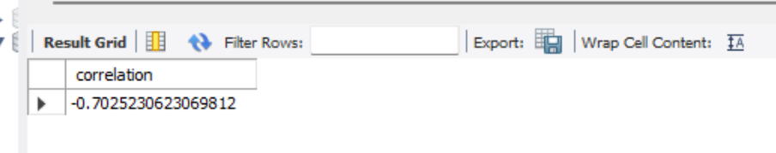
Health Indicators Correlation:
Is there a correlation between life expectancy and adult mortality?
select (count(*) * sum(`adult mortality` * `life expectancy`) - sum(`adult mortality`) * sum(`life expectancy`)) / (sqrt((count(*) * sum(`adult mortality`* `adult mortality`) - sum(`adult mortality`) * sum(`adult mortality`)) * (count(*) * sum(`life expectancy` * `life expectancy`) - sum(`life expectancy`) * sum(`life expectancy`)))) as correlation from life_exp;
(A correlation coefficient of -0.7 suggests a relatively strong inverse relationship, meaning that as one variable (adult mortality) increases, the other variable (life expectancy) decreases, and vice versa. it implies that higher levels of adult mortality are associated with lower life expectancy,)

Slide 13
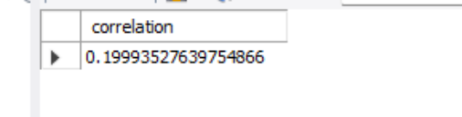
2. Do countries with higher alcohol consumption tend to have lower life expectancy?
select country, avg(life expectancy) , avg(Alcohol)as al
from life_exp
group by country
order by al desc;
(The relationship between alcohol consumption and life expectancy is complex and can be influenced by various factors including cultural, social, economic, and healthcare-related aspects.)
3. Are there any correlations between vaccination rates (e.g., Hepatitis B) and life expectancy?
select (count(*) * sum(`hepatitis b` * `life expectancy`) - sum(`hepatitis b`) * sum(`life expectancy`)) / (sqrt((count(*) * sum(`hepatitis b` * `hepatitis b`) - sum(`hepatitis b`) * sum(`hepatitis b`)) * (count(*) * sum(`life expectancy` * `life expectancy`) - sum(`life expectancy`) * sum(`life expectancy`)))) as correlation from life_exp;
(A correlation coefficient of 0.199 between life expectancy and hepatitis B suggests that there is a slight tendency for life expectancy to increase as hepatitis B prevalence decreases, and vice versa. The relationship between life expectancy and hepatitis B may vary depending on factors such as vaccination coverage, access to healthcare, socioeconomic conditions, and regional differences in disease prevalence.)

Slide 14
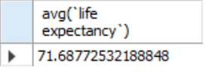
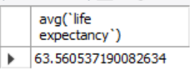
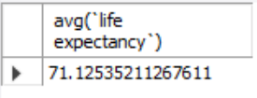

Impact of Diseases and Vaccinations:
1. How have vaccination campaigns (e.g., Hepatitis B, Polio) affected disease prevalence and life expectancy?
select avg(life expectancy) from life_exp where polio > (select avg(polio) from life_exp);
select avg(life expectancy) from life_exp where polio < (select avg(polio) from life_exp);
select avg(life expectancy) from life_exp where Hepatitis B > (select avg(Hepatitis B) from life_exp);
select avg(life expectancy) from life_exp where Hepatitis B < (select avg(Hepatitis B) from life_exp);

Slide 15
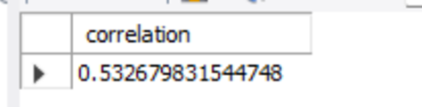
2. Is there a relationship between disease outbreaks (e.g., Measles) and infant mortality rates?
select (count(*) * sum(measles * `infant deaths`) - sum(measles) * sum(`infant deaths`)) / (sqrt((count(*) * sum(measles * measles) - sum(measles) * sum(measles)) * (count(*) * sum(`infant deaths` * `infant deaths`) - sum(`infant deaths`) * sum(`infant deaths`)))) as correlation from life_exp;
(A correlation value of 0.53 indicates a moderate positive correlation between disease outbreaks, such as measles, and infant mortality rates. This suggests that as disease outbreaks increase, infant mortality rates tend to increase as well. )

Slide 16


Economic Factors:
How does GDP correlate with life expectancy?
select (count(*) * sum(GDP * `life expectancy`) - sum(GDP ) * sum(`life expectancy`)) / (sqrt((count(*) * sum(gdp * GDP ) - sum(GDP ) * sum(GDP )) * (count(*) * sum(`life expectancy`* `life expectancy`) - sum(`life expectancy`) * sum(`life expectancy`)))) as correlation from life_exp;
(This value indicates a moderately positive correlation between GDP and life expectancy. In other words, there is a tendency for countries with higher GDPs to have longer life expectancies on average, and vice versa)
2. Is there a relationship between healthcare expenditure (total) and life expectancy?
select (count(*) * sum(`total expenditure` * `life expectancy`) - sum(`total expenditure` ) * sum(`life expectancy`)) / (sqrt((count(*) * sum(`total expenditure` * `total expenditure` ) - sum(`total expenditure` ) * sum(`total expenditure` )) * (count(*) * sum(`life expectancy`* `life expectancy`) - sum(`life expectancy`) * sum(`life expectancy`)))) as correlation from life_exp;
(it indicates that there is some tendency for countries with higher healthcare expenditure to have slightly longer life expectancies, but the relationship is not very strong. relationship between healthcare expenditure and life expectancy is not always straightforward or linear. Other factors such as lifestyle choices, education levels, income distribution, environmental conditions, and genetic factors also play significant roles in determining life expectancy.)

Slide 17


3. Do countries with higher income composition of resources or schooling levels tend to have higher life expectancy?
SELECT (COUNT(*) * SUM(schooling * `life expectancy`) - SUM(schooling) * SUM(`life expectancy`)) /(SQRT((COUNT(*) * SUM(schooling * schooling) - SUM(schooling) * SUM(schooling)) *(COUNT(*) * SUM(`life expectancy` * `life expectancy`) - SUM(`life expectancy`) * SUM(`life expectancy`)))) AS correlation from life_exp;
SELECT (COUNT(*) * SUM(`Income composition of resources` * `life expectancy`) - SUM(`Income composition of resources`) * SUM(`life expectancy`)) /(SQRT((COUNT(*) * SUM(`Income composition of resources` * `Income composition of resources`) - SUM(`Income composition of resources`) * SUM(`Income composition of resources`)) *(COUNT(*) * SUM(`life expectancy` * `life expectancy`) - SUM(`life expectancy`) * SUM(`life expectancy`)))) AS correlation from life_exp;
(A correlation coefficient of 0.72 and 0.721 indicates a robust positive relationship between these variables. In simpler terms, it suggests that countries with higher income composition of resources and higher schooling levels tend to have higher life expectancies)

Slide 18

Undernutrition and Malnutrition:
Is there any correlations between BMI and life expectancy?
select (count(*) * sum(bmi * `life expectancy`) - sum(bmi ) * sum(`life expectancy`)) / (sqrt((count(*) * sum(bmi * bmi ) - sum(bmi ) * sum(bmi )) * (count(*) * sum(`life expectancy`* `life expectancy`) - sum(`life expectancy`) * sum(`life expectancy`)))) as correlation from life_exp;
(There is a general correlation between BMI and life expectancy, individual circumstances and health factors play significant roles, and maintaining a healthy weight through balanced nutrition, regular physical activity, and medical care is crucial for promoting longevity and overall well-being.)

Slide 19

Conclusion
The dataset consists of 133 countries.
Average life expectancy in developed countries:78.69
Average life expectancy in developing countries:67.68
Average Adult Mortality rate in developed countries:182.66
Average Adult Mortality rate in developing countries:84.19
There is a strong correlation between vaccination, a healthy BMI, and life expectancy. Life expectancy increases with an increase in vaccination.
Consequently, it can be deduced that a significant correlation exists between enhanced healthcare, education, and the allocation of income resources on an annual basis.
In summary, better health, higher GDP, access to education, and a well-managed population can all contribute to longer and healthier lives, leading to increased life expectancy. These factors are interconnected and reinforce each other, creating a positive cycle of development and well-being.

Slide 20

THANKYOU

