Slide 1
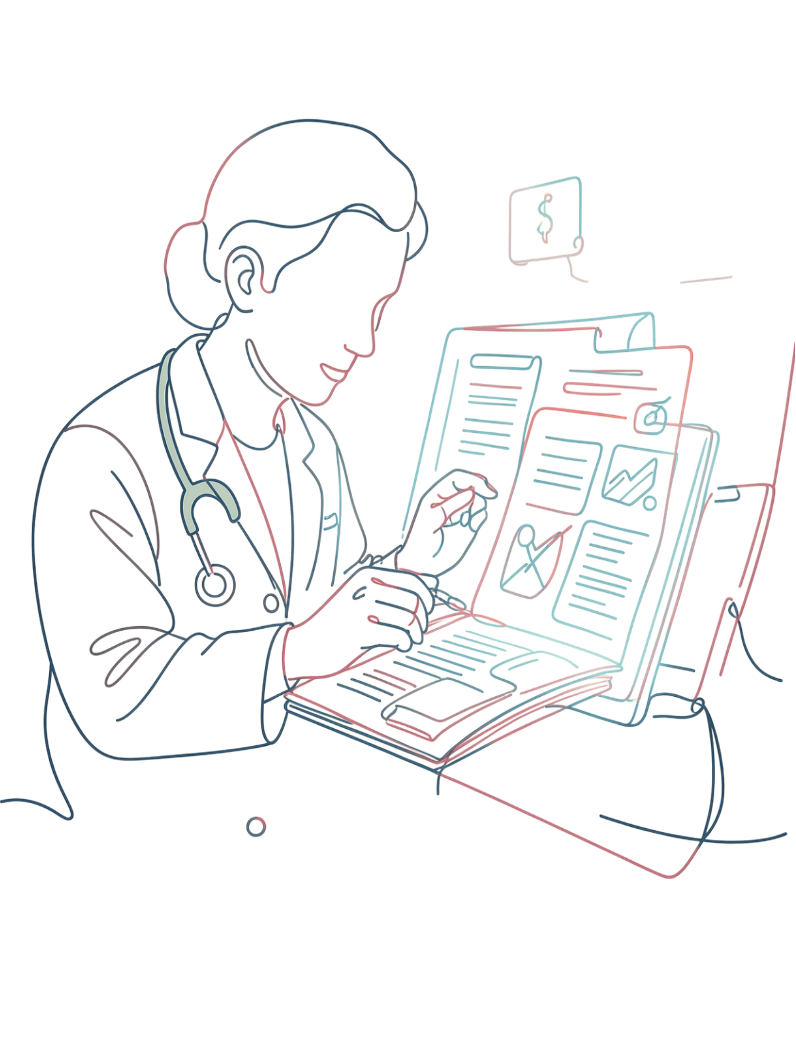
HealthDocs-RAG
AI-Powered Healthcare Document Question Answering
RETRIEVAL-AUGMENTED GENERATION (RAG)

Slide 2



The Problem
Lengthy Documents
Healthcare documents are lengthy and difficult to search through manually.
Time-Consuming Retrieval
Manual information retrieval is slow and inefficient for clinical and research use.
Poor Keyword Search
Keyword-based search lacks semantic understanding of medical terminology and context.
No Natural Language
Users need intuitive, natural language interaction rather than rigid query syntax.

Slide 3




Our Solution: HealthDocs-RAG
Upload
Understand
Healthcare documents processed automatically upon submission.
System learns document content and meaning through embeddings.
Ask
Answer
Users query the system in plain natural language.
Intelligent, context-grounded responses delivered instantly.

Slide 4
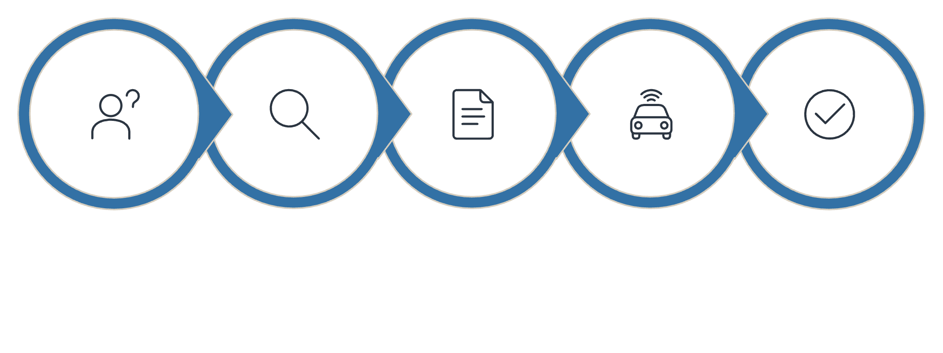
What is Retrieval-Augmented Generation?
1
Retrieval
Find the most relevant information from uploaded documents using semantic similarity search.
2
Augmentation
Provide the retrieved context to the language model as grounding evidence.
Question
Retriever
Context
LLM
Answer
3
Generation
The LLM generates accurate, context-grounded answers based on retrieved passages.

Slide 5
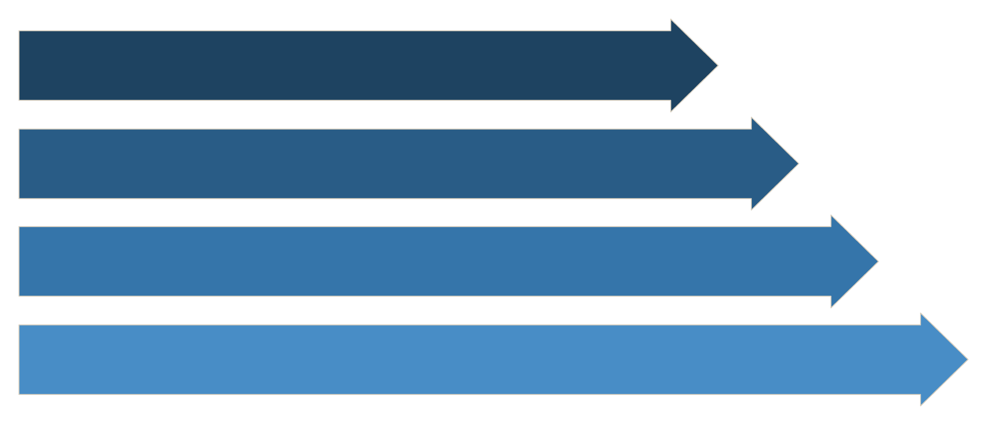
System Architecture
Upload
Loader
Chunking
Embeddings
Each stage transforms raw healthcare documents into precise, context-grounded answers through a fully automated pipeline.

Slide 6
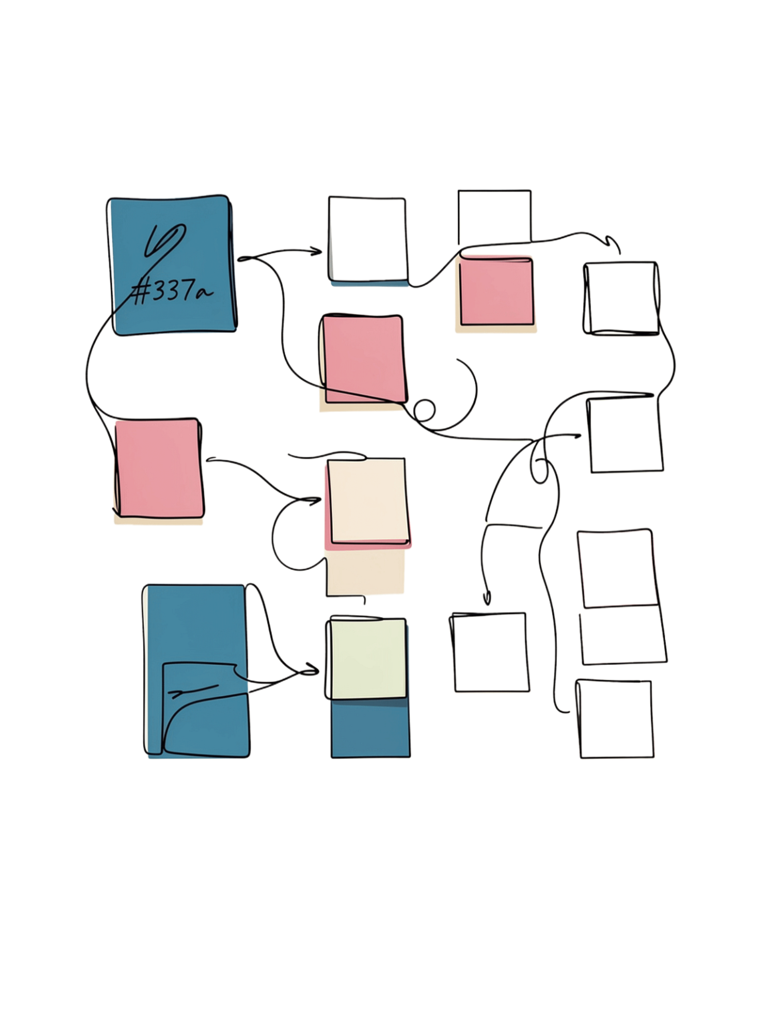
Project Workflow
01
01
User uploads PDF document
Store vectors in FAISS index
02
02
Extract text from PDF
User submits natural language question
03
03
Split text into semantic chunks
Retrieve top-k relevant chunks
04
04
Generate embeddings for each chunk
Generate context-based answer via LLM

Slide 7






Technologies Used
Python
Streamlit
Core programming language powering the entire system.
Interactive web interface for seamless user experience.
LangChain
OpenAI / LLM
RAG pipeline orchestration and component integration.
Large language model for intelligent answer generation.
FAISS + Embeddings
PyPDF
Semantic vector representation and similarity search index.
PDF text extraction and environment configuration via python-dotenv.

Slide 8



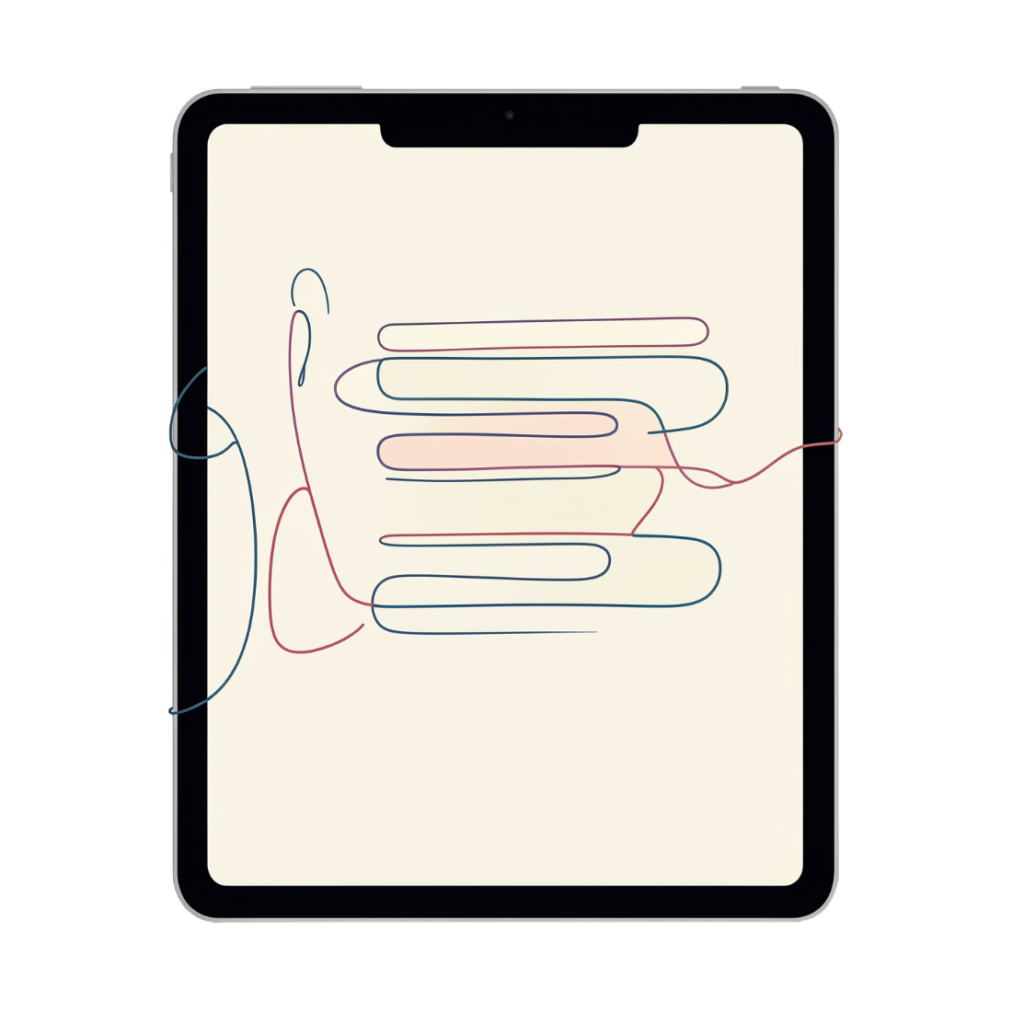

Key Features
Document Upload & Processing
Semantic Search
Fast & Intuitive
Vector-based semantic search with context-grounded AI responses.
Simple Streamlit interface with fast retrieval and answer generation.
Healthcare PDF upload with intelligent text extraction.
Educational Focus
Designed for educational and document-analysis purposes.

Slide 9
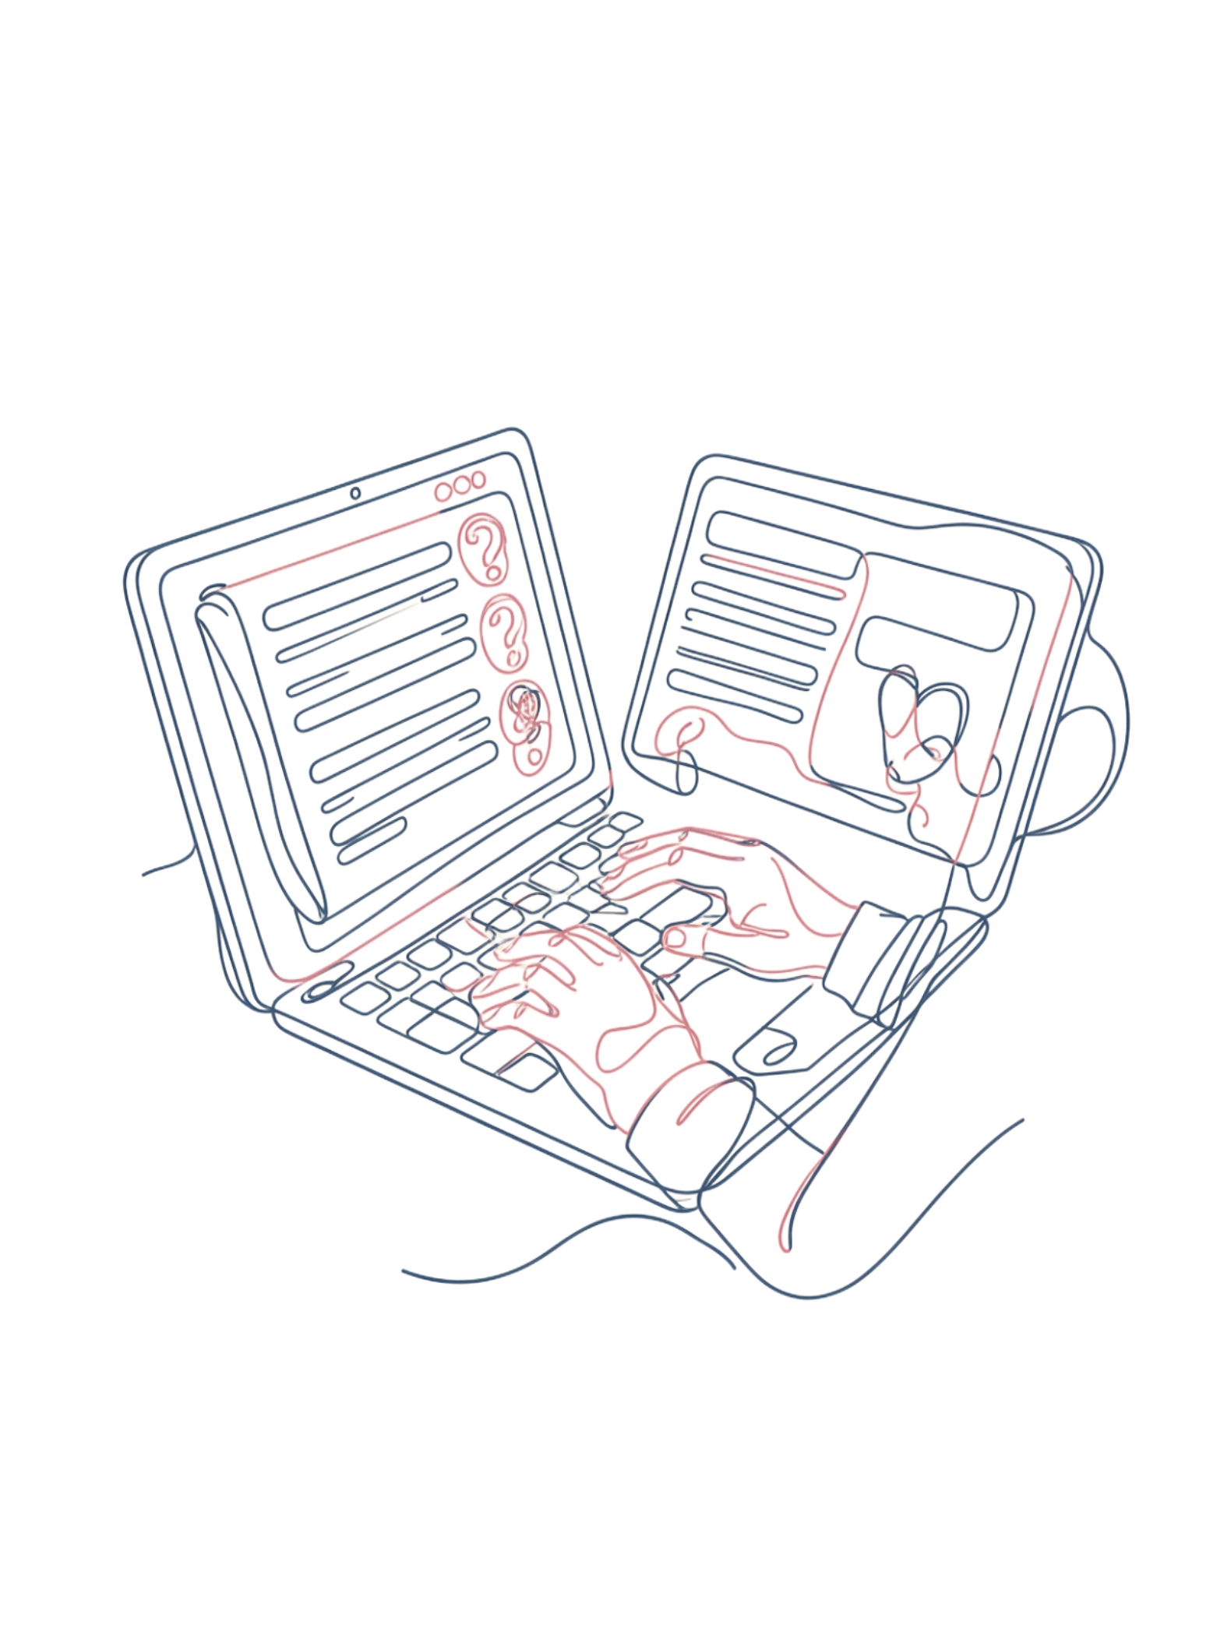

Demo & Results
Workflow:
1
Upload
User uploads a healthcare PDF document.
2
Query
User asks a natural language question.
3
Retrieve
System retrieves relevant document sections.
4
Answer
AI generates a context-based answer.
Note: HealthDocs-RAG is designed for educational and document-analysis purposes only. It is not a medical diagnosis or treatment system.

Slide 10
Conclusion & Future Improvements
What We've Built
Future Enhancements
HealthDocs-RAG demonstrates how RAG combines document retrieval and large language models to provide relevant, context-based answers from healthcare documents.
Support for multiple documents simultaneously
Additional file formats (DOCX, TXT, images)
Improved retrieval accuracy and ranking
Source citations and document references
Conversation history and context memory
Multilingual support
Thank You! Questions & Answers

