Slide 1

MediGuide AI
Medical Symptom Assessment and Patient Guidance Assistant
AI-POWERED EDUCATIONAL HEALTHCARE ASSISTANT
PYTHON · STREAMLIT · LANGCHAIN · OPENAI
BS-IT PROJECT PROTOTYPE

Slide 2


What is MediGuide AI?
Educational AI Assistant
Not a Replacement
Responsible AI Approach
Helps users understand basic symptoms and receive general health guidance in a clear, structured way.
Does not substitute professional medical consultation — always refers users to qualified doctors.
Demonstrates LLM applications in healthcare with proper safety guardrails built in from the ground up.

Slide 3

The Problem
Symptom Confusion
Information Overload
Users struggle to understand basic symptoms without immediate professional guidance.
Online health searches produce overwhelming, unstructured results that cause more anxiety than clarity.
Lack of Structure
No accessible, easy-to-understand educational tools exist for everyday symptom awareness.

Slide 4




Project Objectives
Analyze Symptoms
Responsible Assessment
Process user-provided symptoms and generate clear, structured health guidance.
Identify possible areas of concern responsibly, without overstepping into clinical diagnosis.
Guide Next Steps
Demonstrate LLM Integration
Suggest appropriate next steps and professional consultation when symptoms require attention.
Showcase practical integration of large language models into real-world healthcare applications.

Slide 5



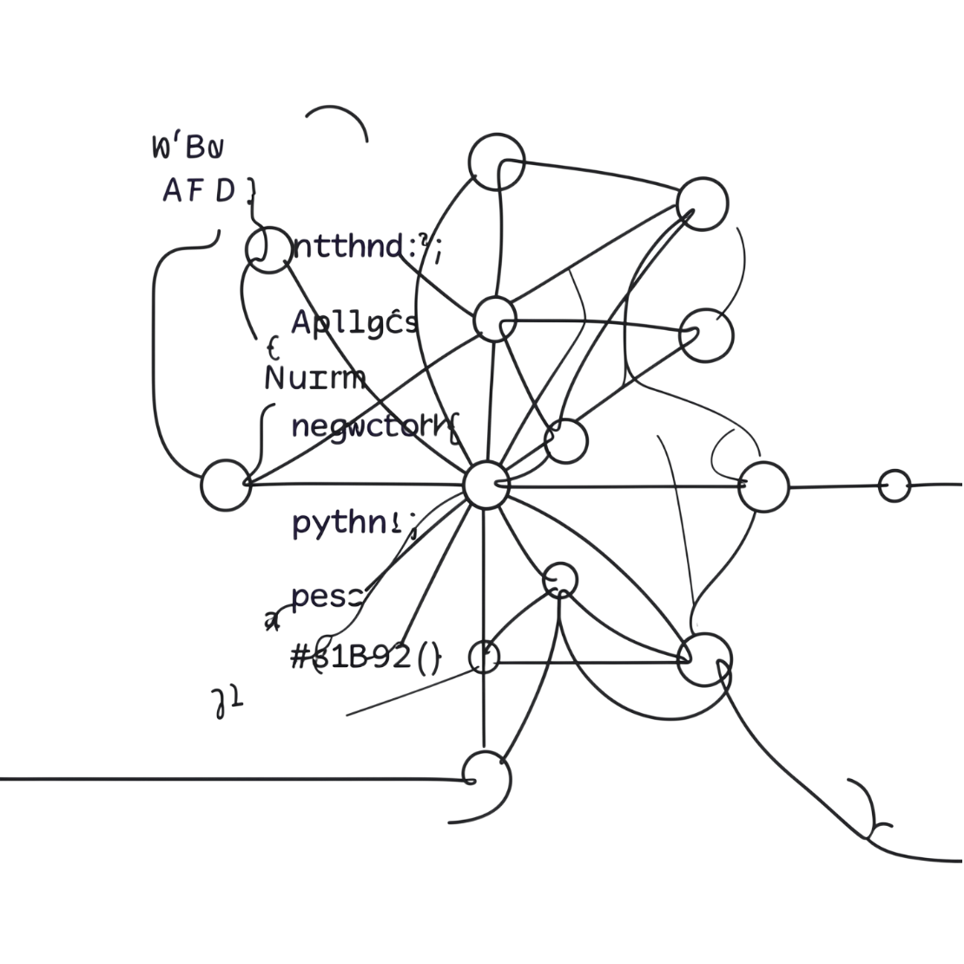



Technology Stack
Python
Streamlit
Core application logic and data processing pipeline.
Interactive, web-based user interface for seamless user experience.
LangChain
OpenAI API
LLM application framework and intelligent prompt management.
Advanced language model for symptom analysis and response generation.

Slide 6

System Architecture
A structured data flow ensures safe and accurate responses at every stage.
User Input
Medical Output
LLM Processing

Slide 7

How MediGuide AI Works
01
02
Enter Symptoms
Validate Input
User inputs symptoms via the Streamlit interface.
Application validates and collects all relevant information.
03
04
Prompt Engineering
AI Processing
LangChain prepares an optimized prompt with safety guidelines embedded.
OpenAI processes the request and generates a structured response.
05
Deliver Guidance
User receives clear guidance alongside a mandatory medical disclaimer.

Slide 8
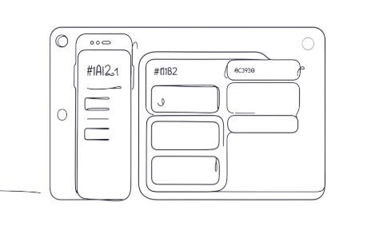
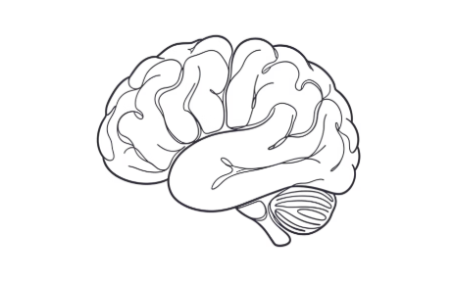


Key Features
User-Friendly Interface
AI-Powered Analysis
Safety-First Design
Secure Configuration
Simple Streamlit design for easy navigation by any user.
LangChain and OpenAI deliver intelligent, context-aware symptom assessment.
Built-in medical disclaimers and professional consultation prompts on every response.
API keys managed through environment variables — never hardcoded in source code.

Slide 9


Safety, Privacy & Limitations
MediGuide AI is NOT a doctor. It cannot diagnose medical conditions. Always consult a qualified healthcare professional for serious health concerns.
Educational Only
Provides general information — not clinical medical advice of any kind.
AI Limitations
Responses may be incomplete or require human verification. AI is not infallible.
Consult Professionals
Seek qualified healthcare providers for any serious or urgent health concern.
API Security
Use environment variables exclusively. Never hardcode API keys in your codebase.

Slide 10


Conclusion & Next Steps
MediGuide AI demonstrates how modern AI tools can be applied responsibly in healthcare education — combining LLM power with essential safety guardrails.
A foundation for learning responsible AI — built by students, for students.
Responsible AI in Healthcare Education
Future Enhancements
A practical, real-world example of safe LLM integration for BS-IT students.
Multi-language support and an expanded medical knowledge base are planned next steps.

