Slide 1
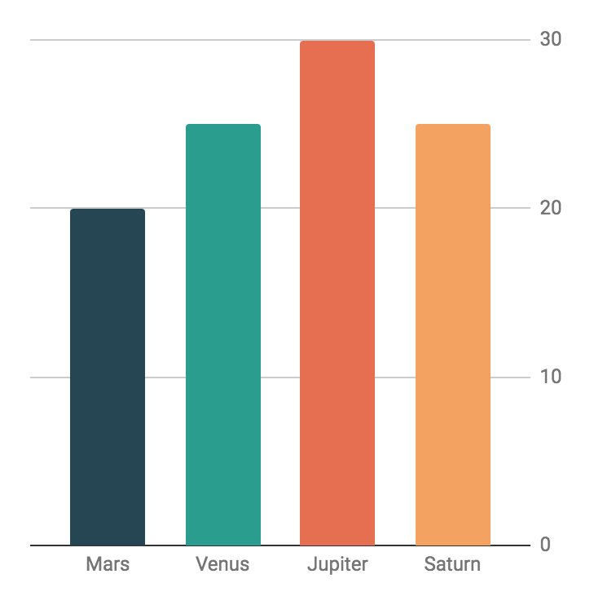
Design Elements Infographics
300,000
Mercury
Neptune
Mercury is the closest planet to the Sun
It is the farthest planet from the Sun
150,000
Mars
Jupiter
50,000
Despite being red, Mars is a cold place
It's the biggest planet in the Solar System
Neptune
Mars
90%
75%
It is the farthest planet from the Sun
Despite being red, Mars is a cold place

