Slide 1
Time Series Modeling of NFL Games for Predicting Betting Lines

Slide 2



motivation
Professional sports bettors win/loss records can be thought of as a stationary process centered around a mean independent of time.
Bettors make $93,000 a year
Gamblers on average win between 53% and 55% of the time.
Even a 1% increase in winnings can equate to thousands of dollars in income.

Slide 3
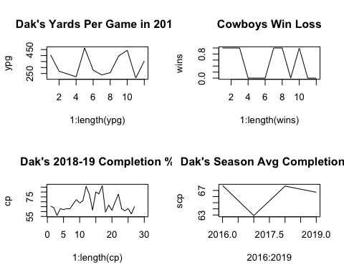
Cyclical Patterns And Means
There is a natural cyclic pattern in stats modeling human performance
Dak Prescott’s season completion% in 2016, 2018, and 2019 are within +/-1% of his career average.
Indicating over 16+ games, there is still an underlying mean time series dictating its behavior.
This fact has driven bettors to rely on linear time invariant models

Slide 4
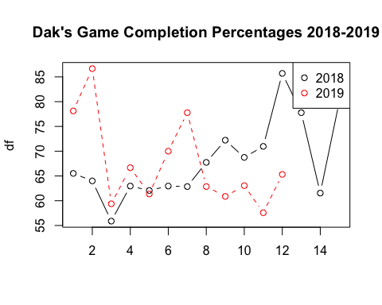
we can consider the individual seasons of a player’s or a team’s performance as different realizations of the same stationary process
we can model this process to predict performance

Slide 5
theory
Given:
Coach and Player performances naturally waver
Team performances can be viewed as linear combinations of players’ and coaches’ performances
Aggregate metrics like total yards are summed representations of the underlying coaches and players.
Performances exhibit properties of stationary time series
Thus:
Modeling team / players performances with time series modeling should be possible
If we can predict the highs and lows, we should be able to predict the winner and margin of victory
Process:
Model each team as a stationary time series to predict score
Difference the predictions to obtain the margin of victory
Win millions

Slide 6
Challenges
Teams change composition year over year.
Consequently, teams can go from being very horrible to very good.
Ravens
49ers
Or go the other way
Jaguars
Rams
Short time series
Short time series (12 game observations / team in NFL this season) are hard to model
AR parameter estimations fail to converge on shorter time series,
Teams performances from year to year might not be consistent enough to include prior year data

Slide 7
Challenges Continued…
The Following methods work well in practice for short TS data:
Composite forecasts
Non-linear time series models
Threshold autoregressive (TAR)
Self-exiting TAR (SETAR)
Neural networks
Modeling by analogy
Domain knowledge

Slide 8
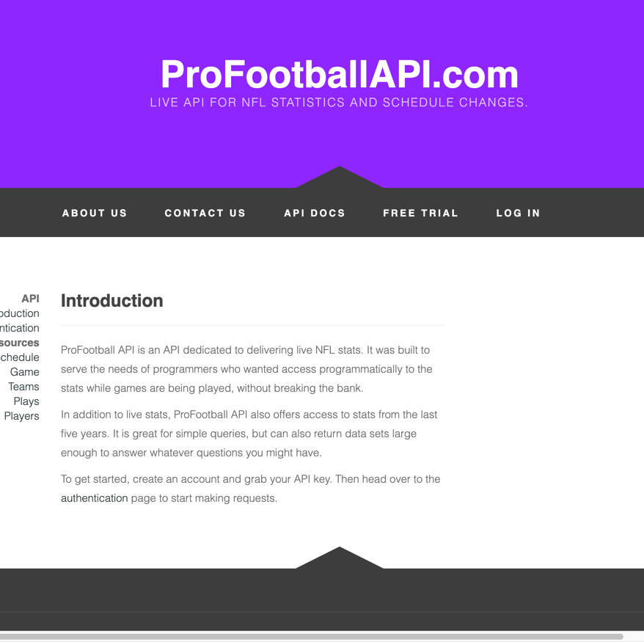
data
I pulled data from profootballapi.Com using the schedule and team APIs. The r code to query the API is in the accompanying code.
Eliminated some columns not pertaining to my models
Created a few calculated columns for score, isHome, and won
Added lags of total yards, punt yards, penalty yards, and turnovers for modeling

Slide 9
Sample data
opponent | totfd | totyds | pyds | ryds | pen | penyds | trnovr | pt | ptyds | ptavg | week | gamedate | won | score
MIA | 31 | 643 | 378 | 265 | 4 | 40 | 0 | 1 | 56 | 56 | 1 | 2019-09-08 | 1 | 59
ARI | 26 | 440 | 258 | 182 | 10 | 62 | 0 | 3 | 129 | 43 | 2 | 2019-09-15 | 1 | 23
KC | 29 | 452 | 249 | 203 | 7 | 60 | 0 | 3 | 153 | 41 | 3 | 2019-09-22 | 0 | 28
CLE | 24 | 395 | 222 | 173 | 3 | 15 | 3 | 3 | 131 | 44 | 4 | 2019-09-29 | 0 | 25
PIT | 22 | 277 | 139 | 138 | 11 | 92 | 3 | 3 | 155 | 41 | 5 | 2019-10-06 | 1 | 26
CIN | 26 | 497 | 228 | 269 | 10 | 81 | 1 | 2 | 84 | 32 | 6 | 2019-10-13 | 1 | 23

Slide 10
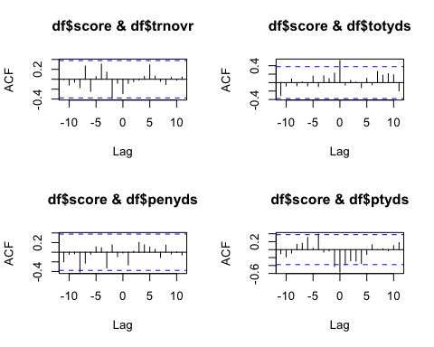
Regressors
Depending on the teams there were varying levels of cross correlation between some of the more interesting regression parameter candidates
Turnovers, total yards, penalties, and punt yards seemed to have more lagging effect than others
Intuition states that if a team is high on turnovers one week, coaches and players would be extra cautious in preventing turnovers the next week
Cross Correlation Plots varied from team to team, and thus domain knowledge augmented analysis in selecting parameters

Slide 11
Arima model method
I chose a list of regressors that seemed to have significance across a broad range of teams selected, although individually these regressors may or may not be appropriate for every team model.
Due to the short time series data horizon (1 3/4 regular seasons), variations in the data appear random and prove difficult to model.
Regressors :
Total yards and lag1
Turnovers and lag1
Penalty yards and lag1
Punt yards and lag1
Builds an ARIMA model for each selected team to predict score.
Returns team predictions, their difference (the line), their sum (over under), and ASE based upon a leave one out approach

Slide 12
mlp model method
I intentionally chose a model that would overfit due to the short time series. Adding capacity with noisy data can help to tease out some underlying patterns. However you risk modeling noise.
Forced lags of 1 to keep consistent. However, I placed an option in the method to allow the mlp routine to choose the lags for the score.
Allowed the MLP routine to exclude regressors showing no significance.
Regressors :
Total yards and lag1
Turnovers and lag1
Penalty yards and lag1
Punt yards and lag1
Builds a MLP Neural Network model for each selected team to predict score.
Returns team predictions, their difference (the line), their sum (over under), and ASE based upon a leave one out approach

Slide 13
VAR model method
The VAR OLS algorithm picks the lags
AIC is the Information criteria used.
Regressors :
Total yards
Turnovers
Penalty yards
Punt yards
Builds a “trend” VAR model for each selected team to predict score.
Returns team predictions, their difference (the line), their sum (over under), and ASE based upon a leave one out approach

Slide 14
ensemble model method
This model simply averages the results of the other 3 models
Builds team models for each of ARIMA, VAR, and MLP models. Averages the predictions from these models to predict score.
Returns team predictions, their difference (the line), their sum (over under), and ASE based upon a leave one out approach

Slide 15
Results
I ran the code to predict the outcome of the DAL @ CHI game.
Vegas
Vegas had DAL as a 2.5 point road favorite, they ended up losing by 7.
The over under was predicted to be 43.5, the actual was 55
The money line settled at -150 for DAL. CHI ended up winning.
Time Series model
Each TS model would have won on the money line predicting CHI to win
Each TS model would have won on the over under, predicting over.
Each TS model would have won against the spread predicting Chicago to win.

Slide 16
Results
model | team1 | team1prediction | team2 | team2prediction | line | OU | ASE_t1 | ASE_t2
ARIMA | DAL | 27.17111 | CHI | 29.09288 | -2.0 | 56 | 26.740406 | 16.751646
VAR | DAL | 19.97455 | CHI | 35.51342 | -15.5 | 55 | 4.102442 | 110.531933
MLP | DAL | 22.98711 | CHI | 22.51853 | 0.5 | 46 | 169.335334 | 2.194764
Ensemble | DAL | 23.37759 | CHI | 29.04161 | -5.5 | 52 | 200.178182 | 129.478343

Slide 17
conclusions
The model was good in predicting at least one game. More testing is needed
The mlp model in particular needs more evaluation. Overfitting might not be appropriate
Adding additional parameters to the model could help identifying weak signals embedded in the data
Adding statistics on key players(quarterback, running back) into the ensemble could help

