Slide 1

Time Series Modeling of NFL Games to Predict Betting Lines

Slide 2



motivation
To Win!
Gamblers on average win between 53% and 55% of the time.
Bettors make ~$93,000 a year
Even a +1% can mean yield $$$ depending on bets

Slide 3
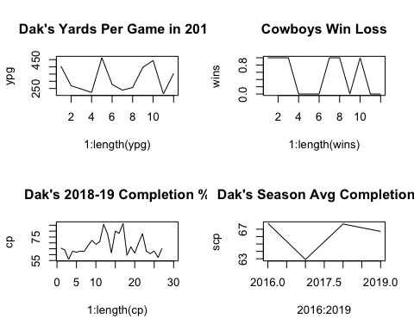
Traditional sports modeling
Traditional methods rely on moving averages
Dak Prescott’s season completion% in 2016, 2018, and 2019 are within +/-1% of his career average.
Players and Teams tend to revert to their mean
This fact has driven bettors to rely on linear time invariant models for predicting games, scores, rushing yards etc.
Vegas makes modifications to predictions for Home/Away, Weather, and Travel, etc. to help improve these mean based predictions. However, they are wrong 45 - 47% of the time.

Slide 4
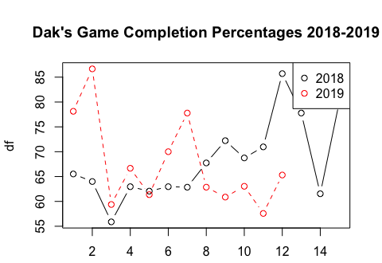
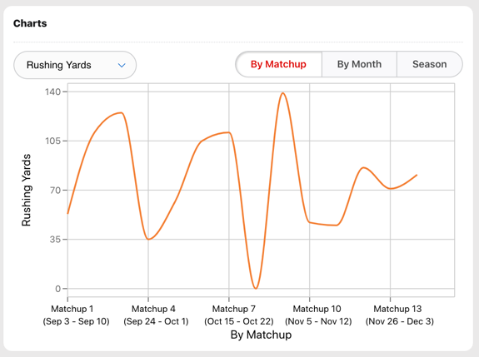
Cyclical patterns in human performance
Zeke’s Rushing yards Per Game 2019
The wandering and cyclic behaviors evident in stats are a mirror into real life
Good players have a higher mean than average players
When all players on a team have a good game, that can raise the expectation of the team winning

Slide 5
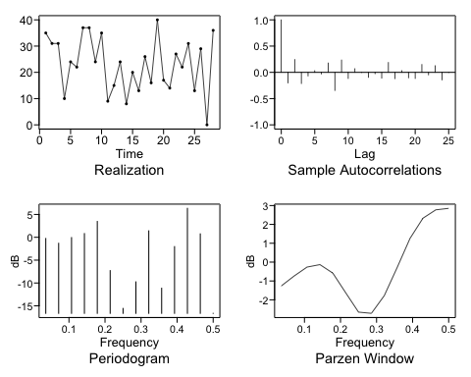
Stationary time series
Dallas Cowboys Score / Game 2018 - 2019
Stats resemble stationary time series
Mean and variance do not dependent on time
We also assume that the correlation of two points t1 and t2 depends only on how far apart they are thus satisfying the 3 conditions of Stationarity

Slide 6
theory
Given
Thus
Process
Player Performance Wavers Naturally
Team Performances are Linear Combinations of Players’ Performances
Performances exhibit properties of stationary time series
Modeling team Performance with Time Series Modeling Should be Possible
If we can predict the highs and lows of natural cycles, we should be able to predict the winner and margin of victory
Model each team as a stationary time series to predict score
Difference the predictions to obtain the margin of victory
Win millions

Slide 7
Challenges
Teams change composition year over year.
Teams can go from being very horrible to very good.
Ravens
49ers
Or go the other way
Jaguars
Rams
Short time series
Hard to model
Teams performances might not be consistent

Slide 8
Methods for modeling short time series
Composite forecasts
Non-linear time series models
Threshold autoregressive (TAR, STAR)
Neural networks
Modeling by Analogy
Domain knowledge
These Methods Work Well in Practice for Modeling Short TS Data

Slide 9

data
I pulled the data from profootballapi.com using r to query API.
Eliminated some columns not pertaining to my models.
Created a few calculated columns to simplify some parameters
Added lags of total yards, punt yards, penalty yards, and turnovers for modeling

Slide 10
Sample data
opponent | totfd | totyds | pyds | ryds | pen | penyds | trnovr | pt | ptyds | ptavg | week | gamedate | won | score
MIA | 31 | 643 | 378 | 265 | 4 | 40 | 0 | 1 | 56 | 56 | 1 | 2019-09-08 | 1 | 59
ARI | 26 | 440 | 258 | 182 | 10 | 62 | 0 | 3 | 129 | 43 | 2 | 2019-09-15 | 1 | 23
KC | 29 | 452 | 249 | 203 | 7 | 60 | 0 | 3 | 153 | 41 | 3 | 2019-09-22 | 0 | 28
CLE | 24 | 395 | 222 | 173 | 3 | 15 | 3 | 3 | 131 | 44 | 4 | 2019-09-29 | 0 | 25
PIT | 22 | 277 | 139 | 138 | 11 | 92 | 3 | 3 | 155 | 41 | 5 | 2019-10-06 | 1 | 26
CIN | 26 | 497 | 228 | 269 | 10 | 81 | 1 | 2 | 84 | 32 | 6 | 2019-10-13 | 1 | 23

Slide 11
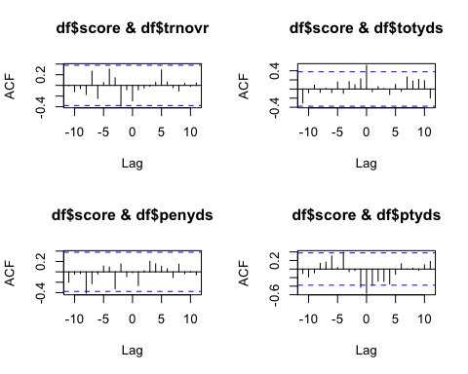
Regressors
Depending on the teams there were varying levels of cross correlation between some of the more interesting regression parameter candidates
Turnovers, total yards, penalties, and punt yards seemed to have more lagging effect than others
Intuition states that if a team is high on turnovers one week, coaches and players would be extra cautious in preventing turnovers the next week
Cross Correlation Plots varied from team to team, and thus domain knowledge augmented analysis in selecting parameters

Slide 12
Arima model method
I chose a list of regressors that seemed to have significance across a broad range of teams, although individually these regressors may or may not be appropriate for every team model.
Due to the short time series data horizon, variations in the data are nearly indistinguishable from noise
Regressors :
Total yards and lag1
Turnovers and lag1
Penalty yards and lag1
Punt yards and lag1
Method builds an ARIMA model for each selected team to predict score.
Returns team predictions, their difference (the line), their sum (over under), and ASE based upon a leave one out approach

Slide 13
mlp model method
I intentionally chose a model that would overfit due to the short time series. Adding capacity with noisy data can help to tease out some underlying patterns. However you risk modeling noise.
Forced lags of 1 to keep consistent. However, I placed an option in the method to allow the mlp routine to choose the lags.
Allowed the MLP routine to exclude regressors showing no significance.
Regressors :
Total yards and lag1
Turnovers and lag1
Penalty yards and lag1
Punt yards and lag1
Builds a MLP Neural Network model for each selected team to predict score.
Returns team predictions, their difference (the line), their sum (over under), and ASE based upon a leave one out approach

Slide 14
VAR model method
The VAR OLS algorithm picks the lags
AIC is the Information criteria used.
Regressors :
Total yards
Turnovers
Penalty yards
Punt yards
Builds a “trend” VAR model for each selected team to predict score.
Returns team predictions, their difference (the line), their sum (over under), and ASE based upon a leave one out approach

Slide 15
ensemble model method
This model simply averages the results of the other 3 models
Builds team models for each of ARIMA, VAR, and MLP models. Averages the predictions from these models to predict score.
Returns team predictions, their difference (the line), their sum (over under), and ASE based upon a leave one out approach

Slide 16
Results
vegas
Ts model
Vegas had DAL as a -2.5 road favorite. They ended up losing by 7.
The over under was predicted to be 43.5. The actual was 55
The money line settled at -150 for DAL. CHI ended up winning.
Each TS model would have won on the money line predicting CHI to win
Each TS model would have won on the over under, predicting over.
Each TS model would have won against the spread predicting Chicago to win.

Slide 17
Results
Model | Team 1 | Team 1 Prediction | Team 2 | Team 2 Prediction | Line | O/U | ASE T1 | ASE T2
ARIMA | DAL | 27.17111 | CHI | 29.09288 | -2.0 | 56 | 26.740406 | 16.7516459
VAR | DAL | 19.97455 | CHI | 35.51342 | -15.5 | 55 | 4.102442 | 110.5319333
MLP | DAL | 20.82924 | CHI | 24.03729 | -3.0 | 45 | 230.151950 | 0.0013904
Ensemble | DAL | 22.65830 | CHI | 29.54786 | -7.0 | 52 | 260.994798 | 127.2849696

Slide 18
conclusions
The model was good in predicting at least one game. More testing is needed.
The mlp model in particular needs more evaluation.
Adding additional parameters to the model could help in identifying weak signals embedded in the data
Adding statistics on key players (quarterback, running backs) into the ensemble could help
https://github.com/realdanielbyrne/NfL-Time-Series-Modeling/

