Slide 1
Document Custody Extracts
Mikhail Kozlov

Slide 2
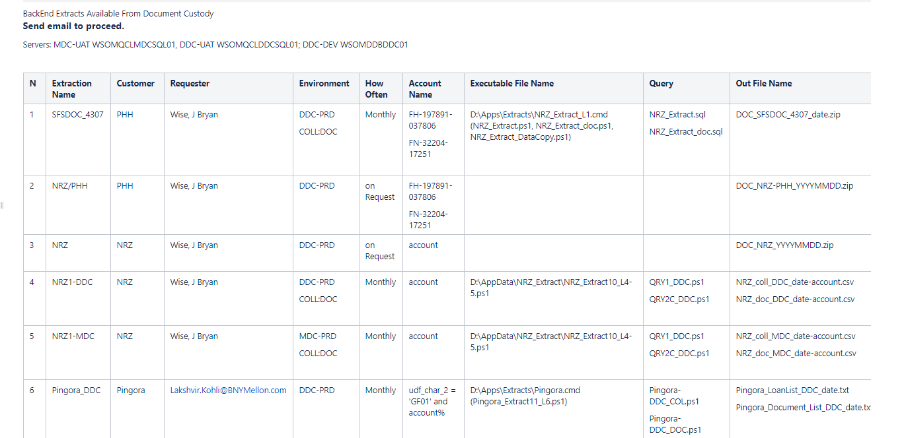
Extract Information 1
The Information on Document Custody Extracts is available at
https://confluence.bnymellon.net/display/~XBBNNTG/DocumentCustody+Extracts
\\wtpchr06320v1\ddc\DCdata\DCExtractDataCollector

Slide 3
Extract Information 2
NRZ Extract History
SFSDOC_4307 – Original version developed by Ken on Bryan request (JIRA SFSDOC_4307 ) for 2 PHH accounts some time ago. Coll and Doc level reports are to be executed monthly on 1st of the month.
NRZ/PHH and NRZ based on SFSDOC_4307 queries: transition from PHH to NRZ extract to include NRZ accounts (not used any more).
NRZ1-DDC and NRZ1-MDC based on SFSDOC_4307 queries and provided on Bryan request. Only final statement of SFSDOC_4307 queries were updated to adjust the NRZ1 output to customer requirements. Some duplicated entries and data inconsistencies related to the original Doc-level queries were reported by Mr. Kohli.
NRZ2-DDC and NRZ2-MDC based on SFSDOC_4307 queries and developed on request of Mr. Kohli (JIRA SFSDOC-4423). Only Doc level queries have been modified under Mr. Kohli’s directions. The ask is to execute this extract on 1st and 15th of every month.
Other extracts
SFSDOC-4414 DDC and MDC queries are executed weekly on Friday, 5 pm EST.
Pingora_DDC/Pingora_MDC (SFSDOC-4398) – Coll and Doc level reports are executed monthly on 1st of the month.
Nationstar (SFSDOC-4405) and Lakeview (SFSDOC-4399) extracts are presently on hold.

Slide 4
Extract Information 3
On Ken’s request Extract files have been copied to the following servers
DDC UAT: WSOMQCLDDCSQL01, folder D:\Apps\Extracts (not good)
MDC UAT: WSOMQCLMDCSQL01, folder D:\Apps\Extracts
Extract | File | Command | Schedule
SFSDOC-4414 | Extract-4414.ps1 | Extract-4414.cmd | Every Friday at 5 pm EST
SFSDOC_4307 | NRZ_Extract.ps1, NRZ_Extract_doc.ps1, NRZ_Extract_DataCopy.ps1 | NRZ_Extract_L1.cmd | After hours on 1st every month
NRZ2-DDC/NRZ2-MDC | NRZ_Extract11_L4-5.ps1 | NRZ2.cmd | After hours on 1st and 15th every month
Pingora_DDC/Pingora_MDC | Pingora_Extract9_L6.ps1 | Pingora.cmd | After hours on 1st every month
Nationstar | Nationstar_Extract10_L6.ps1 |  | On request
Lakeview | Lakeview_Extract9_L6.ps1 |  | On request

