Slide 1
Software For BNYM Document Management (WCM to DM Migration)
Mikhail Kozlov

Slide 2
Software Available For BNYM Document Management (DM) Service
CertTester – executable for DM digital certificate validation
DMhelper – class library that can be linked to a host application and used for DM interaction
DMhelperRunner – self-contained executable aimed at interaction with DM service
Some features are still in development

Slide 3
DM Software Development Objectives
Create user-friendly tools for facilitation of DM access and data handling
Provide executables and class libraries (DLLs) that can be either run from command line or linked to host applications
Create extendable control language that is compatible with common DM API calls
Provide testing for Document Custody applications

Slide 4
1. CertTester
CertTester.exe is aimed at validation of digital certificate and establishing initial connection to DM service
CertTester.exe should be accompanied with CertTester.exe.config file.
Prior to execution, strings with XXXs in CertTester.exe.config file have to be replaced with credentials suitable for the DM access.
<appSettings>
<add key="ENVIRONMENT" value="qa"/>
<add key="CONSUMERKEY" value="XXX"/>
<add key="CONSUMERSECRET" value="XXX"/>
<add key="CERTIFICATEPATH" value="XXX"/>
<add key="CERTIFICATEKEY" value="XXX"/>
</appSettings>
CertTester.exe is to be executed from command line and provided the following output: "Access token received" message if digital certificate is valid or Error message if digital certificate is not valid

Slide 5
2. DMhelper
Dmhelper.dll is class library that can be linked to a host application and aimed at interaction with BNYM Document Management (DM) service
DMhelper.dll provides access to the following externally accessible methods
For Document Upload (DU): public string DU(string ENVIRONMENT, string CONSUMERKEY, string CONSUMERSECRET, string CERTIFICATEPATH, string CERTIFICATEKEY, string docDataModel, string RM_RECORD_CODE, string DocUniqueID, string FullFileName)
For Document Information (DI): public string DI(string ENVIRONMENT, string CONSUMERKEY, string CONSUMERSECRET, string CERTIFICATEPATH, string CERTIFICATEKEY, string docDataModel, string RM_RECORD_CODE, string DocUniqueID)
For Document Download (DD): public string DD(string ENVIRONMENT, string CONSUMERKEY, string CONSUMERSECRET, string CERTIFICATEPATH, string CERTIFICATEKEY, string docDataModel, string RM_RECORD_CODE, string DocUniqueID, out byte[] DocOut)
For Document Erase (DE): public string DE(string ENVIRONMENT, string CONSUMERKEY, string CONSUMERSECRET, string CERTIFICATEPATH, string CERTIFICATEKEY, string docDataModel, string RM_RECORD_CODE, string DocUniqueID)
For Update Document (UD): public string UD(string ENVIRONMENT, string CONSUMERKEY, string CONSUMERSECRET, string CERTIFICATEPATH, string CERTIFICATEKEY, string docDataModel, string RM_RECORD_CODE, string DocUniqueID, string FullFileName)
For Update Information (UI): public string UI(string ENVIRONMENT, string CONSUMERKEY, string CONSUMERSECRET, string CERTIFICATEPATH, string CERTIFICATEKEY, string docDataModel, string RM_RECORD_CODE, string DocUniqueID)
Where,
ENVIRONMENT, CONSUMERKEY, CONSUMERSECRET, CERTIFICATEPATH, CERTIFICATEKEY are DM credentials similar to those for CertTester
docDataModel and RM_RECORD_CODE are DM settings for the application
DocUniqueID is document ID that must be unique in DM
FullFileName is path\filename to document that is to be upload to DM
DocOut is byte array containing document downloaded from DM

Slide 6
3. DMhelperRunner - 1
DMhelperRunner.exe is self-contained executable aimed at interaction with BNYM Document Management (DM) service
DMhelperRunner.exe should be accompanied with DMhelperRunner.exe.config file.
Prior to execution, strings with XXXs in DMhelperRunner.exe.config file have to be replaced with credentials suitable for the DM access.
<appSettings>
<add key="ENVIRONMENT" value="qa"/>
<add key="CONSUMERKEY" value=“XXX"/>
<add key="CONSUMERSECRET" value=“XXX"/>
<add key="CERTIFICATEPATH" value=“XXX"/>
<add key="CERTIFICATEKEY" value=“XXX"/>
<add key="docDataModel" value=“XXX"/>
<add key="RM_RECORD_CODE" value=“XXX"/>
</appSettings>
Where,
ENVIRONMENT, CONSUMERKEY, CONSUMERSECRET, CERTIFICATEPATH, CERTIFICATEKEY are DM credentials similar to those for CertTester
docDataModel and RM_RECORD_CODE are DM settings for the application

Slide 7
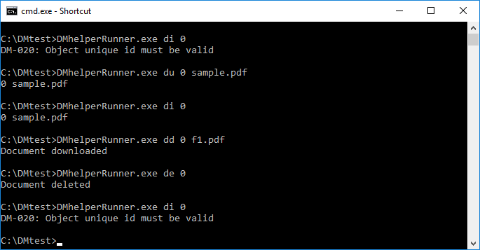
3. DMhelperRunner - 2
DMhelperRunner.exe is to be executed from command line with the following command line parameters
For Document Upload (DU): DMhelperRunner.exe DU DocUniqueID FullFileName
For Document Information (DI): DMhelperRunner.exe DI DocUniqueID
For Document Download (DD): DMhelperRunner.exe DD DocUniqueID DocOutFile
For Document Erase (DE): DMhelperRunner.exe DE DocUniqueID
For Update Document (UD): DMhelperRunner.exe UD DocUniqueID FullFileName
For Update Information (UI): DMhelperRunner.exe UI DocUniqueID
Where,
DocUniqueID is document ID that must be unique in DM
FullFileName is path\filename to document that is to be upload to DM
DocOutFile is path\filename to document that is to be downloaded from DM

Slide 8
Acknowledgement
Valuable suggestions by Erdinc Dincer and helpful discussions with Kenneth Harrelson are highly appreciated.

