Slide 1
Document Custody Health Check
Mikhail Kozlov

Slide 2
Project Objective
Develop software tool capable of launching diverse data acquisition/troubleshooting/report actions from a Web page using email interface.
Enable customization of requested actions for various applications in various environments.
Build and test first 22 support actions in real environment
Design Real Time Health Check Dashboard capable of providing status and support information for Document Custody servers, applications, databases, pending tickets on both periodic and on demand basis.
Summarize data acquired over certain time period in easily readable form on Health Check Readings History page. The page should provided insights into failure over time pattern.
Execute Health Check Dashboard on daily basis and display information on the Web page and emails.

Slide 3
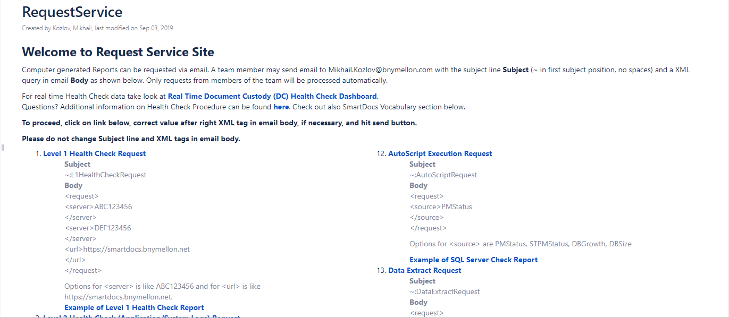
Request Service Page

Slide 4
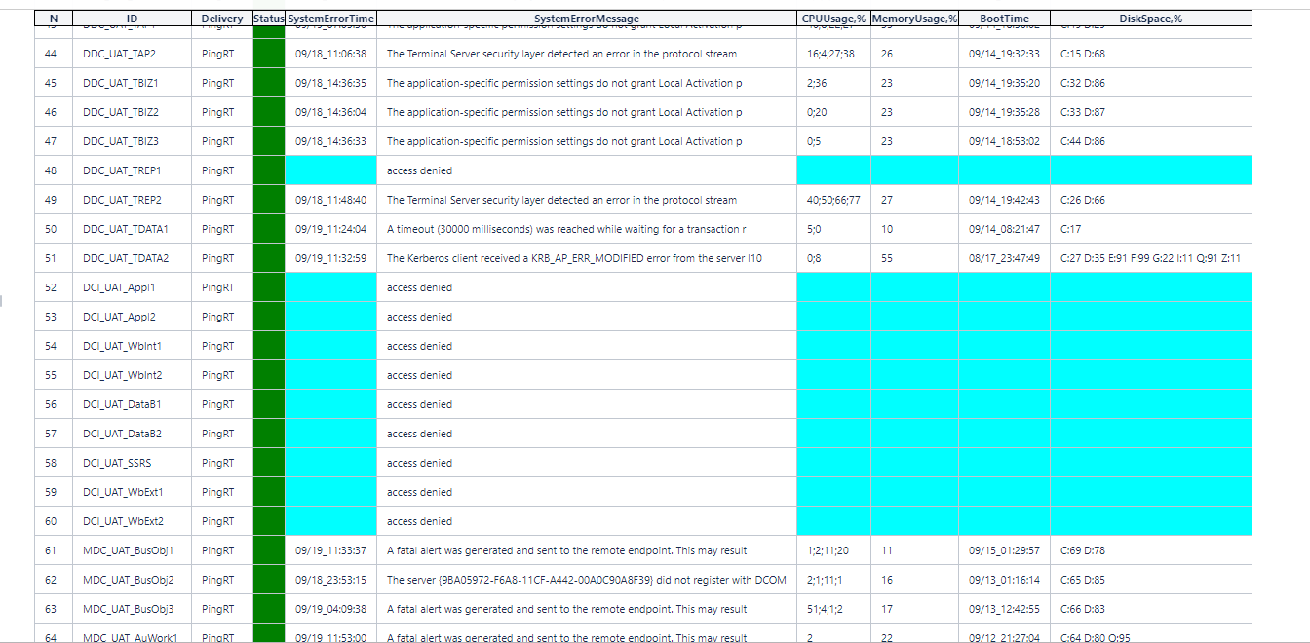
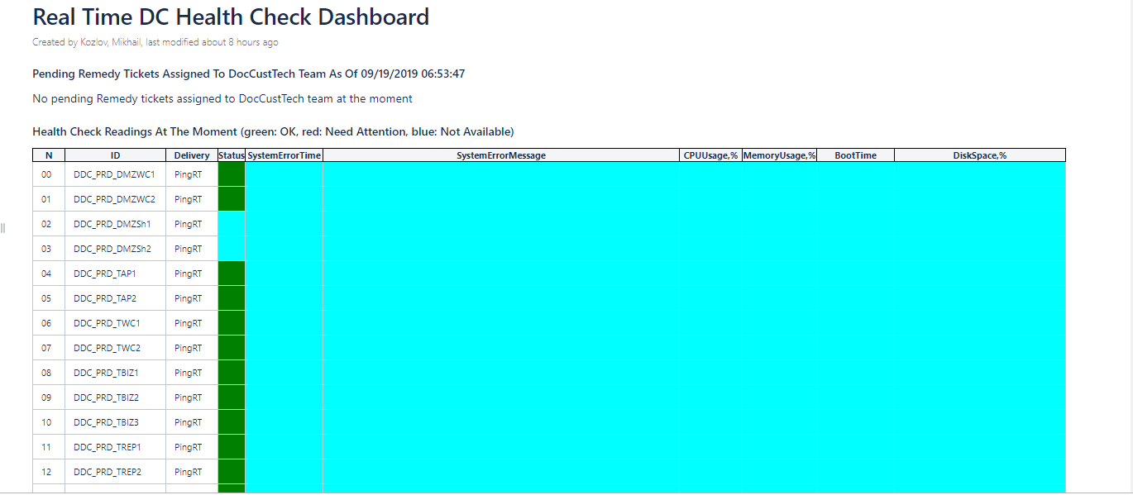
Real-Time Dashboard Page

Slide 5
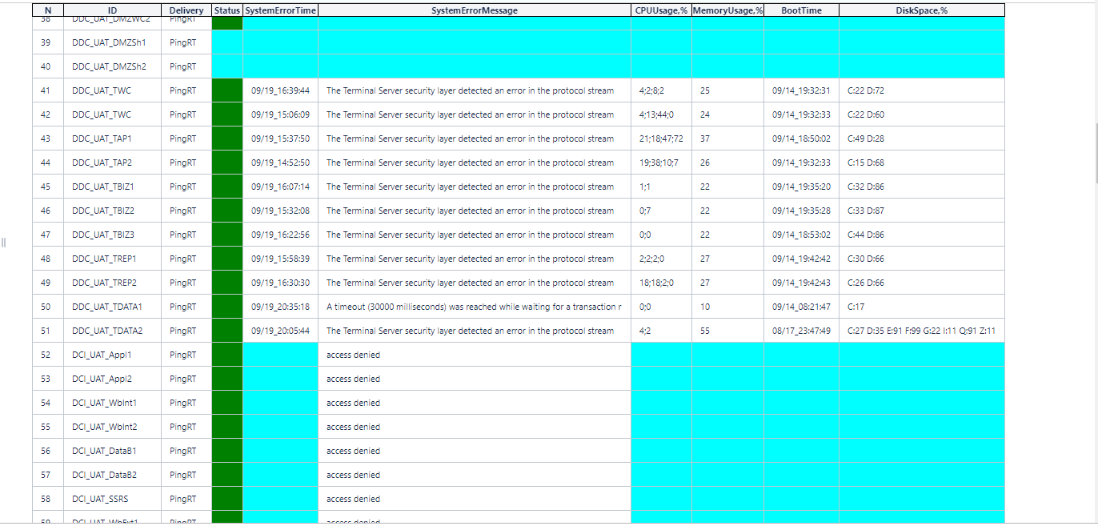
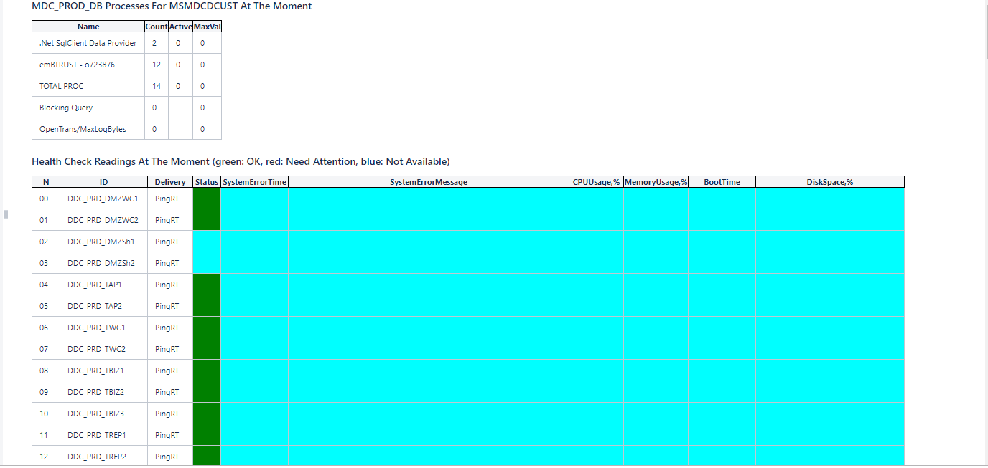
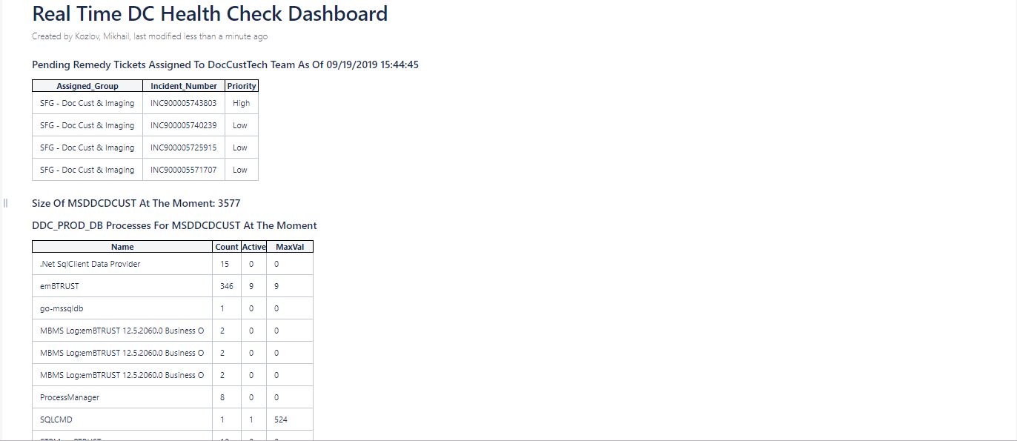

Slide 6
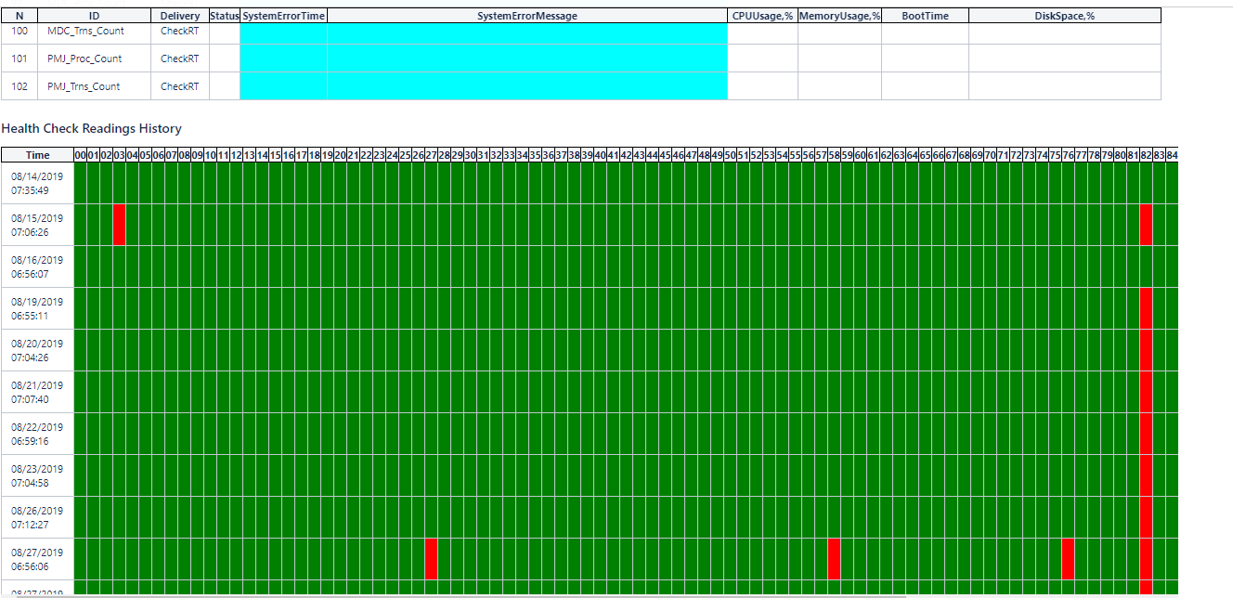

Slide 7
