Slide 1
Server And Application Readiness Status
Mikhail Kozlov

Slide 2
Project Objective
Develop software tool capable of reporting Green Field server and application readiness status based on several emBTRUST/Green Field requirements.
Implement software check for the following server parameters : CPU count, Memory total/visible, Drive: capacity/free, port 80 ping, port 443 ping, Certificate detection, URL ping, URL 200 code and Process ID, 11 in total.
Collect real time data for DCI, PMJ, MDC and DDC servers in the following environments DEV, UAT, PROD.
Execute data scan daily for Green Field servers available at the moment (107 servers) and present color-coded results on a Web page.
Provide enhancements to the tool on as needed bases.
Web link is https://confluence.bnymellon.net/display/~XBBNNTG/DocumentCustody_Server_Status

Slide 3
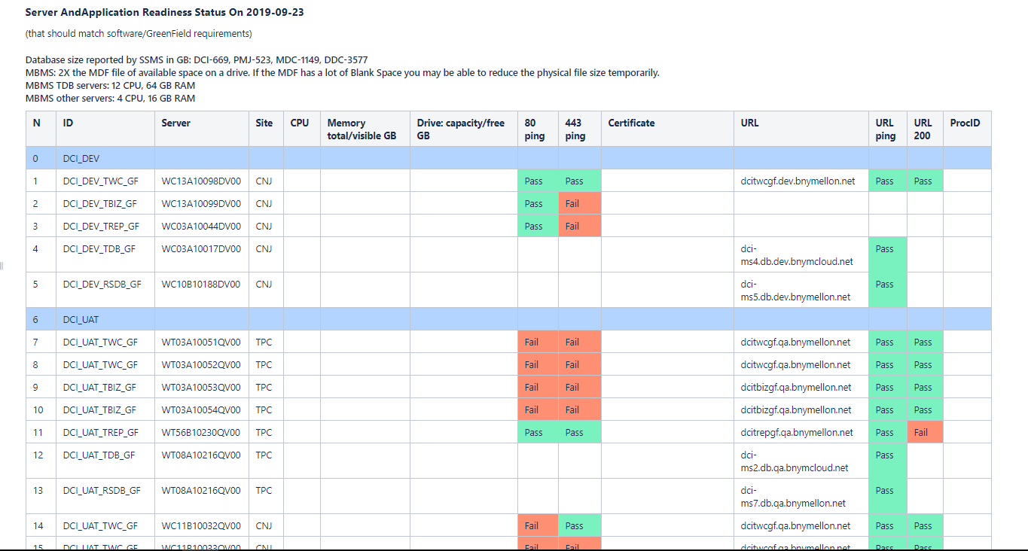
Server Status Output

Slide 4
Server Status Comments
Comments:
Green Box (Pass) indicates successful test
Red Box (Fail) indicates unsuccessful test
Red Box (Down) indicates connection failure
Reasons for Red Box:
No access rights for server/app
Server/app is not available
Server/app settings requite attention

