Slide 1
TECHTITAN / PROBLEM 06
RouteGuard
Autonomous retail supply chain recovery
Gaurav Vyas · Team leader
Utkarsh Umang · Shivam Salve
Agentic AI Hackathon · Tech Zephyr 4.0 · IIT Bhubaneswar
Notes:
We present a working Round 1 solution using original synthetic logistics data. This is a symbolic model-based planning agent, not an LLM chatbot.
Official Round 1 problem/rubric: https://docs.google.com/document/d/1GaCXe9AuFv0KCMPI8wj6FCPHt5AcPYjdIqhgAIIyByA/edit ; submission requirements: https://unstop.com/hackathons/agentic-ai-hackathon-tech-zephyr-40-indian-institute-of-technology-bhubaneswar-1742838/amp ; accessed 2026-09-12.

Slide 2
The recovery problem
A late shipment threatens store inventory; the recovery must respect every constraint.
100 units
INR 14,000 budget
24-hour deadline
110 kg CO2e limit
needed before the deadline
Target users: retail operations teams coordinating inventory, suppliers and transport.
Simulation: 20 units on hand; demand 120; original shipment ETA 36 hours.
TechTitan / RouteGuard 02
Notes:
All values are authored simulator inputs. Expected impact is better recovery discipline and less manual rework; no measured industry savings are claimed.
Official Round 1 problem/rubric: https://docs.google.com/document/d/1GaCXe9AuFv0KCMPI8wj6FCPHt5AcPYjdIqhgAIIyByA/edit ; submission requirements: https://unstop.com/hackathons/agentic-ai-hackathon-tech-zephyr-40-indian-institute-of-technology-bhubaneswar-1742838/amp ; accessed 2026-09-12.

Slide 3
A goal-driven recovery loop
Actions change the environment; observations determine the next action.
Observe
shortage
Search
allocations
Commit
reservations
Verify
state
Tool rejection or changed conditions → refresh state → replan
Persistent memory: goal, catalog revision, orders, ledger, receipts and event history.
TechTitan / RouteGuard 03
Notes:
The controller branches on feedback. Stale commits return to observation; infeasibility escalates; integrity mismatches stop completion. Candidate allocations are computed dynamically. Known faults are environment fixtures; judges can inject other outages.
Official Round 1 problem/rubric: https://docs.google.com/document/d/1GaCXe9AuFv0KCMPI8wj6FCPHt5AcPYjdIqhgAIIyByA/edit ; submission requirements: https://unstop.com/hackathons/agentic-ai-hackathon-tech-zephyr-40-indian-institute-of-technology-bhubaneswar-1742838/amp ; accessed 2026-09-12.

Slide 4
System architecture
Local tools and persistent state; no credentials or internet needed to run.
Operator + browser
Goal controller
SQLite state
+ event history
Inventory +
route lookup
Exact allocation
optimizer
Atomic commit
+ cancellation
Independent
state verifier
Failure feedback returns to the controller; unresolved cases go to operator review.
TechTitan / RouteGuard 04
Notes:
The editable diagram shows major components. Tools are local functions, not separate network microservices. SQLite transaction persistence covers each world mutation and its event. Retrieval is catalog lookup; no RAG or external model is claimed. See docs/ARCHITECTURE.md for the full feedback graph and contracts.
Official Round 1 problem/rubric: https://docs.google.com/document/d/1GaCXe9AuFv0KCMPI8wj6FCPHt5AcPYjdIqhgAIIyByA/edit ; submission requirements: https://unstop.com/hackathons/agentic-ai-hackathon-tech-zephyr-40-indian-institute-of-technology-bhubaneswar-1742838/amp ; accessed 2026-09-12.

Slide 5
Two disruptions, three computed plans
The agent preserves valid reservations and replans only the remaining shortage.
Initial plan
Cuttack: 100 units
INR 9,000 · Rejected: supplier withdrawn
First recovery
Puri: 60 + Khordha: 40
INR 10,600 · Committed, then Puri closes
Final recovery
Khordha: 80 + Berhampur: 20
INR 11,700 · All constraints verified
TechTitan / RouteGuard 05
Notes:
Results come from submission/TechTitan_evidence_agentic.json. Cuttack is withdrawn after the first plan. Puri closes after the second plan is committed. Forty valid Khordha units remain; the next action adds forty Khordha and twenty Berhampur. Cancellation is pre-dispatch, fully refundable, with no sunk carbon in the simulator.
Official Round 1 problem/rubric: https://docs.google.com/document/d/1GaCXe9AuFv0KCMPI8wj6FCPHt5AcPYjdIqhgAIIyByA/edit ; submission requirements: https://unstop.com/hackathons/agentic-ai-hackathon-tech-zephyr-40-indian-institute-of-technology-bhubaneswar-1742838/amp ; accessed 2026-09-12.

Slide 6
Verified recovery
Independent checks use saved orders, inventory and ledger, rather than cached planner totals.
100
INR 11,700
recovery units
38 kg CO2e / latest ETA 22 h
10 checks passed
Quantity · cost · carbon · deadline · routes · ledger · order IDs · stock · prices · receipts
TechTitan / RouteGuard 06
Notes:
Verification scope is reservations and projected inventory coverage in the simulator. This is not physical delivery confirmation. Budget headroom is INR 2,300 and deadline headroom is two hours. Do not interpret synthetic carbon attributes as audited measurements.
Official Round 1 problem/rubric: https://docs.google.com/document/d/1GaCXe9AuFv0KCMPI8wj6FCPHt5AcPYjdIqhgAIIyByA/edit ; submission requirements: https://unstop.com/hackathons/agentic-ai-hackathon-tech-zephyr-40-indian-institute-of-technology-bhubaneswar-1742838/amp ; accessed 2026-09-12.

Slide 7
Reproducible evaluation
80 synthetic cases, seed 1742838, checked against an independent dynamic-programming oracle.
80 / 80
31 / 31 feasible cases verified
49 / 49 infeasible cases identified
17 automated tests passing
Exact feasibility and objective agreement
Cheapest-first baseline: feasible in 28 cases; constrained search: feasible in 31.
Limited five-offer sandbox benchmark. No production or generalization claim.
TechTitan / RouteGuard 07
Notes:
Measured by evaluate.py and tests/test_engine.py. The independent oracle does not call the planner or its total calculator. Feasible and infeasible counts are separate to avoid treating impossible goals as algorithm failures. All test inputs are included in the evaluation JSON. The simple baseline ignores global carbon constraints until post-checking and has no recovery.
Official Round 1 problem/rubric: https://docs.google.com/document/d/1GaCXe9AuFv0KCMPI8wj6FCPHt5AcPYjdIqhgAIIyByA/edit ; submission requirements: https://unstop.com/hackathons/agentic-ai-hackathon-tech-zephyr-40-indian-institute-of-technology-bhubaneswar-1742838/amp ; accessed 2026-09-12.

Slide 8
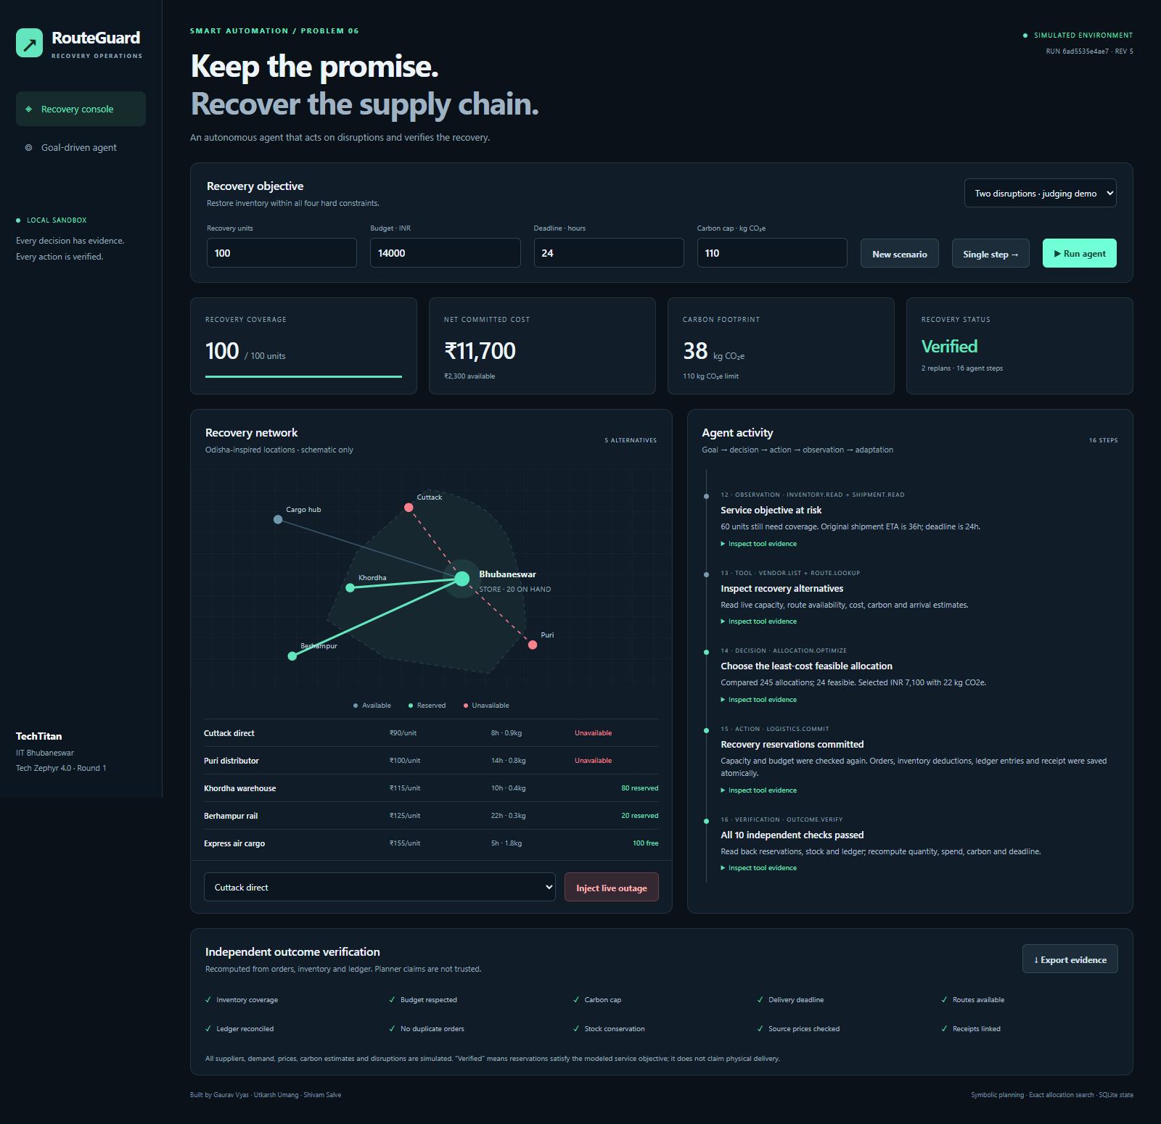
Working prototype
Inspect tool evidence, change constraints, inject an outage and export the full run.
python server.py
Open localhost:8765
Select Two disruptions
Run the agent
Inspect verification
Standard-library Python + browser
TechTitan / RouteGuard 08
Notes:
Actual screenshot from the working application, captured after the two-disruption workflow. It is evidence, not an illustrative mockup. The demo video records real UI actions with synthetic computer narration and captions.
Official Round 1 problem/rubric: https://docs.google.com/document/d/1GaCXe9AuFv0KCMPI8wj6FCPHt5AcPYjdIqhgAIIyByA/edit ; submission requirements: https://unstop.com/hackathons/agentic-ai-hackathon-tech-zephyr-40-indian-institute-of-technology-bhubaneswar-1742838/amp ; accessed 2026-09-12.

Slide 9
Challenges and limits
The prototype is designed to make recovery behavior inspectable and testable.
Consistent state after failure
Keep unaffected orders; cancel and refund affected ones; prevent duplicate charges.
Explicit simulator assumptions
One SKU, five offers, ten-unit lots, snapshot ETAs and fully refundable pre-dispatch cancellations. No live ERP, physical delivery or measured emissions.
TechTitan / RouteGuard 09
Notes:
The exact enumerator does not scale to production network size. A next implementation would introduce MILP/CP optimization, real ERP adapters, partial/sunk cancellation costs, stochastic transit and authentication. Current results apply only to the disclosed model.
Official Round 1 problem/rubric: https://docs.google.com/document/d/1GaCXe9AuFv0KCMPI8wj6FCPHt5AcPYjdIqhgAIIyByA/edit ; submission requirements: https://unstop.com/hackathons/agentic-ai-hackathon-tech-zephyr-40-indian-institute-of-technology-bhubaneswar-1742838/amp ; accessed 2026-09-12.

Slide 10
Conclusion
A recovery action is complete only when the resulting state satisfies the goal.
Act. Observe the consequence.
Replan. Verify.
Delivered: runnable source, architecture, presentation,
demo video and reproducible evaluation evidence.
TechTitan · Gaurav Vyas · Utkarsh Umang · Shivam Salve
TechTitan / RouteGuard 10
Notes:
Problem 6 was selected because the entire sandbox and objective verification can be built with owned synthetic data. No qualification or business-performance guarantee is made. Public source and deliverables: https://github.com/realgauravvyas/TechTitan-RouteGuard-Agentic
Official Round 1 problem/rubric: https://docs.google.com/document/d/1GaCXe9AuFv0KCMPI8wj6FCPHt5AcPYjdIqhgAIIyByA/edit ; submission requirements: https://unstop.com/hackathons/agentic-ai-hackathon-tech-zephyr-40-indian-institute-of-technology-bhubaneswar-1742838/amp ; accessed 2026-09-12.

