Slide 1
THE PROJECT
Teaching a network chess, with no chess knowledge
Following AlphaZero — DeepMind, 2017
DeepMind showed one network, trained only by playing itself, could master chess, shogi and Go and beat the strongest engines of the day.
This project reproduces that recipe at ~1/1,000,000 the compute.
No opening book, no piece values, no evaluation function — just the rules and data.
One network, two heads: policy (which moves look good) and value (who is winning). Monte Carlo Tree Search turns it into a player.
760,717
trainable parameters
676,648
human positions used for pretraining
Silver et al., Science 2018. AlphaZero used ~5,000 TPUs; this runs on one desktop with an RTX 3060.

Slide 2
DATA SCIENCE: REPRESENTATION
From chessboard to tensor to network
Input — 18 binary planes of 8×8
12 piece planes (6 types × 2 colours) · 4 castling rights · 1 en passant · 1 side to move
Output — 4,672 actions
64 origin squares × 73 move types: 56 queen-style, 8 knight, 9 underpromotions. Every legal move maps to exactly one index — round-trip tested, 0 collisions.
The network
3×3 conv 18→64, ten residual blocks with batch norm, then two heads: policy → 4,672 logits, value → one scalar in [−1, 1].
Both heads share the trunk, so one representation must serve two tasks.
18 × 8 × 8
board in
4,672
moves out
760,717
parameters
Representation is the part you cannot fix later with more compute.

Slide 3
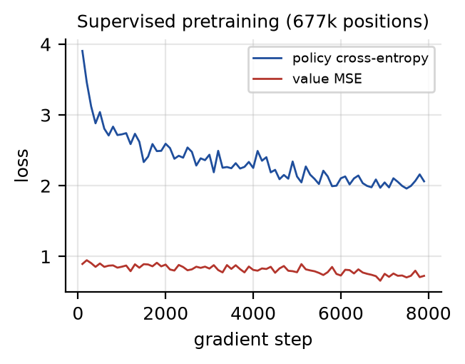
STAGE 1 · SUPERVISED
Learning from 677k human positions
Lichess database, both players rated 1750+
The Elo filter keeps only ~12% of games — imitate competent play, not average play.
Policy cross-entropy 3.90 → 2.06
≈ 13% probability on the exact move a strong human chose, out of 4,672 options.
It plays real chess: e4/d4 openings, wins a hanging queen, finds mate in one. 85% vs random.

Slide 4
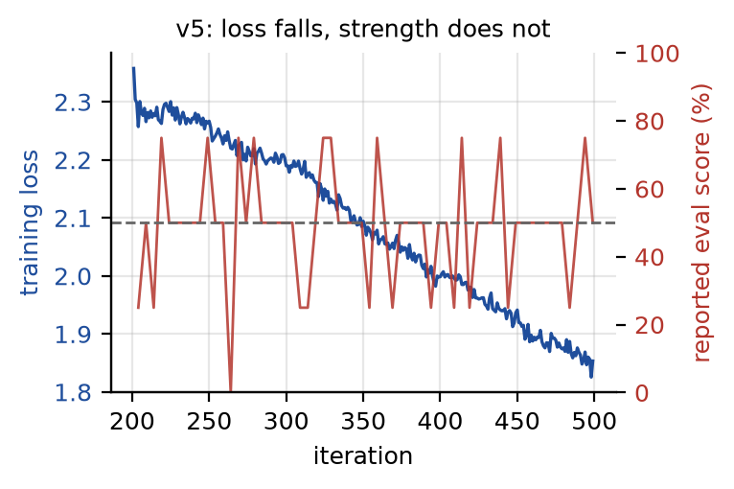
STAGE 2 · SELF-PLAY
300 iterations. The loss fell the whole way.
Training loss: 2.36 → 1.85
Monotonic. Textbook. Exactly what you hope to see.
Reported evaluation score: 50%
For 159 consecutive measurements across two multi-hour runs.
I read that as “evenly matched.”
It was not. It was a metric that could not return anything else.

Slide 5
THE BUG
The evaluation was measuring nothing
The network alternated colours — half its games as white, half as black.
The score counted white’s wins.
So every game the network won as black was recorded as a loss.
With two deterministic players and no opening randomisation, all five games per colour are identical — the tally can only be symmetric.
[iter 454] eval: {'1-0': 0, '0-1': 0, '1/2-1/2': 10} 50%
[iter 499] eval: {'1-0': 0, '0-1': 0, '1/2-1/2': 10} 50%
159
useless data points
44% → 85%
true score, once fixed
A metric returning a plausible constant is more dangerous than one that crashes.

Slide 6
THE REAL RESULT
Self-play made the model worse
v5 final 2.5 — 5.5 its own starting point
8 games, alternating colours, randomised openings
The final model lost to the model it started from.
Hours of compute made it measurably weaker — while the loss curve fell the entire time.
Why the loss is not a strength signal:
The loss is computed against targets the model generated itself. Minimising it proves the model agrees with itself. It says nothing about whether it plays better chess.
Every self-training and self-supervised pipeline shares this structure — and therefore this failure mode.

Slide 7
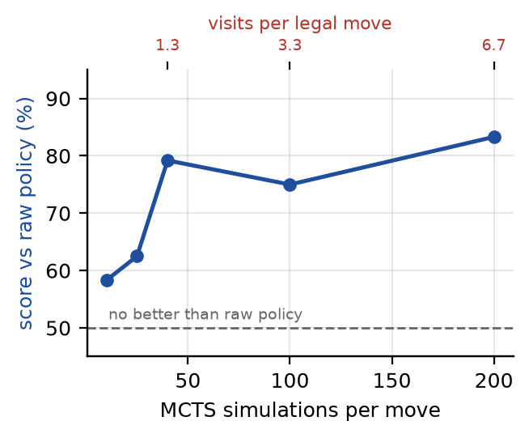
DIAGNOSIS
Two root causes, isolated by experiment
1 · The targets were noise
Search is not weak — MCTS beats the raw policy 79% at 40 simulations. But 40 simulations over ~30 legal moves is 1.3 visits per move.
The best move is good; the distribution is sampling noise — and the loss trains on the distribution.
2 · The augmentation was illegal
Mirroring flipped board files but never swapped the castling planes. The king lands on d1 with “kingside castling” still set — a position that cannot exist in chess.
~50% of every training batch was corrupted.

Slide 8
THE FIX
Gating stopped the bleeding
Acceptance gating, from AlphaGo Zero
Self-play always generates from the best weights so far; new weights are promoted only after scoring ≥ 55% against the incumbent.
Plus castling-aware augmentation, 128 simulations instead of 40, 80 gradient steps instead of 200.
199 iterations later — no regression.
The candidates the gate rejected averaged 42.2% vs baseline (p = 0.004): self-play was still degrading the network.
The gate kept that damage out of the deployed model.
gate: candidate 43.8%
vs best -> rejected
46.2%
gated model vs its starting point — no detectable change
v5 without the fixes: 31.2%. Gating converted a real regression into no change.

Slide 9
WHAT I TAKE AWAY
Measurement is the hard part
A falling loss curve is not evidence that anything is working.
Especially when the model produces its own labels.
Verify the metric before trusting the model.
Mine returned a plausible number 159 times in a row while measuring nothing at all.
Downscaling changes which statistic matters.
800 → 40 simulations preserves the best move but destroys the distribution — and the loss reads the distribution.
Then audit the fix too.
My gate promoted 8 of 20 candidates. Pure chance predicts 7.8 — an 8-game match could never have resolved this. The same mistake, one level up.
Artifacts
Code
github.com/realgauravvyas/chess-ai
Results
RESULTS.md — every number, reproducible
Demo
Live training dashboard + play any checkpoint

