Slide 1


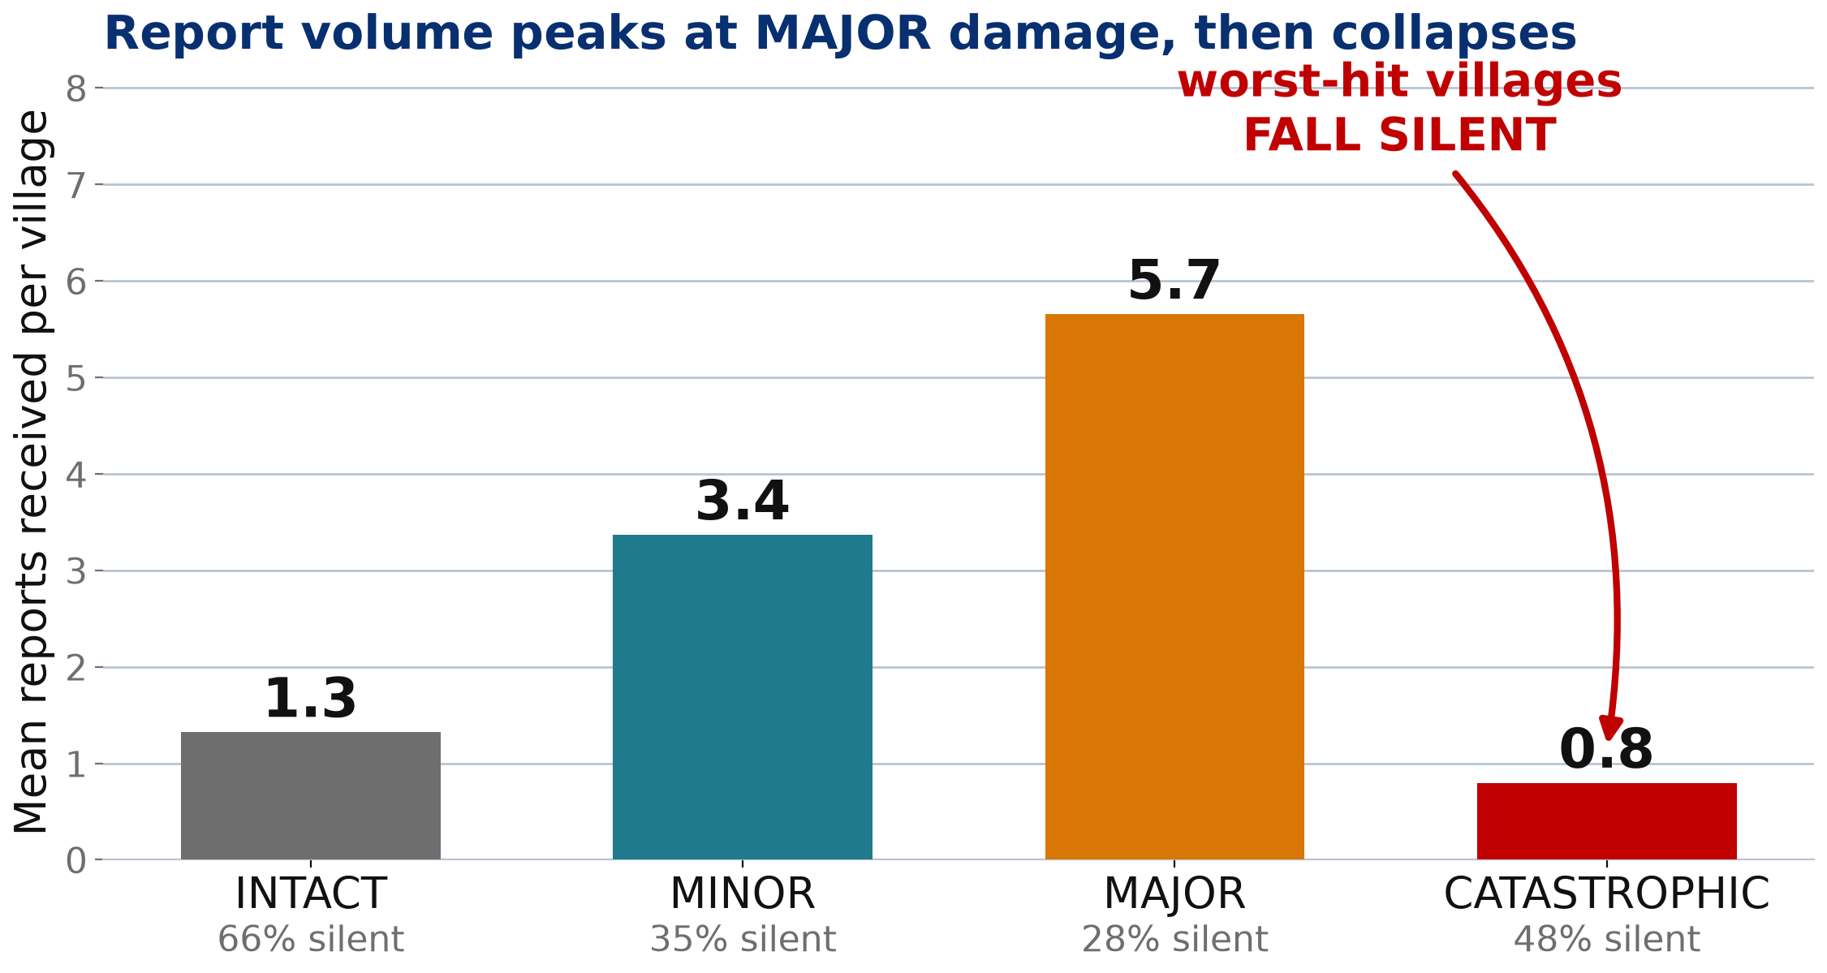
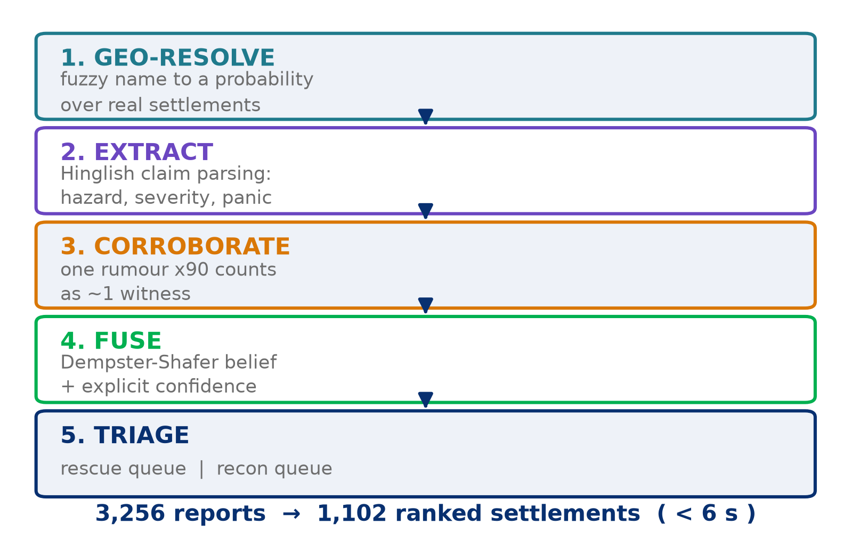
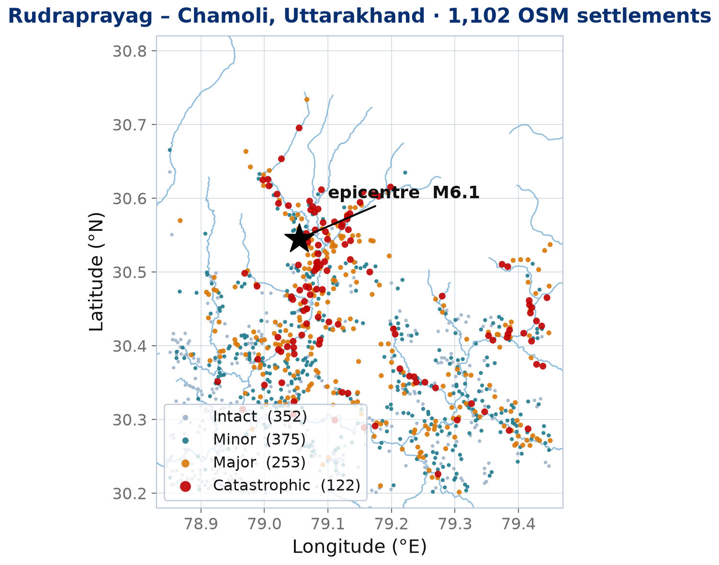
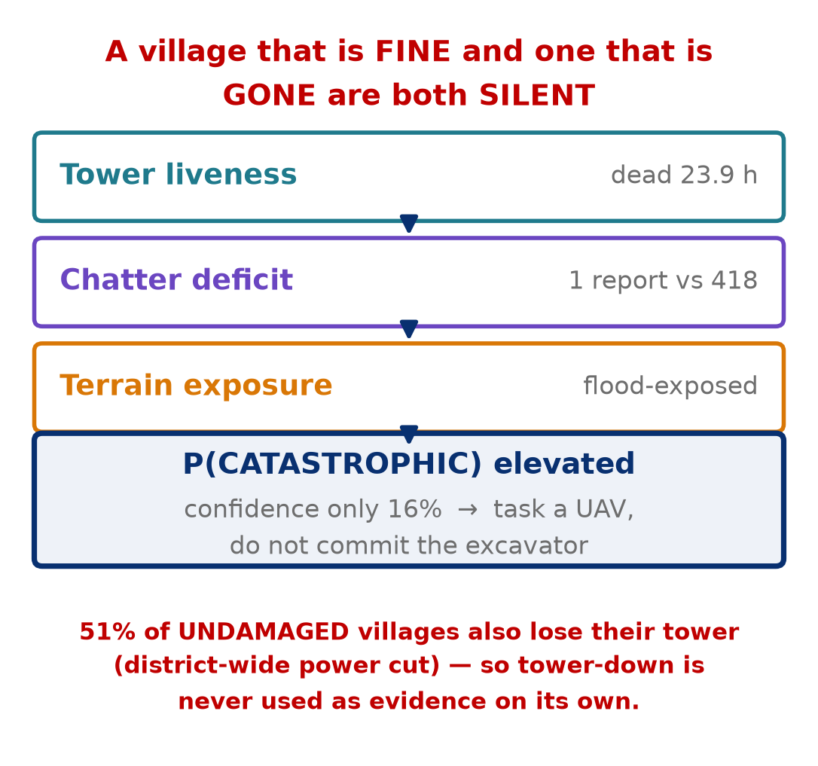
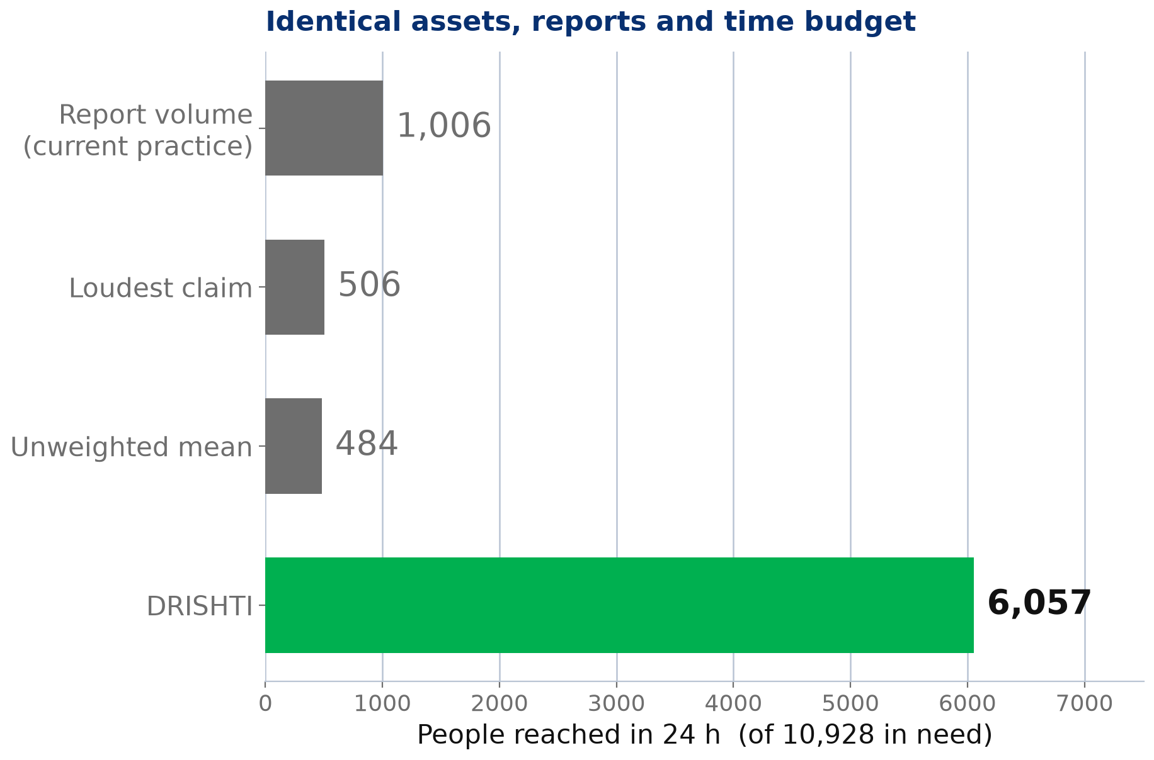
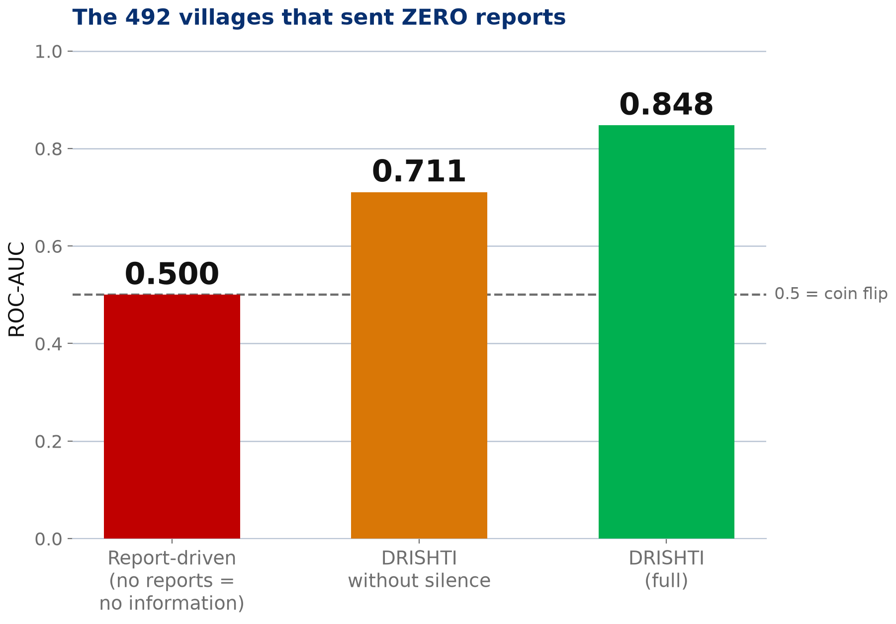
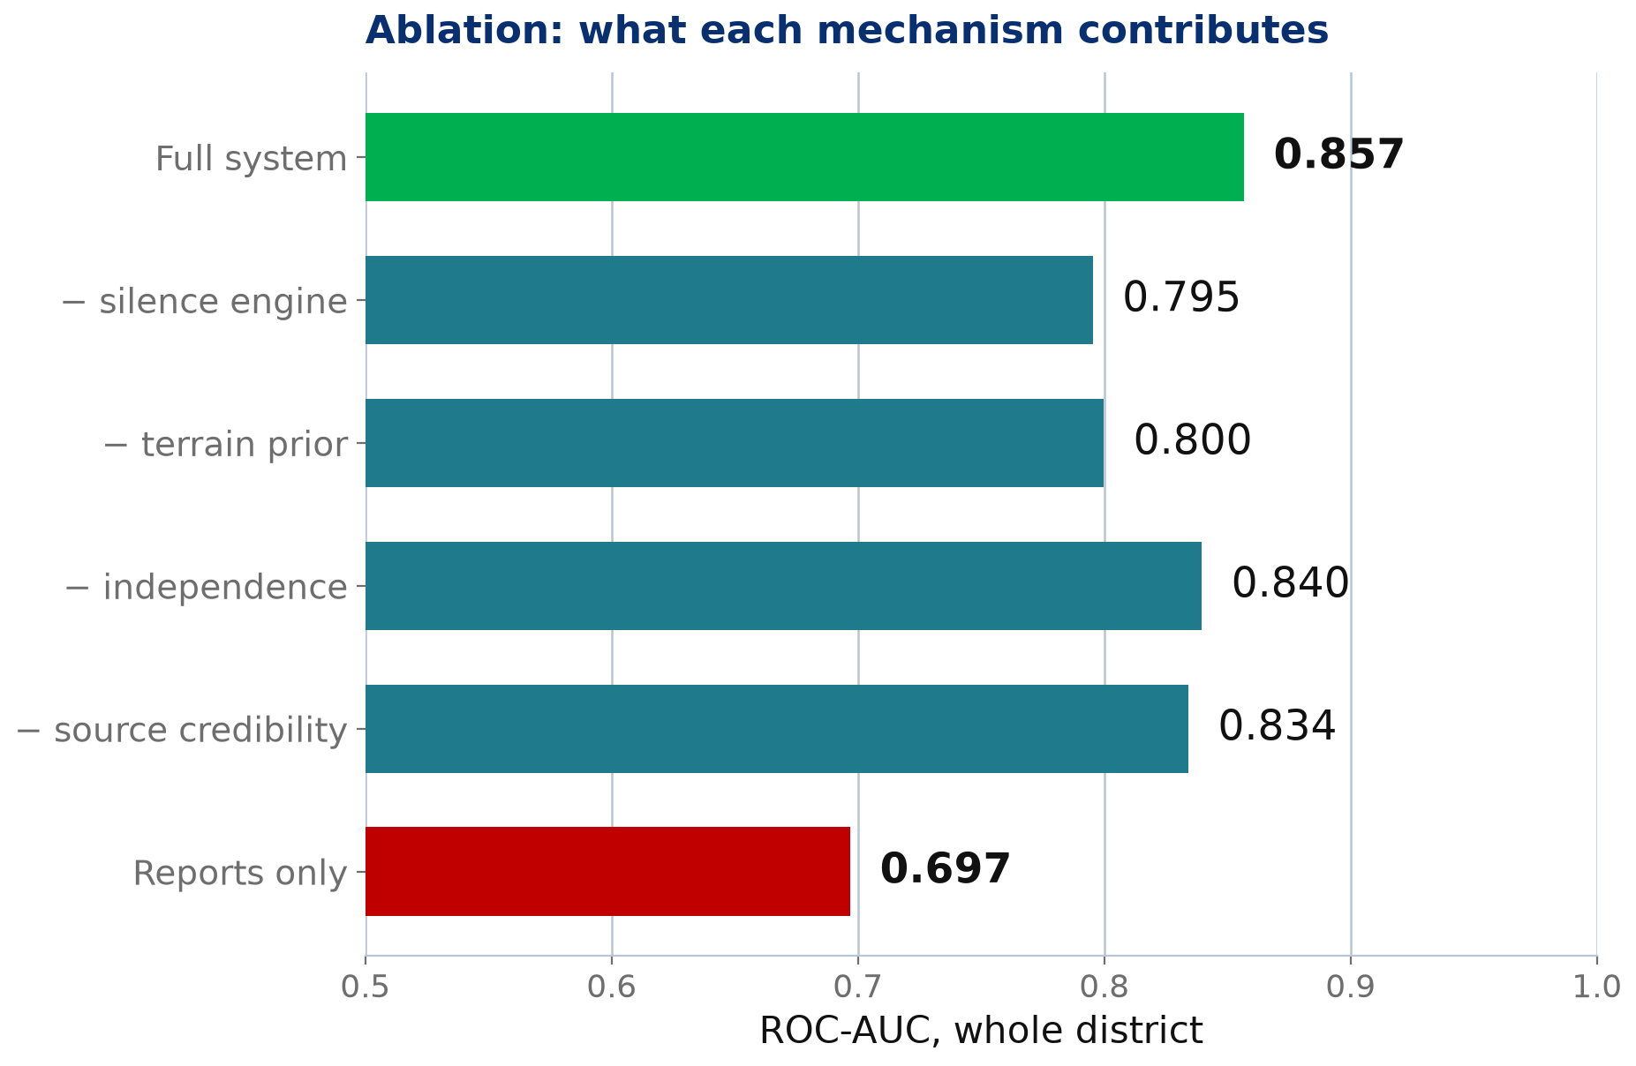
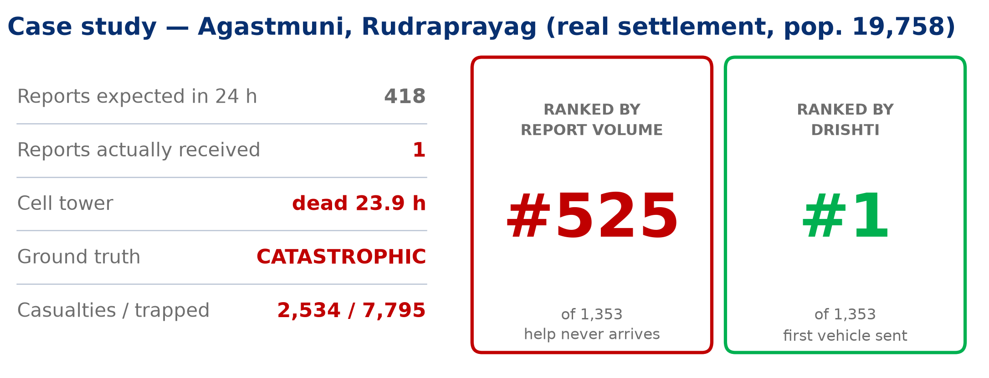
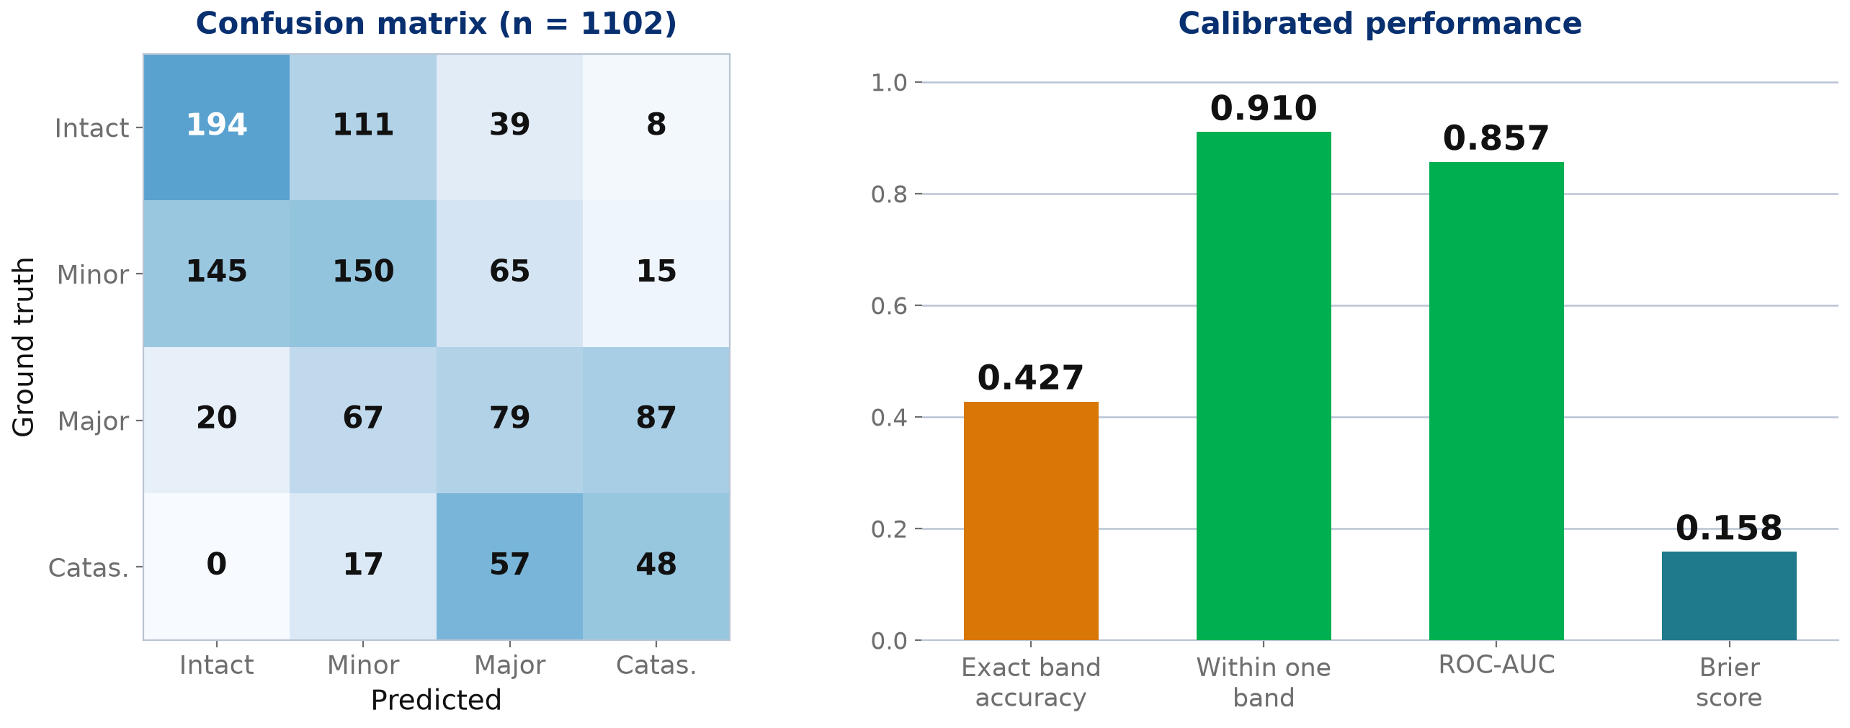


AVINYA 2026
Eco-Innovate Challenge
1st International Conference on Sustainable Innovation and Green Technologies (ICSIGT 2026)
DRISHTI: Resolving the Post-Disaster Information Fog by Treating Silence as Evidence
Gaurav Vyas and Mandavi Singh
Mehta Family School of Data Science and Artificial Intelligence, Indian Institute of Technology Guwahati
g.vyas@op.iitg.ac.in · s.mandavi@op.iitg.ac.in
ABSTRACT
MOTIVATION
OBJECTIVES
In the first 24 hours after a climate-driven multi-hazard event, a District Emergency Operations Centre (EOC) receives thousands of fragmented, contradictory and unverified ground reports, while severed roads prevent physical verification. Scarce rescue assets are therefore allocated to wherever reporting is loudest.
We identify a systematic failure in this practice: report volume is non-monotonic in damage. Undamaged settlements generate no reports because there is nothing to report, and catastrophically damaged settlements also generate none because casualties and destroyed telecom infrastructure remove the reporters themselves. Volume-based triage therefore ranks destroyed villages alongside safe ones.
DRISHTI reframes the task from establishing truth to maintaining a calibrated belief. Reports are geo-resolved to a probability distribution over settlements, parsed for claims, clustered so that amplified rumour cannot masquerade as corroboration, and fused by Dempster-Shafer combination of simple support functions in closed form. Critically, ABSENCE is converted into positive evidence by fusing telecom-tower liveness, chatter deficit against a population baseline, and terrain exposure.
Evaluated on a 1,102-settlement district built from OpenStreetMap with hidden ground truth, DRISHTI reaches 6,057 of 10,928 affected people within 24 h against 1,006 for volume ranking, using identical assets. For the 492 settlements that emit no reports at all, report-driven ranking is statistically indistinguishable from chance (AUC 0.500) whereas DRISHTI attains 0.848.
Keywords: disaster informatics, evidence fusion, Dempster-Shafer theory, climate resilience, humanitarian logistics, open geospatial data
KEY OUTCOMES
• 6.0x more affected people reached with identical assets
• AUC 0.848 vs 0.500 on settlements that never reported
• Blackout detection at 64% precision vs 34% base rate
• ~900 of 3,256 reports suppressed as panic amplification
• Runs offline on one laptop · zero licence or cloud cost
1. Quantify the non-monotonic relationship between damage severity and citizen-report volume, and its effect on asset allocation.
2. Fuse heterogeneous, contradictory reports into a per-settlement belief distribution that states its own confidence.
3. Convert the ABSENCE of expected reports into positive, calibrated evidence of catastrophe, separating “quiet because unharmed” from “quiet because destroyed”.
4. Suppress rumour amplification so that repetition is not mistaken for independent corroboration.
5. Produce two distinct operational queues — rescue under confidence, reconnaissance under uncertainty — routed over a damaged network.
6. Deliver the whole system on free and open data at zero marginal cost, deployable on existing district hardware.
MATERIALS AND METHOD
EXPERIMENTAL SETUP
MECHANISM
RESULT
DISCUSSION
Why silence is hard. An undamaged village and a destroyed village are both silent, so report volume alone can never separate them. We resolve this with telecom-tower liveness, an observation about the PLACE rather than about whether anyone had something to say.
Tower loss is not proof. In our scenario 51% of undamaged settlements also lose their tower, because the grid is cut district-wide to prevent electrocution. Tower-down is therefore treated as weak evidence and never used alone; terrain exposure supplies the prior that separates structural collapse from a generator that ran dry.
Guarding against circular evaluation. An early version of our simulator generated damage from the same terrain variables the engine's prior consumes, yielding an inflated AUC of 0.98. We introduced a spatially-correlated latent vulnerability field (building stock, drainage, upstream release) that no free map layer reveals. The honest figure is 0.857.
Ablation. Removing the silence engine costs 0.061 AUC overall and 0.137 on non-reporting settlements, confirming that absence carries genuine information rather than acting as a tie-breaker.
Limitations. Ground truth is simulated, since no labelled multi-hazard report corpus exists for an Indian district; population is estimated from OSM place class where census figures are absent; and the telecom feed is modelled rather than live. None of these affect the architecture, only the calibration constants.
Fig. 1 People reached within 24 h under a fixed 40-asset budget.
Fig. 2 Detection accuracy on the 492 settlements emitting no reports.
Fig. 3 Ablation: contribution of each mechanism to district-wide AUC.
Fig. 4 Case study. A real settlement of 19,758 people that emitted one report where 418 were expected.
Fig. 5 Confusion matrix over 1,102 settlements and calibrated performance after temperature scaling.
CONCLUSIONS
ACKNOWLEDGEMENT
REFERENCES
1. Report volume is a hill, not a slope. Ranking by it systematically de-prioritises the highest-mortality settlements.
2. Absence of expected communication, fused with infrastructure liveness and terrain exposure, is a usable and calibrated signal of catastrophe.
3. On settlements that never report, report-driven triage is equivalent to a coin flip (AUC 0.500); DRISHTI achieves 0.848.
4. The system reaches 6.0x more affected people within the golden 24 hours using the same vehicles, and wastes fewer deployments.
5. Because it runs offline on free and open data, it is deployable where connectivity and budget are the binding constraints — the conditions that define a disaster.
Submitted to ICSIGT 2026 · AVINYA 2026 Eco-Innovate Challenge, organised by the Prakriti Club, IIT Guwahati.
We thank the OpenStreetMap contributors, Open-Meteo and the USGS for the open data this work rests on.
Team EcoGenesis · MIT Licence
1. Shafer, G. A Mathematical Theory of Evidence. Princeton Univ. Press, 1976.
2. Imran, M. et al. Processing social media messages in mass emergency: a survey. ACM Comput. Surv. 47(4), 2015.
3. Wald, D. J. et al. Relationships between peak ground acceleration, peak ground velocity and Modified Mercalli Intensity. Earthquake Spectra 15(3), 1999.
4. National Disaster Management Authority. National Disaster Management Plan. Govt. of India, 2019.
5. OpenStreetMap contributors. Planet dump, 2026. openstreetmap.org
6. Open-Meteo. Free weather and elevation API, 2026. open-meteo.com
7. USGS. ANSS Comprehensive Earthquake Catalog (ComCat), 2026.
LIVE DASHBOARD
realgauravvyas.github.io /drishti
SOURCE CODE
github.com/realgauravvyas /drishti

