Slide 1
Directed Acyclic Graphs

Slide 2
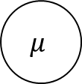

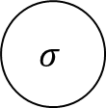
Model of the mean
$$y_{i}$$
$$μ$$
$$σ$$

Slide 3
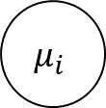

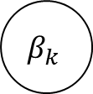
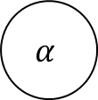
Linear regression
$$x_{k,i}$$
$$y_{i}$$
$$μ_{i}$$
$$σ$$
$$α$$
$$β_{k}$$

Slide 4









Linear regression with random intercept
$${group}_{i}$$
$$x_{k,i}$$
$$y_{i}$$
$$α_{g}$$
$$μ_{i}$$
$$σ$$
$$μ^{α}$$
$$σ^{α}$$
$$β_{k}$$

Slide 5
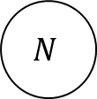



Lincoln-Peterson mark-recapture model
$$M$$
$$R$$
$$C$$
$$N$$

Slide 6










State-space model
Process model: Population time series with annual growth rate
Observation model: Lincoln-Peterson mark-recapture model
$$M_{t}$$
$$R_{t}$$
$$C_{t}$$
$$N_{t}$$
$$σ$$
$$N_{t−1}$$
$$α$$
$$λ_{t}$$
$$β_{k}$$
$$x_{k,t}$$

