Slide 1

  CLUSTERING
Basic Concepts
In clustering or unsupervised learning no training data, with class labeling, are available. The goal becomes: Group the data into a number of sensible clusters (groups). This unravels similarities and differences among the available data.
  Applications:
    Engineering
    Bioinformatics
    Social Sciences
    Medicine
    Data and Web Mining
  To perform clustering of a data set, a clustering criterion must first be adopted. Different clustering criteria lead, in general, to different clusters.

Slide 2
  A simple example
Blue shark,
sheep, cat,
dog
Lizard, sparrow, viper, seagull, gold fish, frog, red mullet
Two clusters
Clustering criterion:
How mammals bear
their progeny
Gold fish, red mullet, blue shark
Sheep, sparrow,
dog, cat, seagull,
lizard, frog, viper
Two clusters
Clustering criterion:
Existence of lungs

Slide 3
Clustering task stages
  Feature Selection: Information rich features-Parsimony
  Proximity Measure: This quantifies the term similar or dissimilar.
  Clustering Criterion: This consists of a cost function or some type of rules.
  Clustering Algorithm: This consists of the set of steps followed to reveal the structure, based on the similarity measure and the adopted criterion.
  Validation of the results.
  Interpretation of the results.

Slide 4
  Depending on the similarity measure, the clustering criterion and the clustering algorithm different clusters may result. Subjectivity is a reality to live with from now on.
  A simple example: How many clusters??
2 or 4 ??

Slide 5
Basic application areas for clustering
  Data reduction. All data vectors within a cluster are substituted (represented) by the corresponding cluster representative.
  Hypothesis generation.
  Hypothesis testing.
  Prediction based on groups.

Slide 6
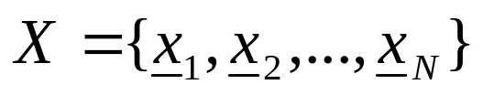
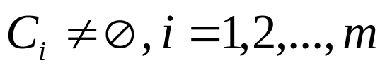
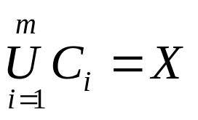
Clustering Definitions
  Hard Clustering: Each point belongs to a single cluster
    Let
    An m-clustering R of X, is defined as the partition of X into m sets (clusters), C₁, C₂,…,C_{m}, so that
  In addition, data in C_{i} are more similar to each other and less similar to the data in the rest of the clusters. Quantifying the terms similar-dissimilar depends on the types of clusters that are expected to underlie the structure of X.

Slide 7

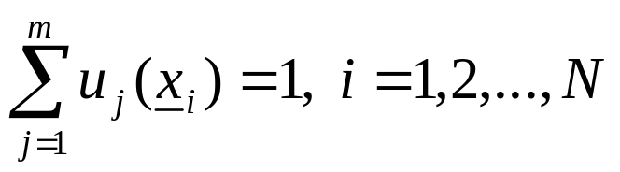
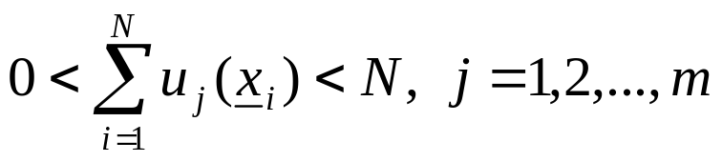
  Fuzzy clustering: Each point belongs to all clusters up to some degree.
  A fuzzy clustering of X into m clusters is characterized by m functions

Slide 8
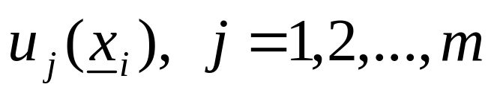
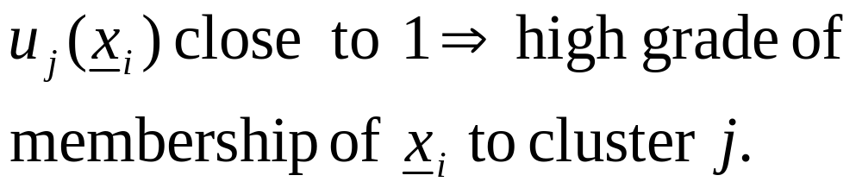
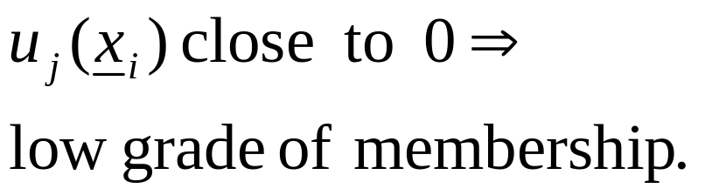
  These are known as membership functions.
  Thus, each x_{i} belongs to any cluster “up to
  some degree”, depending on the value of

Slide 9
TYPES OF FEATURES
With respect to their domain
  Continuous (the domain is a continuous subset of ℜ).
  Discrete (the domain is a finite discrete set).
    Binary or dichotomous (the domain consists of two possible values).
With respect to the relative significance of the values they take
  Nominal (the values code states, e.g., the sex of an individual).
  Ordinal (the values are meaningfully ordered, e.g., the rating of the services of a hotel (poor, good, very good, excellent)).
  Interval-scaled (the difference of two values is meaningful but their ratio is meaningless, e.g., temperature).
  Ratio-scaled (the ratio of two values is meaningful, e.g., weight).

Slide 10
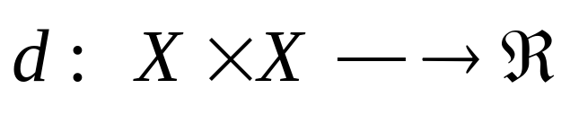
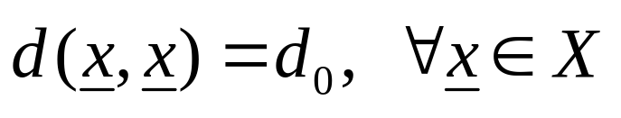
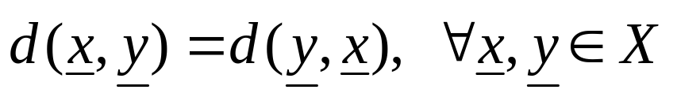
PROXIMITY MEASURES
Between vectors
  Dissimilarity measure (between vectors of X) is a function
with the following properties

Slide 11
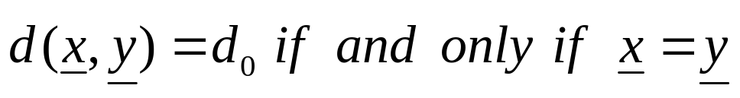
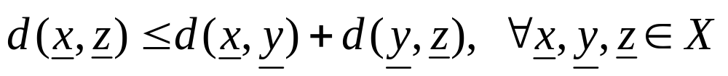
If in addition
  (triangular inequality)
  d is called a metric dissimilarity measure.

Slide 12
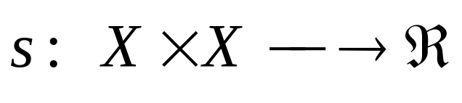
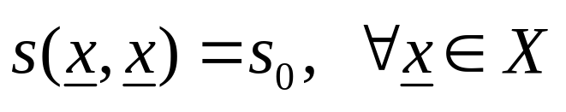
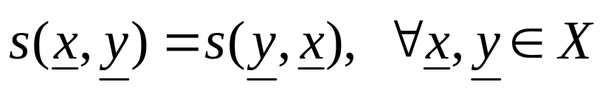
  Similarity measure (between vectors of X) is a function
with the following properties

Slide 13
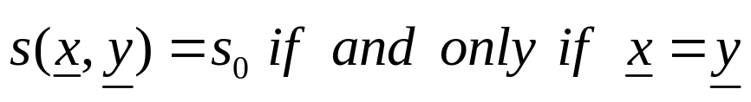
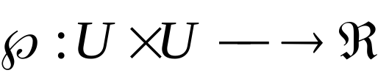
If in addition
  s is called a metric similarity measure.
Between sets
Let D_{i} ⊂ X, i=1,…,k and U={D₁,…,D_{k}}
A proximity measure ℘ on U is a function
A dissimilarity measure has to satisfy the relations of dissimilarity measure between vectors, where D_{i}’ ‘s are used in place of x, y (similarly for similarity measures).

Slide 14
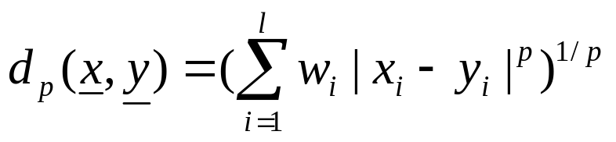
PROXIMITY MEASURES BETWEEN VECTORS
Real-valued vectors
  Dissimilarity measures (DMs)
    Weighted l_{p} metric DMs
    Interesting instances are obtained for
      p=1 (weighted Manhattan norm)
      p=2 (weighted Euclidean norm)
      p=∞ (d∞(x,y)=max_{1≤i≤l} w_{i}|x_{i}-y_{i}| )

Slide 15
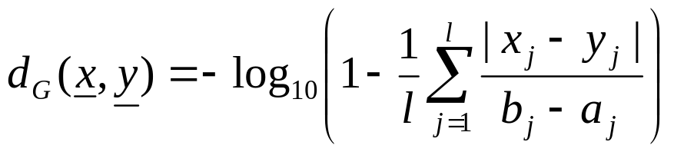
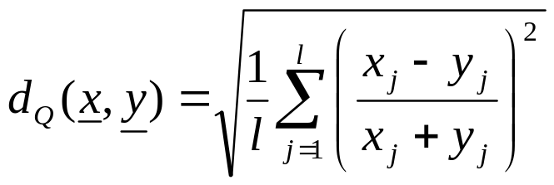
    Other measures
      where b_{j} and a_{j} are the maximum and the minimum values of the j-th feature, among the vectors of X (dependence on the current data set)

Slide 16
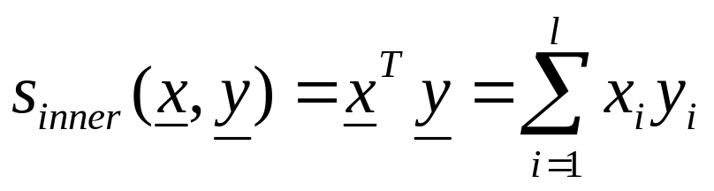
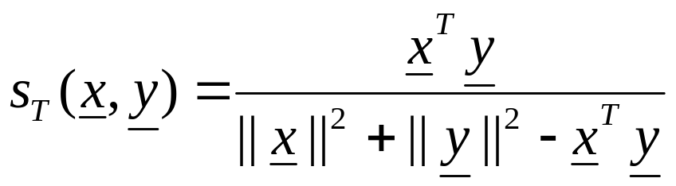
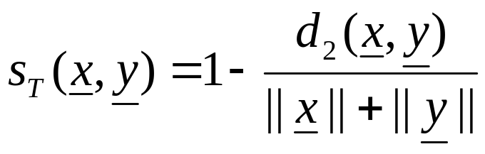
  Similarity measures
    Inner product
    Tanimoto measure

Slide 17
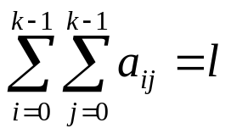
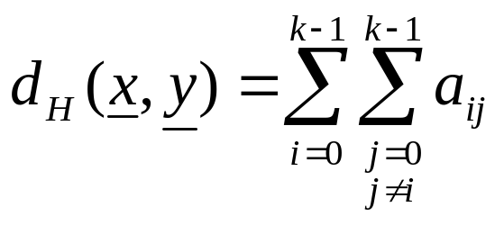
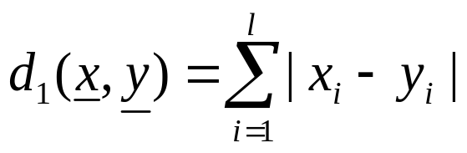
Discrete-valued vectors
  Let F={0,1,…,k-1} be a set of symbols and X={x₁,…,x_{N}} ⊂ F^{l}
  Let A(x,y)=[a_{ij}], i, j=0,1,…,k-1, where a_{ij} is the number of places where x has the i-th symbol and y has the j-th symbol.
NOTE:
Several proximity measures can be expressed as combinations of the elements of A(x,y).
  Dissimilarity measures:
    The Hamming distance (number of places where x and y differ)
    The l₁ distance

Slide 18
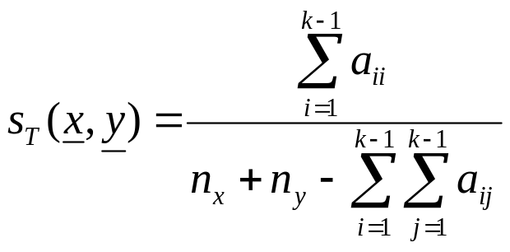
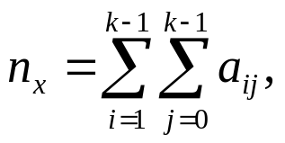
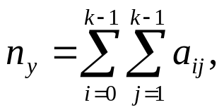
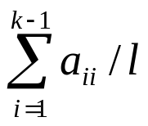
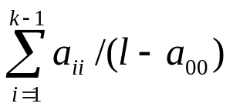
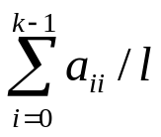
  Similarity measures:
    Tanimoto measure :
    where
    Measures that exclude a₀₀:
    Measures that include a₀₀:

Slide 19
Mixed-valued vectors
Some of the coordinates of the vectors x are real and the rest are discrete.
Methods for measuring the proximity between two such x_{i} and x_{j}:
  Adopt a proximity measure (PM) suitable for real-valued vectors.
  Convert the real-valued features to discrete ones and employ a discrete PM.
  The more general case of mixed-valued vectors:
  Here nominal, ordinal, interval-scaled, ratio-scaled features are treated separately.

Slide 20
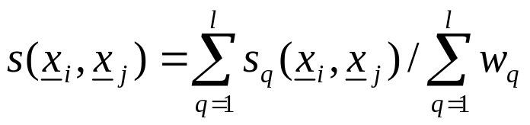
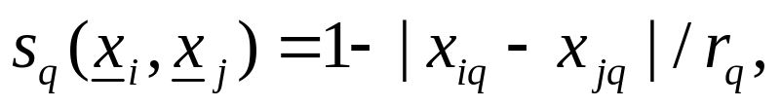
The similarity function between x_{i} and x_{j} is:
In the above definition:
    w_{q}=0, if at least one of the q-th coordinates of x_{i} and x_{j} are undefined or both the q-th coordinates are equal to 0. Otherwise w_{q}=1.
    If the q-th coordinates are binary, s_{q}(x_{i},x_{j})=1 if x_{iq}=x_{jq}=1 and 0 otherwise.
    If the q-th coordinates are nominal or ordinal, s_{q}(x_{i},x_{j})=1 if x_{iq}=x_{jq} and 0 otherwise.
    If the q-th coordinates are interval or ratio scaled-valued
    where r_{q} is the interval where the q-th coordinates of the vectors of the data set X lie.

Slide 21
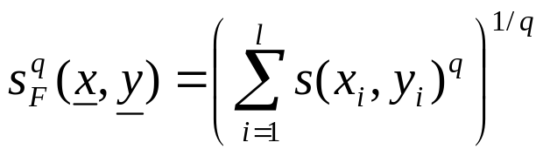
Fuzzy measures
Let x, y∈[0,1]^{l}. Here the value of the i-th coordinate, x_{i,} of x, is not the outcome of a measuring device.
  The closer the coordinate x_{i} is to 1 (0), the more likely the vector x possesses (does not possess) the i-th characteristic.
  As x_{i} approaches 0.5, the certainty about the possession or not of the i-th feature from x decreases.
A possible similarity measure that can quantify the above is:
Then

Slide 22
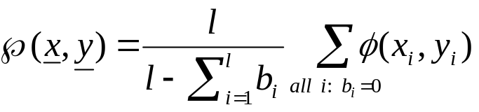
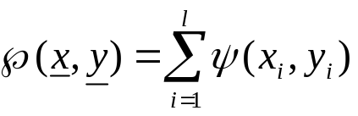
Missing data
For some vectors of the data set X, some features values are unknown
Ways to face the problem:
  Discard all vectors with missing values (not recommended for small data sets)
  Find the mean value m_{i} of the available i-th feature values over that data set and substitute the missing i-th feature values with m_{i}.
  Define b_{i}=0, if both the i-th features x_{i}, y_{i} are available and 1 otherwise. Then
  where φ(x_{i},y_{i}) denotes the PM between two scalars x_{i}, y_{i}.
  Find the average proximities φ_{avg}(i) between all feature vectors in X along all components. Then
  where ψ(x_{i},y_{i})=φ(x_{i},y_{i}), if both x_{i} and y_{i} are available and φ_{avg}(i) otherwise.

Slide 23
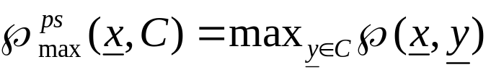

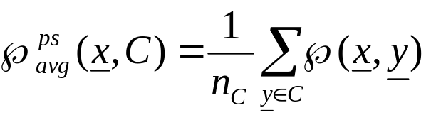
PROXIMITY FUNCTIONS BETWEEN A VECTOR AND A SET
Let X={x₁,x₂,…,x_{N}} and C ⊂ X, x ∈ X
All points of C contribute to the definition of ℘(x, C)
  Max proximity function
  Min proximity function
  Average proximity function
(n_{C} is the cardinality of C)

Slide 24
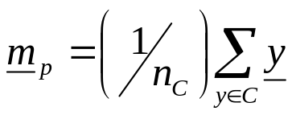
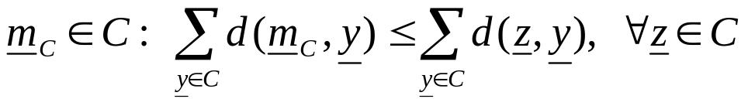
A representative(s) of C, r_{C} , contributes to the definition of ℘(x,C)
In this case: ℘(x,C)=℘(x,r_{C})
Typical representatives are:
  The mean vector:
  The mean center:
  The median center:
NOTE: Other representatives (e.g., hyperplanes, hyperspheres) are useful in certain applications (e.g., object identification using clustering techniques).
where n_{C} is the cardinality of C
d: a dissimilarity measure

Slide 25
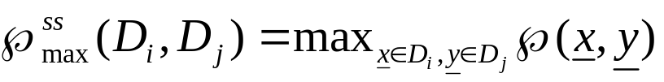

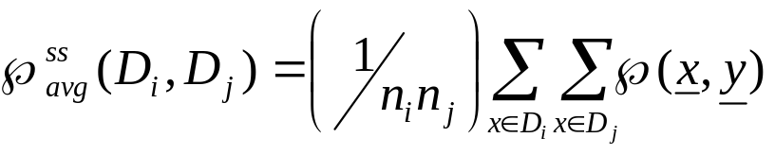
PROXIMITY FUNCTIONS BETWEEN SETS
Let X={x₁,…,x_{N}}, D_{i}, D_{j} ⊂ X and n_{i}=|D_{i}|, n_{j}=|D_{j}|
All points of each set contribute to ℘(D_{i},D_{j})
  Max proximity function (measure but not metric, only if ℘ is a similarity measure)
  Min proximity function (measure but not metric, only if ℘ is a dissimilarity measure)
  Average proximity function (not a measure, even if ℘ is a measure)

Slide 26

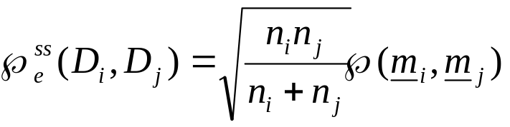
Each set D_{i} is represented by its representative vector m_{i}
  Mean proximity function (it is a measure provided that ℘ is a measure):
  NOTE: Proximity functions between a vector x and a set C may be derived from the above functions if we set D_{i}={x}.

Slide 27
Remarks:
  Different choices of proximity functions between sets may lead to totally different clustering results.
  Different proximity measures between vectors in the same proximity function between sets may lead to totally different clustering results.
  The only way to achieve a proper clustering is
    by trial and error and,
    taking into account the opinion of an expert in the field of application.

