Slide 1

HIERARCHICAL CLUSTERING ALGORITHMS
They produce a hierarchy of (hard) clusterings instead of a single clustering.
Applications in:
  Social sciences
  Biological taxonomy
  Modern biology
  Medicine
  Archaeology
  Computer science and engineering

Slide 2

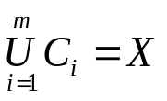
Let X={x₁,…,x_{N}}, x_{i}=[x_{i1},…,x_{il}]^{T}. Recall that:
  In hard clustering each vector belongs exclusively to a single cluster.
  An m-(hard) clustering of X, ℜ, is a partition of X into m sets (clusters) C₁,…,C_{m} , so that:
  By the definition: ℜ={C_{j}, j=1,…m}
  Definition: A clustering ℜ₁ containing k clusters is said to be nested in the clustering ℜ₂ containing r (<k) clusters, if each cluster in ℜ₁ is a subset of a cluster in ℜ₂.
  We write ℜ₁∠ ℜ₂

Slide 3
Example: Let ℜ₁={{x₁,x₃},{x₄},{x₂,x₅}}, ℜ₂={{x₁,x₃,x₄},{x₂,x₅}},
ℜ₃={{x₁,x₄},{x₃},{x₂,x₅}}, ℜ₄={{x₁,x₂,x₄},{x₃,x₅}}.
It is ℜ₁∠ ℜ₂, but not ℜ₁∠ ℜ₃, ℜ₁∠ ℜ₄, ℜ₁∠ ℜ₁.
Remarks:
  Hierarchical clustering algorithms produce a hierarchy of nested clusterings.
  They involve N steps at the most.
  At each step t, the clustering ℜ_{t} is produced by ℜ_{t-1}.
Main categories:
  Agglomerative clustering algorithms: Here ℜ₀={{x₁},…,{x_{N}}},
  ℜ_{N-1} ={{x₁,…,x_{N}}} and ℜ₀∠ … ∠ ℜ_{N-1}.
  Divisive clustering algorithms: Here ℜ₀={{x₁,…,x_{N}}},
  ℜ_{N-1}= {{x₁},…,{x_{N}}} and ℜ_{N-1}∠ … ∠ ℜ₀.

Slide 4
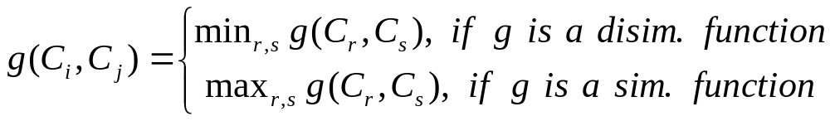
AGGLOMERATIVE ALGORITHMS
Let g(C_{i},C_{j}) a proximity function between two clusters of X.
Generalized Agglomerative Scheme (GAS)
  Initialization
    Choose ℜ₀={{x₁},…,{x_{N}}}
    t=0
  Repeat
    t=t+1
    Choose (C_{i},C_{j}) in ℜ_{t-1} such that
    Define C_{q}=C_{i}∪C_{j} and produce ℜ_{t}=(ℜ_{t-1}-{C_{i},C_{j}}) ∪{C_{q}}
  Until all vectors lie in a single cluster.

Slide 5
Remarks:
  If two vectors come together into a single cluster at level t of the hierarchy, they will remain in the same cluster for all subsequent clusterings. As a consequence, there is no way to recover a “poor” clustering that may have occurred in an earlier level of hierarchy.
  Number of operations: O(N³)

Slide 6
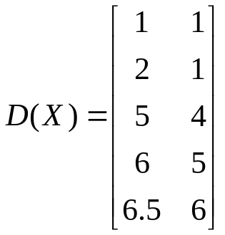
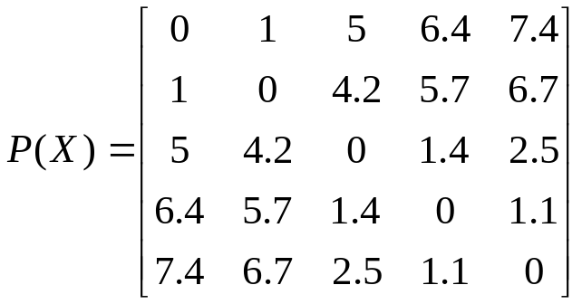
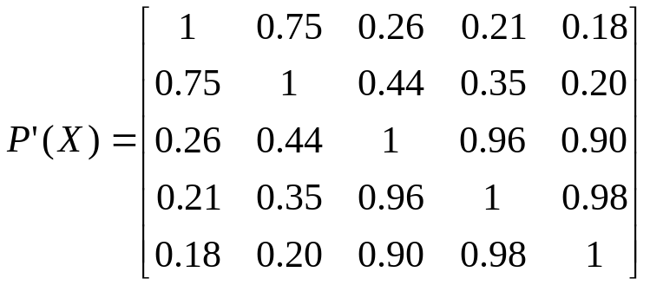
Definitions of some useful quantities:
Let X={x₁,x₂,…,x_{N}}, with x_{i}=[x_{i1},x_{i2},…,x_{il}]^{T}.
  Pattern matrix (D(X)): An Nxl matrix whose i-th row is x_{i} (transposed).
  Proximity (similarity or dissimilarity) matrix (P(X)): An NxN matrix whose (i,j) element equals the proximity ℘(x_{i},x_{j}) (similarity s(x_{i},x_{j}), dissimilarity d(x_{i},x_{j})).
  Example 1: Let X={x₁, x₂, x₃, x₄, x₅}, with x₁=[1, 1]^{T}, x₂=[2, 1]^{T},
  x₃=[5, 4]^{T}, x₄=[6, 5]^{T}, x₅=[6.5, 6]^{T}.
Euclidean distance Tanimoto distance

Slide 7

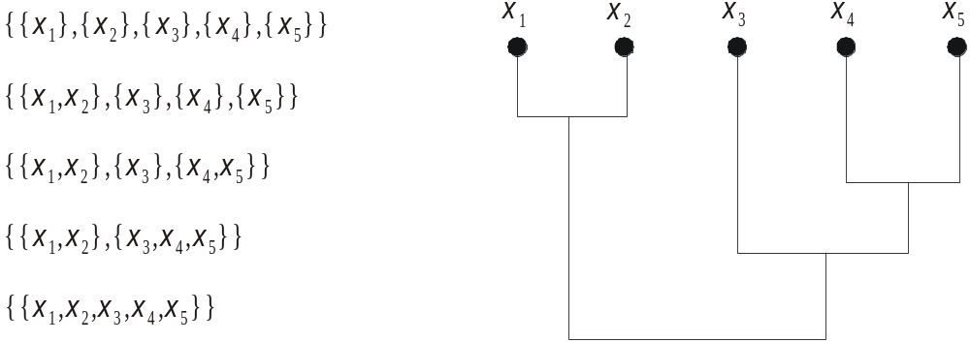
Threshold dendrogram (or dendrorgram): It is an effective way of representing the sequence of clusterings which are produced by an agglomerative algorithm.
In the previous example, if is employed as the distance measure between two sets and the Euclidean one as the distance measure between two vectors, the following series of clusterings are produced:

Slide 8
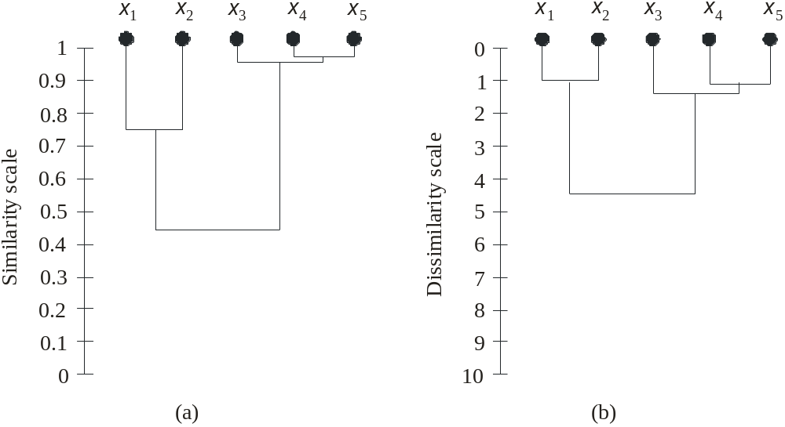
Proximity (dissimilarity or dissimilarity) dendrogram: A dendrogram that takes into account the level of proximity (dissimilarity or similarity) where two clusters are merged for the first time.
Example 2: In terms of the previous example, the proximity dendrograms that correspond to P΄(X) and P(X) are
Remark: One can readily observe the level in which a cluster is formed and the level in which it is absorbed in a larger cluster (indication of the natural clustering).

Slide 9
Agglomerative algorithms are divided into:
  Algorithms based on matrix theory.
  Algorithms based on graph theory.
In the sequel we focus only on dissimilarity measures.
  Algorithms based on matrix theory.
    They take as input the NxN dissimilarity matrix P₀=P(X).
    At each level t where two clusters C_{i} and C_{j} are merged to C_{q}, the dissimilarity matrix P_{t} is extracted from P_{t-1} by:
      Deleting the two rows and columns of P_{t} that correspond to C_{i} and C_{j}.
      Adding a new row and a new column that contain the distances of newly formed C_{q}=C_{i}∪C_{j} from the remaining clusters C_{s}, via a relation of the form
    d(C_{q},C_{s})=f(d(C_{i},C_{s}),d(C_{j},C_{s}),d(C_{i},C_{j}))

Slide 10
  A number of distance functions comply with the following update equation
d(C_{q},C_{s})=a_{i}d(C_{i},C_{s})+a_{j}(d(C_{j},C_{s})+bd(C_{i},C_{j})+c|d(C_{i},C_{s})-d(C_{j},C_{s})|
Algorithms that follow the above equation are:
Single link (SL) algorithm (a_{i}=1/2, a_{j}=1/2, b=0, c=-1/2). In this case
d(C_{q},C_{s})=min{d(C_{i},C_{s}), d(C_{j},C_{s})}
Complete link (CL) algorithm (a_{i}=1/2, a_{j}=1/2, b=0, c=1/2). In this case
d(C_{q},C_{s})=max{d(C_{i},C_{s}), d(C_{j},C_{s})}
Remarks:
  Single link forms clusters at low dissimilarities while complete link forms clusters at high dissimilarities.
  Single link tends to form elongated clusters (chaining effect ) while complete link tends to form compact clusters.
  The rest algorithms are compromises between these two extremes.

Slide 11
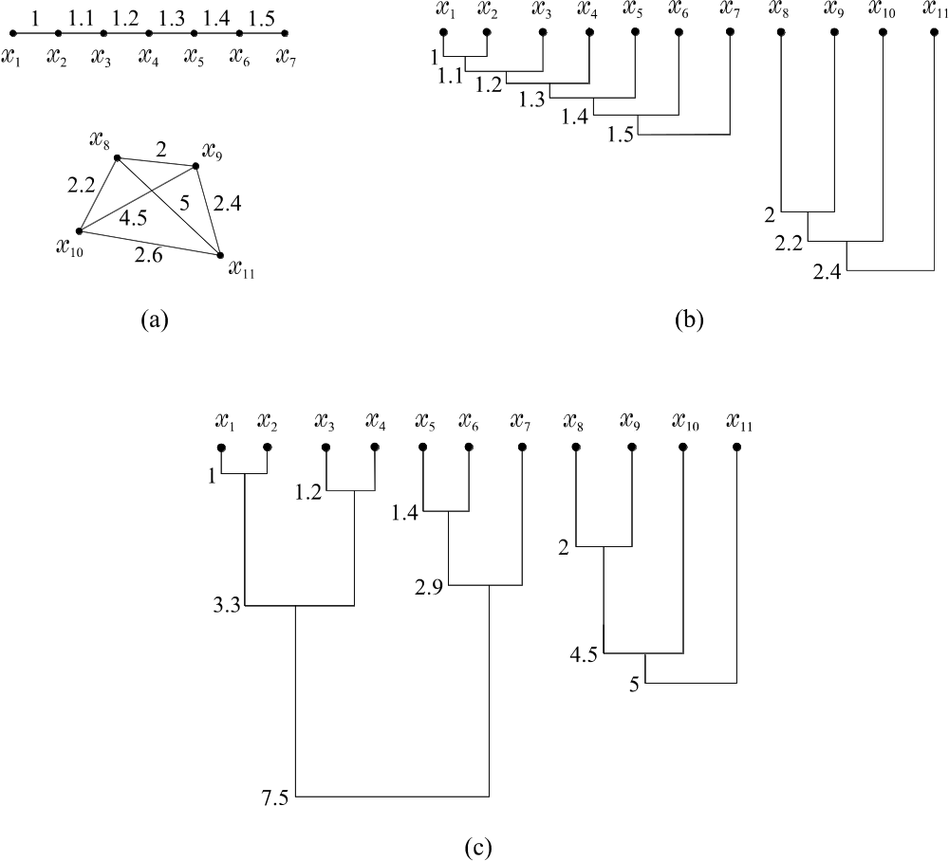
Example:
(a) The data set X.
(b) The single link algorithm dissimilarity dendrogram.
(c) The complete link algorithm dissimilarity dendrogram

Slide 12
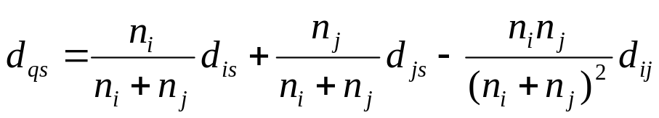
Weighted Pair Group Method Average (WPGMA) (a_{i}=1/2, a_{j}=1/2, b=0, c=0). In this case:
d(C_{q},C_{s})=(d(C_{i},C_{s}) + d(C_{j},C_{s}))/2
Unweighted Pair Group Method Average (UPGMA) (a_{i}=n_{i}/(n_{i}+n_{j}), a_{j}=n_{j}/(n_{i}+n_{j}), b=0, c=0, where n_{i} is the cardinality of C_{i}). In this case:
d(C_{q},C_{s})=(n_{i} d(C_{i},C_{s}) + n_{j} d(C_{j},C_{s}))/(n_{i}+n_{j})
Unweighted Pair Group Method Centroid (UPGMC) (a_{i}=n_{i}/(n_{i}+n_{j}), a_{j}=n_{j}/(n_{i}+n_{j}), b=-n_{i} n_{j}/(n_{i}+n_{j})², c=0). In this case:
For the UPGMC, it is true that d_{qs}=||m_{q}-m_{s}||², where m_{q} is the mean of C_{q} .

Slide 13
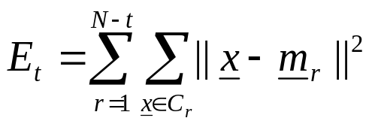
Weighted Pair Group Method Centroid (WPGMC) (a_{i}=1/2, a_{j}=1/2, b=-1/4, c=0). In this case
d_{qs}=(d_{is} + d_{js})/2 –d_{ij}/4
For WPGMC there are cases where d_{qs}≤ max{d_{is}, d_{js}} (crossover)
Ward or minimum variance algorithm. Here the distance d´_{ij} between C_{i} and C_{j} is defined as
d´_{ij}=(n_{i} n_{j}/(n_{i}+n_{j})) ||m_{i}-m_{j}||²
d´_{qs} can also be written as
d´_{qs}=((n_{i} + n_{j} )d´_{is} + (n_{i} + n_{j})d´_{js} – n_{s}d´_{ij} )/(n_{i}+n_{j}+n_{s})
Remark: Ward’s algorithm forms ℜ_{t+1} by merging the two clusters that lead to the smallest possible increase of the total variance, i.e.,

Slide 14
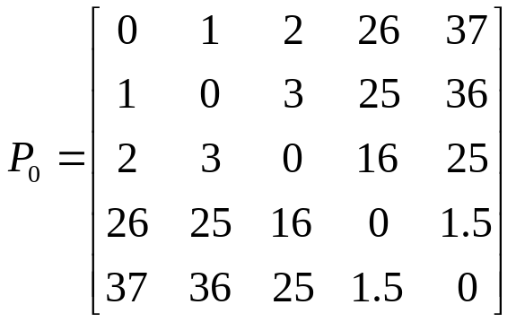
Example 3: Consider the following dissimilarity matrix (Euclidean distance)
All the algorithms produce the above sequence of clusterings at different proximity levels:
 | ℜ₀={{x₁}, {x₂}, {x₃}, {x₄}, {x₅}}, ℜ₁={{x₁, x₂}, {x₃}, {x₄}, {x₅}}, ℜ₂={{x₁, x₂}, {x₃}, {x₄, x₅}}, ℜ₃={{x₁, x₂, x₃}, {x₄, x₅}}, ℜ₄={{x₁, x₂, x₃, x₄, x₅}}
 | SL | CL | WPGMA | UPGMA | WPGMC | UPGMC | Ward
ℜ₀ | 0 | 0 | 0 | 0 | 0 | 0 | 0
ℜ₁ | 1 | 1 | 1 | 1 | 1 | 1 | 0.5
ℜ₂ | 1.5 | 1.5 | 1.5 | 1.5 | 1.5 | 1.5 | 0.75
ℜ₃ | 2 | 3 | 2.5 | 2.5 | 2.25 | 2.25 | 1.5
ℜ₄ | 16 | 37 | 25.75 | 27.5 | 24.69 | 26.46 | 31.75

Slide 15
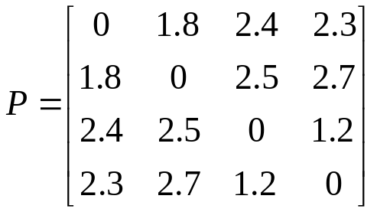
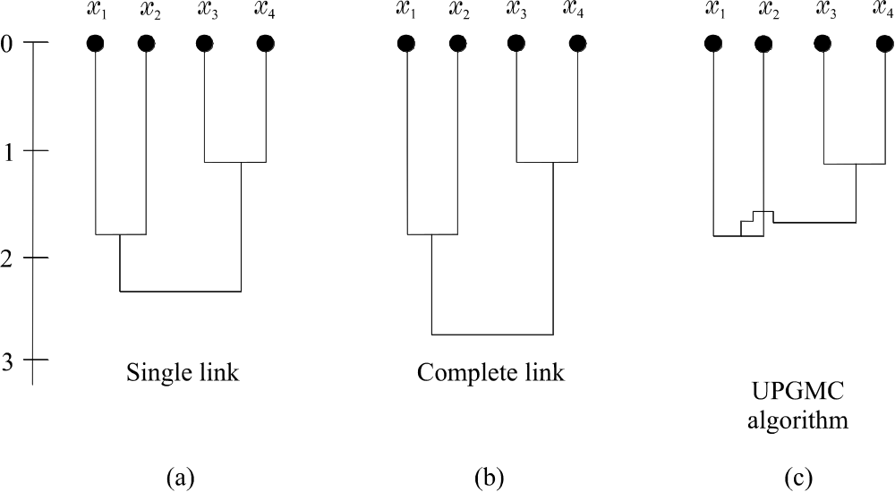
Monotonicity and crossover:
For the following dissimilarity matrix
 | the dissimilarity dendrograms produced by single link, complete link and UPGMC (the same result is produced if WPGMC is employed) are:
{x₁, x₂, x₃, x₄} is formed at lower dissimilarity level than {x₁, x₂} (crossover)

Slide 16
Monotonicity condition:
If clusters C_{i} and C_{j} are selected to be merged in cluster C_{q}, at the tth
level of the hierarchy, the condition
d(C_{q},C_{k}) ≥ d(C_{i},C_{j})
must hold for all C_{k}, k ≠ i, j , q.
In other words, the monotonicity condition implies that a cluster is formed at higher dissimilarity level than any of its components.
Remarks:
  Monotonicity is a property that is exclusively related to the clustering algorithm and not to the (initial) proximity matrix.
  An algorithm that does not satisfy the monotonicity condition, does not necessarily produce dendrograms with crossovers.
  Single link, complete link, UPGMA, WPGMA and the Ward’s algorithm satisfy the monotonicity condition, while UPGMC and WPGMC do not satisfy it.

Slide 17
Complexity issues:
  GAS requires, in general, O(N³) operations.
  More efficient implementations require O(N²logN) computational time.
  For a class of widely used algorithms, implementations that require O(N²) computational time and O(N²) or O(N) storage have also been proposed.
  Parallel implementations on SIMD machines have also been considered.

Slide 18
Algorithms based on graph theory
Some basic definitions from graph theory:
  A graph, G, is defined as an ordered pair G=(V,E), where V={v_{i}, i=1,…,N} is a set of vertices and E is a set of edges connecting some pairs of vertices. An edge connecting v_{i} and v_{j} is denoted by e_{ij} or (v_{i},v_{j}).
  A graph is called undirected graph if there is no direction assigned to any of its edges. Otherwise, we deal with directed graphs.
  A graph is called unweighted graph if there is no cost associated with any of its edges. Otherwise, we deal with weighted graphs.
  A path in G between vertices v_{i1} and v_{in} is a sequence of vertices and edges of the form v_{i1} e_{i1i2}v_{i2.}...v_{in-1}e_{in-1in}v_{in}.
  A loop in G is a path where v_{i1} and v_{in} coincide.
  A subgraph G´=(V´,E´) of G is a graph with V´ ⊆ V and E´ ⊆ E₁, where E₁ is a subset of E containing vertices that connect vertices of V´. Every graph is a subgraph to itself.
  A connected subgraph G´=(V´,E´) is a subgraph where there exists at least one path connecting any pair of vertices in V´.

Slide 19
  A complete subgraph G´=(V´,E) is a subgraph where for any pair of vertices in V’ there exists an edge in E´´ connecting them.
  A maximally connected subgraph of G is a connected subgraph G´ of G that contains as many vertices of G as possible.
  A maximally complete subgraph of G is a complete subgraph G´ of G that contains as many vertices of G as possible.
  Examples for the above, are shown in the following figure.

Slide 20
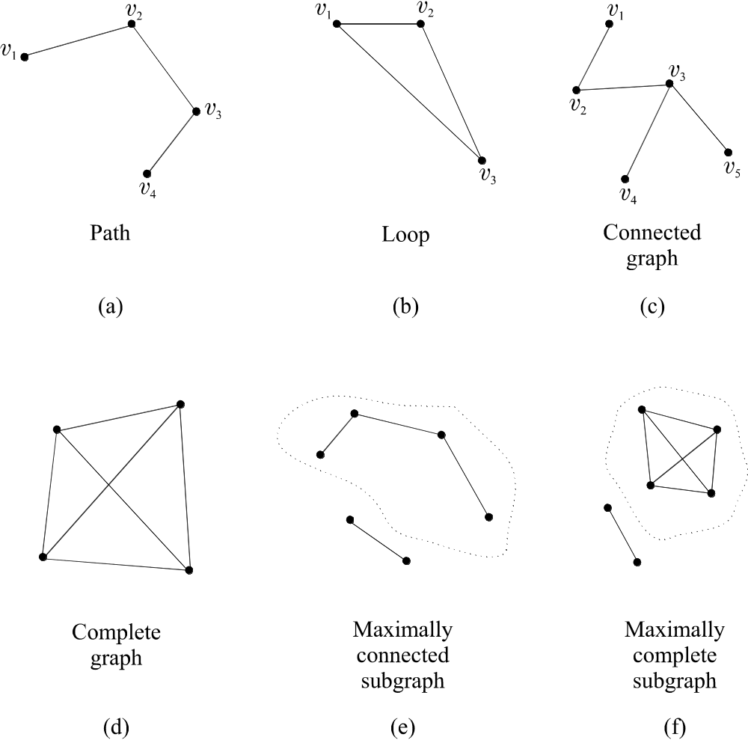

Slide 21
NOTE: In the framework of clustering, each vertex of a graph corresponds to a feature vector.
Useful tools for the algorithms based on graph theory are the threshold graph and the proximity graph.
  A threshold graph G(a)
    is an undirected, unweighted graph with N nodes, each one corresponding to a vector of X.
    No self-loops or multiple edges between any two vertices are encountered.
    The set of edges of G(a) contains those edges (v_{i}, v_{j}) for which the distance d(x_{i},x_{j}) between the vectors corresponding to v_{i} and v_{j} is less than a.
  A proximity graph G_{p}(a) is a threshold graph G(a), all of whose edges (v_{i}, v_{j}) are weighted with the proximity measure d(x_{i},x_{j}).

Slide 22
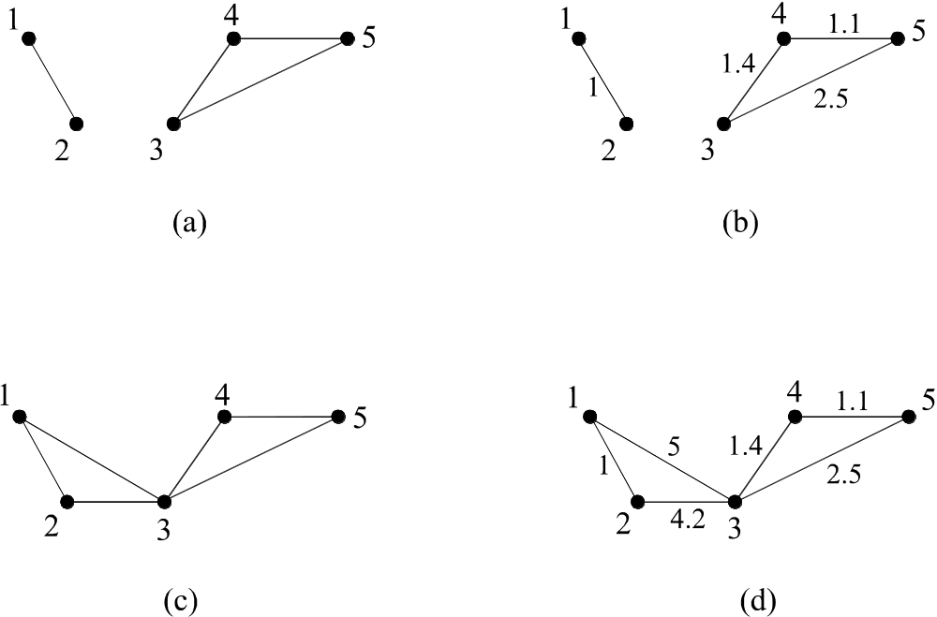
(a) The threshold graph G(3), (b) the proximity (dissimilarity) graph G_{p}(3), (c ) the threshold graph G(5), (d) the dissimilarity graph G_{p}(5), for the dissimilarity matrix P(X) given in example 1.

Slide 23
More definitions:
In this framework, we consider graphs G, of N nodes, where each node corresponds to a vector of X.
Valid clusters are connected components of G that satisfy an additional graph property h(k).
Typical graph properties for a connected subgraph G´ of G are:
  Node connectivity: The largest integer k such that all pairs of nodes of G´ are joined by at least k paths having no nodes in common.
  Edge connectivity: The largest integer k such that all pairs of nodes are joined by at least k paths having no edges in common.
  Node degree: The largest integer k such that each node has at least k incident edges.

Slide 24
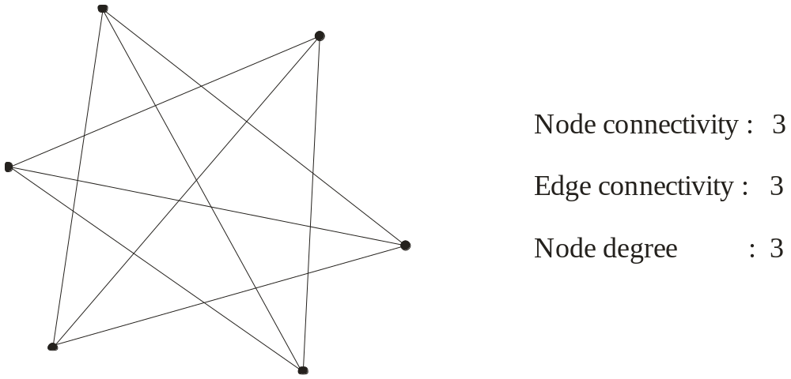

Slide 25
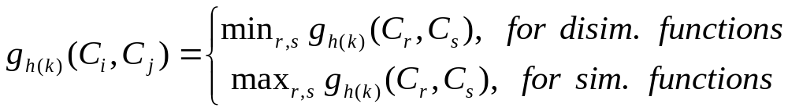
  The proximity function g_{h(k)}(C_{r},C_{s}) between two clusters is defined in terms of
    a proximity measure between vectors (nodes)
    certain constraints imposed by property h(k) on the subgraphs that are formed.
  In mathematical language:
  g_{h(k)}(C_{r},C_{s}) = min_{xu∈Cr, xv∈Cs} {d(x_{u},x_{v})≡a: the G(a) subgraph defined by C_{r}∪C_{s} is (a) connected and either (b1) has the property h(k) or (b2) is complete}
Graph theory-based algorithmic scheme (GTAS): It is the GAS in the context of graph theory. In the context of GTAS, a pair of clusters (C_{i},C_{j}) is selected to be merged according to:

Slide 26
  Single link (SL) algorithm. Here
  g_{h(k)}(C_{r},C_{s}) = min_{xu∈Cr, xv∈Cs} {d(x_{u},x_{v})≡a: the G(a) subgraph defined by C_{r}∪C_{s} is connected} ≡ min_{x∈Cr, y∈Cs} d(x, y) (why?)
  Remarks:
    No property h(k) or completeness is required.
    The SL stemming from the graph theory is exactly the same with the SL stemming from the matrix theory.
  Complete link (CL) algorithm. Here
  g_{h(k)}(C_{r},C_{s}) = min_{xu∈Cr, xv∈Cs} {d(x_{u},x_{v})≡a: the G(a) subgraph defined by C_{r}∪C_{s} is complete} ≡ max_{x∈Cr, y∈Cs} d(x, y) (why?)
  Remarks:
    No property h(k) is required.
    The CL stemming from graph theory is exactly the same with the CL stemming from matrix theory.

Slide 27
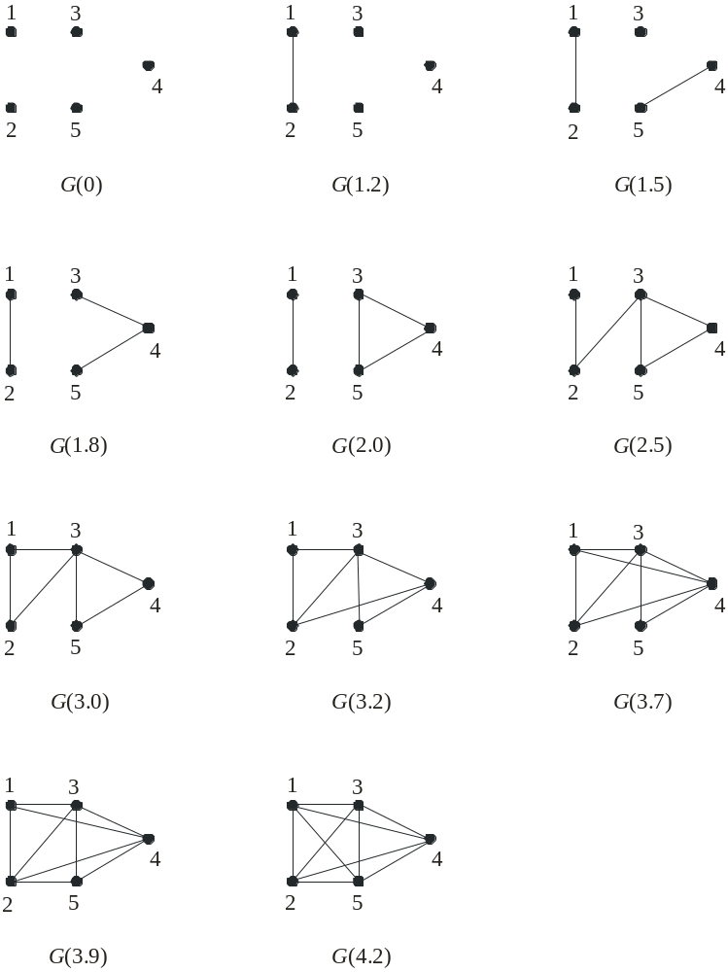
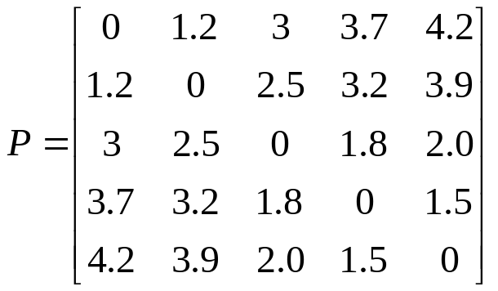
Example 5: For the dissimilarity matrix,
SL and CL produce the same hierarchy of clusterings at the levels given in the table.
 | SL | CL
ℜ₀={{x₁}, {x₂}, {x₃}, {x₄}, {x₅}} ℜ₁={{x₁, x₂}, {x₃}, {x₄}, {x₅}} ℜ₂={{x₁, x₂}, {x₃}, {x₄, x₅}} ℜ₃={{x₁, x₂, x₃}, {x₄, x₅}} ℜ₄={{x₁, x₂, x₃, x₄, x₅}} | 0 1.2 1.5 1.8 2.5 | 0 1.2 1.5 2.0 4.2

Slide 28
  Remarks:
    SL poses the weakest possible graph condition (connectivity) for the formation of a cluster, while CL poses the strongest possible graph condition (completeness) for the formation of a cluster.
    A variety of graph theory-based algorithms, that lie between these two extremes result for various choices of h(k).
      For k=1 all these algorithms collapse to the single link algorithm.
      As k increases, the resulting subgraphs approach completeness.
Clustering algorithms based on the Minimum Spanning Tree (MST)
  Definitions:
    Spanning Tree: It is a connected graph (containing all the vertices of the graph), with no loops (only one path connects any two vertices).
    Weight of a Spanning Tree: The sum of the weights of its edges (provided that they have been assigned with a weight).
    Minimum Spanning Tree (MST): A spanning tree with the smallest weight among the spanning trees connecting all the vertices of the graph.

Slide 29
  Remarks:
    The MST has N-1 edges.
    When all the weights are different from each other, the MST is unique. Otherwise, it may not be unique.
  Employing the GTAS and substituting g_{h(k)}(C_{r},C_{s}) with
  g(C_{r},C_{s})=min_{ij}{w_{ij}: x_{i}∈C_{r}, x_{j}∈C_{s}}
  where w_{ij}=d(x_{i},x_{j}), we can determine the MST.
  Alternatively, a hierarchy of clusterings may be obtained by the MST as follows:
  The clustering ℜ_{t} at the tth level is the set of connected components of the MST, when only its t smallest weights are considered.
  Remark:
    The hierarchy produced by MST is the same with that produced by the single link algorithm, at least when all w_{ij}´ s are different from each other.

Slide 30
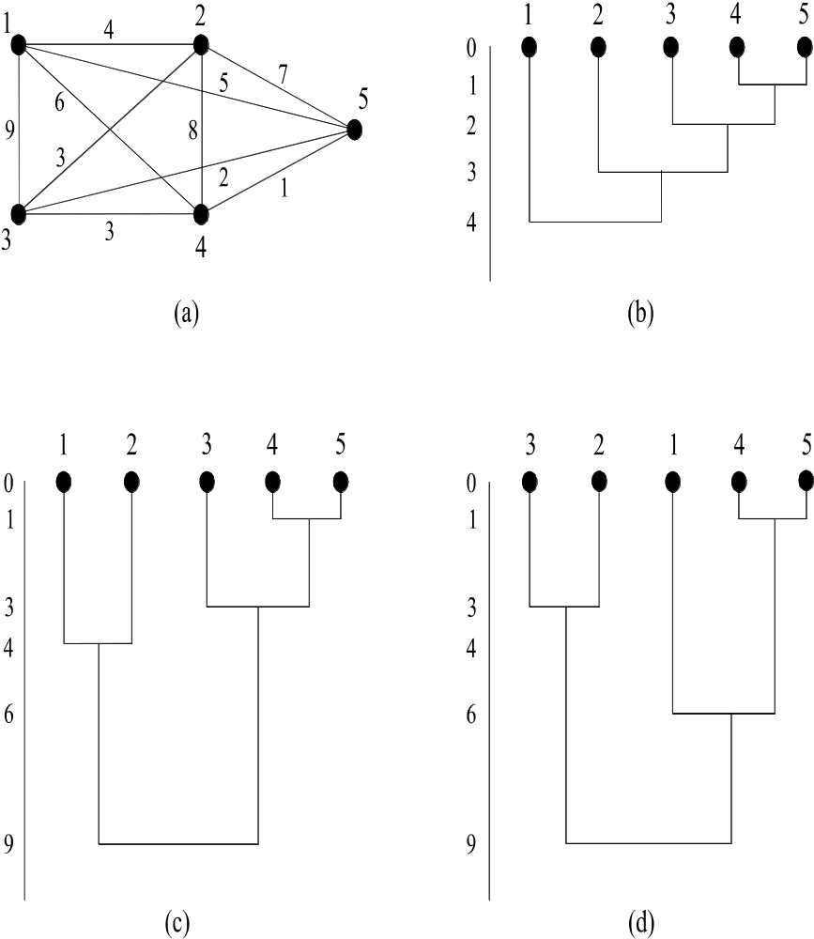
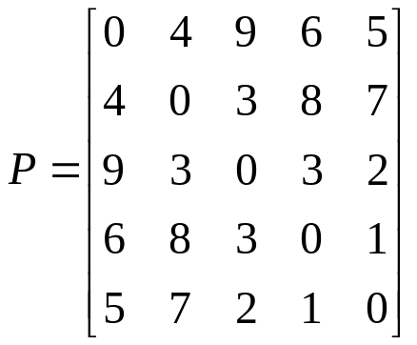
Ties in the proximity matrix
  SL produces the same hierarchy of clusterings, independent of the order of consideration of edges with equal weights.
  CL may produce different hierarchies, depending on the order of consideration of edges with equal weights.
  The other graph theory-based algorithms behave as the CL.
  The same trend appears in the matrix-based algorithms. In this case, ties may appear at a later stage of the algorithm.
Example 6: Let
Note that P(2,3)=P(3,4).
(SL)
(CL(a))
(CL(b))

Slide 31
DIVISIVE ALGORITHMS
Let g(C_{i},C_{j}) be a dissimilarity function between two clusters.
Let C_{tj} denote the jth cluster of the tth clustering ℜ_{t}, t=0,…,N-1, j=1,…,t+1.

Slide 32
  Generalized Divisive Scheme (GDS)
    Initialization
      Choose ℜ₀={X} as the initial clustering
      t=0
    Repeat
      t=t+1
      For i=1 to t
        Among all possible pairs of clusters (C_{r},C_{s}) that form a partition of C_{t-1,i}, find the pair (C¹_{t-1,i}, C²_{t-1,i}) that gives the maximum value for g.
      End for
      From the t pairs defined in the previous step, choose the one that maximizes g. Suppose that this is (C¹_{t-1,j}, C²_{t-1,j}).
      The new clustering is:
      ℜ_{t}=(ℜ_{t-1} – {C_{t-1,j}})∪{C¹_{t-1,j}, C²_{t-1,j}}
      Relabel the clusters of ℜ_{t}.
    Until each vector lies in a single cluster.

Slide 33
    Remarks:
      Different choices of g give rise to different algorithms.
      The GDS is computationally very demanding even for small N.
      Algorithms that rule out many partitions as not “reasonable”, under a prespecified criterion, have also been proposed.
      Algorithms where the splitting of the clusters is based on all features of the feature vectors are called polythetic algorithms. Otherwise, if the splitting is based on a single feature at each step, the algorithms are called monothetic algorithms.

Slide 34
HIERARCHICAL ALGORITHMS FOR LARGE DATA SETS
Since the number of operations required by GAS is greater than O(N²),
algorithms resulting by GAS are prohibitive for very large data sets encountered, for example, in web mining and bioinformatics. To overcome this drawback, various hierarchical algorithms of special type have been developed that are tailored to handle large data sets.
Typical examples are:
  The CURE algorithm.
  The ROCK algorithm.
  The Chameleon algorithm.

Slide 35

The CURE (Clustering Using Representatives) algorithm
In CURE:
  Each cluster C is represented by a set of k > 1 representatives, denoted by R_{C}.
  These representatives try to “capture” the shape of the cluster.
  They are chosen at the “border” of the cluster and then, they are pushed toward its mean, in order to discard the irregularities of the border.
More specifically, R_{C} is determined as follows:
  Select x∈C, with the maximum distance from the mean m_{C} of C and set R_{C}={x}
  For i=2 to min{k,n_{C}} (n_{C} is the number of points in C)
    Determine y∈C-R_{C} that lies farthest from the points of R_{C} and set
    R_{C}= R_{C} ∪{y}.
  Shrink the points x∈R_{C} toward the mean m_{C} in C by a factor a. That is x=(1-a) x+a m_{C} , ∀x∈R_{C} .
CURE is a special case of GAS where the distance between two clusters is
defined as:

Slide 36
  Worst case time complexity for CURE: O(N²log₂N).
  This is prohibitive for very large data sets.
  Solution: Adoption of the random sampling technique.
The size N´ of a sample data set X´, created from X, via random
sampling, should be sufficiently large in order to ensure that the
probability of missing a cluster due to sampling is low.
CURE utilizing random sampling
  Identification of clusters
    Partition randomly X into p=N/N´ sample data sets.
    For each one of the p sample data sets.
      Apply the original version of CURE, until N´/q clusters (at the most) are formed (q is user-defined).
    Consider all the above p(N´/q) clusters (at the most) and apply the original CURE until the required number of clusters, m, is formed.
  Assignment of points to clusters
    For each of the m clusters select a random sample of representative points.
    Assign each point x that is not cluster representative to the cluster that contains the representative closest to it.

Slide 37
  Remarks:
    CURE is sensitive to the parameters k, N´, a. Specifically:
      k must be large enough to capture the geometry of each cluster.
      N´ must be higher than a certain percentage of N
      (typically N´ ≥ 2.5% N)
      For small a CURE behaves like the MST algorithm, while for large a it resembles the algorithms that use a single point representative for each cluster.
    Worst case time complexity for CURE using random sampling: O(N´²log₂N´)
    The algorithm exhibits low sensitivity with respect to outliers within the clusters.
    A few stages before its termination, CURE checks for clusters containing very few data points and removes them (since they are likely to be outliers).
    If N´/q is sufficiently large, compared to m, it is expected that the partition of X will not affect significantly the final clustering obtained by CURE.
    CURE can, in principle, reveal clusters of non-spherical or elongated shapes, as well as clusters of wide variance in size.
    CURE can be implemented efficiently using the heap and the k-d tree data structures.

Slide 38
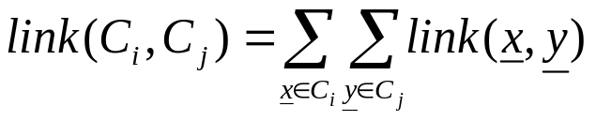
The ROCK (RObust Clustering using linKs) algorithm
It is best suited for nominal (categorical) features.
  Some preliminaries
    Two points x,y∈X are considered neighbors if s(x,y) ≥ θ, where s(.) is a similarity function and θ a user-defined threshold of similarity between two vectors.
    link(x,y) is the number of common neighbors between x and y.
  Assumption: There exists a function f(θ) (<1) such that:
“Each point assigned to a cluster C_{i} has approximately n_{i}^{f(θ)} neighbors in
C_{i} (n_{i} is the number of points in C_{i}) ”
It can be proved that the expected total number of links among all pairs
in C_{i} is n_{i}^{1+2f(θ)}.

Slide 39
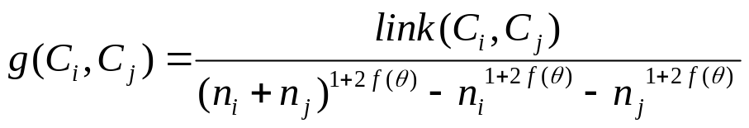
ROCK is a special case of GAS where
  The closeness between two clusters is defined as
  The denominator is the expected total number of links between the two clusters.
  The larger the g(.), the more similar the clusters C_{i} and C_{j} are .
The stopping criterion is:
  the number of clusters become equal to a predefined number m or
  link(C_{i},C_{j})=0 for every pair in a clustering ℜ_{t}.
Time complexity for ROCK: Similar to CURE for large N.
Prohibitive for very large data sets.
Solution: Adoption of random sampling techniques.

Slide 40
ROCK utilizing Random Sampling
  Identification of clusters
    Select a subset X´ of X via random sampling
    Run the original ROCK algorithm on X´
  Assignment of points to clusters
    For each cluster C_{i} select a set L_{i} of n_{Li} points
    For each z∈X-X´
      Compute t_{i}=N_{i} /(n_{Li}+1)^{f(θ)}, where N_{i} is the number of neighbors of z in L_{i}.
      Assign z to the cluster with the maximum t_{i}.
Remarks:
  A choice for f(θ) is f(θ)=(1-θ)/(1+θ), with (θ<1) .
  f(θ) depends on the data set and the type of clusters we are interested in.
  The hypothesis about the existence of f(θ) is very strong. It may lead to poor results if the data do not satisfy it.

Slide 41
The Chameleon algorithm
  This algorithm is not based on a “static” modeling of clusters like CURE (where each cluster is represented by the same number of representatives) and ROCK (where constraints are posed through the function f(θ)).
  It enjoys both divisive and agglomerative features.
  Some preliminaries:
  Let G=(V,E) be a graph where:
    each vertex of V corresponds to a data point in X.
    E is a set of edges connecting pairs of vertices in V. Each vertex is weighted by the similarity of the corresponding points.
  Edge cut set: Let C be a set of points corresponding to a subset of V.
  Assume that C is partitioned into two nonempty sets C_{i} and C_{j}
  The subset E´_{ij} of E that connect C_{i} and C_{j} is called edge cut set.

Slide 42
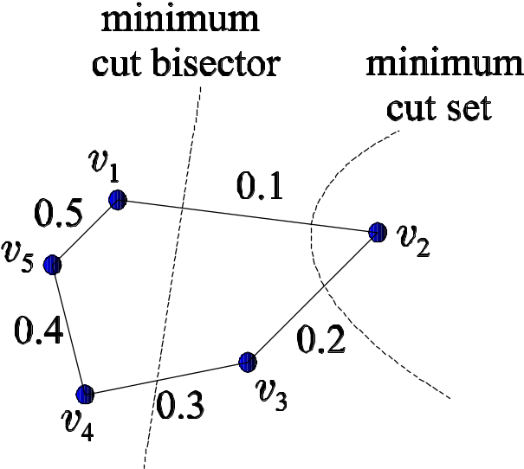
  Minimum cut set: Let |E´_{ij}| be the sum of weights of the edges in E´_{ij}.
  If |E´_{ij}|=min_{(Cu,Cv)}|E_{uv}|, then (C_{i} ,C_{j}) is the minimum cut set of C.
  Minimum cut bisector: If C_{i}, C_{j} are constrained to be of approximate
  equal size, the minimum cut set (over all possible partitions of
  approximately equal size) is known as the minimum cut bisector.
  Example 7: The graph in the following figure consists of 5 vertices and the edges shown, each one weighted by the similarity of the points that correspond to the vertices it connects. The minimum cut set and the minimum cut bisector are shown.

Slide 43
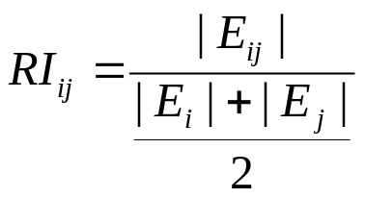
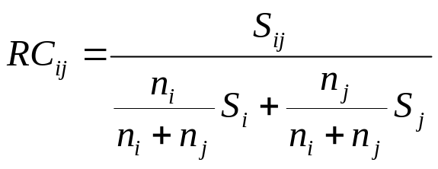
  Measuring the similarity between clusters
    Relative interconnectivity:
      Let E_{ij} be the set of edges connecting points in C_{i} with points in C_{j}.
      Let E_{i} be the set of edges corresponding to the minimum cut bisector of C_{i}.
      Let |E_{i}|, |E_{ij}| be the sum of the weights of the edges of E_{i}, E_{ij}, respectively.
      Absolute interconnectivity between C_{i}, C_{j} = |E_{ij}|
      Internal interconnectivity of C_{i} = |E_{i}|
      Relative interconnectivity between C_{i}, C_{j}:
    Relative closeness:
      Let S_{ij} be the average weight of the edges in E_{ij} .
      Let S_{i} be the average weight of the edges in E_{i} .
      Relative closeness between C_{i} and C_{j}:

Slide 44
  The Chameleon algorithm
  Preliminary phase
  Create a k-nearest neighbor graph G=(V,E) such that:
    Each vertex of V corresponds to a data point.
    The edge between two vertices v_{i} and v_{j} is added to E if v_{i} is one of the k-nearest neighbors of v_{j} or vise versa.
  Divisive phase
  Set ℜ₀={X}
  t=0
  Repeat
    t=t+1
    Select the largest cluster C in ℜ_{t-1}.
    Referring to E, partition C into two sets so that:
      the sum of the weights of the edge cut set between the resulting clusters is minimized.
      each cluster contains at least 25% of the vertices of C.
  Until each cluster in ℜ_{t} contains fewer than q points.

Slide 45
The Chameleon algorithm (cont)
Agglomerative phase
Set ℜ΄₀= ℜ_{t}
t=0
Repeat
  t=t+1
  Merge C_{i}, C_{j} in ℜ’_{t-1} to a single cluster if
  RI_{ij}≥T_{RI} and RC_{ij}≥T_{RC} (A)
(if more than one C_{j} satisfy the conditions for a given C_{i}, the C_{j} with the highest
|E_{ij}| is selected).
Until (A) does not hold for any pair of clusters in ℜ΄_{t-1}.
Return ℜ΄_{t-1}
ΝΟΤΕ: The internal structure of two clusters to be merged is of significant importance. The more similar the elements with in each cluster the higher “their resistance” in merging with another cluster.

Slide 46
  Remarks:
    Condition (A) can be replaced by max_{(Ci,Cj)} RI_{ij} RC_{ij}ª
    Chameleon is not very sensitive to the choice of the user-defined parameters k (typically it is selected between 5 and 20), q (typically chosen in the range 1 to 5% of the total number of data points), T_{RI}, T_{RC} and/or a.
    Chameleon is well suited for large data sets (better estimation of |E_{ij}|, |E_{i}|, S_{ij}, S_{i})
    For large N, the worst-case time complexity of the algorithm is O(N(log₂N+m)), where m is the number of clusters formed by the divisive phase.

Slide 47
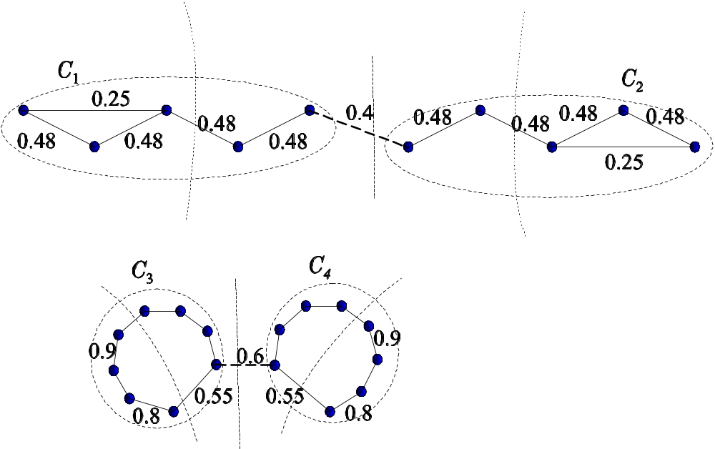
  Example 8: For the clusters shown in the figure we have:
  |E₁|=0.48, |E₂|=0.48, |E₃|=1.45, |E₄|=1.45,
  |S₁|=0.48, |S₂|=0.48, |S₃|=0.725, |S₄|=0.725,
  |E₁₂|=0.4, |E₃₄|=0.6, |S₁₂|=0.4, |S₃₄|=0.6.
  Thus,
  RI₁₂=0.833, RI₃₄=0.414
  RC₁₂=0.833, RC₃₄=0.828
  In conclusion:
  Both RI and RC favor the merging
  C₁ and C₂ against the merging of
  C₃ and C₄.
  Note that MST would merge C₃ and C₄ instead
  of C₁ and C₂.

Slide 48
CHOICE OF THE BEST NUMBER OF CLUSTERS
A major issue associated with hierarchical algorithms is:
“How the clustering that best fits the data is extracted from a hierarchy of clusterings?”
Some approaches:
  Search in the proximity dendrogram for clusters that have a large lifetime (the difference between the proximity level at which a cluster is created and the proximity level at which it is absorbed into a larger cluster (however, this method involves human subjectivity)).
  Define a function h(C) that measures the dissimilarity between the vectors of the same cluster C. Let ϑ be an appropriate threshold for h(C). Then ℜ_{t} is the final clustering if there exists a cluster C in ℜ_{t+1} with dissimilarity between its vectors (h(C)) greater than ϑ (extrinsic method). The final clustering ℜ_{t} must satisfy the following condition:
  d^{ss}_{min}(C_{i},C_{j})> max{h(C_{i}),h(C_{j})}, ∀C_{i},C_{j} ∈ ℜ_{t}
  In words, in the final clustering, the dissimilarity between every pair of clusters is larger than the “self-similarity” of each one of them (intrinsic method).

