Slide 1

CLUSTERING ALGORITHMS VIA FUNCTION OPTIMIZATION
In this context the clusters are assumed to be described by a parametric specific model whose parameters are unknown (all parameters are included in a vector denoted by θ).
Examples:
  Compact clusters. Each cluster C_{i} is represented by a point m_{i} in the l-dimensional space. Thus θ=[m₁ ^{T}, m₂ ^{T}, …, m_{m} ^{T} ]^{T}.
  Ring-shaped clusters. Each cluster C_{i} is modeled by a hypersphere C(c_{i},r_{i}), where c_{i} and r_{i} are its center and its radius, respectively. Thus
θ=[c₁^{T}, r₁, c₂^{T}, r₂, …, c_{m}^{T}, r_{m}]^{T}.
A cost J(θ) is defined as a function of the data vectors in X and θ. Optimization of J(θ) with respect to θ results in θ that characterizes optimally the clusters underlying X.
The number of clusters m is a priori known in most of the cases.

Slide 2
Cost optimization clustering algorithms considered in the sequel
  Mixture decomposition schemes.
  Fuzzy clustering algorithms.
  Possibilistic clustering algorithms.

Slide 3
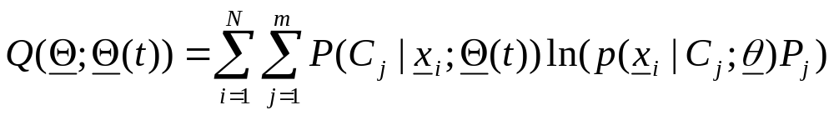
Mixture Decomposition (MD) schemes
  Here, each vector belongs to a single cluster with a certain probability
  MD schemes rely on the Bayesian framework:
  A vector x_{i} is appointed to cluster C_{j} if
  P(C_{j}| x_{i})>P(C_{k}| x_{i}), k=1,…,m, k≠j.
However:
  No cluster labeling information is available for the data vectors
  The a priori cluster probabilities P(C_{j})≡P_{j} are also unknown
  A solution: Adoption of the EM algorithm
    E-step
    where
    θ=[θ₁^{Τ},…,θ_{m}^{T}]^{T} (θ_{j} the parameter vector corresponding to C_{j})
    P=[P₁,…P_{m}]^{T} (P_{j} the a priori probability for C_{j})
    Θ=[θ^{T}, P^{T}]^{T}

Slide 4
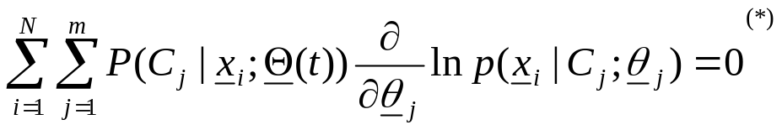
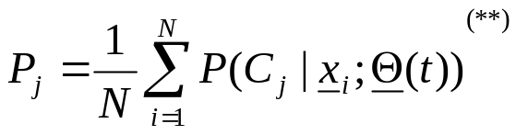
    M-step
    Θ(t+1)=argmax_{Θ}Q(Θ;Θ(t))
    More specifically, the M-step results in:
    For θ_{j}’s:
    (*) Provided that all pairs of (θ_{k},θ_{j}) are functionally independent.
    For P_{j}’s:
    (**) Taking into account the constraints P_{k}≥0, k=1,…,m and P₁+P₂+…P_{m}=1.
    Thus, the EM algorithm for this case may be stated as follows:

Slide 5
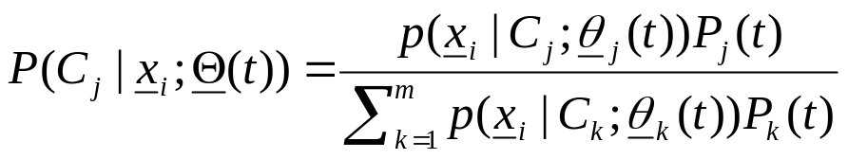
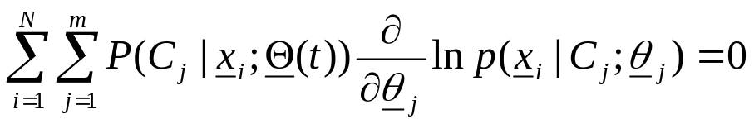
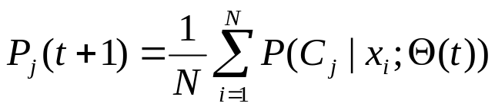
Generalized Mixture Decomposition Algorithmic Scheme (GMDAS)
  Choose initial estimates, θ=θ(0) and P=P(0).
  t=0
  Repeat
    Compute
    , i=1,…,N, j=1,…,m (1)
    Set θ_{j}(t+1) equal to the solution of the equation
  (2)
  with respect to θ_{j}, for j=1,…,m.
    Set
  , j=1,…,m (3)
    t=t+1
  Until convergence, with respect to Θ, is achieved.

Slide 6
Remarks:
  A termination condition for GMDAS is
  ||Θ(t+1)-Θ(t)||<ε
  where ||.|| is an appropriate vector norm and ε a small user-defined constant.
  The above scheme is guaranteed to converge to a global or a local maximum of the loglikelihood function.
  Once the algorithm has converged, x_{í}’s are assigned to clusters according to the Bayes rule.

Slide 7
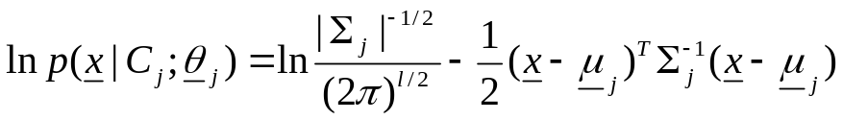
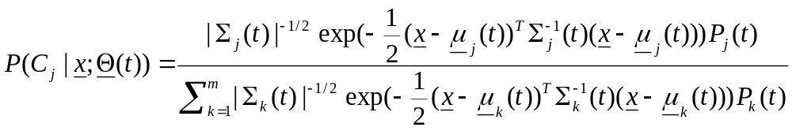
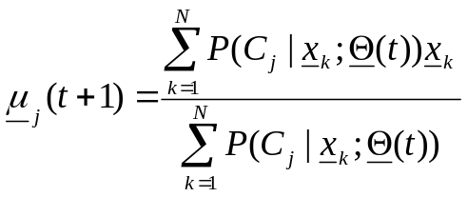
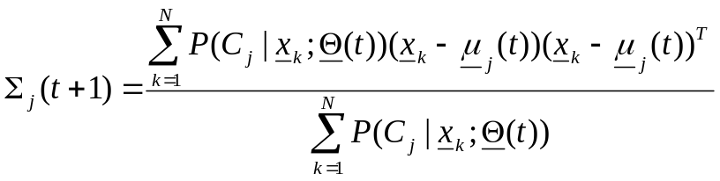
  Compact and Hyperellipsoidal Clusters
  In this case :
    each cluster C_{j} is modeled by a normal distribution N(μ_{j},Σ_{j}).
    θ_{j} consists of the parameters of μ_{j} and the (independent) parameters of Σ_{j}.
    It is
    , j=1,…,m
    For this case:
    Eq. (1) in GMDAS is replaced by
    Eq. (2) in GMDAS is replaced by the equations

Slide 8
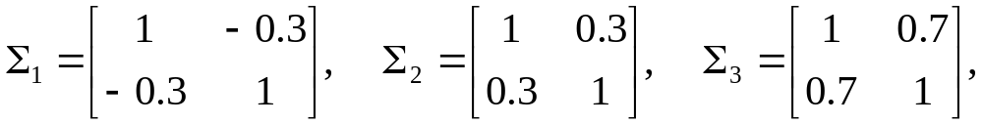
  Remark:
    The above scheme is computationally very demanding since it requires the inversion of the m covariance matrices at each iteration step. Two ways to deal with this problem are:
    The use of a single covariance matrix for all clusters.
    The use of different diagonal covariance matrices.
  Example 1: (a) Consider three two-dimensional normal distributions with mean values:
  μ₁=[1, 1]^{T}, μ₂=[3.5, 3.5]^{T}, μ₃=[6, 1]^{T}
  and covariance matrices
  respectively.
  A group of 100 vectors stem from each distribution. These form the data set X.

Slide 9
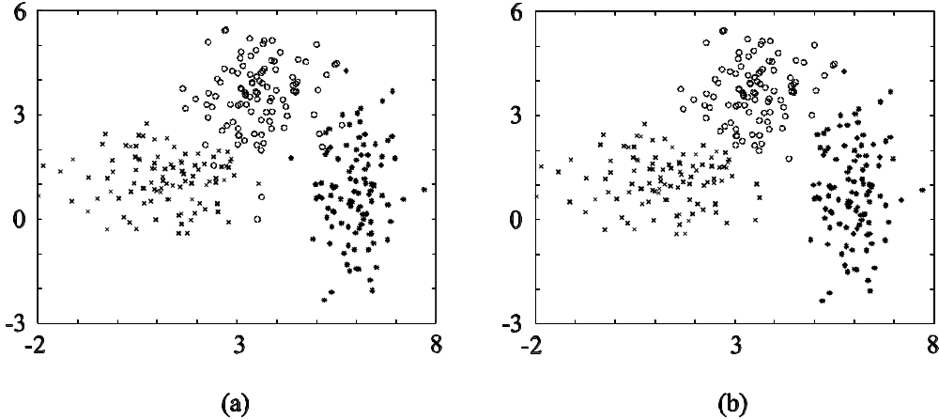
The data set
Results of GMDAS
Confusion matrix:
 | Cluster 1 | Cluster 2 | Cluster 3
1st distribution | 99 | 0 | 1
2nd distribution | 0 | 100 | 0
3rd distribution | 3 | 4 | 93
The algorithm reveals accurately the underlying structure.

Slide 10
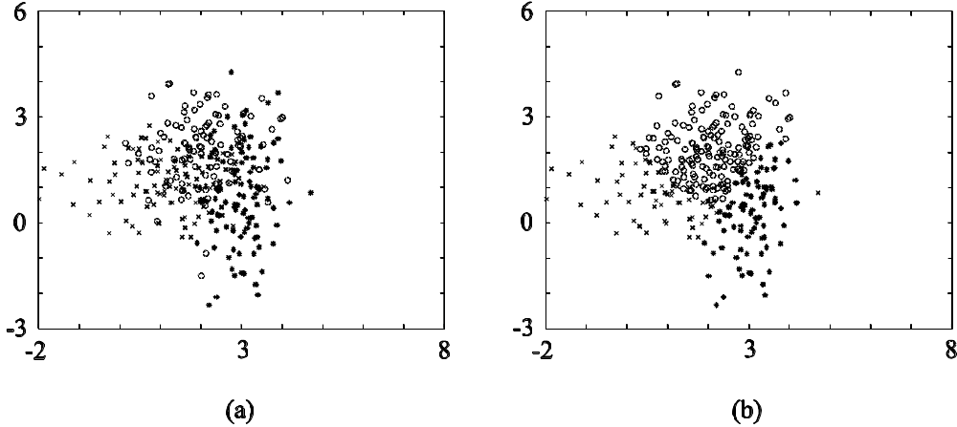
(b) The same as (a) but now μ₁=[1, 1]^{T}, μ₂=[2, 2]^{T}, μ₃=[3, 1]^{T} (The clusters are closer).
The data set
Results of GMDAS
Confusion matrix:
 | Cluster 1 | Cluster 2 | Cluster 3
1st distribution | 85 | 4 | 11
2nd distribution | 35 | 56 | 9
3rd distribution | 26 | 0 | 74
The algorithm reveals the underlying structure less accurately.

Slide 11
Fuzzy clustering algorithms
  Each vector belongs simultaneously to more than one clusters.
  A fuzzy m-clustering of X, is defined by a set of functions
  u_{j}: X → A≡[0, 1], j=1,…,m.
  If A={0,1}, a hard m-clustering of X is produced.
  u_{j}(x_{i}) denotes the degree of membership of x_{i} in cluster C_{j}. It is
  u₁(x_{i})+ u₂(x_{i})+…+ u_{m}(x_{i})=1
  The number of clusters m is assumed to be known a priori.

Slide 12
Fuzzy clustering algorithms (cont)
  Cost function definition
  Let
    θ_{j} be the representative vector of C_{j}.
    θ≡[θ₁^{T},…, θ_{m}^{T}] ^{T}.
    U ≡[u_{ij}]=[u_{j}(x_{i})]
    d(x_{i},θ_{j}) be the dissimilarity between x_{i} and θ_{j}
    q(>1) a parameter called fuzzifier.

Slide 13
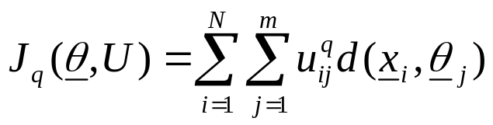
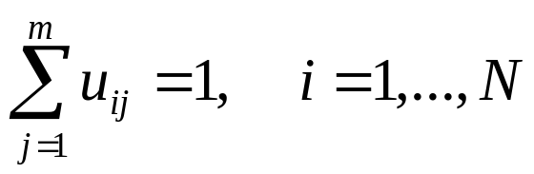
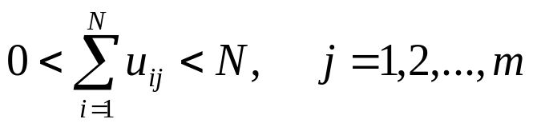
Fuzzy clustering algorithms (cont)
Most fuzzy clustering schemes result from the minimization of :
Subject to the constraints:
where
u_{ij}∈[0,1], i=1,…,N, j=1,…,m
and

Slide 14
Remarks:
  The degree of membership of x_{i} in C_{j} cluster is related to the grade of membership of x_{i} in rest m-1 clusters.
  If q=1, no fuzzy clustering is better than the best hard clustering in terms of J_{q}(θ,U).
  If q>1, there are fuzzy clusterings with lower values of J_{q}(θ,U) than the best hard clustering.

Slide 15
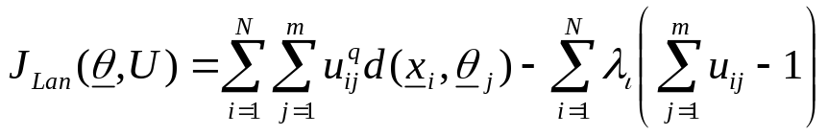
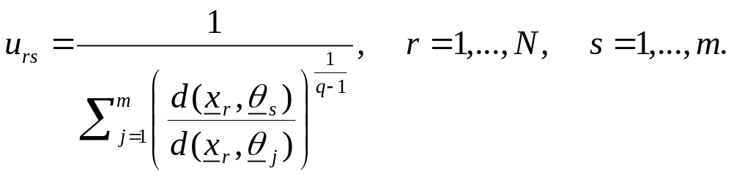
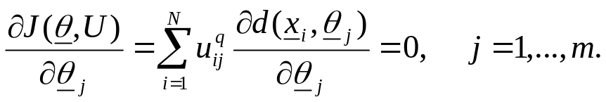
Fuzzy clustering algorithms (cont)
  Minimizing J_{q}(θ,U):
  Minimization J_{q}(θ,U) with respect to U, subject to the constraints leads to the following Lagrangian function,
  Minimizing J_{Lan}(θ,U) with respect to u_{rs}, we obtain
  Setting the gradient of J (θ,U), with respect to θ, equal to zero we obtain,
  The last two equations are coupled. Thus, no closed form solutions are expected. Therefore, minimization is carried out iteratively.

Slide 16
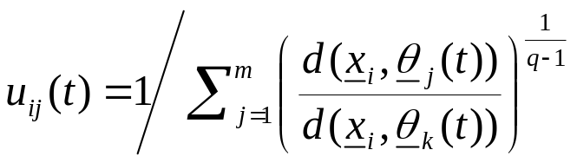
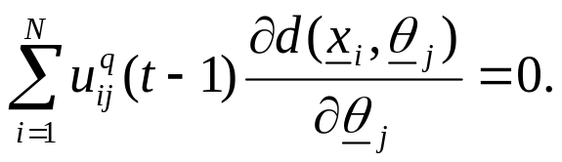
  Generalized Fuzzy Algorithmic Scheme (GFAS)
    Choose θ_{j}(0) as initial estimate for θ_{j}, j=1,…,m.
    t=0
    Repeat
      For i=1 to N
        For j=1 to m
        (A)
        End {For-j}
      End {For-i}
      t=t+1
      For j=1 to m
        Parameter updating: Solve
    (B)
        with respect to θ_{j} and set θ_{j}(t) equal to this solution.
      End {For-j}
    Until a termination criterion is met

Slide 17
Remarks:
  A candidate termination condition is
  ||θ(t)-θ(t-1)||<ε,
  where ||.|| is any vector norm and ε a user-defined constant.
  GFAS may also be initialized from U(0) instead of θ_{j}(0), j=1,…,m and start iterations with computing θ_{j} first.
  If a point x_{i} coincides with one or more representatives, then it is shared arbitrarily among the clusters whose representatives coincide with x_{i}, subject to the constraint that the summation of the degree of membership over all clusters sums to 1.

Slide 18
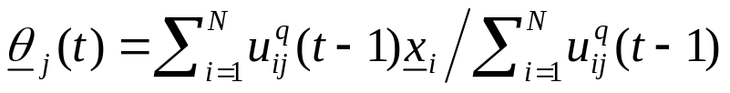
Fuzzy Clustering – Point Representatives
  Point representatives are used in the case of compact clusters
  Each θ_{j} consists of l parameters
  Every dissimilarity measure d(x_{i},θ_{j}) between two points can be used
  Common choices for d(x_{i},θ_{j}) are
    d(x_{i},θ_{j}) = (x_{i}- θ_{j})^{T}A(x_{i}- θ_{j}),
  where A is symmetric and positive definite matrix.
  In this case:
  ∂d(x_{i},θ_{j}) / ∂θ_{j} = 2A(θ_{j}-x_{i}).
  Thus the updating equation (B) in GFAS becomes
  GFAS with the above distance is also known as Fuzzy c-Means (FCM) or Fuzzy k-Means algorithm.
  FCM converges to a stationary point of the cost function or it has at least one subsequence that converges to a stationary point. This point may be a local (or global) minimum or a saddle point.

Slide 19
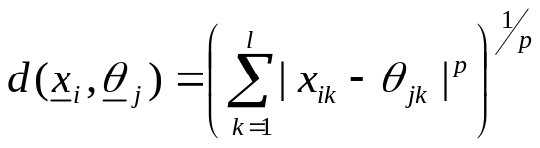
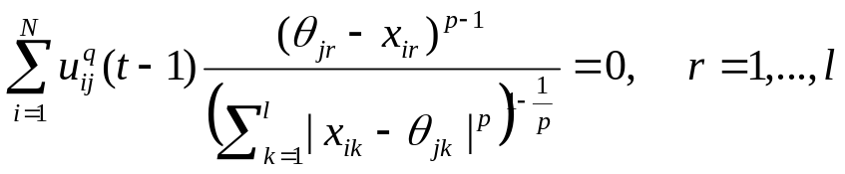
Fuzzy clustering – Point representatives (cont.)
    The Minkowski distance
  where p is a positive integer and x_{ik}, θ_{jk} are the k-th coordinates of x_{i}
  and θ_{j}.
  For even and finite p, the differentiability of d(x_{i},θ_{j}) is guaranteed. In
  this case the updating equation (B) of GFAS gives
  a system of l nonlinear equations with l unknowns.
  GFAS algorithms with the Minkowski distance are also known as
  pFCM algorithms.

Slide 20
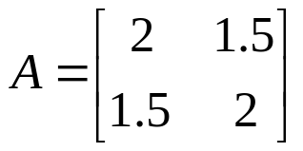
Fuzzy Clustering – Point representatives (cont.)
  Example 2(a):
    Consider the setup of example 1(a).
    Consider GFAS with distances
      (i) d(x_{i},θ_{j}) = (x_{i}- θ_{j})^{T}A(x_{i}- θ_{j}), with A being the identity matrix
      (ii) d(x_{i},θ_{j}) = (x_{i}- θ_{j})^{T}A(x_{i}- θ_{j}), with
      (iii) The Minkowski distance with p=4.
  Example 2(b):
    Consider the setup of example 1(b).
    Consider GFAS with the distances considered in example 2(a).

Slide 21
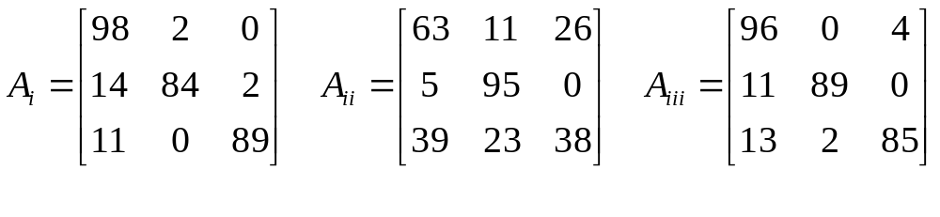
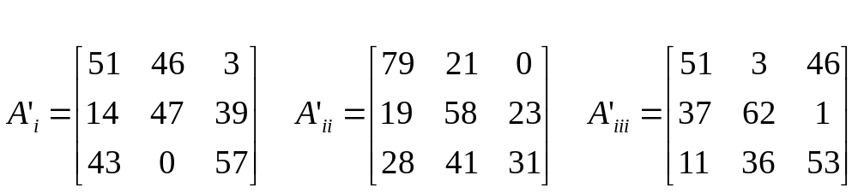
    The corresponding confusion matrices for example 2(a) and 2(b) are (Here a vector is assigned to the cluster for which u_{ij} has the maximum value.)
For the example 2(a)
For the example 2(b)
  Remarks:
    In A_{i} and A_{iii} (example 2(a)) almost all vectors from the same distribution are assigned to the same cluster.
    The closer the clusters are, the worse the performance of all the algorithms.
    The choice of matrix A in d(x_{i},θ_{j}) = (x_{i}- θ_{j})^{T}A(x_{i}- θ_{j}) plays an important role to the performance of the algorithm.

Slide 22
Fuzzy Clustering – Quadric surfaces as representatives
Here the representatives are quadric surfaces (hyperellipsoids,
hyperparaboloids, etc.)
  General form of an equation describing a quadric surface Q:
    x^{T}Ax + b^{T}x + c = 0,
    where A is an lxl symmetric matrix, b is an lx1 vector, c is a scalar and x=[x₁,…,x_{l}]^{T}.
    For various choices of these quantities we obtain hyperellipses, hyperparabolas and so on.
    q^{T}p=0,
    where
    q=[x₁², x₂²,…, x_{l}², x₁x₂,…, x_{l-1}x_{l}, x₁, x₂,…, x_{l}, 1]^{T}
    and
    p=[p₁, p₂,…, p_{l}, p_{l+1},…, p_{r}, p_{r+1},…, p_{s}]^{T}
    with r=l(l+1)/2 and s=r+l+1.
  NOTE: The above representations of Q are equivalent.

Slide 23
Fuzzy Clustering – Quadric surfaces as representatives (cont)
First concern:“Definition of the distance of a point x to a quadric surface Q”
  Types of distances
    (Squared) Algebraic distance:
    d_{a}²(x,Q)=(x^{T}Ax + b^{T}x + c)² ≡ p^{T}Mp,
    where M=qq^{T}.
    Perpendicular distance:
    d_{p}²(x,Q)=min_{z}||x-z||²
    subject to the constraint
    z^{T}Az + b^{T}z + c=0
  In words, d_{p}²(x,Q) is the distance between x and the closest to x point that lies in Q.

Slide 24
Fuzzy Clustering – Quadric surfaces as representatives (cont)
    Radial distance (only when Q is a hyperellipsoidal):
    For Q hyperellipsoidal, the representative equation can become
    (x-c)^{T}A(x-c)=1
    where c is the center of the ellipse and A a positive definite symmetric matrix defining major axis, minor axis and orientation.
    Then the following is true
    d_{r}²(x,Q)=||x-z||²,
    subject to the constraints
    (z-c)^{T}A(z-c)=1
    and
    (z-c)=a(x-c)
    In words,
      the intersection point z between the line segment x-c and Q is determined
      the squared Euclidean distance between x and z is computed.

Slide 25
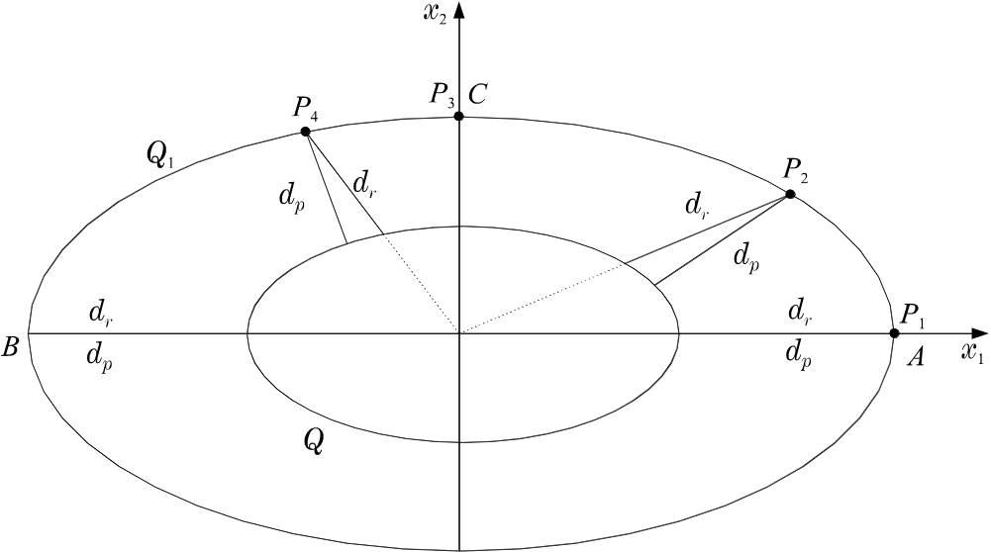
Fuzzy Clustering – Quadric surfaces as representatives (cont)
    (Squared) Normalized radial distance (only when Q is a hyperellipsoidal):
    d_{nr}²(x,Q)=(((x-c)^{T}A(x-c))^{1/2}-1)²
  Example 3:
    Consider two ellipses Q and Q₁, centered at c=[0, 0]^{T}, with A=diag(0.25, 1) and A₁=diag(1/16, ¼), respectively.
    Let P(x₁,x₂) be a point in Q₁ moving from A(4,0) to B(-4,0), with x₂>0.

Slide 26
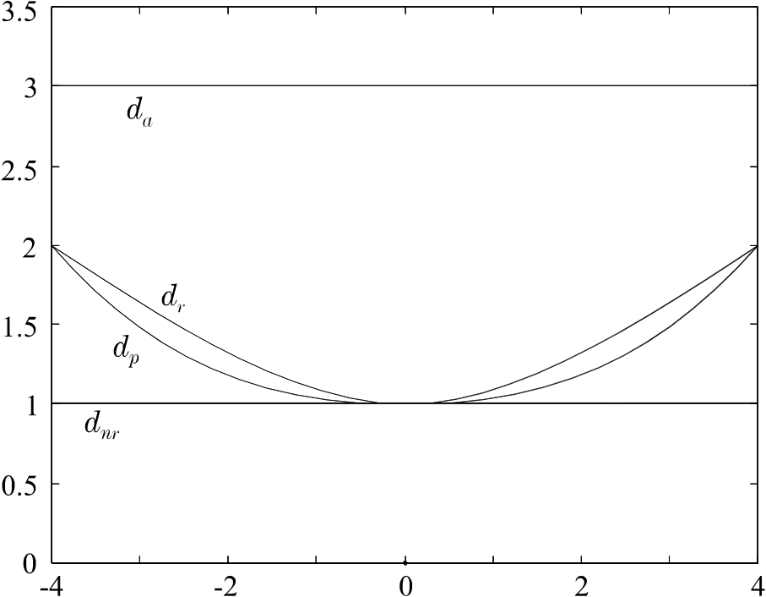
Fuzzy Clustering – Quadric surfaces as representatives (cont)
  d_{a} and d_{nr} do not vary as P moves.
  d_{r} can be used as an approximation of d_{p}, when Q is a hyperellipsoid.

Slide 27
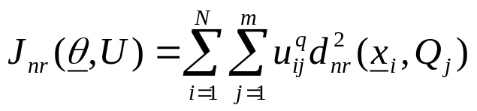
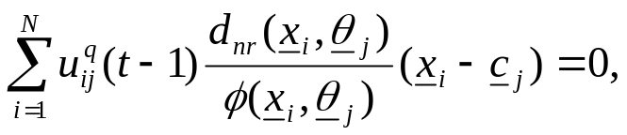
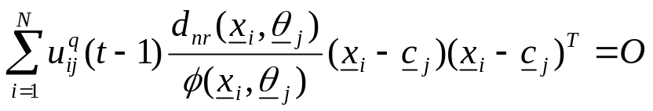
Fuzzy Clustering – Quadric surfaces as representatives (cont)
Fuzzy Shell Clustering Algorithms
  The Adaptive Fuzzy C-Shells (AFCS) algorithm.
    It recovers hyperellipsoidal clusters.
    It is the result of the minimization of the cost function
  with respect to u_{ij},’s, c_{j}’s, A_{j}’s, j=1,…,m.
    AFCS stems from GFAS, with the “parameter updating” being as follows:
      Parameter updating:
        Solve with respect to c_{j} and A_{j} the following equations

Slide 28

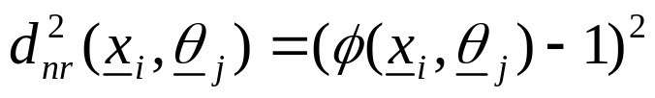
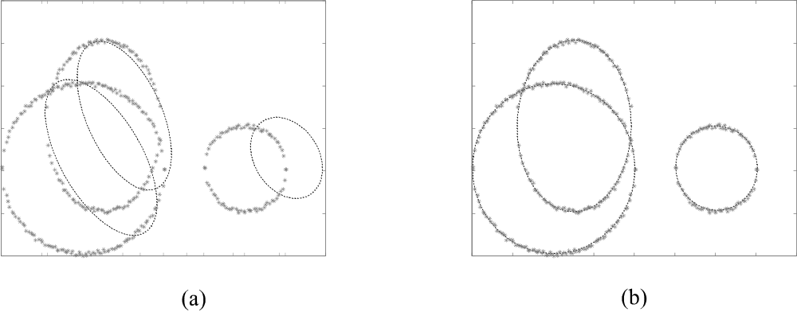
  where:
      Set c_{j}(t) and A_{j}(t), j=1,…,m, equal to the resulting solution
  Example 4: Thick dots represent the points of the data set. Thin dots represent (a) the initial estimates and (b) the final estimates of the ellipses

Slide 29
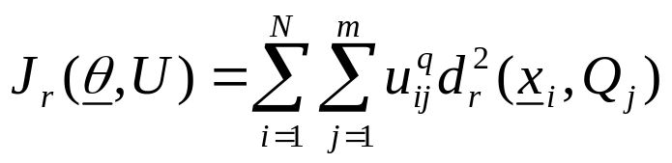
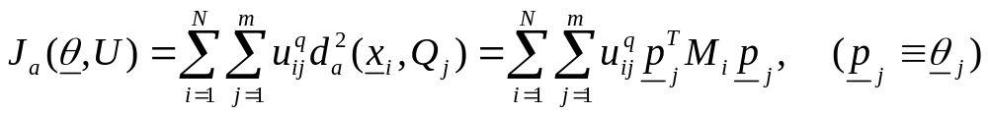
Fuzzy Clustering – Quadric surfaces as representatives (cont)
  The Fuzzy C Ellipsoidal Shells (FCES) Algorithm
    It recovers hyperellipsoidal clusters.
    It is the result of the minimization of the cost function
    FCES stems from GFAS. Setting the derivative of J_{r}(θ,U) with respect to c_{j}’s and A_{j}’s equal to zero, the “parameter updating” part of the algorithm follows.
  The Fuzzy C Quadric Shells (FCQS) Algorithm
    It recovers general hyperquadric shapes.
    It is the result of the minimization of the cost function
subject to constraints such as:

Slide 30
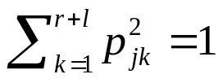
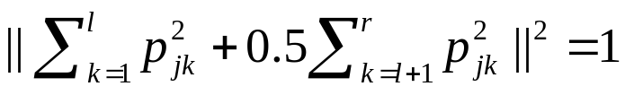
Fuzzy Clustering – Quadric surfaces as representatives (cont)
(i) ||p_{j}||²=1, (ii)
(iii) p_{j1}=1, (iv) p_{js}²=1, (v)
    FCQS stems from GFAS. Setting the derivative of J_{r}(θ,U) with respect to p_{j}’s equal to zero and taking into account the constraints, the “parameter updating” part of the algorithm follows.
  The Modified Fuzzy C Quadric Shells (MFCQS) Algorithm
    It recovers hyperquadric shapes.
    It results from the GFAS scheme where
      The grade of membership of a vector x_{i} in a cluster is determined using the perpendicular distance.
      The updating of the parameters of the representatives is carried out using the parameter updating part of FCQS (where the algebraic distance is used).

Slide 31
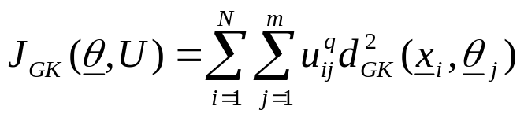
Fuzzy Clustering – Hyperplanes as representatives
Algorithms that recover hyperplanar clusters.
  Fuzzy c-varieties (FCV) algorithm
    It is based on the minimization of the distances of the vectors in X from hyperplanes.
    Disadvantage: It tends to recover very long clusters and, thus, collinear distinct clusters may be merged to a single one.
  Gustafson-Kessel (GK) algorithm
    Each planar cluster is represented by a center c_{j} and a covariance matrix Σ_{j}, i.e., θ_{j}=(c_{j}, Σ_{j}).
    The distance between a point x and the j-th cluster is defined as
  d_{GK}²(x,θ_{j})=|Σ_{j}|^{1/l}(x-c_{j})^{T}Σ_{j}⁻¹(x-c_{j})
    The GK algorithm is derived via the minimization of the cost function

Slide 32
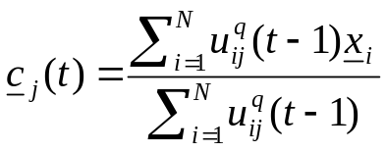
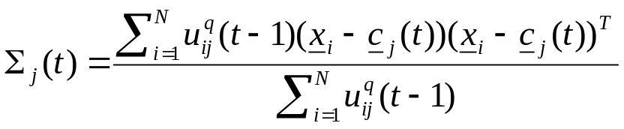
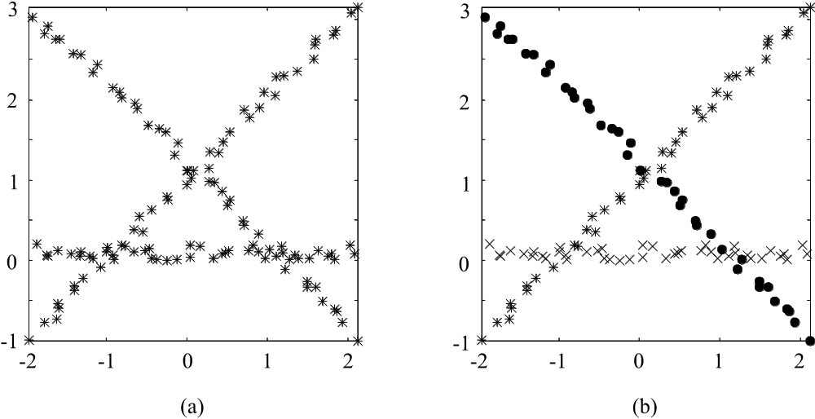
Fuzzy Clustering – Hyperplanes as representatives (cont)
    The GK algorithm stems from GFAS. Setting the derivative of J_{GK}(θ,U) with respect to c_{j}’s and A_{j}’s equal to zero, the “parameter updating” part of the algorithm becomes:
Example 5:

Slide 33
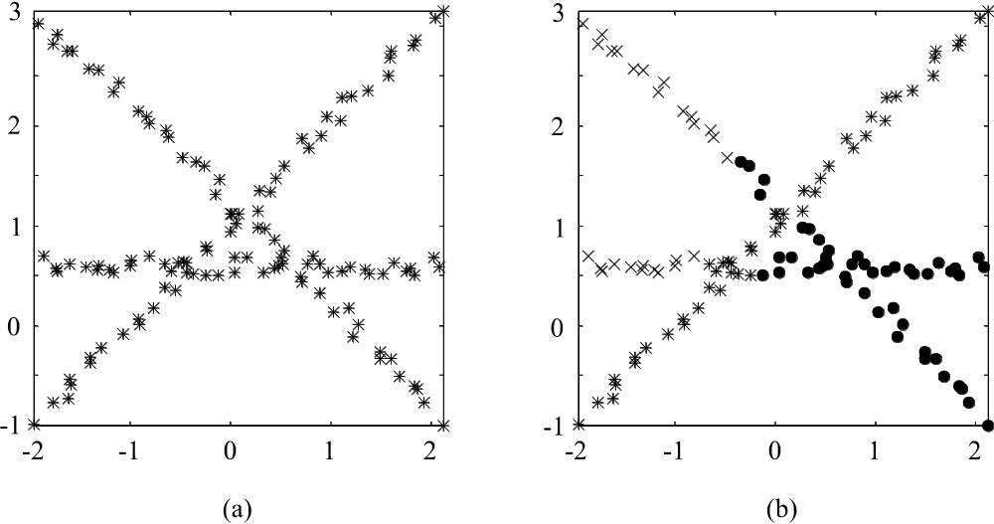
    In the first case, the clusters are well separated and the GK-algorithm recovers them correctly.
    In the second case, the clusters are not well separated and the GK-algorithm fails to recover them correctly.

Slide 34
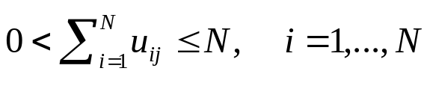
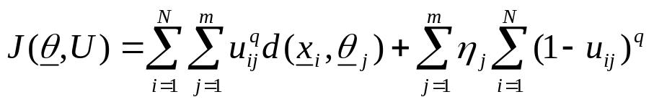
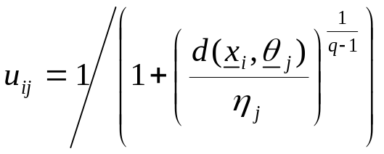
Possibilistic Clustering
  Unlike fuzzy clustering, the constraints on u_{ij}’s are
    u_{ij} ∈ [0, 1]
    max_{j=1,…,m} u_{ij} > 0, i=1,…,N
  Possibilistic clustering algorithms result from the optimization of cost functions like
where η_{j} are suitably chosen positive constants (see below). The 2nd term is inserted in order to avoid the trivial zero solution for the u_{ij}’ s.
(other choices for the second term of the cost function are also possible (see below)).
  Setting ∂J(θ,U)/ ∂u_{ij}=0 we obtain:

Slide 35
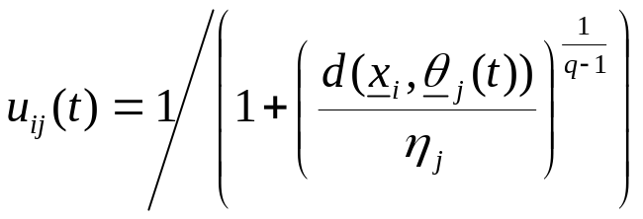
Possibilistic clustering (cont)
  Generalized Possibilistic Algorithmic Scheme (GPAS)
    Fix η_{j}, j=1,…,m.
    Choose θ_{j}(0) as the initial estimates of θ_{j} , j=1,…,m.
    t=0
    Repeat
      For i=1 to N
        For j=1 to m
        End {For-j}
      End {For-i}
      t=t+1

Slide 36
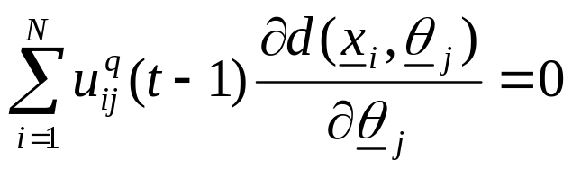
Possibilistic clustering (cont)
  Generalized Possibilistic Algorithmic Scheme (GPAS) (cont)
      For j=1 to m
        Parameter updating: Solve
    with respect to θ_{j} and set θ_{j}(t) equal to the computed solution
      End {For j}
    Until a termination criterion is met
  Remarks:
    ||θ(t)-θ(t-1)||<ε may be employed as a termination condition.
    Based on GPAS, a possibilistic algorithm can be derived, for each fuzzy clustering algorithm derived previously.

Slide 37
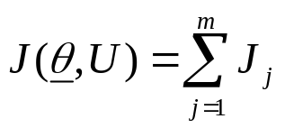
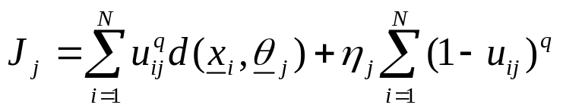


Possibilistic clustering (cont)
  Two observations
    Decomposition of J(θ,U): Since for each vector x_{i}, u_{ij}’s, j=1,…,m are independent from each other, J(θ,U) can be written as
    where
    Each J_{j} corresponds to a different cluster and minimization of J(θ,U) with respect to u_{ij}’s can be carried out separately for each J_{j}.
    About η_{j}’s:
      They determine the relative significance of the two terms in J(θ,U).
      They are related to the size and the “shape” of the C_{j}’s, j=1,…,m.
      They may be determined as follows:
        Run the GFAS algorithm and after its convergence estimate η_{j}’s as
    or
        Run the GPAS algorithm

Slide 38
Possibilistic clustering (cont)
  Remark:
  High values of q:
    In possibilistic clustering imply almost equal contributions of all vectors to all clusters
    In fuzzy clustering imply increased sharing of the vectors among all clusters.
  The mode-seeking property
    Unlike GMDAS and GFAS which are partition algorithms (they terminate with the predetermined number of clusters no matter how many clusters are naturally formed in X), GPAS is a mode-seeking algorithm (it searches for dense regions of vectors in X).
    Advantage: The number of clusters need not be a priori known.
    If the number of clusters in GPAS, m, is greater than the true number of clusters k in X, some representatives will coincide with others. If m<k, some (and not all) of the clusters will be captured.

Slide 39



Hard Clustering Algorithms
Each vector belongs exclusively to a single cluster. This implies that:
  u_{ij}∈{0, 1}, j=1,…,m
  That is, it can be seen as an extreme special case of the fuzzy algorithmic schemes.
However, now, the cost function
is not differentiable with respect to θ_{j}.
Despite that, the two-step optimization procedure (with respect to u_{ij}’s and with respect to θ_{j}’s) adopted in GFAS is applied also here, taking into account that, for fixed θ_{j}’s, the u_{ij}’s that minimize J(θ,U) are chosen as

Slide 40

Hard Clustering Algorithms (cont)
  Generalized Hard Algorithmic Scheme (GHAS)
    Choose θ_{j}(0) as initial estimates for θ_{j}, j=1,…,m.
    t=0
    Repeat
      For i=1 to N
        For j=1 to m
        Determination of the partition:
        End {For-j}
      End {For-i}
      t=t+1

Slide 41

Hard Clustering Algorithms (cont)
  Generalized Hard Algorithmic Scheme (GHAS) (cont.)
      For j=1 to m
        Parameter updating: Solve
        with respect to θ_{j} and set θ_{j}(t) equal to the computed solution
      End {For-j}
    Until a termination criterion is met
  Remarks:
    In the update of each θ_{j}, only the vectors x_{i} for which u_{ij}(t-1)=1 are used.
    GHAS may terminate when either
      ||θ(t)-θ(t-1)||<ε or
      U remains unchanged for two successive iterations.

Slide 42
Hard Clustering Algorithms (cont)
  More Remarks:
    For each hard clustering algorithm there exists a corresponding fuzzy clustering algorithm. The updating equations for the parameter vectors θ_{j} in the hard clustering algorithms are obtained from their fuzzy counterparts for q=1.
    Hard clustering algorithms are not as robust as the fuzzy clustering algorithms when other than point representatives are used.
    The two-step optimization procedure in GHAS does not necessarily lead to a local minimum of J(θ,U).

Slide 43

Hard Clustering Algorithms (cont)
  The Isodata or k-Means or c-Means algorithm
General comments
    It is a special case of GHAS where
      Point representatives are used.
      The squared Euclidean distance is employed.
    The cost function J(θ,U) becomes now
    Applying GHAS in this case, it turns out that it converges to a minimum of the cost function.
    Isodata recovers clusters that are as compact as possible.
    For other choices of the distance (including the Euclidean), the algorithm converges but not necessarily to a minimum of J(θ,U).

Slide 44

Hard Clustering Algorithms (cont)
  The Isodata or k-Means or c-Means algorithm
    Choose arbitrary initial estimates θ_{j}(0) for the θ_{j}’ s, j=1,…,m.
    Repeat
      For i=1 to N
        Determine the closest representative, say θ_{j}, for x_{i}
        Set b(i)=j.
      End {For}
      For j=1 to m
        Parameter updating: Determine θ_{j} as the mean of the vectors x_{i}∈X with b(i)=j.
      End {For}
    Until no change in θ_{j}’ s occurs between two successive iterations
  Example 6(a): The k-means algorithm with m=3 identifies successfully the clusters in the data set of example 1(a). The confusion matrix is

Slide 45

Hard Clustering Algorithms – k-means (cont)
  Example 6(b): (i) Consider two 2-dimensional Gaussian distributions N(μ₁,Σ₁), N(μ₂,Σ₂), with μ₁=[1, 1]^{T}, μ₂=[8, 1]^{T}, Σ₁=1.5I and Σ₂=I. (ii) Generate 300 points from the 1st distribution and 10 points from the 2nd distribution. (iii) Set m=2 and initialize randomly θ_{j}’s (θ_{j}≡μ_{j}).
  After convergence the large group has been split into two clusters.
  Its right part has been assigned to the same cluster with the points of the small group (see figure below).
  This indicates that k-means cannot deal accurately with clusters having significantly different sizes.

Slide 46
Hard Clustering Algorithms – k-means (cont)
  Remarks:
    k-means recovers compact clusters.
    Sequential versions of the k-means, where the updating of the representatives takes place immediately after the identification of the representative that lies closer to the current input vector x_{i}, have also been proposed.
    A variant of the k-means results if the number of vectors in each cluster is constrained a priori.
    The computational complexity of the k-means is O(Nmq), where q is the number of iterations required for convergence. In practice, m and q are significantly less than N, thus, k-means becomes eligible for processing large data sets.
  Further remarks:
  Some drawbacks of the original k-means accompanied with the variants of the k-means that deal with them are discussed next.

Slide 47
Hard Clustering Algorithms – k-means (cont)
  Drawback 1: Different initial partitions may lead k-means to produces
  different final clusterings, each one corresponding to a different local minimum.
  Strategies for facing drawback 1:
    Single run methods
      Use a sequential algorithm (discussed previously) to produce initial estimates for θ_{j}’s.
      Partition randomly the data set into m subsets and use their means as initial estimates for θ_{j}’ s.
    Multiple run methods
      Create different partitions of X, run k-means for each one of them and select the best result.
      Compute the representatives iteratively, one at a time, by running k-means mN times. It is claimed that convergence is independent of the initial estimates of θ_{j}’ s.
    Utilization of tools from stochastic optimization techniques (simulated annealing, genetic algorithms etc).

Slide 48
Hard Clustering Algorithms – k - means (cont)
  Drawback 2: Knowledge of the number of clusters m is required a priori.
Strategies for facing drawback 2:
    Employ splitting, merging and discarding operations of the clusters resulting from k-means.
    Estimate m as follows:
      Run a sequential algorithm many times for different thresholds of dissimilarity Θ.
      Plot Θ versus the number of clusters and identify the largest plateau in the graph and set m equal to the value that corresponds to this plateau.

Slide 49
Hard Clustering Algorithms – k - means (cont)
  Drawback 3: k-means is sensitive to outliers and noise.
Strategies for facing drawback 3:
    Discard all “small” clusters (they are likely to be formed by outliers).
    Use a k-medoids algorithm (see below), where a cluster is represented by one of its points.
  Drawback 4: k-means is not suitable for data with nominal (categorical) coordinates.
Strategies for facing drawback 4:
    Use a k-medoids algorithm.

Slide 50
Hard Clustering Algorithms
  k-Medoids Algorithms
    Each cluster is represented by a vector selected among the elements of X (medoid).
    A cluster contains
      Its medoid
      All vectors in X that
        Are not used as medoids in other clusters
        Lie closer to its medoid than the medoids representing other clusters.
  Let Θ be the set of medoids of all clusters, I_{Θ} the set of indices of the points in X that constitute Θ and I_{X-Θ} the set of indices of the points that are not medoids.
    Obtaining the set of medoids Θ that best represents the data set, X is equivalent to minimizing the following cost function

Slide 51


k-Medoids Algorithms (cont)
  with

Slide 52
  Representing clusters with mean malues vs representing clusters with medoids
Mean Values | Medoids
1. Suited only for continuous domains | 1. Suited for either cont. or discrete domains
2. Algorithms using means are sensitive to outliers | 2. Algorithms using medoids are less sensitive to outliers
3. The mean possess a clear geometrical and statistical meaning | 3. The medoid has not a clear geometrical meaning
4. Algorithms using means are not computationally demanding | 4. Algorithms using medoids are more computationally demanding

Slide 53

k-Medoids Algorithms (cont)
Example 7: (It illustrates the first two points in the above comparison)
(a) The five-point two-dimensional set stems from the discrete domain
D={1,2,3,4,…}x{1,2,3,4,…}. Its medoid is the circled point and its mean is
the “+” point, which does not belong to D.
(b) In the six-point two-dimensional set , the point (9,2) can be considered as an outlier. While the outlier affects significantly the mean of the set, it does not affect its medoid.

Slide 54
Hard Clustering Algorithms - k-Medoids Algorithms (cont)
Algorithms to be considered
  PAM (Partitioning Around Medoids)
  CLARA (Clustering LARge Applications)
  CLARANS (Clustering Large Applications based on RANdomized Search)
  The PAM algorithm
    The number of clusters m is required a priori.
    Definitions-preliminaries
    Two sets of medoids Θ and Θ´, each one consisting of m elements, are called neighbors if they share m-1 elements.
    A set Θ of medoids with m elements can have m(N-m) neighbors.
    Let Θ_{ij} denote the neighbor of Θ that results if x_{j}, j∈I_{X-Θ} replaces x_{i}, i∈I_{Θ}.
    Let ΔJ_{ij}=J(Θ_{ij} ,U_{ij}) - J(Θ ,U).

Slide 55

Hard Clustering Algorithms - k-Medoids Algorithms (cont)
  The PAM algorithm
    Determination of Θ that best represents the data
      Generate a set Θ of m medoids, randomly selected out of X.
      (A) Determine the neighbor Θ_{qr}, q∈I_{Θ}, r∈I_{X-Θ} among the m(N-m) neighbors of Θ for which ΔJ_{qr}=min _{i∈IΘ, j∈IX-Θ} ΔJ_{ij}.
      If ΔJ_{qr}< 0 is negative then
        Replace Θ by Θ_{qr}
        Go to (A)
      End
    Assignment of points to clusters
      Assign each x∈I_{X-Θ} to the cluster represented by the closest to x medoid.
  Computation of ΔJ_{ij}. It is defined as:
  where C_{hij} is the difference in J, resulting from the (possible) assignment of the vector x_{h}∈X-Θ from the cluster it currently belongs to another, as a consequence of the replacement of x_{i}∈Θ by x_{j}∈X-Θ.

Slide 56



Hard Clustering Algorithms - k-Medoids Algorithms (cont)
  The PAM algorithm (cont)
  Computation of C_{hij}:
    x_{h} belongs to the cluster represented by x_{i} (x_{h2}∈Θ denotes the second closest to x_{h} representative) and d(x_{h}, x_{j}) ≥ d(x_{h}, x_{h2}). Then
    C_{hi j}= d(x_{h}, x_{h2}) - d(x_{h}, x_{i}) ≥ 0
    x_{h} belongs to the cluster represented by x_{i} (x_{h2}∈Θ denotes the second closest to x_{h} representative) and d(x_{h}, x_{j}) ≤ d(x_{h}, x_{h2}). Then
    C_{hij} = d(x_{h}, x_{j}) - d(x_{h}, x_{i}) (><) 0

Slide 57


Hard Clustering Algorithms - k-Medoids Algorithms (cont)
  The PAM algorithm (cont)
  Computation of C_{hij} (cont.):
    x_{h} is not represented by x_{i} (x_{h1} denotes the closest to x_{h} medoid) and d(x_{h}, x_{h1}) ≤ d(x_{h}, x_{j}). Then
    C_{hij}=0
    x_{h} is not represented by x_{i} (x_{h1} denotes the closest to x_{h} medoid) and d(x_{h}, x_{h1}) > d(x_{h}, x_{j}). Then
    C_{hij} = d(x_{h}, x_{j}) - d(x_{h}, x_{h1}) < 0

Slide 58
Hard Clustering Algorithms - k-Medoids Algorithms (cont)
  The PAM algorithm (cont)
  Remarks:
    Experimental results show the PAM works satisfactorily with small data sets.
    Its computational complexity per iteration is O(m(N-m)²). Unsuitable for large data sets.

Slide 59

Hard Clustering Algorithms - k-Medoids Algorithms (cont)
  The CLARA algorithm
    It is more suitable for large data sets.
    The strategy:
      Draw randomly a sample X΄ of size N΄ from the entire data set.
      Run the PAM algorithm to determine Θ΄ that best represents X΄.
      Use Θ΄ in the place of Θ to represent the entire data set X.
    The rationale:
      Assuming that X´ has been selected in a way representative of the statistical distribution of the data points in X, Θ΄ will be a good approximation of Θ, which would have been produced if PAM were run on X.
    The algorithm:
      Draw s sample subsets of size N΄ from X, denoted by X΄₁,…,X΄_{s} (typically s = 5, N΄ = 40+2m).
      Run PAM on each one of them and identify Θ΄₁,…,Θ΄_{s}.
      Choose the set Θ΄_{j} that minimizes
      based on the entire data set X.

Slide 60
Hard Clustering Algorithms - k-Medoids Algorithms (cont)
  The CLARANS algorithm
    It is more suitable for large data sets.
    It follows the philosophy of PAM with the difference that only a fraction q(<m(N-m)) of the neighbors of the current set of medoids is considered.
    It performs several runs (s) starting from different initial conditions for Θ.
    The algorithm:
      For i=1 to s
        Initialize randomly Θ.
        (A) Select randomly q neighbors of Θ.
        For j=1 to q
        * If the present neighbor of Θ is better than Θ (in terms of J(Θ,U))
        then
        -- Set Θ equal to its neighbor
        -- Go to (A)
      * End If
        End For
        Set Θ^{i}=Θ
      End For
      Select the best Θ^{i} with respect to J(Θ,U).
      Based on this set of medoids assign each vector x∈X-Θ to
      the cluster whose representative is closest to x.

Slide 61
Hard Clustering Algorithms - k-Medoids Algorithms (cont)
  The CLARANS algorithm (cont)
  Remarks:
    CLARANS depends on q and s. Typically, s=2 and
    q=max(0.125m(N-m), 250)
    As q approaches m(N-m) CLARANS approaches PAM and the complexity increases.
    CLARANS can also be described in terms of graph theory concepts.
    CLARANS unravels better quality clusters than CLARA.
    In some cases, CLARA is significantly faster than CLARANS.
    CLARANS retains its quadratic computational nature and thus it is not appropriate for very large data sets.

