Slide 1

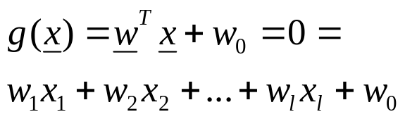
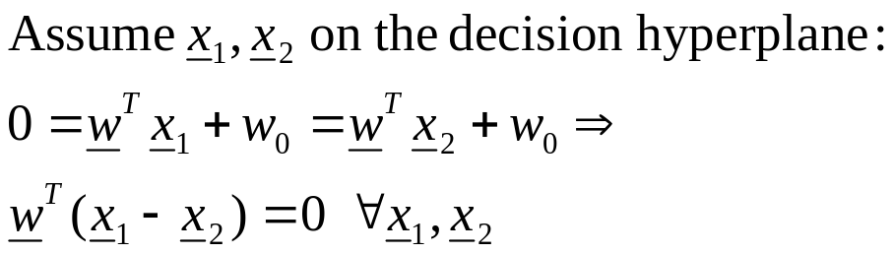
LINEAR CLASSIFIERS
The Problem: Consider a two class task with ω₁, ω₂

Slide 2

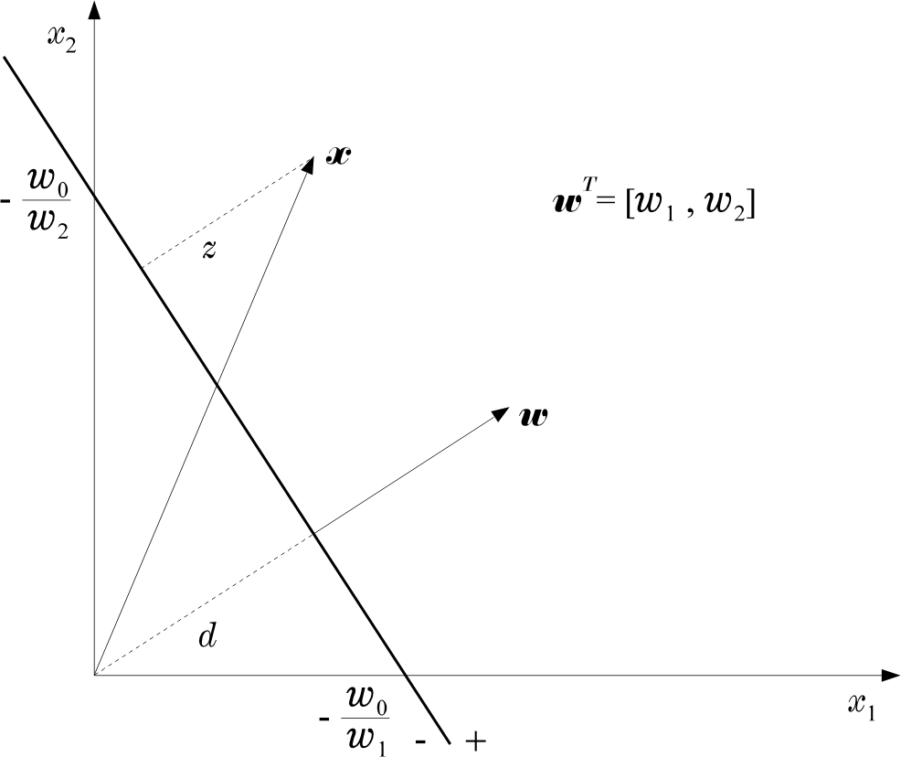
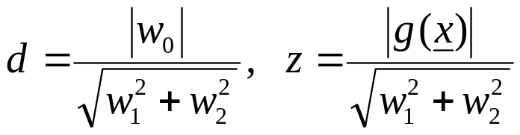
  Hence:

Slide 3
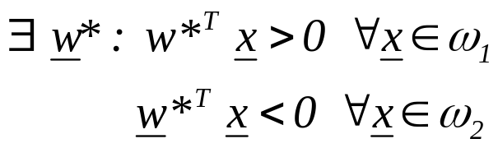
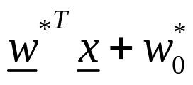
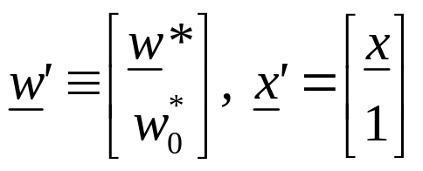
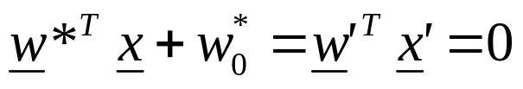
The Perceptron Algorithm
  Assume linearly separable classes, i.e.,
  The case
  falls under the above formulation, since

Slide 4
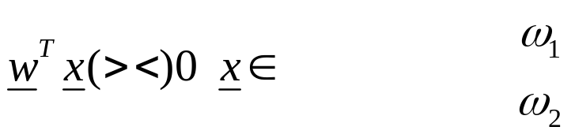
  Our goal: Compute a solution, i.e., a hyperplane w,
  so that
    The steps
      Define a cost function to be minimized
      Choose an algorithm to minimize the cost function
      The minimum corresponds to a solution

Slide 5
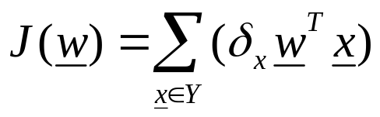
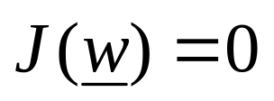
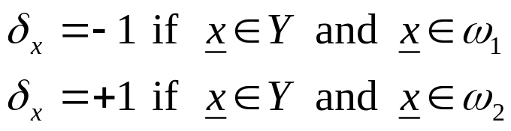
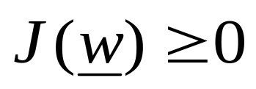
  The Cost Function
    Where Y is the subset of the vectors wrongly classified by w. When Y=(empty set) a solution is achieved and

Slide 6
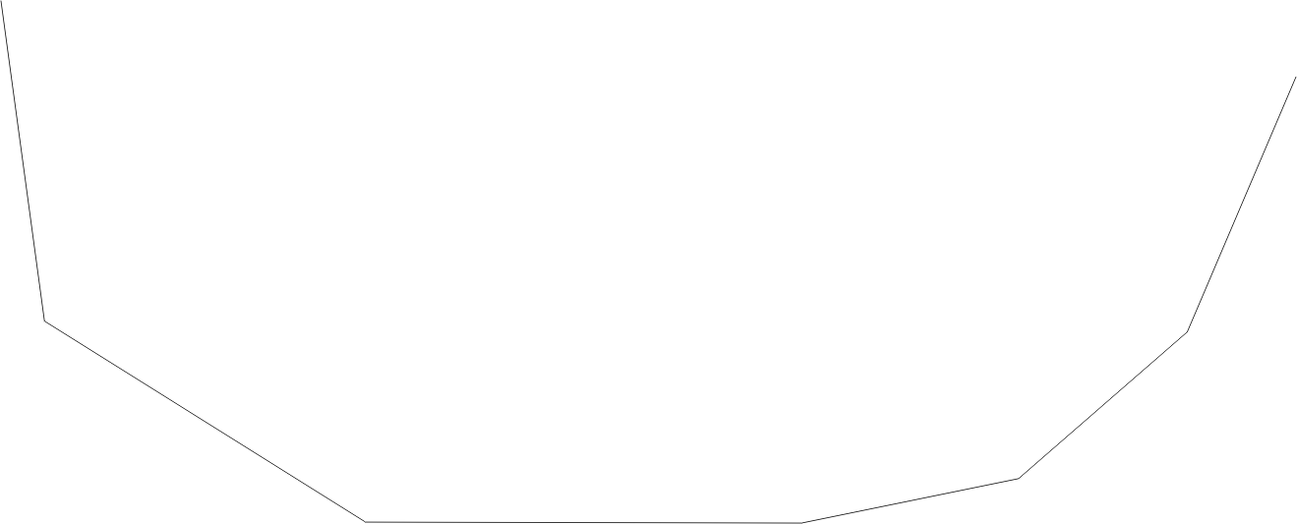
    J(w) is piecewise linear (WHY?)
  The Algorithm
    The philosophy of the gradient descent is adopted.

Slide 7
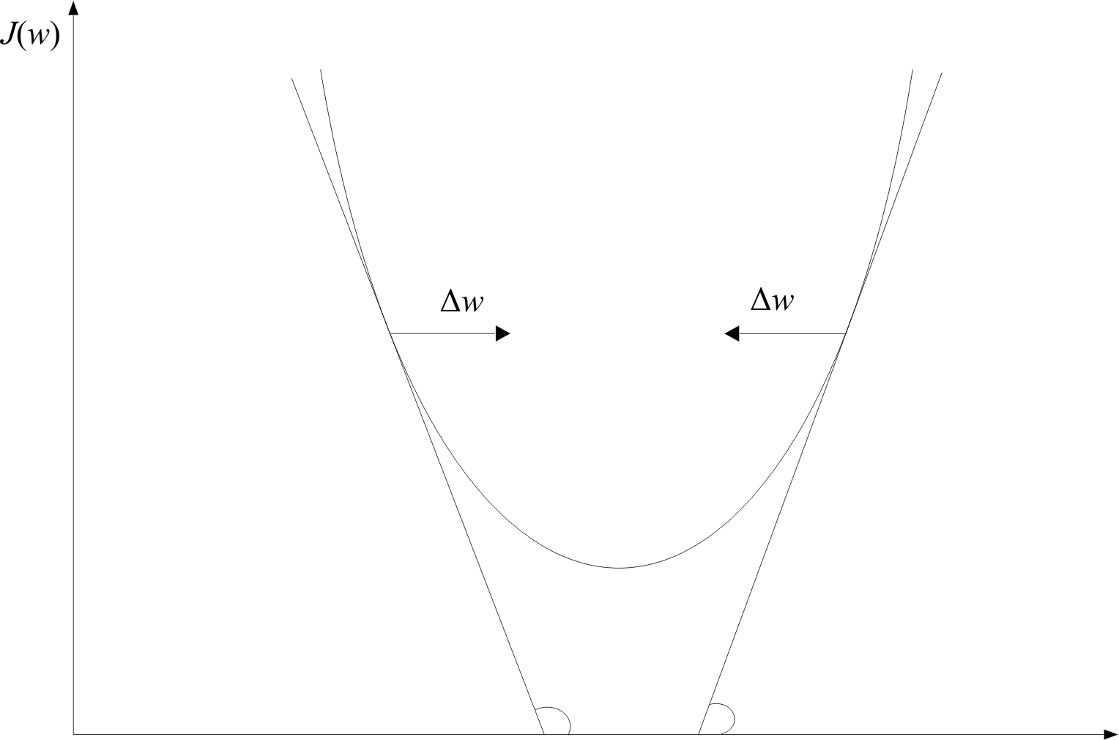
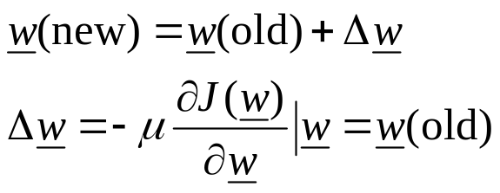
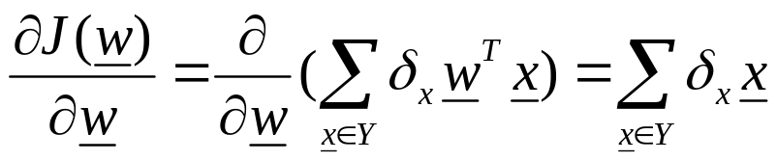
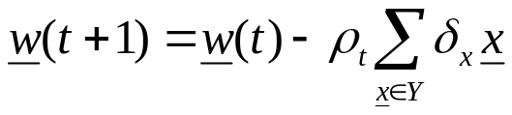
    Wherever valid
    This is the celebrated Perceptron Algorithm
w

Slide 8
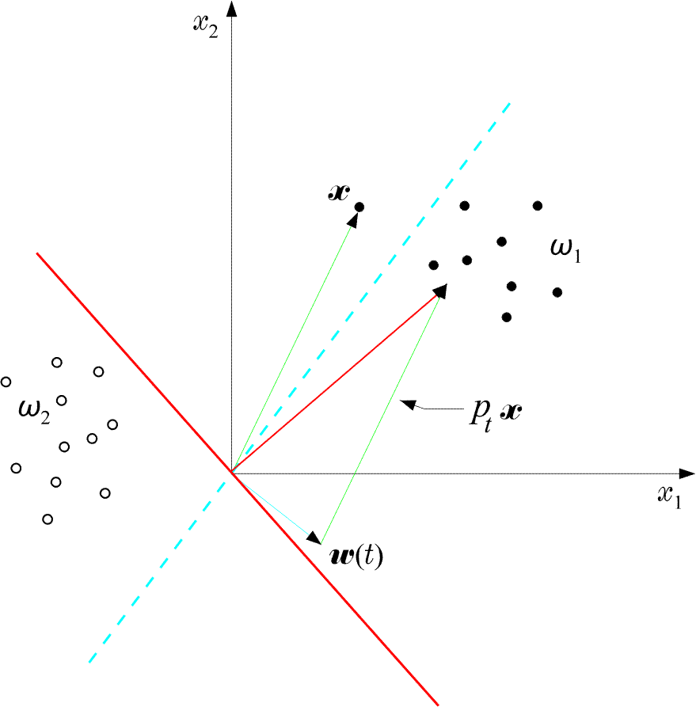
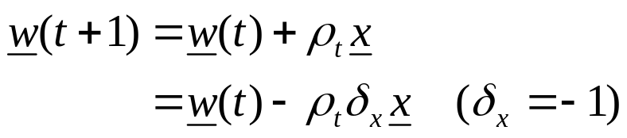
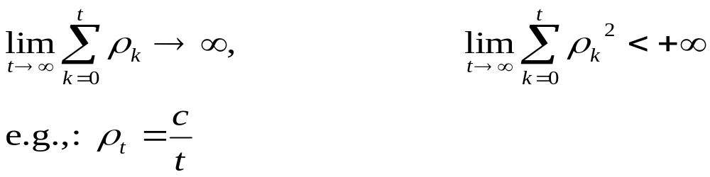
  An example:
  The perceptron algorithm converges in a finite number of iteration steps to a solution if

Slide 9
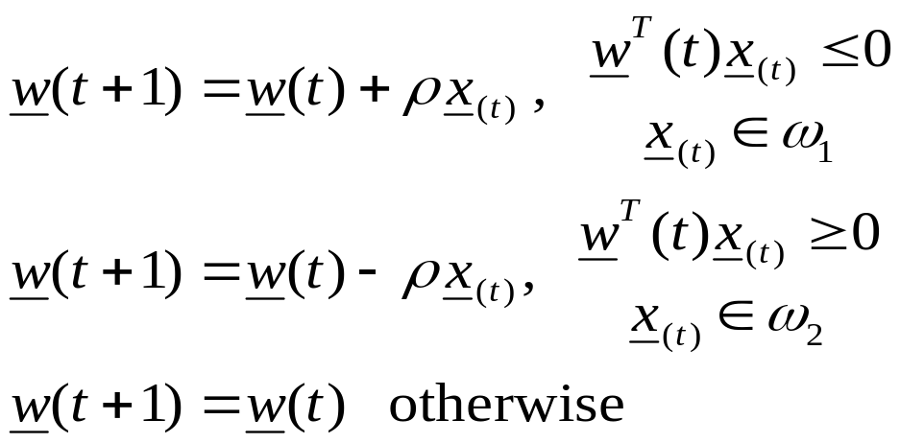
A useful variant of the perceptron algorithm
  It is a reward and punishment type of algorithm

Slide 10
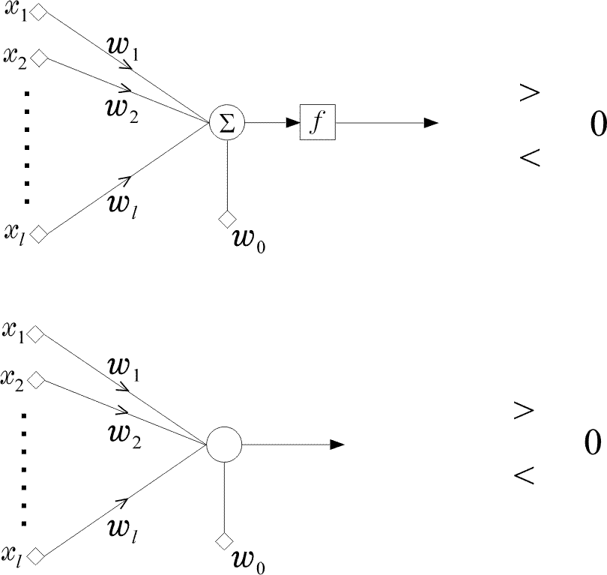
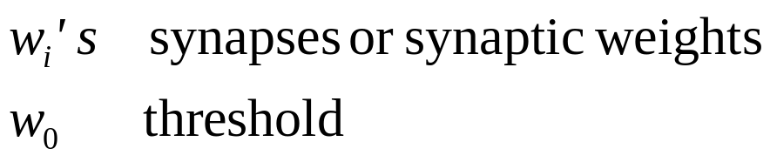
The perceptron
The network is called perceptron or neuron
It is a learning machine that learns from the training vectors via the perceptron algorithm

Slide 11

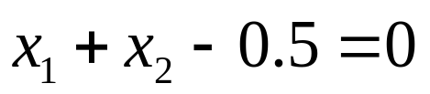
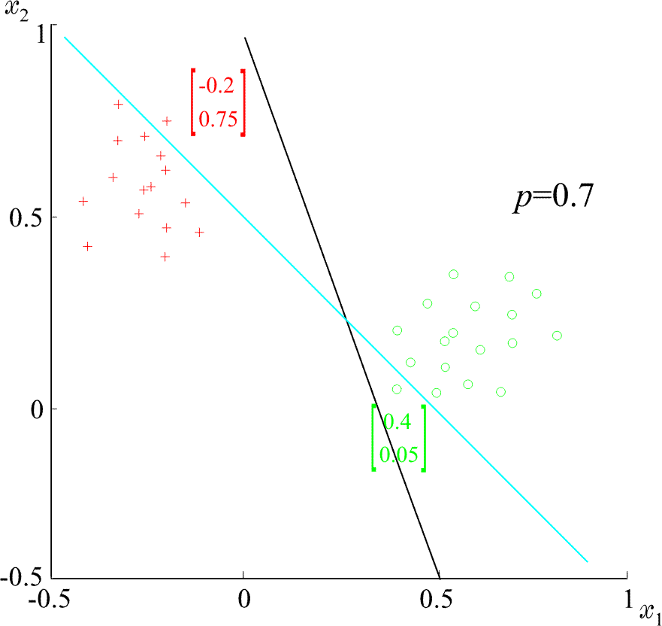
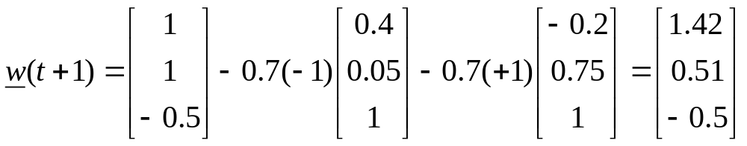
  Example: At some stage t the perceptron algorithm results in
  The corresponding hyperplane is
ρ=0.7

Slide 12

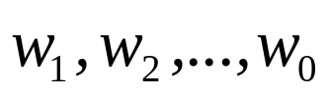

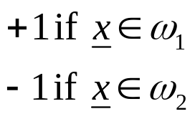
Least Squares Methods
  If classes are linearly separable, the perceptron output results in
  If classes are NOT linearly separable, we shall compute the weights
  so that the difference between
    The actual output of the classifier, , and
    The desired outputs, e.g.
    to be SMALL

Slide 13

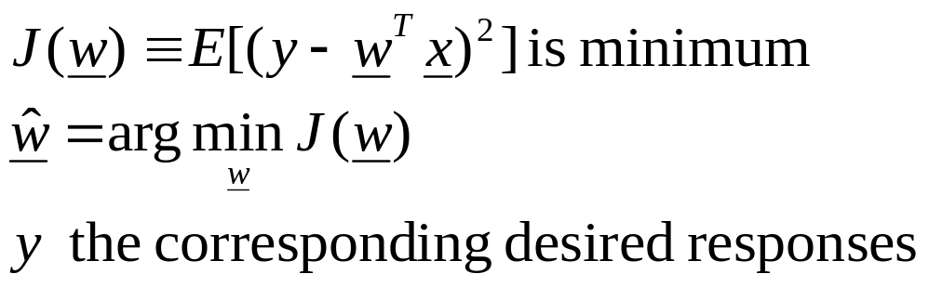
  SMALL, in the mean square error sense, means to choose so that the cost function

Slide 14
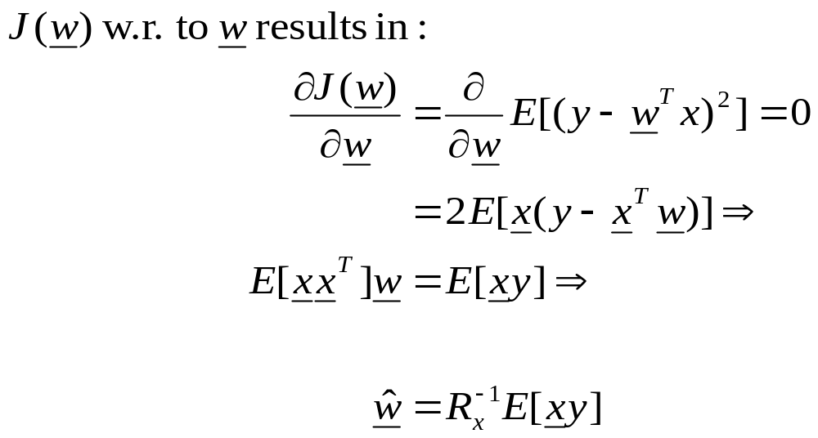
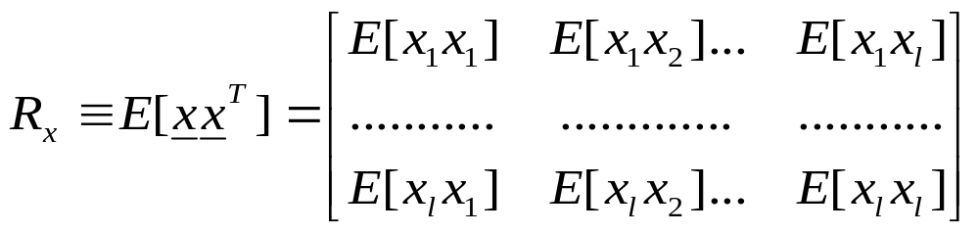
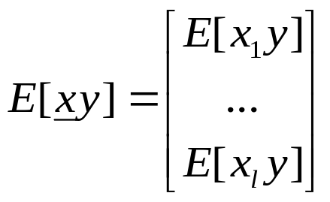
  Minimizing
    where R_{x} is the autocorrelation matrix
    and the crosscorrelation vector

Slide 15
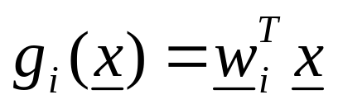
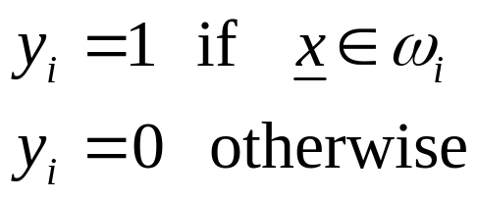
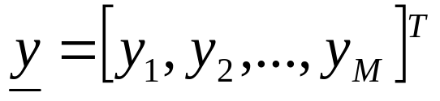
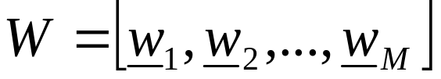
  Multi-class generalization
    The goal is to compute M linear discriminant functions:
    according to the MSE.
    Adopt as desired responses y_{i}:
    Let
    And the matrix

Slide 16

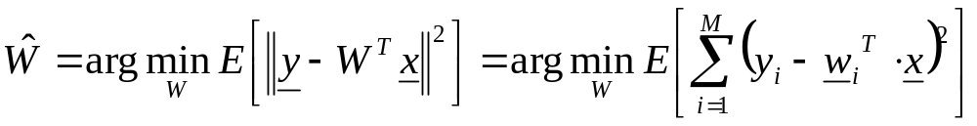





    The goal is to compute :
    The above is equivalent to a number M of MSE minimization problems. That is:
    Design each so that its desired output is 1 for and 0 for any other class.
  Remark: The MSE criterion belongs to a more general class of cost function with the following important property:
    The value of is an estimate, in the MSE sense, of the
    a-posteriori probability , provided that the desired responses used during training are and 0 otherwise.

Slide 17
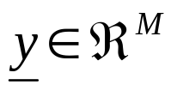

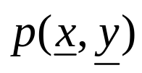







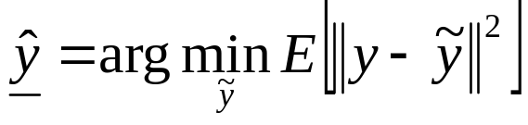
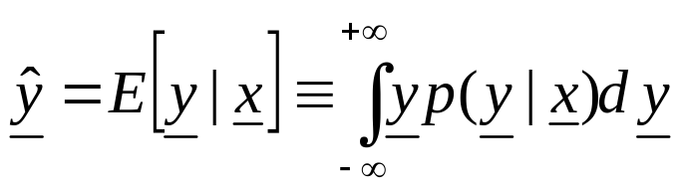



  Mean square error regression: Let , be jointly distributed random vectors with a joint pdf
    The goal: Given the value of estimate the value of . In the pattern recognition framework, given one wants to estimate the respective label .
    The MSE estimate of given is defined as:
    It turns out that:
    The above is known as the regression of given and it is, in general, a non-linear function of . If is Gaussian the MSE regressor is linear.

Slide 18
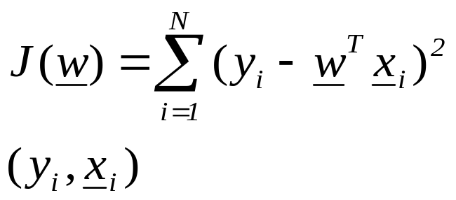

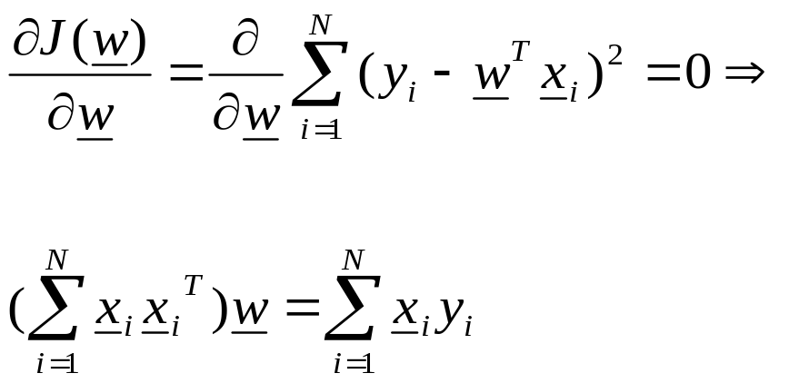
SMALL in the sum of error squares sense means
  that is, the input x_{i} and its
    corresponding class label (±1).
: training pairs

Slide 19
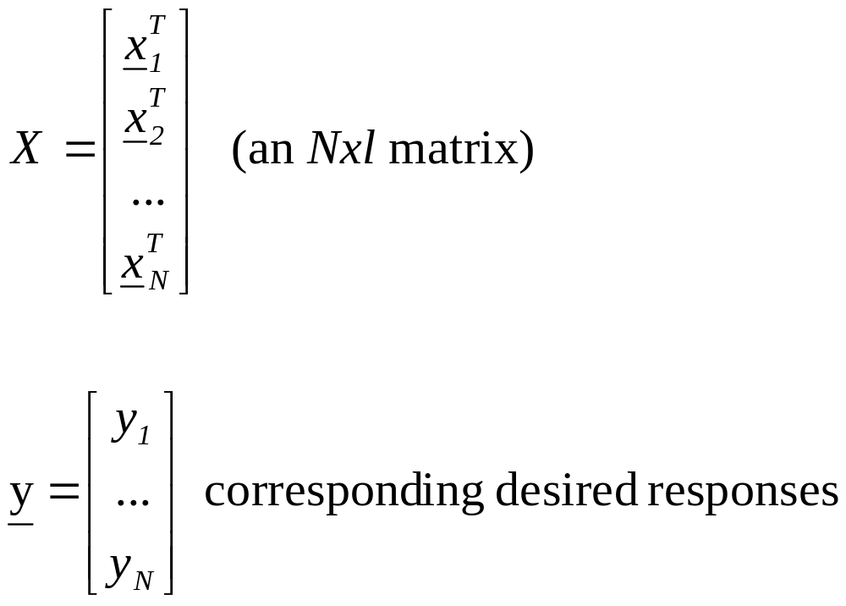
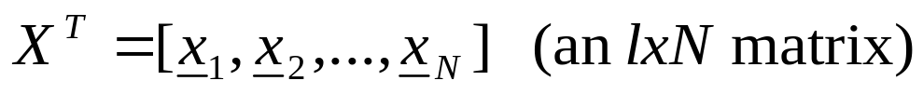
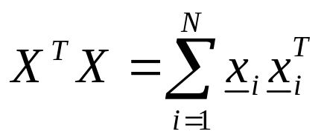
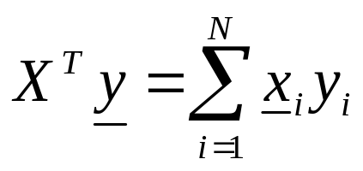
Pseudoinverse Matrix
  Define

Slide 20
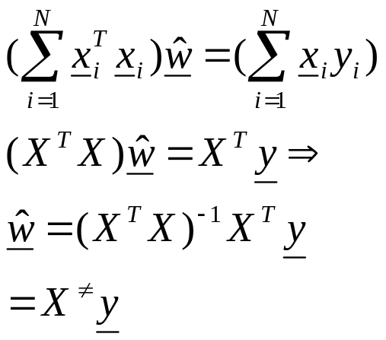


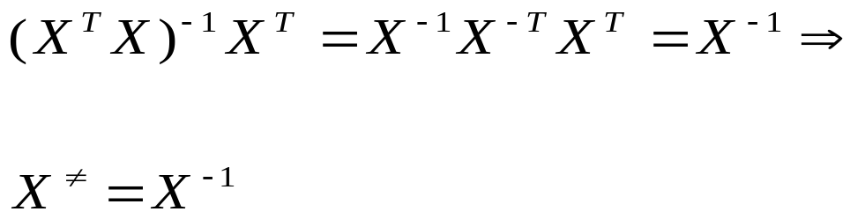
Thus
  Assume N=l X square and invertible. Then
Pseudoinverse of X

Slide 21


  Assume N>l. Then, in general, there is no solution to satisfy all equations simultaneously:
  The “solution” corresponds to the minimum sum of squares solution

Slide 22



  Example:

Slide 23


Slide 24





The Bias – Variance Dilemma
A classifier is a learning machine that tries to predict the class label y of . In practice, a finite data set D is used for its training. Let us write . Observe that:
  For some training sets, , the training may result to good estimates, for some others the result may be worse.
  The average performance of the classifier can be tested against the MSE optimal value, in the mean squares sense, that is:
  where E_{D} is the mean over all possible data sets D.

Slide 25

    The above is written as:
    In the above, the first term is the contribution of the bias and the second term is the contribution of the variance.
    For a finite D, there is a trade-off between the two terms. Increasing bias it reduces variance and vice verse. This is known as the bias-variance dilemma.
    Using a complex model results in low-bias but a high variance, as one changes from one training set to another. Using a simple model results in high bias but low variance.

Slide 26




LOGISTIC DISCRIMINATION
  Let an -class task, . In logistic discrimination, the logarithm of the likelihood ratios are modeled via linear functions, i.e.,
  Taking into account that
  it can be easily shown that the above is equivalent with modeling posterior probabilities as:

Slide 27




  For the two-class case it turns out that

Slide 28

  The unknown parameters are usually estimated by maximum likelihood arguments.
  Logistic discrimination is a useful tool, since it allows linear modeling and at the same time ensures posterior probabilities to add to one.

Slide 29


Support Vector Machines
  The goal: Given two linearly separable classes, design the classifier
  that leaves the maximum margin from both classes

Slide 30

  Margin: Each hyperplane is characterized by
    Its direction in space, i.e.,
    Its position in space, i.e.,
    For EACH direction, , choose the hyperplane that leaves the SAME distance from the nearest points from each class. The margin is twice this distance.

Slide 31





  The distance of a point from a hyperplane
  is given by
  Scale, so that at the nearest points from each class the discriminant function is ±1:
  Thus the margin is given by
  Also, the following is valid

Slide 32






  SVM (linear) classifier
  Minimize
  Subject to
  The above is justified since by minimizing
  the margin is maximised

Slide 33






  The above is a quadratic optimization task, subject to a set of linear inequality constraints. The Karush-Kuhh-Tucker conditions state that the minimizer satisfies:
    (1)
    (2)
    (3)
    (4)
    Where is the Lagrangian

Slide 34


  The solution: from the above, it turns out that

Slide 35




  Remarks:
    The Lagrange multipliers can be either zero or positive. Thus,
      where , corresponding to positive Lagrange multipliers
      From constraint (4) above, i.e.,
      the vectors contributing to
satisfy

Slide 36

      These vectors are known as SUPPORT VECTORS and are the closest vectors, from each class, to the classifier.
      Once is computed, is determined from conditions (4).
      The optimal hyperplane classifier of a support vector machine is UNIQUE.
      Although the solution is unique, the resulting Lagrange multipliers are not unique.

Slide 37


  Dual Problem Formulation
    The SVM formulation is a convex programming problem, with
      Convex cost function
      Convex region of feasible solutions
    Thus, its solution can be achieved by its dual problem, i.e.,
      maximize
      subject to
λ

Slide 38


    Combine the above to obtain
      maximize
      subject to
      λ

Slide 39

  Remarks:
    Support vectors enter via inner products
  Non-Separable classes

Slide 40


  In this case, there is no hyperplane such that
    Recall that the margin is defined as twice the distance between the following two hyperplanes

Slide 41



  The training vectors belong to one of three possible categories
    1) Vectors outside the band which are correctly
    classified, i.e.,
    2) Vectors inside the band, and correctly classified,
    i.e.,
    3) Vectors misclassified, i.e.,

Slide 42



  All three cases above can be represented as
    1)
    2)
    3)
    are known as slack variables

Slide 43




  The goal of the optimization is now two-fold
    Maximize margin
    Minimize the number of patterns with ,
    One way to achieve this goal is via the cost
  where C is a constant and
    I(.) is not differentiable. In practice, we use an approximation
    Following a similar procedure as before we obtain

Slide 44

  KKT conditions

Slide 45



  The associated dual problem
  Maximize
  subject to
  Remarks: The only difference with the separable
  class case is the existence of in the constraints

Slide 46
  Training the SVM
  A major problem is the high computational cost. To this end, decomposition techniques are used. The rationale behind them consists of the following:
    Start with an arbitrary data subset (working set) that can fit in the memory. Perform optimization, via a general purpose optimizer.
    Resulting support vectors remain in the working set, while others are replaced by new ones (outside the set) that violate severely the KKT conditions.
    Repeat the procedure.
    The above procedure guarantees that the cost function decreases.
    Platt’s SMO algorithm chooses a working set of two samples, thus analytic optimization solution can be obtained.

Slide 47

  Multi-class generalization
  Although theoretical generalizations exist, the most popular in practice is to look at the problem as M two-class problems (one against all).
  Example:
  Observe the effect of different values of C in the case of non-separable classes.

