Slide 1

FEATURE SELECTION
The goals:
  Select the “optimum” number l of features
  Select the “best” l features
Large l has a three-fold disadvantage:
  High computational demands
  Low generalization performance
  Poor error estimates

Slide 2

  Given N
    l must be large enough to learn
      what makes classes different
      what makes patterns in the same class similar
    l must be small enough not to learn what makes patterns of the same class different
    In practice, has been reported to be a sensible choice for a number of cases
  Once l has been decided, choose the l most informative features
    Best: Large between class distance,
    Small within class variance

Slide 3
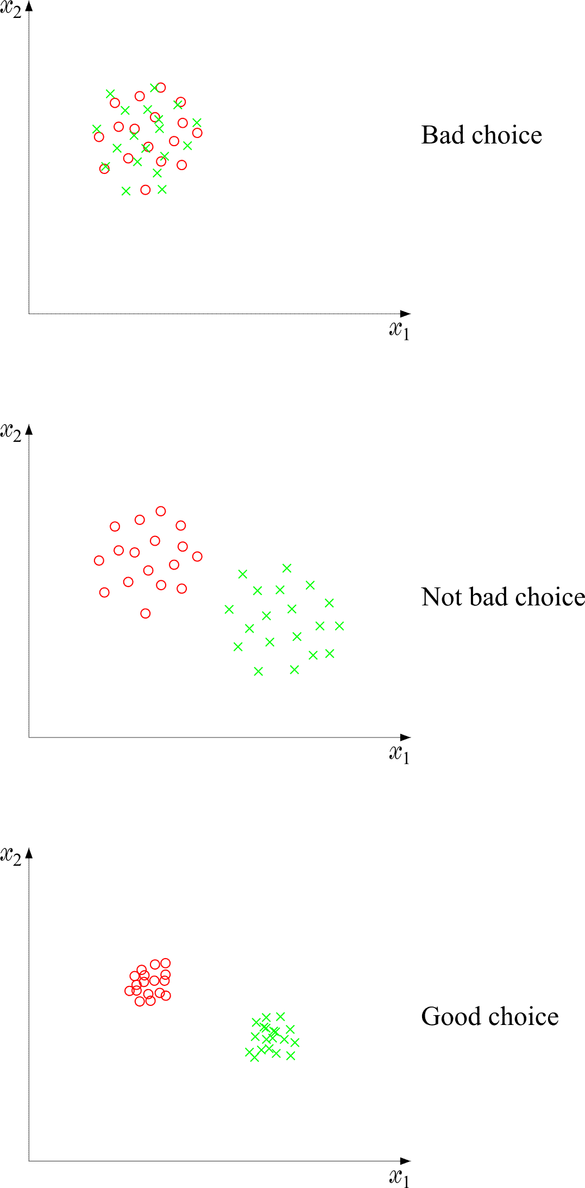

Slide 4
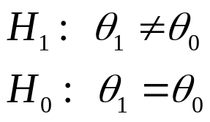
The basic philosophy
  Discard individual features with poor information content
  The remaining information rich features are examined jointly as vectors
Feature Selection based on statistical Hypothesis Testing
  The Goal: For each individual feature, find whether the values, which the feature takes for the different classes, differ significantly.
  That is, answer
    : The values differ significantly
    : The values do not differ significantly
  If they do not differ significantly reject feature from subsequent stages.
Hypothesis Testing Basics

Slide 5


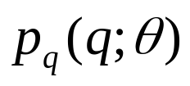

  The steps:
    N measurements
    are known
    Define a function of them
    test statistic
    so that is easily parameterized in terms of θ.
    Let D be an interval, where q has a high probability to lie under H₀, i.e., p_{q}(q׀θ₀)
    Let D be the complement of D
    D Acceptance Interval
    D Critical Interval
    If q, resulting from
    lies in D we accept H₀, otherwise we reject it.

Slide 6
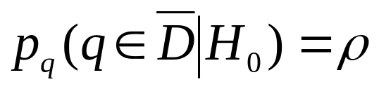
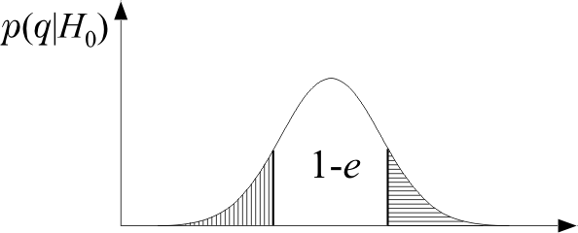
  Probability of an error
    ρ is preselected and it is known as the significance level.
1-ρ

Slide 7

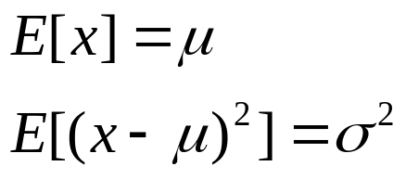
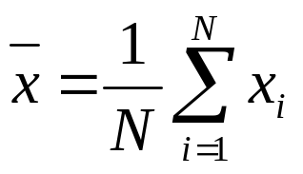
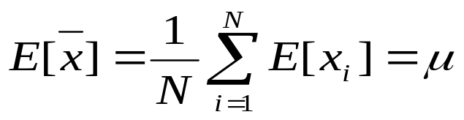
Application: The known variance case:
  Let x be a random variable and the experimental samples, , are assumed mutually independent. Also let
  Compute the sample mean
  This is also a random variable with mean value
  That is, it is an Unbiased Estimator

Slide 8

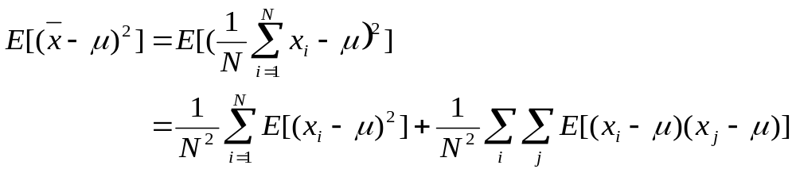
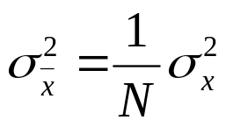
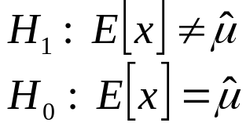
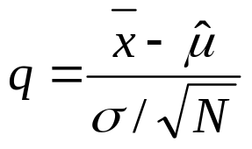
  The variance
  Due to independence
  That is, it is Asymptotically Efficient
  Hypothesis test
  Test Statistic: Define the variable

Slide 9
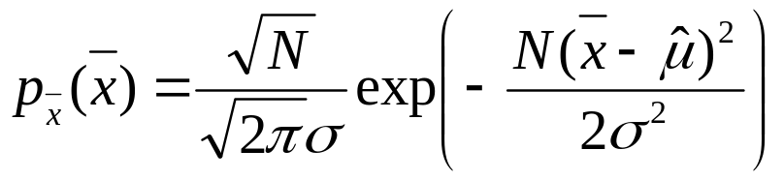
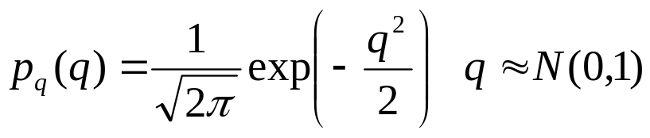
  Central limit theorem under H₀
  Thus, under H₀

Slide 10
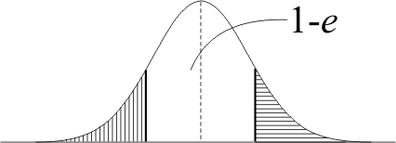
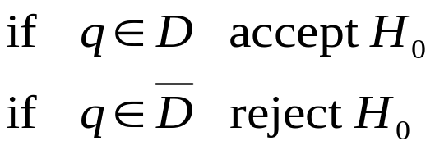

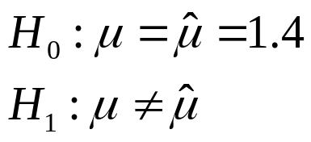
  The decision steps
    Compute q from x_{i}, i=1,2,…,N
    Choose significance level ρ
    Compute from N(0,1) tables D=[-x_{ρ}, x_{ρ}]
  An example: A random variable x has variance σ²=(0.23)². Ν=16 measurements are obtained giving
  . The significance level is ρ=0.05.
  Test the hypothesis
1-ρ

Slide 11
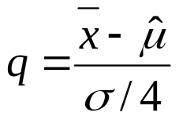
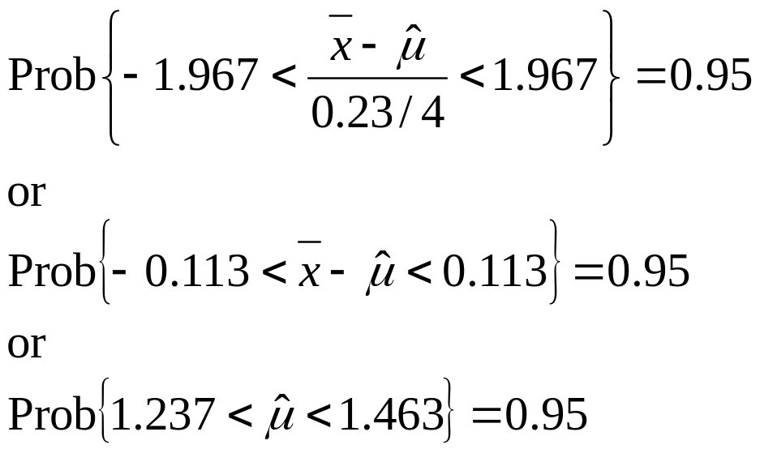
  Since σ² is known, is N(0,1).
  From tables, we obtain the values with acceptance intervals [-x_{ρ}, x_{ρ}] for normal N(0,1)
  Thus
1-ρ | 0.8 | 0.85 | 0.9 | 0.95 | 0.98 | 0.99 | 0.998 | 0.999
x_{ρ} | 1.28 | 1.44 | 1.64 | 1.96 | 2.32 | 2.57 | 3.09 | 3.29

Slide 12



  Since lies within the above acceptance interval, we accept H₀, i.e.,
  The interval [1.237, 1.463] is also known as confidence interval at the 1-ρ=0.95 level.
  We say that: There is no evidence at the 5% level that the mean value is not equal to

Slide 13
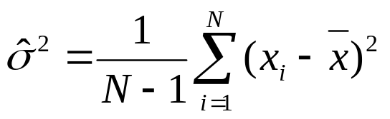

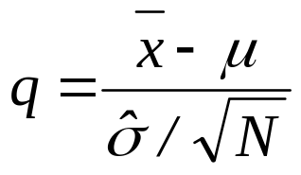
The Unknown Variance Case
  Estimate the variance. The estimate
  is unbiased, i.e.,
  Define the test statistic

Slide 14
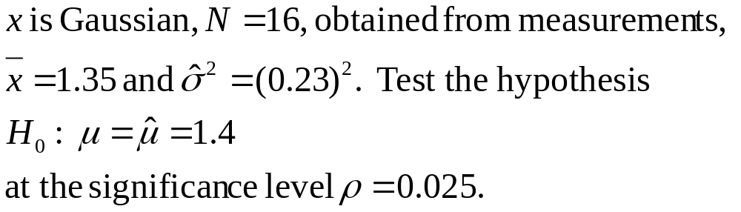
  This is no longer Gaussian. If x is Gaussian, then
  q follows a t-distribution, with N-1 degrees of freedom
  An example:

Slide 15
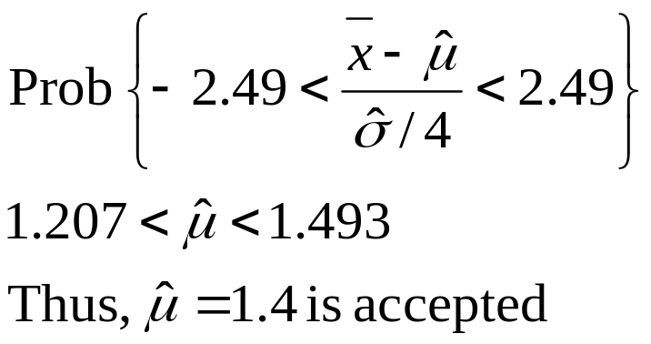

  Table of acceptance intervals for t-distribution
Degrees of Freedom | 1-ρ | 0.9 | 0.95 | 0.975 | 0.99
12 |  | 1.78 | 2.18 | 2.56 | 3.05
13 |  | 1.77 | 2.16 | 2.53 | 3.01
14 |  | 1.76 | 2.15 | 2.51 | 2.98
15 |  | 1.75 | 2.13 | 2.49 | 2.95
16 |  | 1.75 | 2.12 | 2.47 | 2.92
17 |  | 1.74 | 2.11 | 2.46 | 2.90
18 |  | 1.73 | 2.10 | 2.44 | 2.88

Slide 16

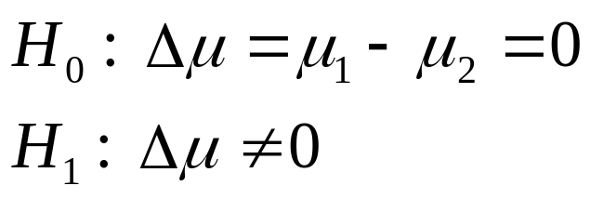
Application in Feature Selection
  The goal here is to test against zero the difference μ₁-μ₂ of the respective means in
  ω₁, ω₂ of a single feature.
  Let x_{i} i=1,…,N , the values of a feature in ω₁
  Let y_{i} i=1,…,N , the values of the same feature in ω₂
  Assume in both classes
  (unknown or not)
  The test becomes

Slide 17
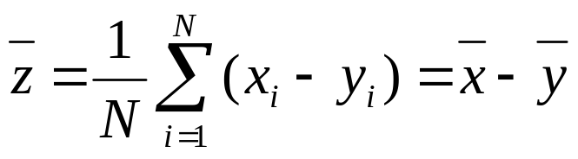
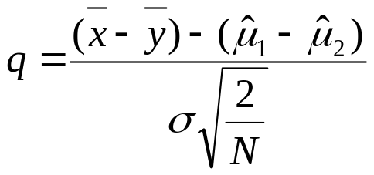
  Define
  z=x-y
  Obviously
  E[z]=μ₁-μ₂
  Define the average
  Known Variance Case: Define
  This is N(0,1) and one follows the procedure as before.

Slide 18
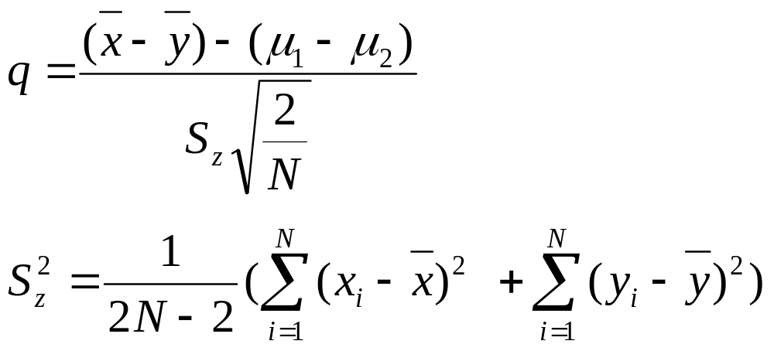
  Unknown Variance Case:
  Define the test statistic
    q is t-distribution with 2N-2 degrees of freedom,
    Then apply appropriate tables as before.
  Example: The values of a feature in two classes are:
  ω₁: 3.5, 3.7, 3.9, 4.1, 3.4, 3.5, 4.1, 3.8, 3.6, 3.7
  ω₂: 3.2, 3.6, 3.1, 3.4, 3.0, 3.4, 2.8, 3.1, 3.3, 3.6
  Test if the mean values in the two classes differ significantly, at the significance level ρ=0.05

Slide 19
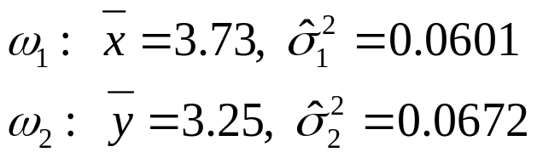
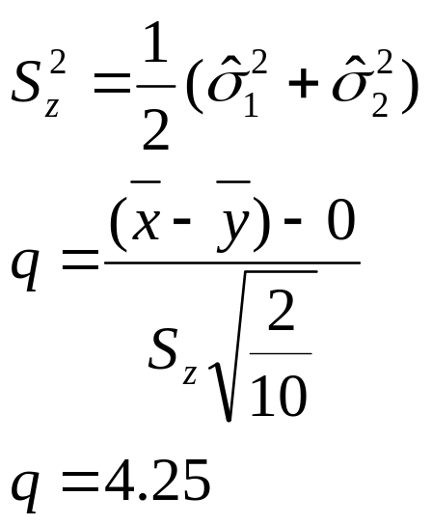
  We have
  For N=10
  From the table of the t-distribution with 2N-2=18 degrees of freedom and ρ=0.05, we obtain D=[-2.10,2.10] and since q=4.25 is outside D, H₁ is accepted and the feature is selected.

Slide 20

Class Separability Measures
The emphasis so far was on individually considered features. However, such an approach cannot take into account existing correlations among the features. That is, two features may be rich in information, but if they are highly correlated we need not consider both of them. To this end, in order to search for possible correlations, we consider features jointly as elements of vectors. To this end:
  Discard poor in information features, by means of a statistical test.
  Choose the maximum number, , of features to be used. This is dictated by the specific problem (e.g., the number, N, of available training patterns and the type of the classifier to be adopted).

Slide 21
  Combine remaining features to search for the “best” combination. To this end:
    Use different feature combinations to form the feature vector. Train the classifier, and choose the combination resulting in the best classifier performance.
    A major disadvantage of this approach is the high complexity. Also, local minima, may give misleading results.
    Adopt a class separability measure and choose the best feature combination against this cost.

Slide 22

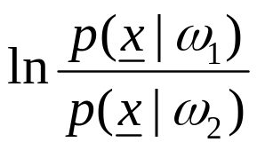
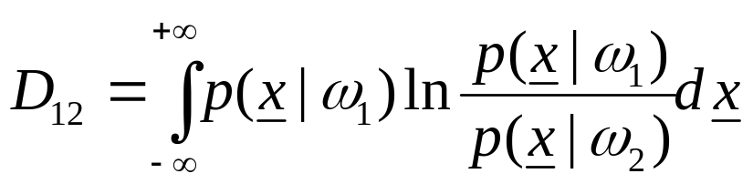
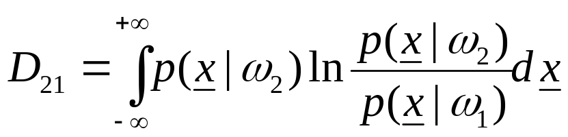

  Class separability measures: Let be the current feature combination vector.
    Divergence. To see the rationale behind this cost, consider the two – class case. Obviously, if on the average the
    value of is close to zero, then should be a
    poor feature combination. Define:
      d₁₂ is known as the divergence and can be used as a class separability measure.

Slide 23
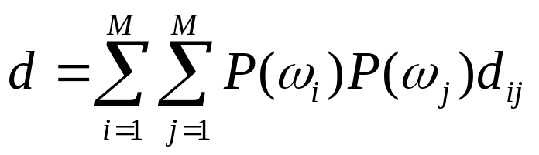
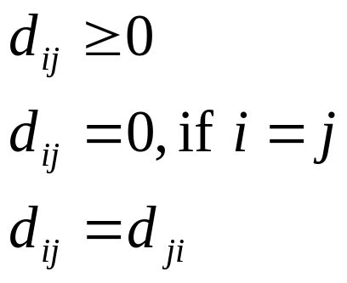
      For the multi-class case, define d_{ij} for every pair of classes ω_{i}, ω_{j} and the average divergence is defined as
      Some properties:
      Large values of d are indicative of good feature combination.

Slide 24
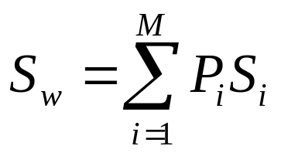
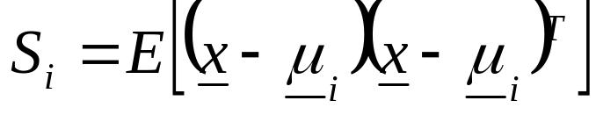
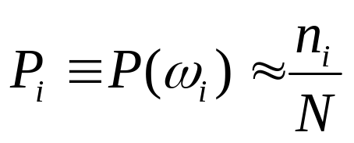
  Scatter Matrices. These are used as a measure of the way data are scattered in the respective feature space.
    Within-class scatter matrix
    where
    and
    n_{i} the number of training samples in ω_{i}.
    Trace {S_{w}} is a measure of the average variance of the features.

Slide 25
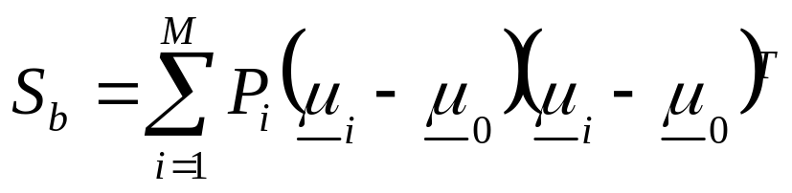
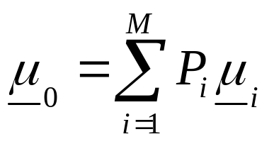
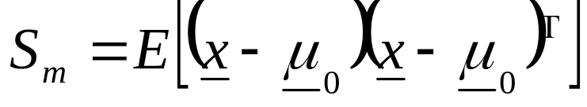
    Between-class scatter matrix
    Trace {S_{b}} is a measure of the average distance of the mean of each class from the respective global one.
    Mixture scatter matrix
    It turns out that:
    S_{m} = S_{w} + S_{b}

Slide 26
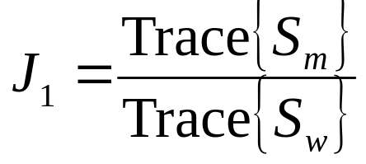
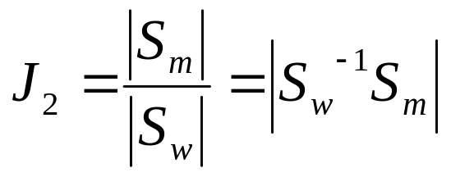
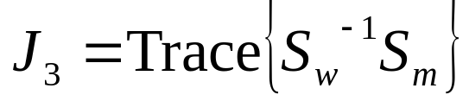
  Measures based on Scatter Matrices.
    Other criteria are also possible, by using various combinations of S_{m}, S_{b}, S_{w}.
  The above J₁, J₂, J₃ criteria take high values for the cases where:
    Data are clustered together within each class.
    The means of the various classes are far.

Slide 27
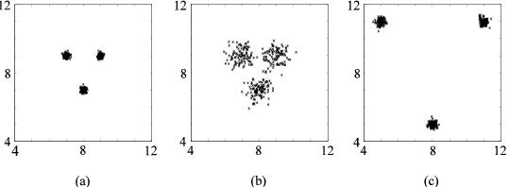

Slide 28
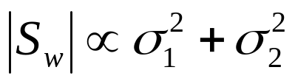
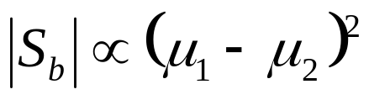
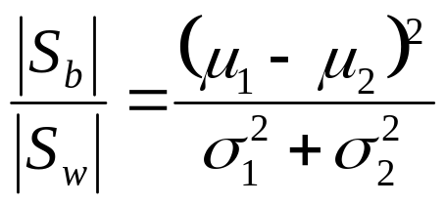
    Fisher’s discriminant ratio. In one dimension and for two equiprobable classes the determinants become:
    and
    known as Fischer’s ratio.

Slide 29
Ways to combine features:
Trying to form all possible combinations of features from an original set of m selected features is a computationally hard task. Thus, a number of suboptimal searching techniques have been derived.
  Sequential forward selection. Let x₁, x₂, x₃, x₄ the available features (m=4). The procedure consists of the following steps:
    Adopt a class separability criterion (could also be the error rate of the respective classifier). Compute its value for ALL features considered jointly [x₁, x₂, x₃, x₄]^{T}.
    Eliminate one feature and for each of the possible resulting combinations, that is [x₁, x₂, x₃]^{T}, [x₁, x₂, x₄]^{T}, [x₁, x₃, x₄]^{T}, [x₂, x₃, x₄]^{T}, compute the class reparability criterion value C. Select the best combination, say [x₁, x₂, x₃]^{T}.

Slide 30
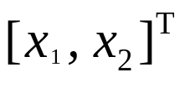
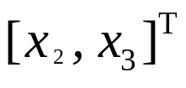
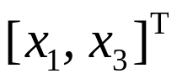




    From the above selected feature vector eliminate one feature and for each of the resulting combinations, , , compute and select the best combination.
  The above selection procedure shows how one can start from features and end up with the “best” ones. Obviously, the choice is suboptimal. The number of required calculations is:
  In contrast, a full search requires:
  operations.

Slide 31

  Sequential backward selection. Here the reverse procedure is followed.
    Compute C for each feature. Select the “best” one, say x₁
    For all possible 2D combinations of x₁, i.e., [x₁, x₂], [x₁, x₃], [x₁, x₄] compute C and choose the best, say [x₁, x₃].
    For all possible 3D combinations of [x₁, x₃], e.g., [x₁, x₃, x₂], etc., compute C and choose the best one.
  The above procedure is repeated till the “best” vector with
  features has been formed. This is also a suboptimal technique, requiring:
  operations.

Slide 32
  Floating Search Methods
  The above two procedures suffer from the nesting effect. Once a bad choice has been done, there is no way to reconsider it in the following steps.
  In the floating search methods one is given the opportunity in reconsidering a previously discarded feature or to discard a feature that was previously chosen.
  The method is still suboptimal, however it leads to improved performance, at the expense of complexity.

Slide 33
  Remarks:
    Besides suboptimal techniques, some optimal searching techniques can also be used, provided that the optimizing cost has certain properties, e.g., monotonic.
    Instead of using a class separability measure (filter techniques) or using directly the classifier (wrapper techniques), one can modify the cost function of the classifier appropriately, so that to perform feature selection and classifier design in a single step (embedded) method.
    For the choice of the separability measure a multiplicity of costs have been proposed, including information theoretic costs.

Slide 34


Hints from Generalization Theory.
Generalization theory aims at providing general bounds that relate the error performance of a classifier with the number of training points, N, on one hand, and some classifier dependent parameters, on the other. Up to now, the classifier dependent parameters that we considered were the number of its free parameters and the dimensionality, , of the subspace, in which the classifier operates. ( also affects the number of free parameters).
  Definitions
    Let the classifier be a binary one, i.e.,
    Let F be the set of all functions f that can be realized by the adopted classifier (e.g., changing the synapses of a given neural network different functions are implemented).

Slide 35

    The shatter coefficient S(F,N) of the class F is defined as:
    the maximum number of dichotomies of N points that can be formed by the functions in F.
    The maximum possible number of dichotomies is 2^{N}. However, NOT ALL dichotomies can be realized by the set of functions in F.
    The Vapnik – Chernovenkis (VC) dimension of a class F is the largest integer k for which S(F,k) = 2^{k}. If S(F,N)=2^{N},
    we say that the VC dimension is infinite.
      That is, VC is the integer for which the class of functions F can achieve all possible dichotomies, 2^{k}.
      It is easily seen that the VC dimension of the single perceptron class, operating in the ℓ-dimensional space, is ℓ+1.

Slide 36

      It can be shown that
      V_{c}: the VC dimension of the class.
      That is, the shatter coefficient is either 2^{N} (the maximum possible number of dichotomies) or it is upper bounded, as suggested by the above inequality.
      In words, for finite V_{c} and large enough N, the shatter coefficient is bounded by a polynomial growth.
        Note that in order to have a polynomial growth of the shatter coefficient, N must be larger than the V_{c} dimension.
      The V_{c} dimension can be considered as an intrinsic capacity of the classifier, and, as we will soon see, only if the number of training vectors exceeds this number sufficiently, we can expect good generalization performance.

Slide 37









    The dimension may or may not be related to the dimension and the number of free parameters.
      Perceptron:
      Multilayer perceptron with hard limiting activation function
      where is the total number of hidden layer nodes, the total number of nodes, and the total number of weights.
      Let be a training data sample and assume that

Slide 38







      Let also a hyperplane such that
      and
      (i.e., the constraints we met in the SVM formulation). Then
      That is, by controlling the constant c, the of the linear classifier can be less than . In other words, can be controlled independently of the dimension.
      Thus, by minimizing in the SVM, one attempts to keep as small as possible. Moreover, one can achieve finite dimension, even for infinite dimensional spaces. This is an explanation of the potential for good generalization performance of the SVM’s, as this is readily deduced from the following bounds.

Slide 39



  Generalization Performance
    Let be the error rate of classifier f, based on the N training points, also known as empirical error.
    Let be the true error probability of f (also known as generalization error), when f is confronted with data outside the finite training set.
    Let be the minimum error probability that can be attained over ALL functions in the set F.

Slide 40








    Let be the function resulting by minimizing the empirical (over the finite training set) error function.
    It can be shown that:
      Taking into account that for finite dimension, the growth of is only polynomial, the above bounds tell us that for a large N :
        is close to , with high probability.
        is close to , with high probability.

Slide 41







    Some more useful bounds
      The minimum number of points, , that guarantees, with high probability, a good generalization error performance is given by
      That is, for any
      Where, constants. In words, for the performance of the classifier is guaranteed, with high probability, to be close to the optimal classifier in the class F. is known as the sample complexity.

Slide 42



      With a probability of at least the following bound holds:
      where
  Remark: Observe that all the bounds given so far are:
    Dimension free
    Distribution free

Slide 43







Model Complexity vs Performance
This issue has already been touched in the form of overfitting in neural networks modeling and in the form of bias-variance dilemma. A different perspective of the issue is dealt below.
  Structural Risk Minimization (SRM)
    Let be he Bayesian error probability for a given task.
    Let be the true (generalization) error of an optimally design classifier , from class , given a finite training set.
    is the minimum error attainable in
      If the class is small, then the first term is expected to be small and the second term is expected to be large. The opposite is true when the class is large

Slide 44







    Let be a sequence of nested classes:
    with increasing, yet finite dimensions.
    Also, let
    For each N and class of functions F^{(i)}, i=1, 2, …, compute the optimum f*_{N,i}, with respect to the empirical error. Then from all these classifiers choose the one than minimizes, over all i, the upper bound in:
    That is,

Slide 45




    Then, as
      The term
      in the minimized bound is a complexity penalty term. If the classifier model is simple the penalty term is small but the empirical error term
      will be large. The opposite is true for complex models.
    The SRM criterion aims at achieving the best trade-off between performance and complexity.

Slide 46









  Bayesian Information Criterion (BIC)
  Let the size of the training set, the vector of the unknown parameters of the classifier, the dimensionality of , and runs over all possible models.
    The BIC criterion chooses the model by minimizing:
      is the log-likelihood computed at the ML estimate , and it is the performance index.
      is the model complexity term.
    Akaike Information Criterion:

