Slide 1

TEMPLATE MATCHING
The Goal: Given a set of reference patterns known as TEMPLATES, find to which one an unknown pattern matches best. That is, each class is represented by a single typical pattern.
The crucial point is to adopt an appropriate “measure” to quantify similarity or matching.
These measures must accommodate, in an efficient way, deviations between the template and the test pattern. For example the word beauty may have been read a beeauty or beuty, etc., due to errors.

Slide 2


Typical Applications
  Speech Recognition
  Motion Estimation in Video Coding
  Data Base Image Retrieval
  Written Word Recognition
  Bioinformatis
Measures based on optimal path searching techniques
  Representation: Represent the template by a sequence of measurement vectors
  Template:
  Test pattern:

Slide 3

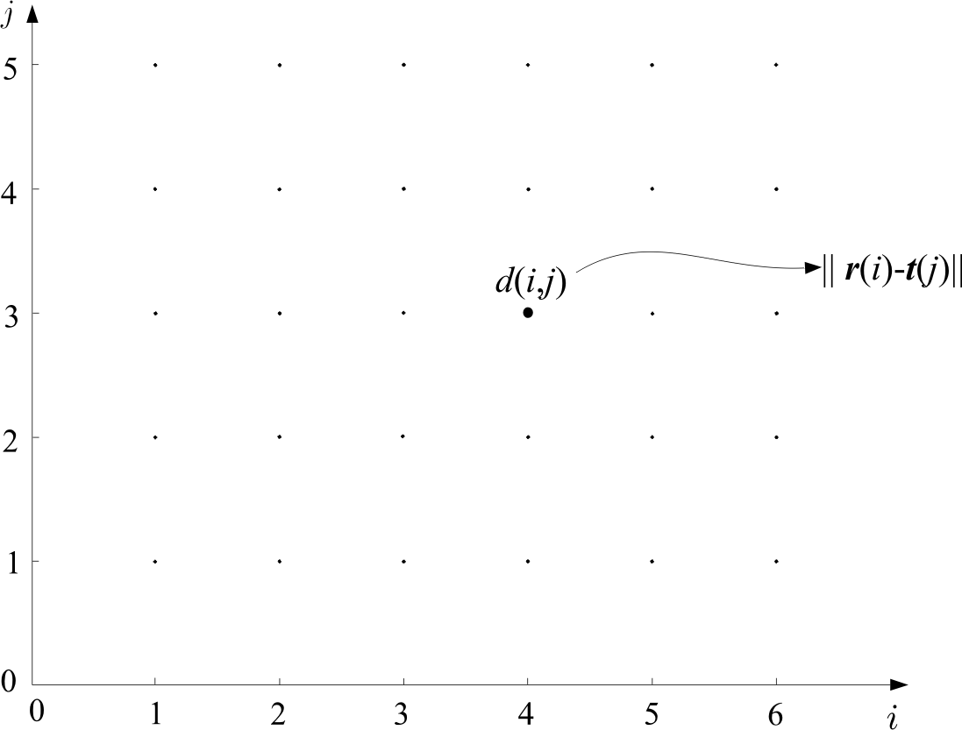
  In general
  Form a grid with I points (template) in horizontal and J points (test) in vertical
  Each point (i,j) of the grid measures the distance between r(i) and t(j)

Slide 4
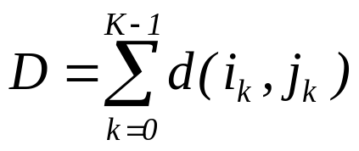
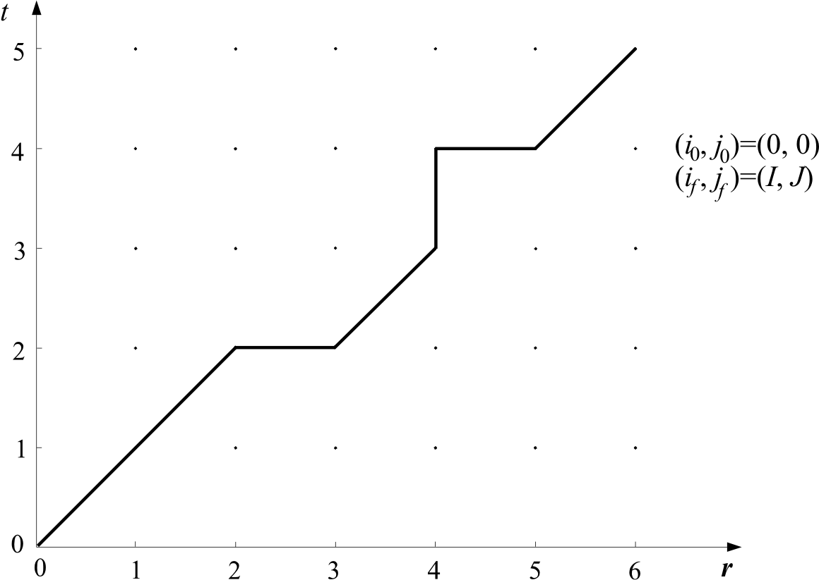
  Path: A path through the grid, from an initial node
  (i₀, j₀) to a final one (i_{f}, j_{f}), is an ordered set of nodes
  (i₀, j₀), (i₁, j₁), (i₂, j₂) … (i_{k}, j_{k}) … (i_{f}, j_{f})
  Each path is associated with a cost
  where K is the number of nodes across the path

Slide 5


  Search for the path with the optimal cost D_{opt.}
  The matching cost between template and test pattern is D_{opt.}

Slide 6
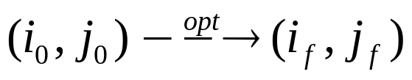
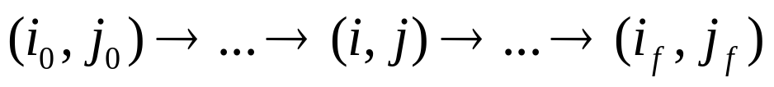
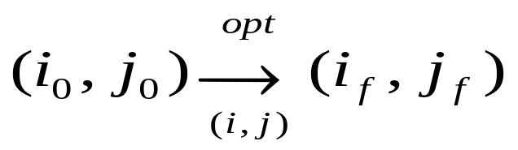
BELLMAN’S OPTIMALITLY PRINCIPLE
Optimum path:
Let (i,j) be an intermediate node, i.e.
Then write the optimal path through (i, j)

Slide 7
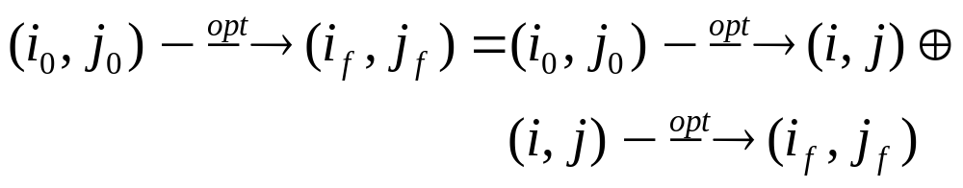
Bellman’s Principle:
In words: The overall optimal path from (i₀,j₀) to (i_{f},j_{f}) through (i,j) is the concatenation of the optimal paths from (i₀,j₀) to (i,j) and from (i,j) to (i_{f},j_{f})
Let D_{opt.} (i,j) is the optimal path to reach (i,j) from (i₀,j₀), then Bellman’s principle is stated as:

Slide 8
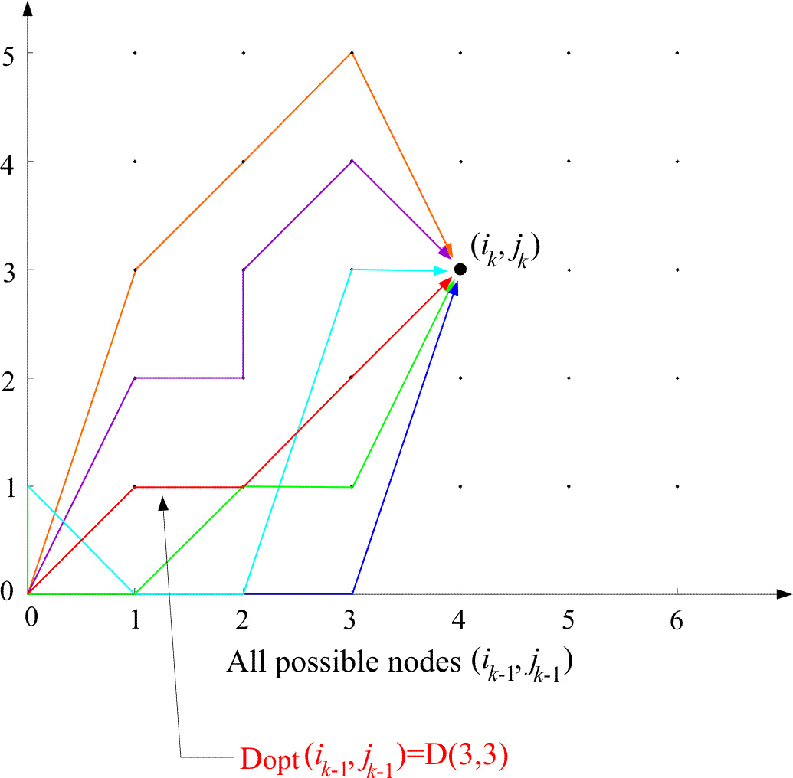

Slide 9
The Edit distance
  It is used for matching written words. Applications:
    Automatic Editing
    Text Retrieval
  The measure to be adopted for matching, must take into account:
    Wrongly identified symbols
    e.g. “befuty” instead of “beauty”
    Insertion errors, e.g. “bearuty”
    Deletion errors, e.g. “beuty”

Slide 10
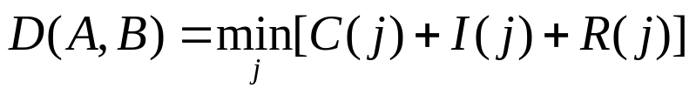
The cost is based on the philosophy behind the so-called variational similarity, i.e.,
  Measure the cost associated with converting one pattern to the other
Edit distance: Minimal total number of changes, C, insertions I and deletions R, required to change pattern A into pattern B,
where j runs over All possible variations of symbols, in order to convert A B

Slide 11

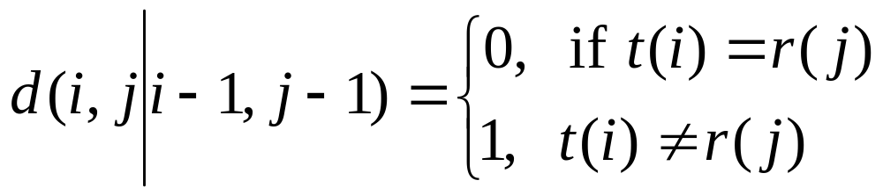
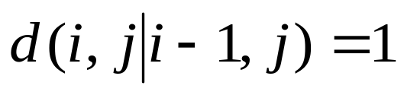
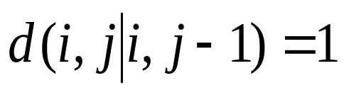
Allowable predecessors and costs
  Horizontal
  Vertical

Slide 12
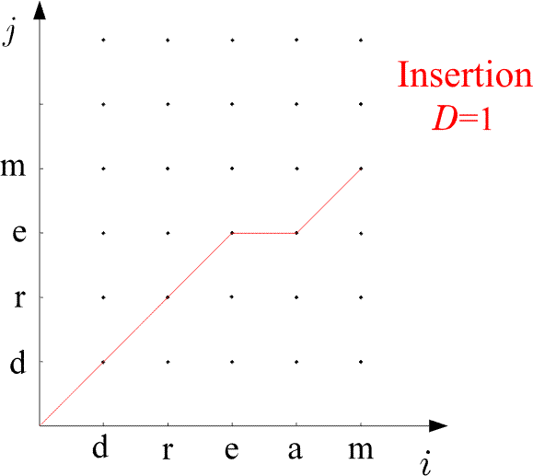
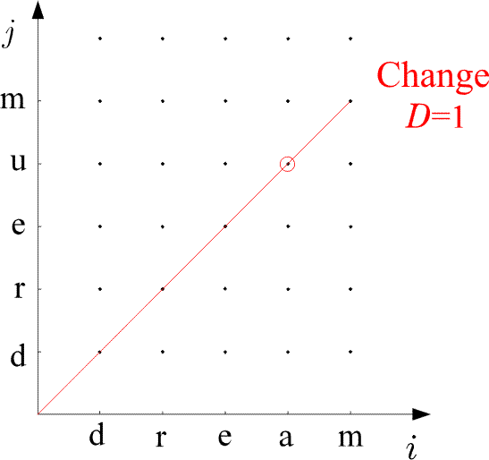
Examples:

Slide 13
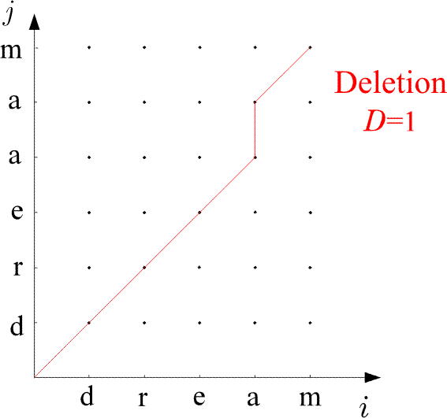
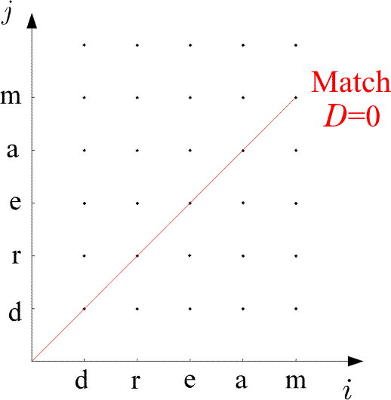
Examples:

Slide 14
The Algorithm
  D(0,0)=0
  For i=1, to I
    D(i,0)=D(i-1,0)+1
  END {FOR}
  For j=1 to J
    D(0,j)=D(0,j-1)+1
  END{FOR}
  For i=1 to I
    For j=1, to J
      C₁=D(i-1,j-1)+d(i,j ׀ i-1,j-1)
      C₂=D(i-1,j)+1
      C₃=D(i,j-1)+1
      D(i,j)=min (C₁,C₂,C₃)
    END {FOR}
  END {FOR}
  D(A,B)=D(I,J)

Slide 15


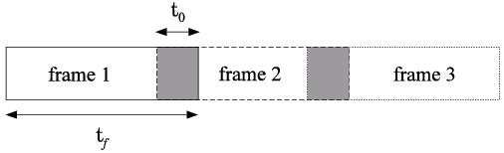
Dynamic Time Warping in Speech Recognition
The isolated word recognition (IWR) will be discussed.
  The goal: Given a segment of speech corresponding to an unknown spoken word (test pattern), identify the word by comparing it against a number of known spoken words in a data base (reference patterns).
  The procedure:
    Express the test and each of the reference patterns as sequences of feature vectors , , .
    To this end, divide each of the speech segments in a number of successive frames.

Slide 16
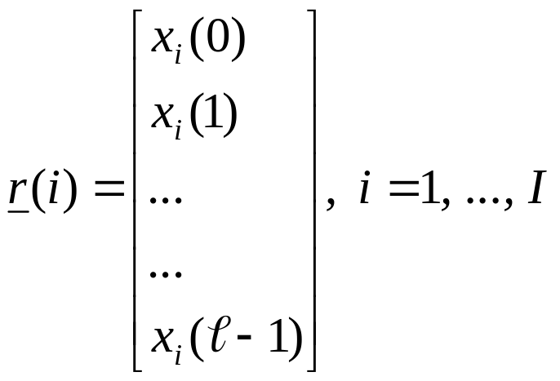
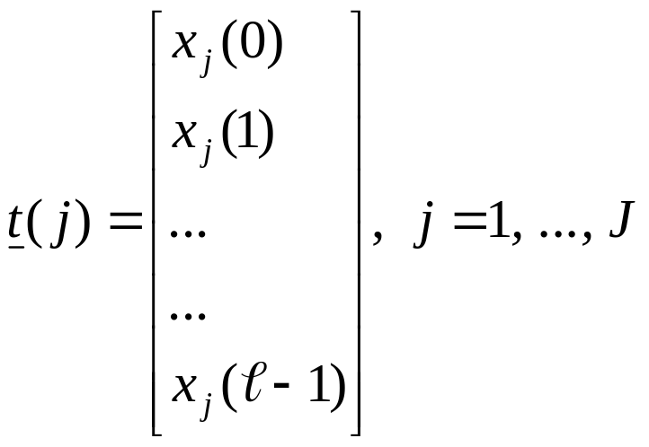
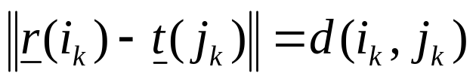
    For each frame compute a feature vector. For example, the DFT coefficients and use, say, ℓ of those:
    Choοse a cost function associated with each node across a path, e.g., the Euclidean distance
    For each reference pattern compute the optimal path and the associated cost, against the test pattern.
    Match the test pattern to the reference pattern associated with the minimum cost.

Slide 17
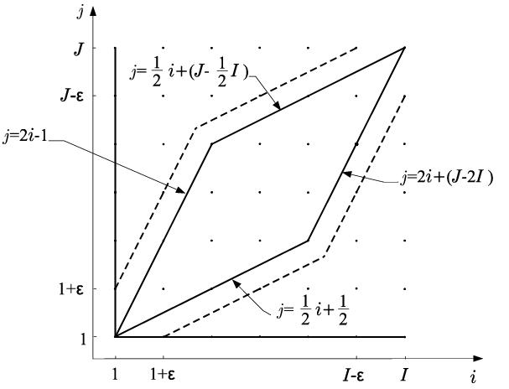
  Prior to performing the math one has to choose:
    The global constraints: Defining the region of space within which the search for the optimal path will be performed.

Slide 18
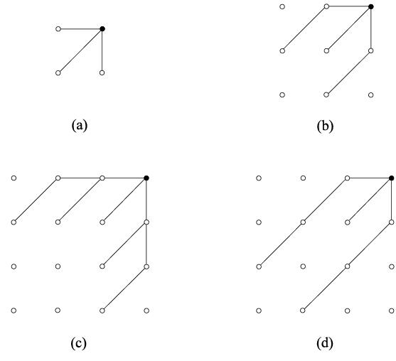
    The local constraints: Defining the type of transitions allowed between the nodes of the grid.

Slide 19
Measures based on Correlations: The major task here is to find whether a specific known reference pattern resides within a given block of data. Such problems arise in problems such as target detection, robot vision, video coding. There are two basic steps in such a procedure:
  Step 1: Move the reference pattern to all possible positions within the block of data. For each position, compute the “similarity” between the reference pattern and the respective part of the block of data.
  Step 2: Compute the best matching value.

Slide 20
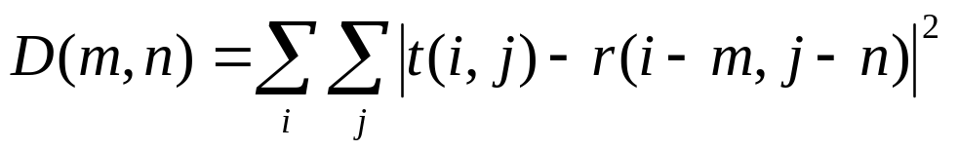
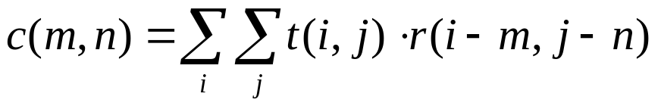
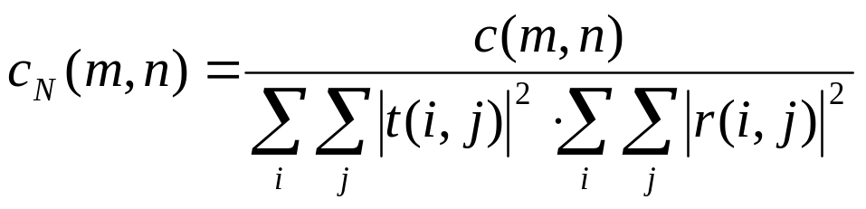
  Application to images: Given a reference image, r(i,j) of MxN size, and an IxJ image array t(i,j). Move r(i,j) to all possible positions (m,n) within t(i,j). Compute:
    for every (m,n).
    For all (m,n) compute the minimum.
    The above is equivalent, for most practical cases, to compute the position (m,n) for which the correlation is maximum.
      Equivalently, the normalized correlation can be computed as

Slide 21

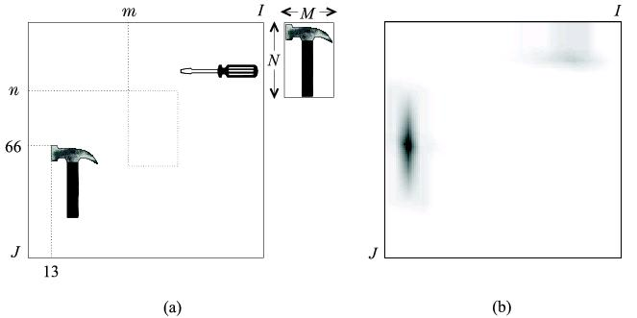
      c_{N}(m,n) is less than one and becomes equal to one only if

Slide 22
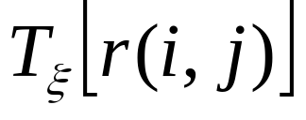
Deformable Template Matching
In correlation matching, the reference pattern was assumed to reside within the test block of data. However, in most practical cases a version of the reference pattern lives within the test data, which is “similar” to the reference pattern, but not exactly the same. Such cases are encountered in applications such as content based retrieval from data bases.
  The philosophy: Given a reference pattern r(i,j) known as prototype:
    Deform the prototype to produce different variants. Deformation is described by the application of a parametric transform on r(i,j):

Slide 23



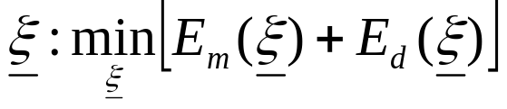
    For different values of the parameter vector the goodness of fit with the test pattern is given by the matching energy:
    However, the higher the deformation, the higher the deviation from the prototype. This is quantified by a cost known as deformation energy:
    In deformable template matching compute , so that
    Ideally, one should like to have both terms low: small deformation and small matching energy. This means that one can retrieve a pattern very similar to the prototype.

Slide 24
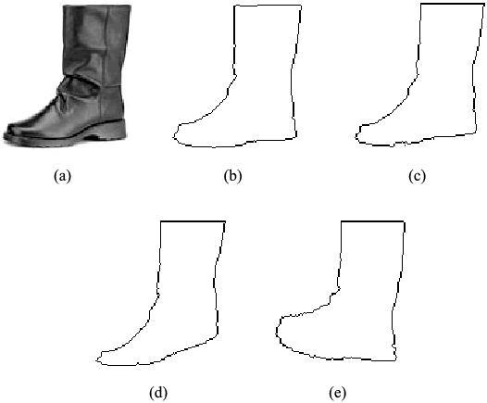
    .
    Different choices of:
      Transformation function
      Matching Energy Cost
      Deformation Energy cost
    are obviously possible.

