Slide 1

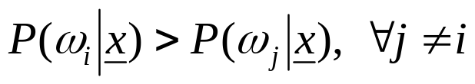
CONTEXT DEPENDENT CLASSIFICATION
Remember: Bayes rule
Here: The class to which a feature vector
belongs depends on:
  Its own value
  The values of the other features
  An existing relation among the various classes

Slide 2
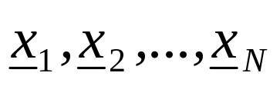
This interrelation demands the classification to be performed simultaneously for all available feature vectors
Thus, we will assume that the training vectors
occur in sequence, one after the other and we will refer to them as observations

Slide 3
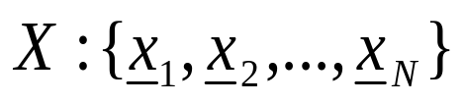



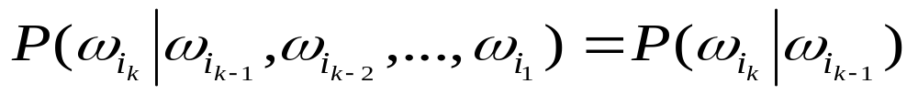
The Context Dependent Bayesian Classifier
  Let
  Let
  Let be a sequence of classes, that is
  There are M^{N} of those
  Thus, the Bayesian rule can equivalently be stated as
Markov Chain Models (for class dependence)

Slide 4
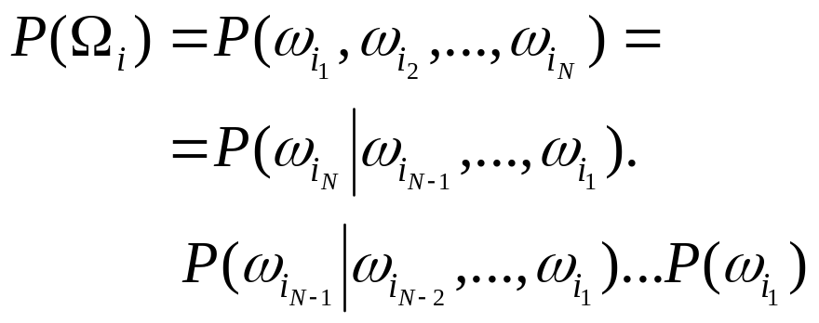
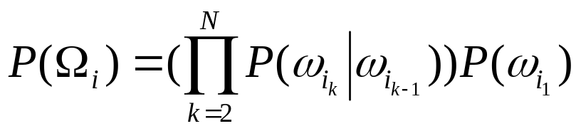

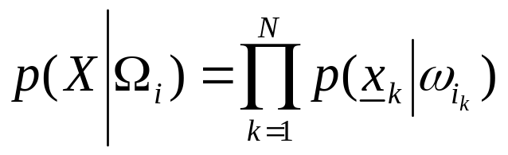
NOW remember:
or
Assume:
  statistically mutually independent
  The pdf in one class independent of the others, then

Slide 5
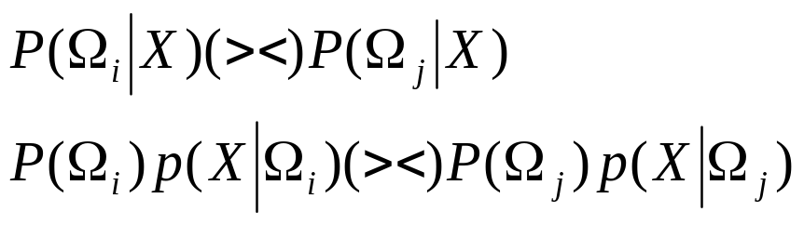
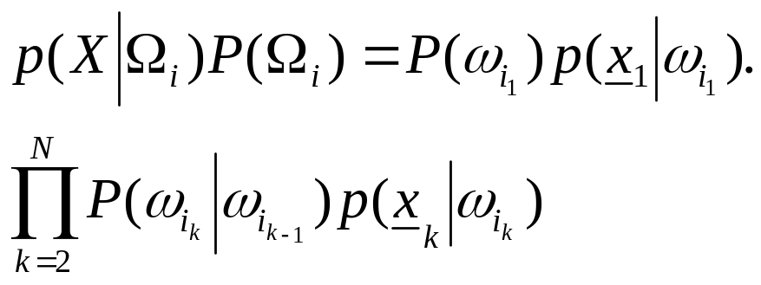
From the above, the Bayes rule is readily seen to be equivalent to:
that is, it rests on
To find the above maximum in brute-force task we need Ο(NM^{Ν} ) operations!!

Slide 6
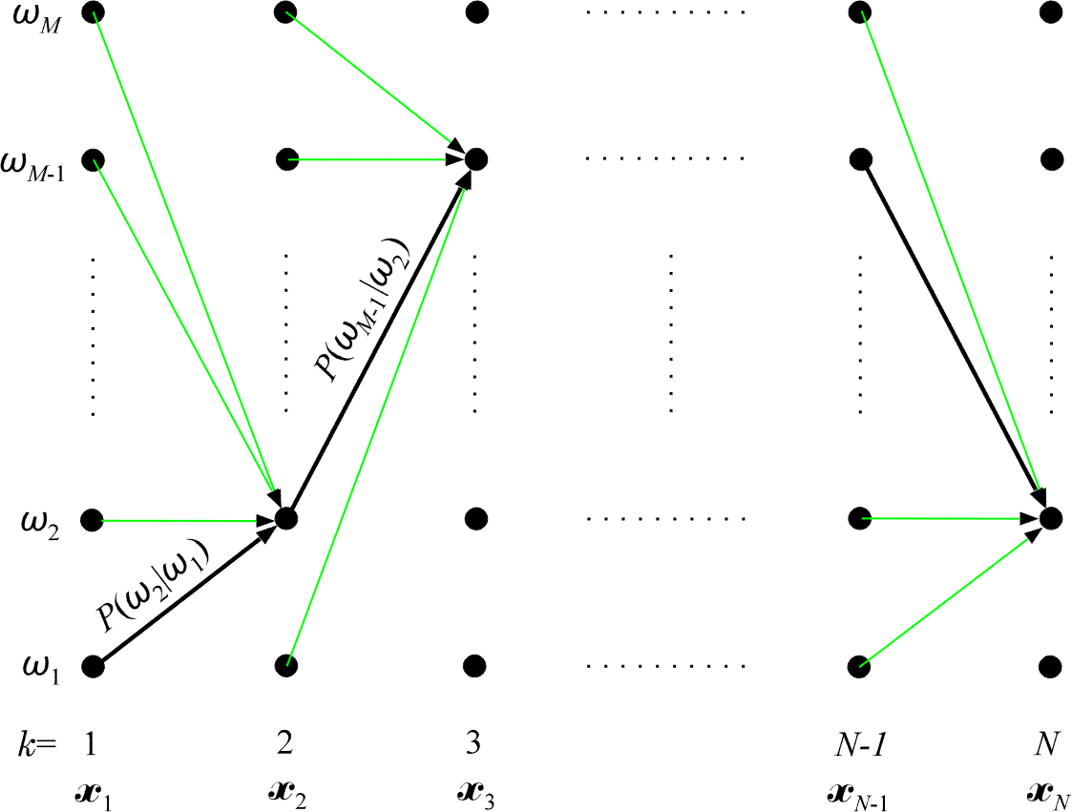
The Viterbi Algorithm

Slide 7
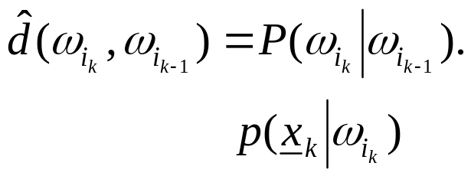
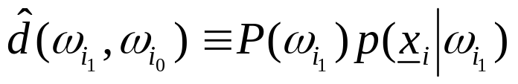
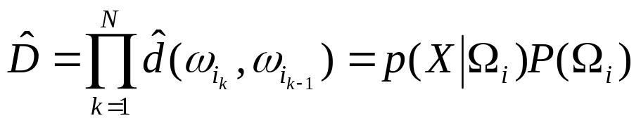
  Thus, each Ω_{i} corresponds to one path through the trellis diagram. One of them is the optimum (e.g., black). The classes along the optimal path determine the classes to which ω_{i} are assigned.
  To each transition corresponds a cost. For our case

Slide 8
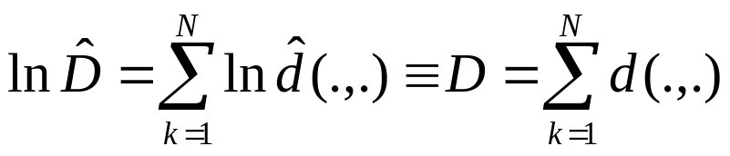
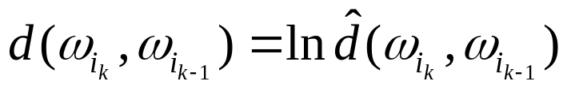
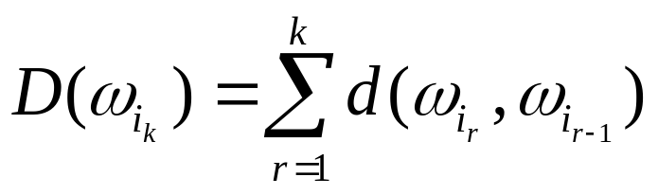
    Equivalently
    where,
    Define the cost up to a node ,k,

Slide 9
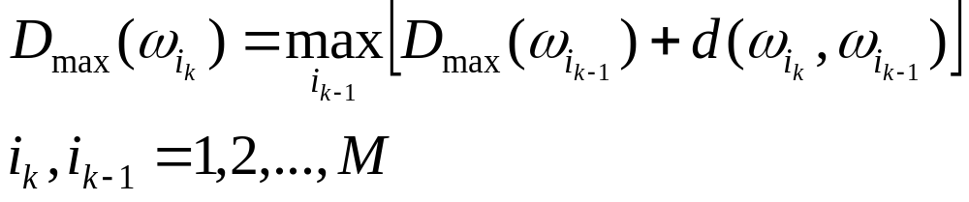
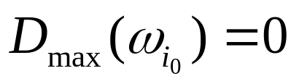
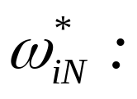
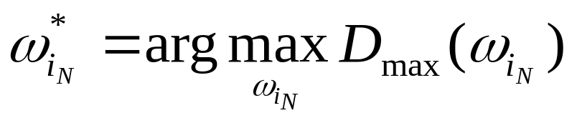
  Bellman’s principle now states
  The optimal path terminates at
    Complexity O (NM²)

Slide 10
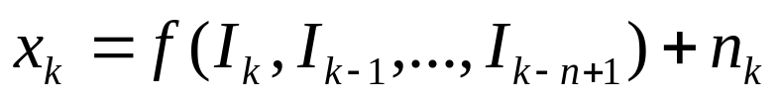
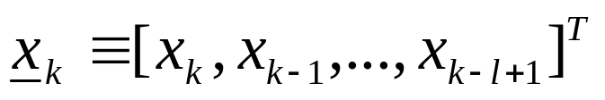
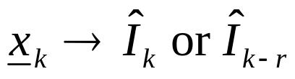
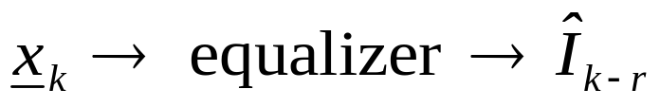
Channel Equalization
  The problem

Slide 11
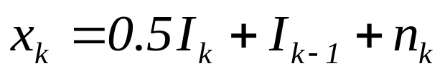
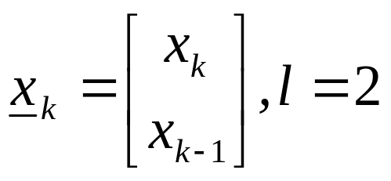
  Example
    In x_{k} three input symbols are involved:
    I_{k}, I_{k-1}, I_{k-2}

Slide 12
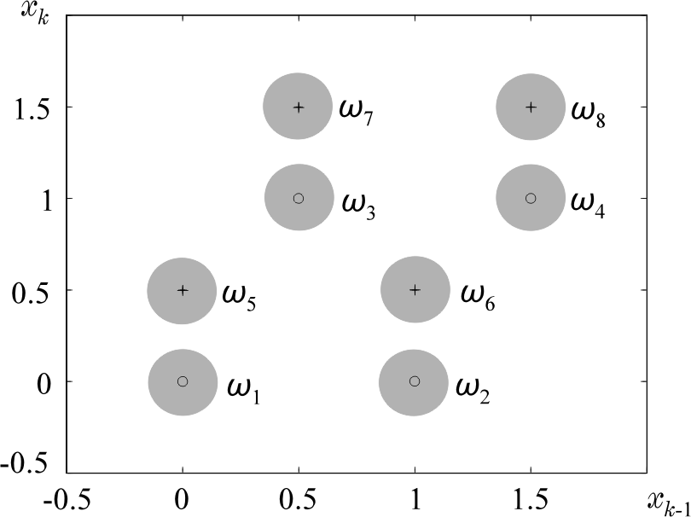

I_{k} | I_{k-1} | I_{k-2} | x_{k} | x_{k-1}
0 | 0 | 0 | 0 | 0 | ω₁
0 | 0 | 1 | 0 | 1 | ω₂
0 | 1 | 0 | 1 | 0.5 | ω₃
0 | 1 | 1 | 1 | 1.5 | ω₄
1 | 0 | 0 | 0.5 | 0 | ω₅
1 | 0 | 1 | 0.5 | 1 | ω₆
1 | 1 | 0 | 1.5 | 0.5 | ω₇
1 | 1 | 1 | 1.5 | 1.5 | ω₈

Slide 13


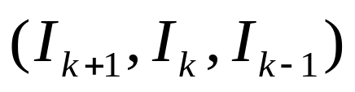




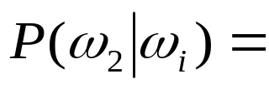


  Not all transitions are allowed
    Then

Slide 14
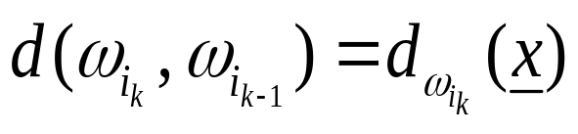
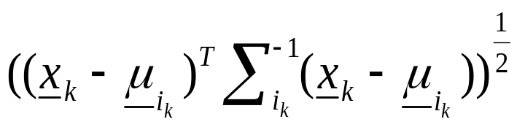
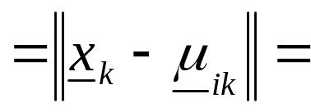
    In this context, ω_{i} are related to states. Given the current state and the transmitted bit, I_{k}, we determine the next state. The probabilities P(ω_{i}|ω_{j}) define the state dependence model.
  The transition cost
    for all allowable transitions

Slide 15

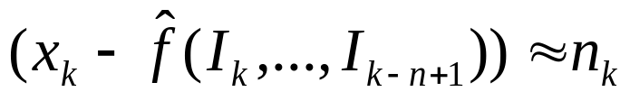
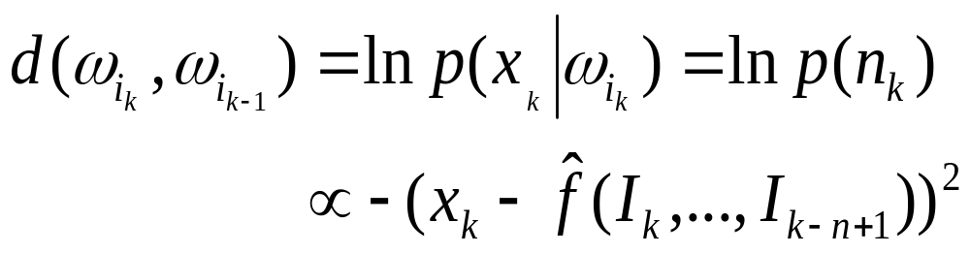
  Assume:
    Noise white and Gaussian
    A channel impulse response estimate to be available
    The states are determined by the values of the binary variables
    I_{k-1},…,I_{k-n+1}
    For n=3, there will be 4 states

Slide 16
Hidden Markov Models
  In the channel equalization problem, the states are observable and can be “learned” during the training period
  Now we shall assume that states are not observable and can only be inferred from the training data
  Applications:
    Speech and Music Recognition
    OCR
    Blind Equalization
    Bioinformatics

Slide 17
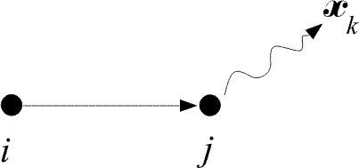
  An HMM is a stochastic finite state automaton, that generates the observation sequence, x₁, x₂,…, x_{N}
  We assume that: The observation sequence is produced as a result of successive transitions between states, upon arrival at a state:

Slide 18
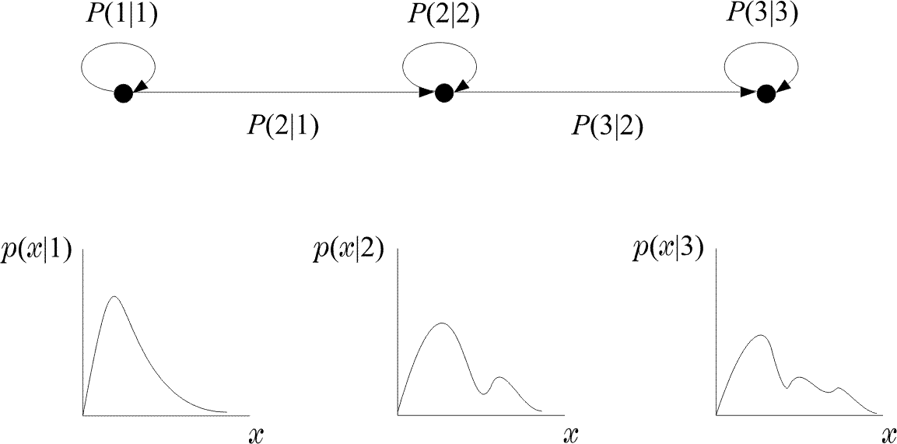
  This type of modeling is used for nonstationary stochastic processes that undergo distinct transitions among a set of different stationary processes.

Slide 19
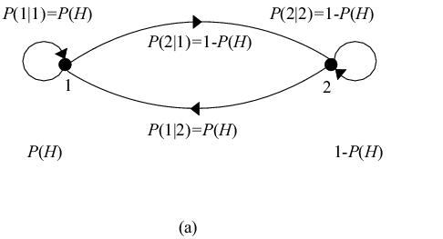
  Examples of HMM:
    The single coin case: Assume a coin that is tossed behind a curtain. All it is available to us is the outcome, i.e., H or T. Assume the two states to be:
    S = 1→H
    S = 2→T
    This is also an example of a random experiment with observable states. The model is characterized by a single parameter, e.g., P(H). Note that
    P(1|1) = P(H)
    P(2|1) = P(T) = 1 – P(H)

Slide 20
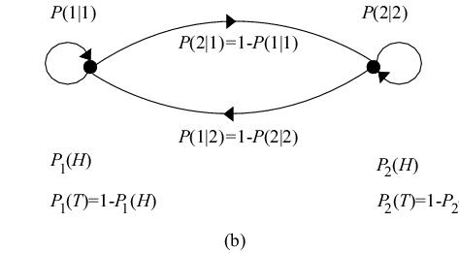
    The two-coins case: For this case, we observe a sequence of H or T. However, we have no access to know which coin was tossed. Identify one state for each coin. This is an example where states are not observable. H or T can be emitted from either state. The model depends on four parameters.
    P₁(H), P₂(H),
    P(1|1), P(2|2)

Slide 21
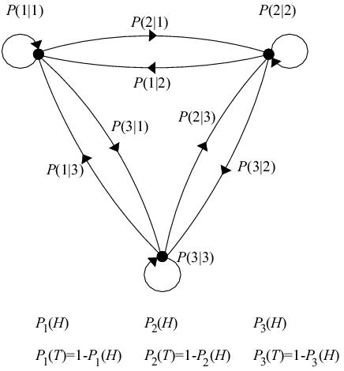
    The three-coins case example is shown below:
    Note that in all previous examples, specifying the model is equivalent to knowing:
      The probability of each observation (H,T) to be emitted from each state.
      The transition probabilities among states: P(i|j).

Slide 22
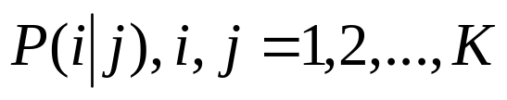
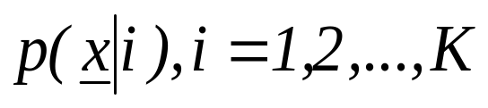
  A general HMM model is characterized by the following set of parameters
    Κ, number of states

Slide 23
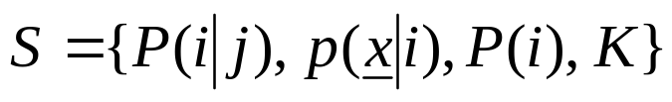
  That is:
  What is the problem in Pattern Recognition
    Given M reference patterns, each described by an HMM, find the parameters, S, for each of them (training)
    Given an unknown pattern, find to which one of the M, known patterns, matches best (recognition)

Slide 24
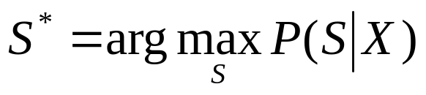
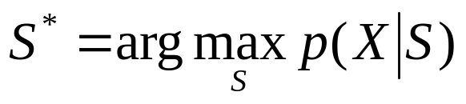
  Recognition: Any path method
    Assume the M models to be known (M classes).
    A sequence of observations, X, is given.
    Assume observations to be emissions upon the arrival on successive states
    Decide in favor of the model S* (from the M available) according to the Bayes rule
      for equiprobable patterns

Slide 25
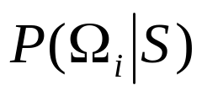
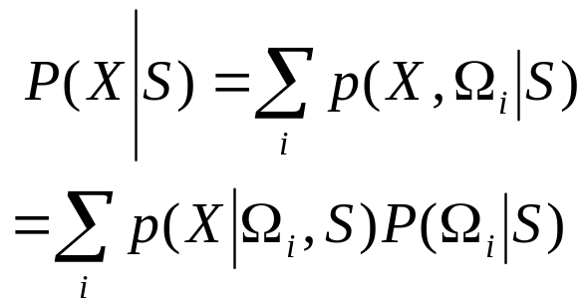
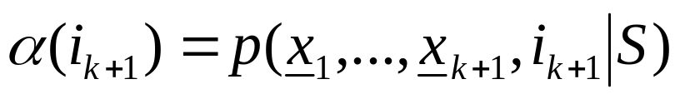
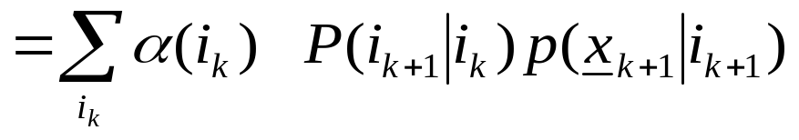
    For each model S there is more than one possible sets of successive state transitions Ω_{i}, each with probability
    Thus:
    For the efficient computation of the above DEFINE
Local activity
History

Slide 26
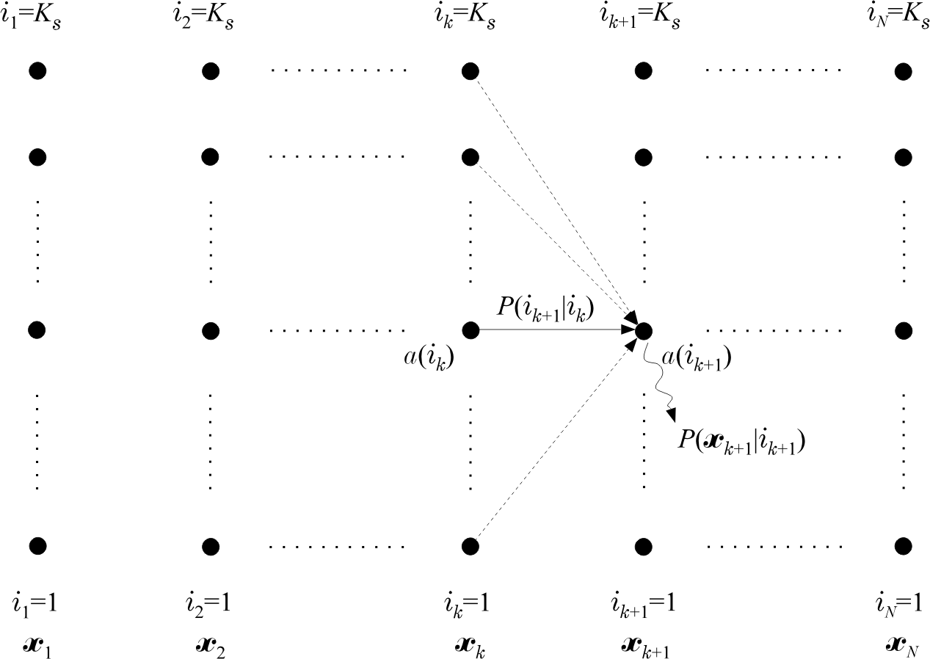
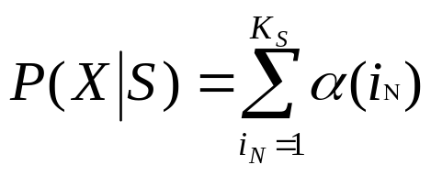
    Observe that
Compute this for each S

Slide 27


    Some more quantities

Slide 28

  Training
    The philosophy:
    Given a training set X, known to belong to the specific model, estimate the unknown parameters of S, so that the output of the model, e.g.
    to be maximized
  This is a ML estimation problem with missing data

Slide 29



  Assumption: Data x discrete
  Definitions:

Slide 30






  The Algorithm:
    Initial conditions for all the unknown parameters.
    Step 1: From the current estimates of the model parameters reestimate the new model S from

Slide 31


    Step 3: Compute
    go to step 2. Otherwise stop
    Remarks:
      Each iteration improves the model
      The algorithm converges to a maximum (local or global)
      The algorithm is an implementation of the EM algorithm

