Slide 1

VARAXIS · HEALTHCARE
An AI scribe for the Indian clinic that never sends a byte to the cloud.
Consultation in, structured note and printable prescription out — drafted locally, corrected by the doctor, signed before it ever becomes a record.
Local AI, no cloud
Bengali · Hindi · English
Consent-gated by design
Prepared for a student hackathon · August 2026

Slide 2




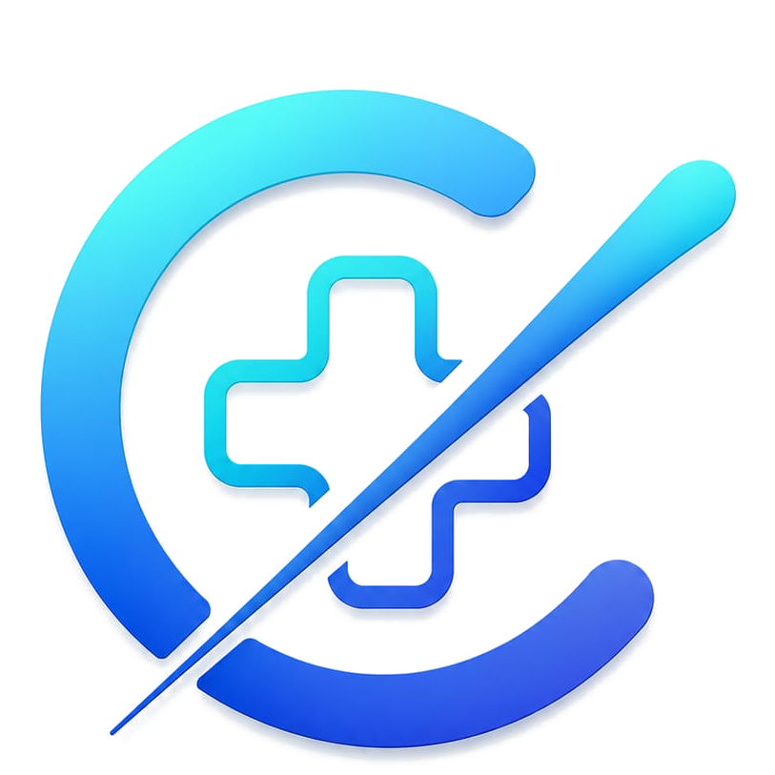
THE PROBLEM
The paperwork eats the doctor's day
In the vast majority of India's small clinics, documentation, history retrieval, prescriptions,
backups and follow-up are still manual work — done on paper, from memory, or not at all.
Scattered history
Handwritten, unsearchable notes
Fragile backups
Follow-up nobody tracks
A patient seen six months ago walks back in — and the record doesn't walk in with them.
No structure, no audit trail, and no way to know what changed between visits.
“Copy this file” is not a backup strategy. One laptop failure can end a clinic's records.
Patients who should come back often don't — and nobody in the clinic notices.
Source: ClinicOS baseline docs — feature backlog and launch plan, Varaxis, Aug 2026.
Problem
ClinicOS · Varaxis

Slide 3






THE SOLUTION
One consultation, five steps, zero typing
The doctor talks to the patient like normal. ClinicOS listens, drafts, and gets out of the way — the doctor stays the final authority on every word.
1
2
3
4
5
Consent
Record
Transcribe
Draft note
Review & sign
Bengali consent script shown and confirmed — enforced server-side, not just UI.
Browser microphone captures the consult in any mix of Bengali, Hindi and English.
faster-whisper turns speech to text, entirely on the clinic's own machine.
A local model structures complaint, history, exam, diagnosis, meds, advice.
Doctor corrects and signs. Only then is the note filed and the raw audio deleted.
Everything runs on the doctor's own laptop. No API keys, no cloud account, no per-consult cost.
Solution
ClinicOS · Varaxis

Slide 4

CURRENT STATE
Not a mockup — a working v0.5 prototype
Every item below runs today, on a MacBook Air, against real recorded consultations.
Consent gate enforced server-side — the audio API itself returns 403 without it
Dual-layer autosave; interrupted consultations are recoverable, not lost
Patient list, full visit history, phone-number search
Full record → transcribe → draft → sign workflow, end to end
Signed notes are immutable; every pre-sign correction is logged as an edit
One-tap SQLite backup, automatic daily backups, guarded restore
Local transcription (faster-whisper) + local note generation (Ollama, qwen2.5:7b)
Professional A4 prescription, generated and printable on the spot
Type-to-confirm deletion and per-patient JSON export — no lock-in
Zero cloud calls · Zero API keys · Zero cost to run a consultation
What's built
ClinicOS · Varaxis

Slide 5



THE CORE INSIGHT
The edit log is the point
Every field the doctor changes between the AI draft and the signed note is captured. That one table quietly does three jobs at once.
Edit rate per note (illustrative)
Your accuracy metric
Target trend once pilots are live — not measured yet
“Edits per note” — shown on the home page, not buried in a log file.
Your training signal
Exactly where the model is wrong, in Bengali, Hindi and code-mixed speech.
Your best investor artefact
An edit rate falling over eight weeks is a real graph — almost nobody at this stage has one.
Doctors correct the draft — they don't regenerate it. That habit is what keeps the log honest and the metric real.
Edit log
ClinicOS · Varaxis

Slide 6





ARCHITECTURE
Local-first by design, not by accident
Consultation audio never touches a network — the only configuration in which the patient consent script can honestly be read as written.
Browser mic
faster-whisper
Ollama · qwen2.5:7b
SQLite
Prescription
5-second chunks, streamed to disk
Local ASR — Bengali / Hindi / English
Local LLM drafts the structured note
data/clinicos.db — one file, easy to back up
A4 print, generated on the spot
Stack: Next.js 15 · React 19 · TypeScript · better-sqlite3 · Next.js API routes
The prompt is a safety surface. The model is instructed to leave a field empty rather than guess a symptom, dose or diagnosis. Both ASR and note-generation sit behind one swappable interface each — cloud providers can be plugged in later, only after their data policy is checked in writing.
Architecture
ClinicOS · Varaxis

Slide 7



WHY INDIA, WHY NOW
Designed around the transition from paper
India's digital-health story isn't uniform — and that gap is the product opportunity, not a footnote to build later.
Code-mixed speech is normal here
Connectivity is inconsistent
Bengali, Hindi and English inside a single consultation is treated as a first-class requirement, not an edge case a global product bolts on later.
Offline-first isn't a resilience feature — it's the only way a clinic in a district with patchy internet can rely on the product every day.
ABDM is building the rails
Local AI just became affordable
The Health Facility Registry, ABHA and consent-aware exchange give an India-first product real interoperability to plug into rather than compete against.
A 7B-parameter model and Whisper both run acceptably on an 8–16GB laptop — the hardware bar for “local-first” dropped enough to matter this year.
Why India, why now
ClinicOS · Varaxis

Slide 8

MARKET
A long tail nobody has properly digitized
India has a vast base of owner-operated clinics still running on paper. Land with the smallest unit — one doctor, one clinic, one laptop — and the economics scale from there.
100 clinics
1,000 clinics
10,000 clinics
₹1.5L
₹15L MRR
₹1.5Cr MRR
monthly recurring revenue
₹1.8Cr annual recurring revenue
₹18Cr ARR before enterprise expansion
Illustrative planning assumptions at a blended ARPA of ₹1,500/month — not a forecast. To be replaced with real pilot data.
Beachhead: single-doctor and small clinics, where the whole visit rests on one person — then multi-doctor clinics, hospitals and health systems, then international markets. Density through referrals beats advertising early.
Market
ClinicOS · Varaxis

Slide 9



BUSINESS MODEL
Price against time saved, not hosting cost
Free to prove it works. Cheap enough that saying yes costs a doctor almost nothing. Priced up only once the value is obvious.
Free pilot
Early paid
Scale ARPA
90 days
₹500 / month
₹1,500 / month
3 clinics, real patients, full support — the doctor risks nothing.
Crosses the line from “would pay” to actually paying. Target: 5 clinics by week 16.
Blended target as receptionist, queue and multi-doctor features land.
The expansion loop
Solo doctor
Receptionist
2nd doctor
Shared clinic
2nd location
Multi-clinic
Revenue streams beyond subscription: implementation/migration, premium support, enterprise integrations, hospital modules.
Business model
ClinicOS · Varaxis

Slide 10


GO-TO-MARKET
Evidence before scale — a 16-week validation plan
The scarcest resource for a part-time student founder is doctor conversations, not code. Every phase has a kill criterion, written down in advance.
Phase 0 · Weeks 1–4
Phase 1 · Weeks 3–8
Phase 2 · Weeks 9–16
20 doctor conversations
3 free pilot clinics
Convert to ₹500/month
No selling, no laptop for the first 15 minutes. Listening only.
Real patients. Consult volume, cost/consult and edit log instrumented from day one.
Money changing hands matters more than a bigger number promised later.
Kill: < 6/20 name documentation unprompted as a top-3 pain.
Metric: still used, unattended, on day 21.
Target: 5 paying clinics by week 16.
Distribution after: referral density beats ads — chain referrals, IMA branch introductions, and a referral loop where every satisfied doctor names two colleagues.
Go-to-market
ClinicOS · Varaxis

Slide 11

COMPETITION
The moat is doors knocked on, not features bundled
Funded teams can out-bundle a feature list. They will not give every small clinic hands-on, same-day setup — that is the early moat.
Enterprise HIS
Generic cloud EMR
ClinicOS
Setup for a solo doctor
Weeks, IT staff
Hours, still cloud-dependent
Minutes, works offline
Works with no internet
No
No
Yes — core loop is fully local
Code-mixed Bengali/Hindi/English
No
Partial (Eka Care is closest)
First-class, from v0.5
Price for a ₹500-OPD clinic
Out of reach
Often out of reach
₹500–1,500/month
Honest caveat: Eka Care announced an offline-capable, code-mixing-aware scribe with NVIDIA in Feb 2026 — “no monitoring, no referral loop” describes a roadmap gap, not a permanent one. The first 200 clinics get zero network effect; Phase 1 has to win on standalone product quality alone.
Competition
ClinicOS · Varaxis

Slide 12




COMPLIANCE & TRUST
Trust is a feature, built in from v0.5
Healthcare software earns the right to scale by getting the boring things right first. This is a strategy document, not legal advice — qualified counsel is needed before real deployment.
Clinic is Data Fiduciary, ClinicOS is Data Processor
Consent before the first byte of audio
Standard DPDP roles, formalised in a plain-language pilot agreement with each clinic.
Enforced in the API, not just the UI — recording is technically impossible without it.
No pharmaceutical access, ever
Raw audio deleted at signing
No patient identity, no prescribing data, no influence on a prescribing decision — survives contract termination.
Clinic owns every record; free export in PDF and structured data within 7 days of request, always.
CDSCO line, known in advance
DPDP timeline tracked
Documentation and retrieval sit outside SaMD today. Chronic-monitoring / risk-alerting later would cross into regulated territory — that's flagged now, not discovered later.
Full enforcement lands ~May 2027 — consent capture and audit logging are being built now, because retrofitting later is the painful path.
Compliance & trust
ClinicOS · Varaxis

Slide 13



ROADMAP
0 to 24 months, in four honest stages
Nothing here jumps ahead of what the last stage proved.
0–3 mo
4–6 mo
7–12 mo
13–24 mo
Prove the wedge
First paid product
Clinic product
Connected clinic
20 doctor interviews
3 pilot clinics live
Crash recovery + audit log
Faster patient search
Convert pilots to ₹500/mo
Queue + phone search
Follow-up reminders
Support process live
Multi-doctor support
Receptionist mode
Paper digitisation MVP
Analytics + consent revocation
ABDM integration pilot
Optional encrypted backup
WhatsApp follow-up + QR
Multi-clinic foundations
Roadmap
ClinicOS · Varaxis

Slide 14



THE ASK
Help us reach the next 20 doctors
1–2 clinical advisors or pilot clinic introductions
The single highest-leverage thing this stage needs.
Feedback on the edit-log-as-moat thesis
The vision
And on where this deck's arithmetic is still too optimistic.
A healthcare operating system for the India that hasn't gone digital yet — starting with one doctor, one clinic, one laptop, and expanding only as far as real usage proves it should.
A pointer toward NVIDIA Inception / cloud credits
For when local inference needs to be validated against cloud accuracy.
ClinicOS by Varaxis · built by Ishaan

