Slide 1
DESIGN THINKING · PRODUCT CASE STUDY · VARAXIS
ClinicOS
Designing documentation for the two-minute consultation
Built by Varaxis to work at the scale of the whole country, and in time, beyond it — this design-thinking case study traces the evidence back to where it started: a single-doctor rural clinic, one room, one doctor, one register.
THE PROCESS
Empathize
Define
Ideate
Prototype
Varaxis
Test
National reach today. Global reach ahead.
Notes:
Introduce the setting in one line: a one-room clinic in Krishnanagar. This deck walks the five design-thinking stages in order, and each stage changed something about what we built.

Slide 2
CONTEXT
One room, one doctor, one register
Indian rural primary care runs on very small units. Alongside the public network of health centres sits a far larger, largely uncounted layer of private single-doctor chambers: one room, one doctor, a paper register and a queue outside.
31,882
Primary Health Centres across rural India
That chamber is the unit this project studies — it is where the largest number of Indian patients are seen, and almost no clinical software is built for it. It is also where Varaxis's national ambitions for this product begin.
40,583
doctors posted across all of them
≈ 1.3
doctors per centre — the scale we design for
Where this began: a single-doctor rural clinic — the starting point, not the limit.
Health Dynamics of India (Infrastructure & Human Resources) 2022–23, Ministry of Health & Family Welfare — figures as of 31 March 2023.
Notes:
The point of this slide is scale: not hospitals, not chains — a single doctor, alone, with a register.

Slide 3
METHOD
How the project was run
Each stage produced something the next one had to answer to. The order below is the order of this deck.
01
02
03
04
05
Empathize
Define
Ideate
Prototype
Test
Interviews and
observation in
real clinics
One problem
statement the
team agreed on
Four options,
three of them
rejected
A working app,
not a mockup
Falsifiable gates
with numbers
set in advance
Stanford d.school five-stage model, applied to a single field problem rather than a hypothetical brief.
Notes:
Say plainly: we did not start from a solution. The prototype is stage four of five, and stage five has not passed yet.

Slide 4



EMPATHIZE
EMPATHIZE
How we set out to listen
Discovery interviews
Sitting in the room
Consent, co-designed
Twenty conversations with practising doctors, using a script that never mentions software — only what their day actually contains.
Watching consultations end to end and timing what really happens, rather than asking a doctor to recall it afterwards.
Writing the spoken consent line in Bengali together with the people who will have to say yes to it, out loud, in front of a queue.
20 doctors · 30 minutes each
Observation, not recall
Bengali and English
Why the script matters: a doctor asked “would you use an AI scribe?” will say yes. A doctor asked “what took the longest yesterday?” will tell you the truth. Every leading question we removed made the finding harder to fake.
Notes:
Emphasise the anti-leading-question design. This is the methodological point the course cares about.

Slide 5
EMPATHIZE
EMPATHIZE
What we know, and what we must still hear
ALREADY DOCUMENTED
WHAT WE STILL HAVE TO HEAR OURSELVES
≈ 2 min
the average primary-care consultation in India — against 22.5 minutes in Sweden
What actually took the longest in your clinic yesterday?
Show me how you would find this patient's last visit.
49.2%
of a physician's office time goes to records and desk work; 27.0% to the patient in front of them
What happens to the register when it is full?
18
countries, about half the world's population, get five minutes or less
What would make you stop using something on day three?
Published evidence tells us the shape of the problem. It cannot tell us this clinic's version of it — that is what the interviews are for, and the deck marks clearly which is which.
Irving et al., BMJ Open 7(10), 2017 · Sinsky et al., Annals of Internal Medicine, 2016.
Notes:
Be explicit that the right-hand column is not yet answered. Honesty here is the point — do not present unheard quotes as findings.

Slide 6
EMPATHIZE
EMPATHIZE
The assumption that broke
WE ASSUMED
THE EVIDENCE SAID
SO WE REFRAMED
Rural clinics are offline. Connectivity is the binding constraint.
83.3% of rural households have internet access, against 91.6% urban — a real gap, but far smaller than we assumed.
The constraint is not the absence of a connection. It is what a dropped one costs mid-consultation.
→
→
WE ASSUMED
THE EVIDENCE SAID
SO WE REFRAMED
Give the clinic an electronic record and the paperwork problem goes away.
Physicians spend 49.2% of office time on records and desk work against 27.0% on direct patient care.
Software that asks a doctor to type during a two-minute visit does not return time. It takes it.
→
→
NSSO Comprehensive Modular Survey: Telecom, 80th Round (Jan–Mar 2025), MoSPI · Sinsky et al., Annals of Internal Medicine, 2016.
Notes:
This is the slide that shows the process working. Our first framing was wrong, and the data — not an opinion — is what corrected it.

Slide 7
EMPATHIZE
EMPATHIZE
Who we are designing for
What he needs
AR
To finish each visit with a usable written record without spending the visit producing it.
Dr. A. Roy, 46
What frustrates him
Solo practitioner · rural India
Recalling a patient he last saw eight months ago from a line in a register — or not recalling them at all.
40–60 patients on a working day
No receptionist, no assistant
What he will not tolerate
One laptop, one paper register
Anything that adds a step in front of a waiting patient, or that loses a consultation once.
Fluent in Bengali; writes in English
Notes:
Composite persona built from the context of the field site. The third block is the one that killed most of our early ideas.

Slide 8
EMPATHIZE
EMPATHIZE
The consultation as it happens today
1
2
3
4
5
6
Patient
arrives
History
taken
Examination
Explanation
given
Prescription
written
Patient
leaves
WHAT SURVIVES IN WRITING
Only the prescription reliably becomes a record — and it is written for the pharmacist, not for the next visit.
The breakdown point
Everything the doctor learns between steps 2 and 4 exists only in his head and in the two minutes he has. By step 6 it is gone, and the patient's next visit starts from nothing.
Notes:
Walk the six steps quickly, then land hard on the bar chart: the record is thinnest exactly where the clinical value is highest.

Slide 9
DEFINE
DEFINE
Four problems, not one
Clustering what we found produced four distinct problems. Solving only the first one is how most clinical software fails.
01
Time is the scarce resource
02
The record is sacrificed first
Two minutes must hold the greeting, the history, the examination, the explanation and the record.
It is the only part of the visit with no one in the room advocating for it.
03
Continuity dies with the register
04
Consent is unwritten
A patient's history is only as durable as one notebook and one laptop.
Nobody in this workflow has ever been asked to record permission, and the law now requires it.
Notes:
Cluster 2 is the insight the project turns on: no one in the room is advocating for the record.

Slide 10
DEFINE
DEFINE · THE PROBLEM STATEMENT
In single-doctor rural clinics, a consultation lasting roughly two minutes must produce both care and a record — and the record is routinely the part sacrificed. Existing software answers this by asking the doctor to type during the visit, which measurably consumes more clinical attention than paper does, and is abandoned. Clinics are left with no usable history, unsystematic follow-up, and years of records resting on a single register or a single laptop.
Any acceptable remedy must additionally stop short of clinical judgements it is not permitted to make, and must protect consultation content that is legally sensitive personal data.
Notes:
Read this slide aloud, slowly. It is the hinge of the whole presentation.

Slide 11
DEFINE
DEFINE
Point of view, and the questions it opens
POINT OF VIEW
Dr. Roy needs to end each consultation with a usable record without spending consultation time producing it — because the two minutes he has belong to the patient, and every second the record takes is taken from care.
HOW MIGHT WE…
01
02
03
04
…let a record write itself from what is already being said in the room?
…make recording feel like less work than the paper it replaces?
…guarantee no consultation is ever lost, whatever fails?
…stop short of clinical judgement while still being useful?
Notes:
The four How-Might-We questions map one-to-one onto the four principles later in the deck.

Slide 12


DEFINE
DEFINE
The boundaries we designed inside
TWO LINES WE MAY NOT CROSS
FOUR THINGS WE CHOSE NOT TO BUILD
CDSCO — Software as a Medical Device
×
No diagnosis, no risk score
Software confined to storing, formatting and communicating data sits outside device regulation. Software that quantifies a physiological parameter to drive a clinical decision does not.
the system carries the record, it does not judge it
×
Nothing identifiable leaves the machine
no cloud, no upload, no exception
×
No audio kept after signing
Digital Personal Data Protection Act, 2023
the recording is deleted the moment the note is signed
Consultation content is sensitive personal data. Informed consent, purpose limitation and deletion rights apply to an early-stage product exactly as they apply to an established company.
×
No lock-in
complete records exportable in an open format, any time
Constraints of this kind are not obstacles to the design. They are the reason the design took the shape it did.
Notes:
If asked why no diagnosis feature: it is a regulatory line, not a technical limitation. Say so directly.

Slide 13
IDEATE
IDEATE
What we considered, and what we kept
×
Faster paper — printed templates and tick-boxes
Still costs the doctor attention during the visit, and produces a record no one can search.
×
A conventional clinic EMR with typed fields
The measured failure mode: documentation time goes up, and the software is abandoned within weeks.
×
A cloud AI scribe
Sends the most sensitive audio a clinic produces off the premises, and stops working when the link drops.
✓
An on-device ambient scribe
Listens to the consultation already happening, drafts the note locally, and asks the doctor only to review and sign.
Three of the four were rejected on evidence gathered in the Empathize stage, not on preference.
Notes:
Note the third rejection is on privacy and reliability, not capability — the cloud option would have worked technically.

Slide 14



IDEATE
IDEATE
Four principles we committed to
Each principle answers one How-Might-We question, and each one has cost us a feature we would otherwise have built.
Listen, don't ask
Never lose a consultation
Carry, don't judge
Leave the door open
The record is drafted from the conversation that was going to happen anyway. The doctor is never asked to enter data mid-visit.
Audio is written to disk continuously, not at the end. Work in progress survives a crash, a closed laptop or a power cut.
The system transcribes, structures and prints. It does not diagnose, score or advise — that boundary is deliberate.
Every record exportable in an open format at any moment. A clinic that wants to leave should find it easy.
Notes:
Principle two is the one that generated the most engineering work and the least visible feature.

Slide 15
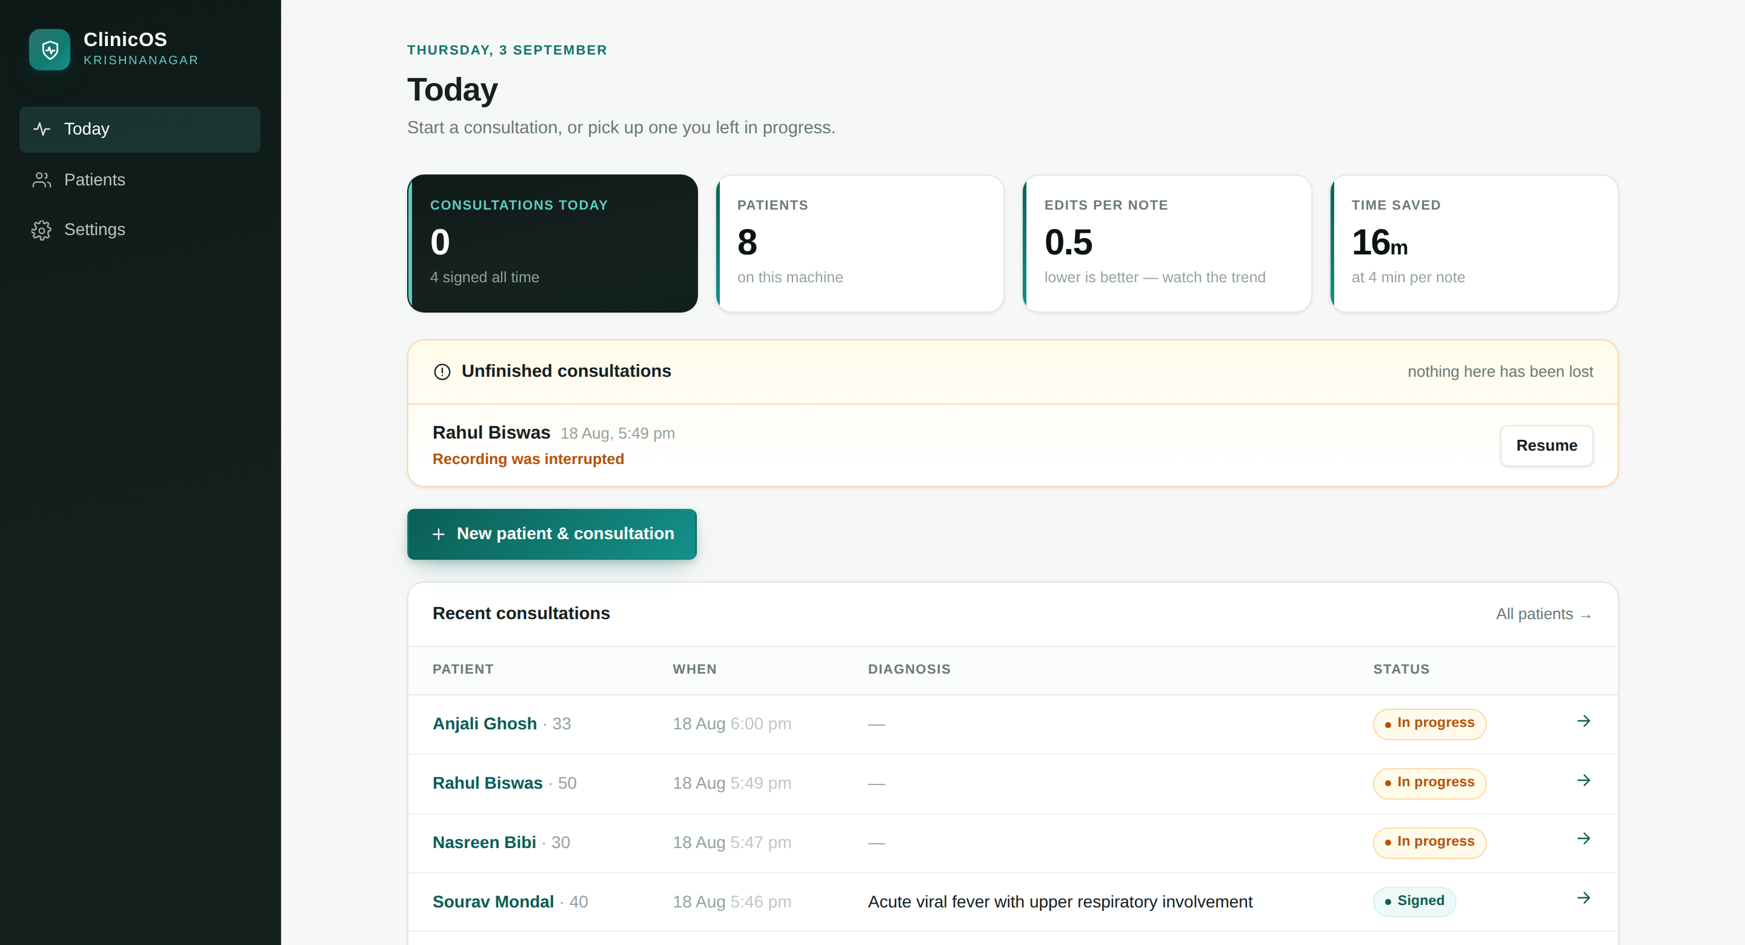
PROTOTYPE
PROTOTYPE
The prototype, running
Working software, not a mockup
Runs on an ordinary laptop with no internet connection and no account.
Nothing here has been lost
Interrupted consultations surface on the home screen with the reason they stopped.
Honest measures on the front page
Edits per note is shown because it is the number that would expose the system as unreliable.
Audio never leaves the machine
Stated on every screen, and enforced in the code rather than in a policy.
Notes:
Open the real app here if the room allows it. A running prototype is worth more than any slide about it.

Slide 16
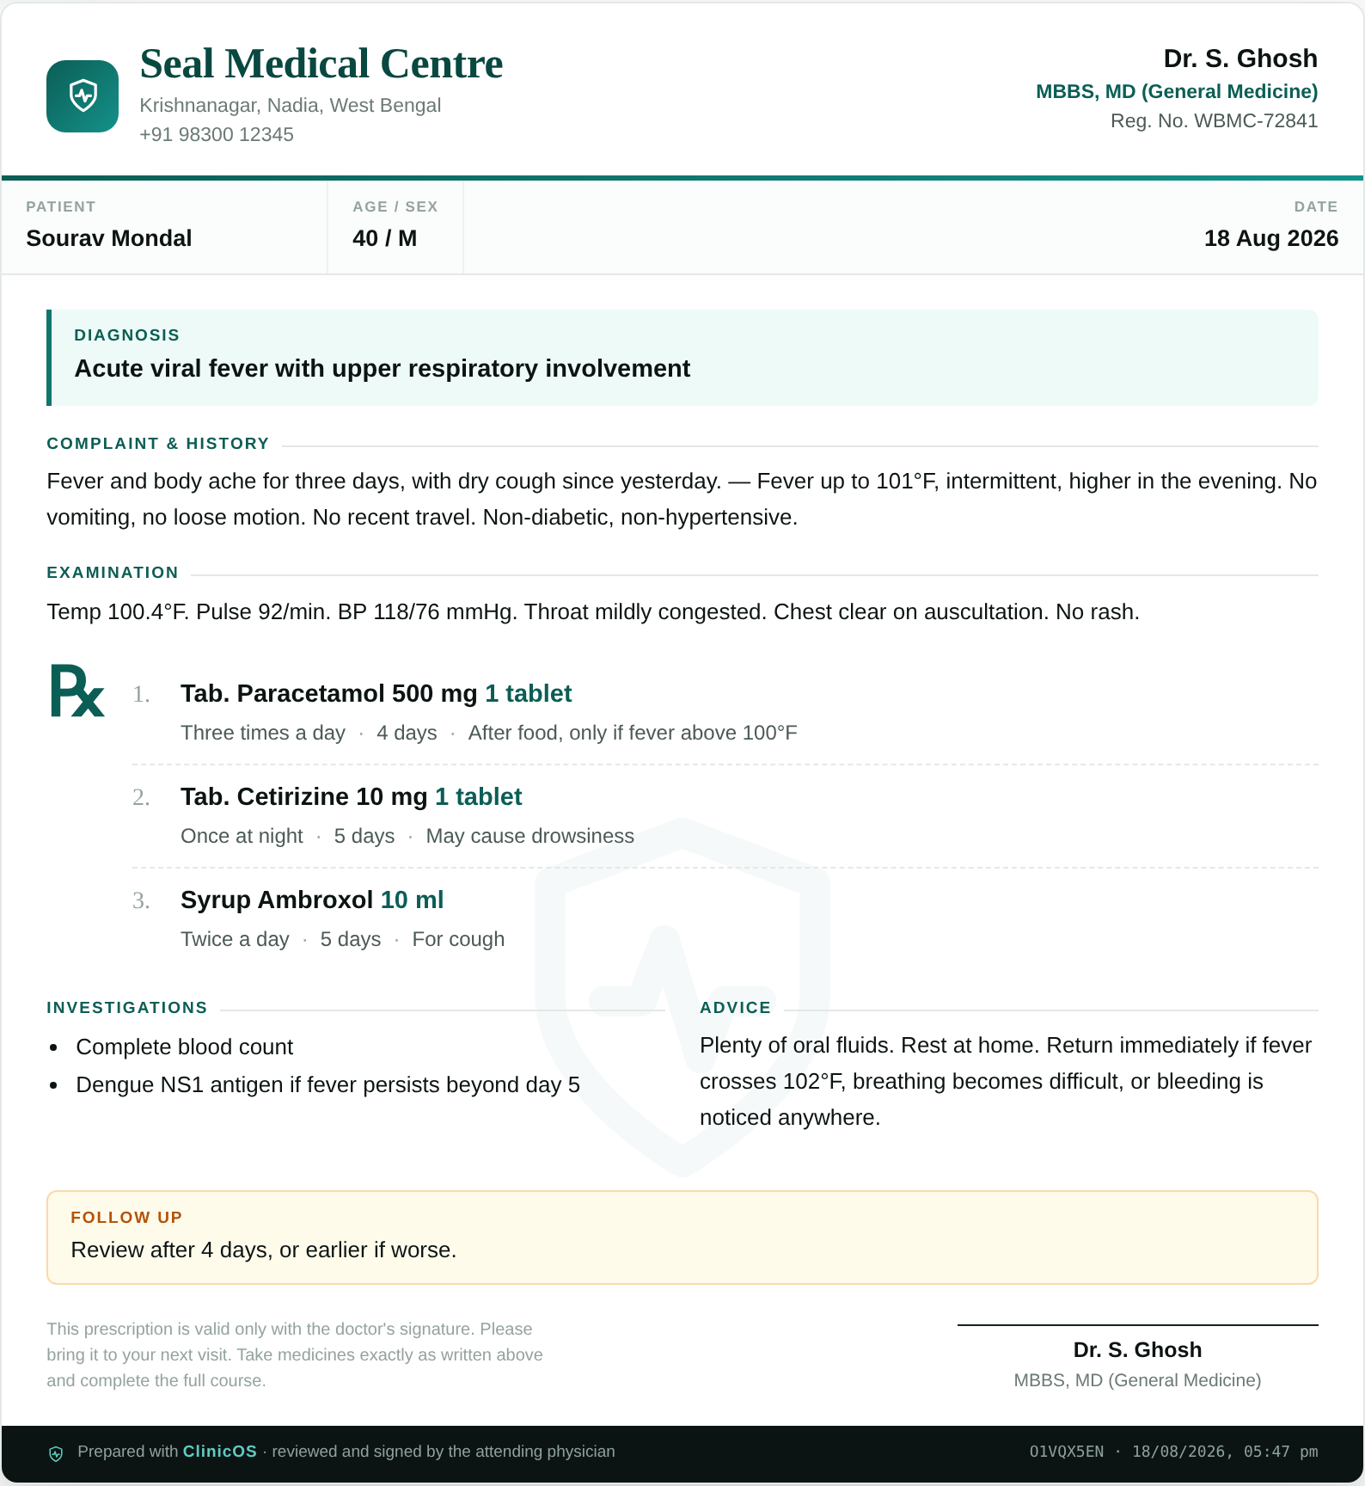
PROTOTYPE
PROTOTYPE
What the patient walks out with
THREE DECISIONS TRACED BACK TO THE FIELD
“A consultation must survive anything.”
Audio is streamed to disk in five-second pieces as it is recorded, with the note autosaved to two independent places. A crash costs seconds, not a visit.
“Consent has to fit in the room.”
A spoken Bengali line the doctor can say in fifteen seconds, and a server that refuses to record at all until it is marked given.
“One laptop is one point of failure.”
A verified daily snapshot of the whole clinic, restorable in one step — and a plain-file export that works without this software at all.
Printed prescription, generated from the signed note
Notes:
Each of the three is a direct answer to something observed, not a feature chosen for its own sake.

Slide 17
TEST
TEST
How we will know we were wrong
Thresholds set before the test, not after it. Failing any gate stops the project at that gate.
GATE 1 · WEEK 4
GATE 2 · WEEK 8
GATE 3 · ONGOING
6 of 20
2 of 3
0
doctors name documentation, unprompted, among their three worst frustrations
pilot clinics still using the system unattended on day twenty-one
consultations lost to a crash, a power cut or a closed laptop
Below this, the problem is not the one we think it is.
Below this, it is being endured, not adopted.
Above this, nothing else on this slide matters.
Alongside the gates: edits per generated note must trend downwards · reported time per consultation must not get worse · every deletion request honoured within the same day
Notes:
Stress that these numbers were written down before any testing began. That is what makes them a test rather than a description.

Slide 18
SCALE
SCALE
One room first. Built for the country.
This began in one rural clinic. ClinicOS is built by Varaxis to scale — nationally, then internationally.
01
Accounts and roles
02
A front desk that runs the day
Doctor, front desk and clinic admin — checked on every request, not just hidden behind a menu.
A queue, a day's list and a doctor's worklist, so the clinic works as more than one person.
03
An activity log
04
A public site, live
Every account action is recorded, so who did what is always answerable.
Describing the product to clinics of every size, and taking enquiries beyond the pilot.

Slide 19
ALL FIVE STAGES
REFLECTION
What the process changed
01
The first solution we imagined was the one the evidence rejected.
We began by assuming a clinic needed an electronic record. The measured effect of exactly that intervention is more documentation time, not less.
02
The hardest constraint turned out to be legal, not technical.
Generating a diagnosis is easy. Deciding not to — and understanding why — took longer than building anything.
03
The measure of success moved from features to survival.
Not what the system can do, but whether a busy doctor is still choosing to use it, unhelped, on day twenty-one.
Thank you · Varaxis
Questions welcome — particularly about what we have not tested yet.
Notes:
Close on the third reflection. Invite challenge on the untested parts — that is the honest position and it reads as confidence.

