Slide 1
AXI4-Lite
Multi-Peripheral SoC
한승훈
2026.06.29

Slide 2
INDEX
Chapter 1. | Overview
Chapter 2. | MicroBlaze
Chapter 3. | AXI4-Lite
Chapter 4. | Peripheral
Chapter 5. | Implementation
Chapter 6. | Conclusion

Slide 3
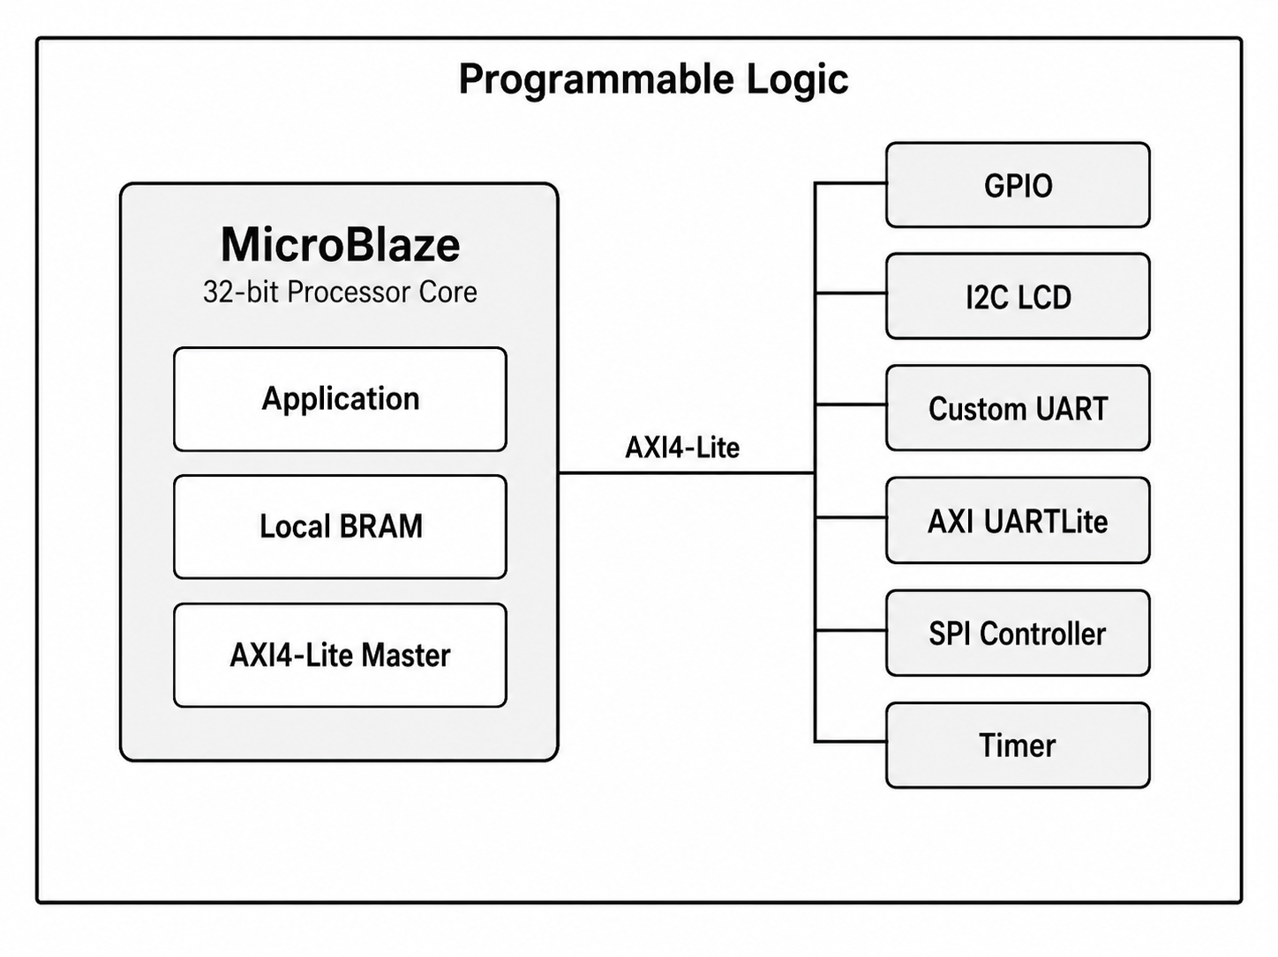
Overview
프로젝트 목표
MicroBlaze 기반 Software-Controlled SoC 구조 학습
AXI4-Lite를 통한 Memory-Mapped Peripheral 제어 이해
Vitis C Application과 Peripheral Register 연동
I2C LCD / SPI Custom Peripheral 통합 및 Board 검증

Slide 4
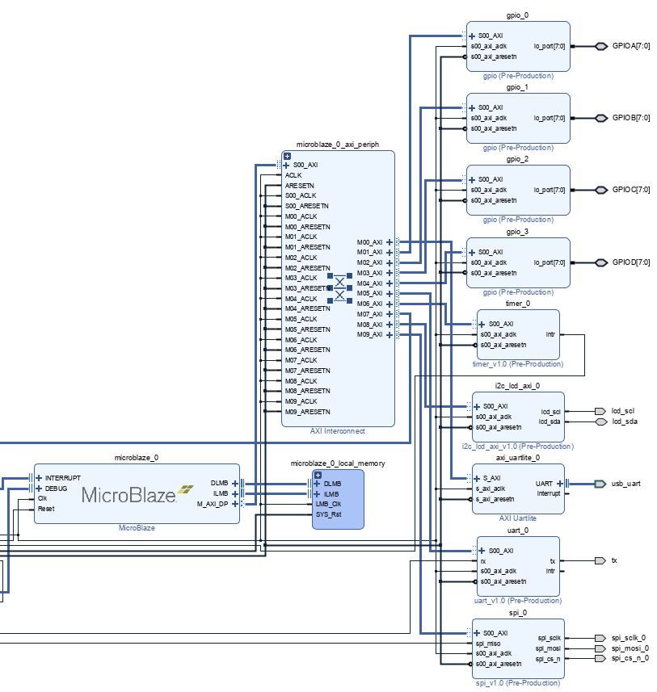
MicroBlaze-Based Control System
MicroBlaze Role
32-bit Soft Processor
Vitis C Application 실행
AXI4-Lite Master
Peripheral Register 제어
Local BRAM 사용

Slide 5
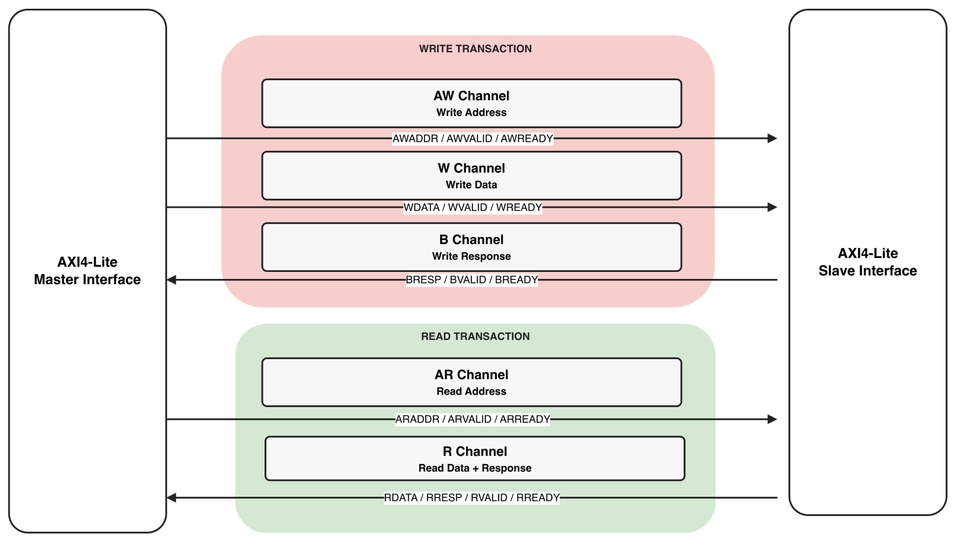
AXI4-Lite Interface
Item | AXI4-Lite | APB
Control | VALID / READY | PSEL / PENABLE
Structure | 5 channels | Setup / Access
Use | AXI SoC peripheral | Simple peripheral
Burst | No | No
AXI4-Lite 특징
• Memory-mapped register access
• 5 independent channels: AW / W / B / AR / R
• Single read/write transaction
• No burst transfer
• Transfer when VALID && READY

Slide 6
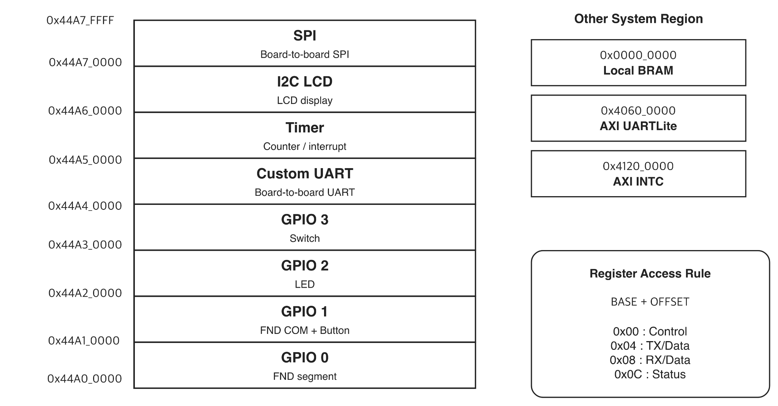
Memory-Mapped Address Map

Slide 7
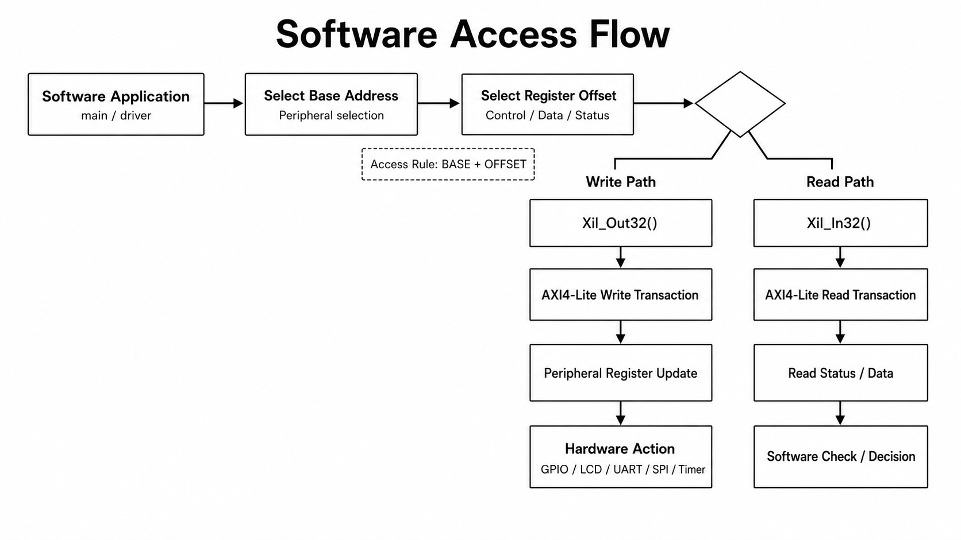
Software Access Flow

Slide 8
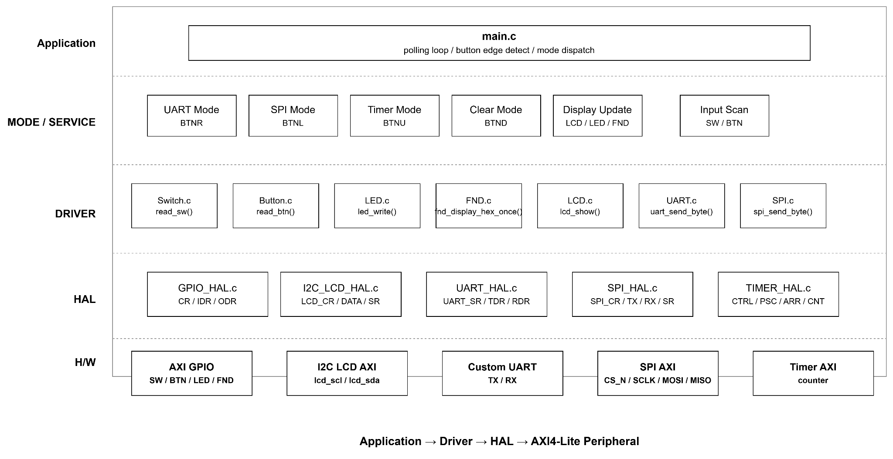
C Application Architecture Layer

Slide 9
AXI4-Lite Peripheral Integration
Peripheral | Register Block | Core Logic | Role
GPIO | CR / IDR / ODR | Direction Control | SW / BTN / LED / FND
I2C LCD | CR / DATA / SR | I2C LCD Core | LCD Mode & Data Display
Custom UART | SR / TDR / RDR / CR | UART TX/RX | Board-to-Board UART
SPI | CR / TX / RX / SR | SPI Master | Board-to-Board SPI
Timer | CTRL / PSC / ARR / CNT | Counter | Timer Counter

Slide 10
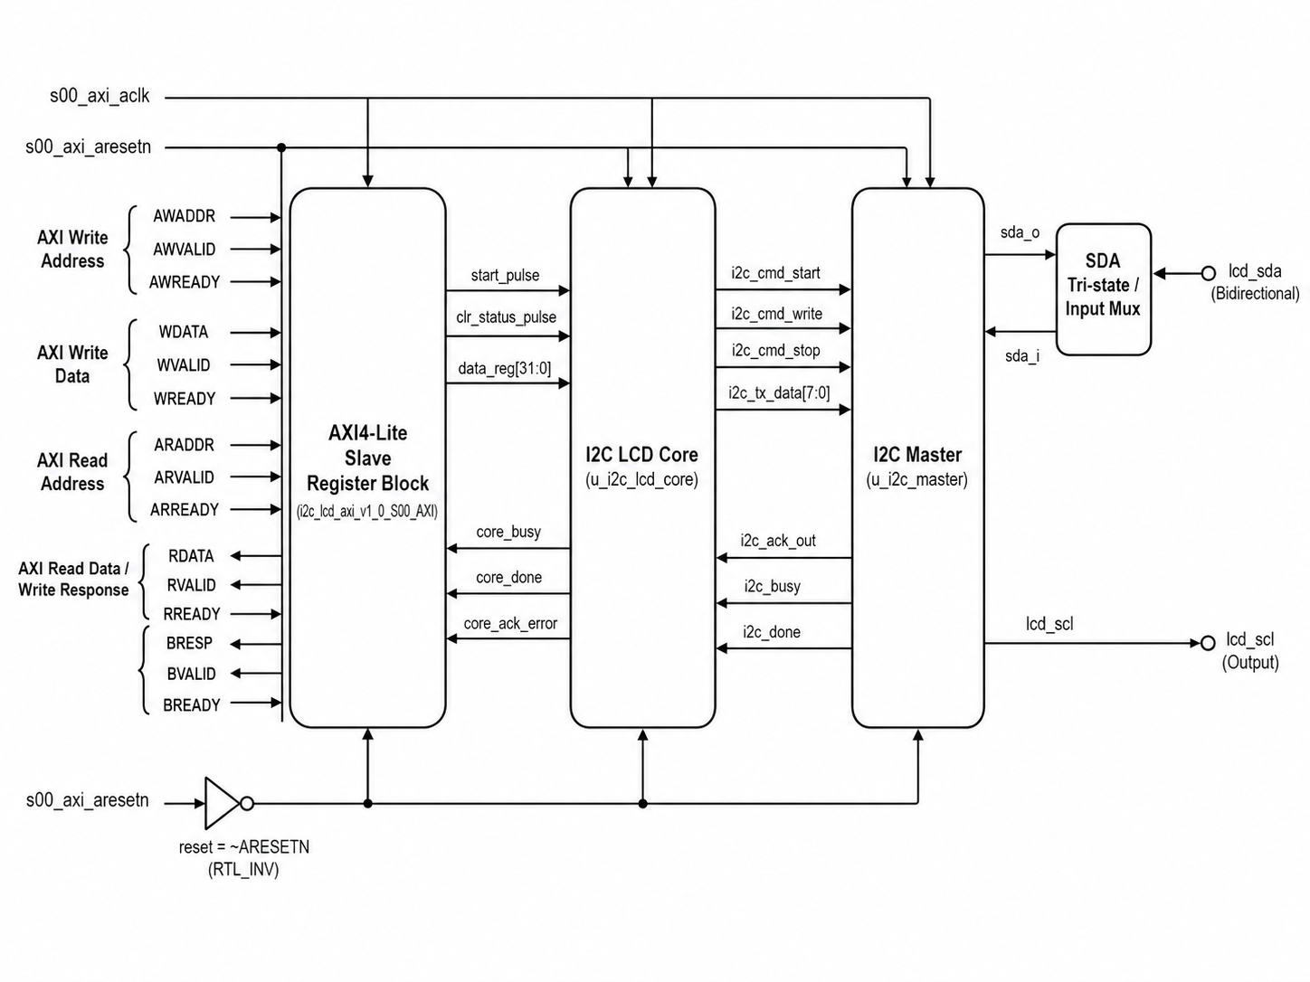
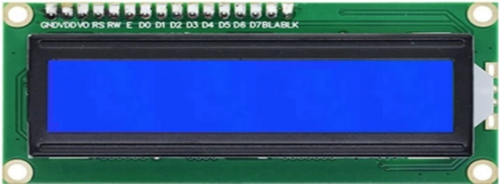
I2C LCD Peripheral Structure
I2C LCD Control Flow
1. Write mode/data + START
2. LCD Core generates command sequence
3. I2C Master drives SCL/SDA to LCD

Slide 11
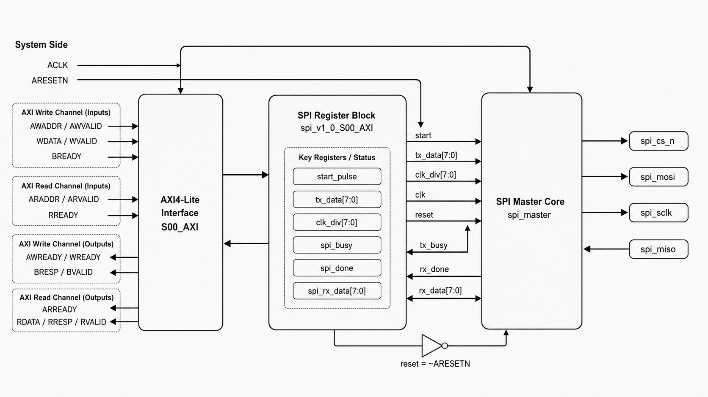
SPI AXI-Lite Peripheral Overview
AXI4-Lite register block converts software writes into SPI control signals
start_pulse, tx_data, clk_div are generated by register access
SPI master drives CS_n, SCLK, MOSI and samples MISO

Slide 12
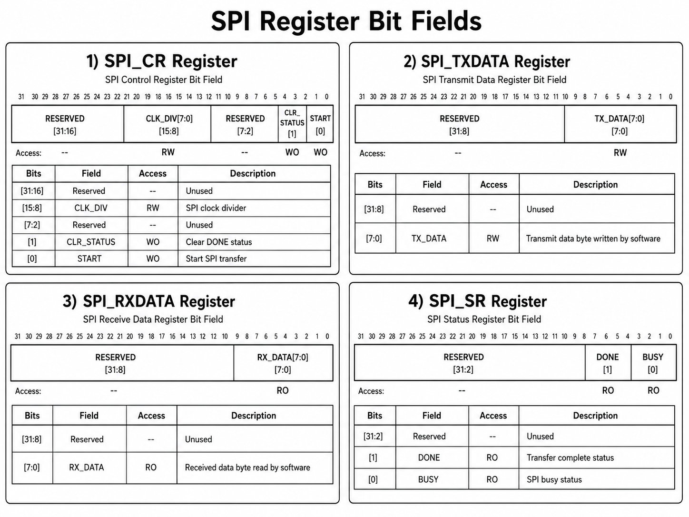
SPI Register Map

Slide 13
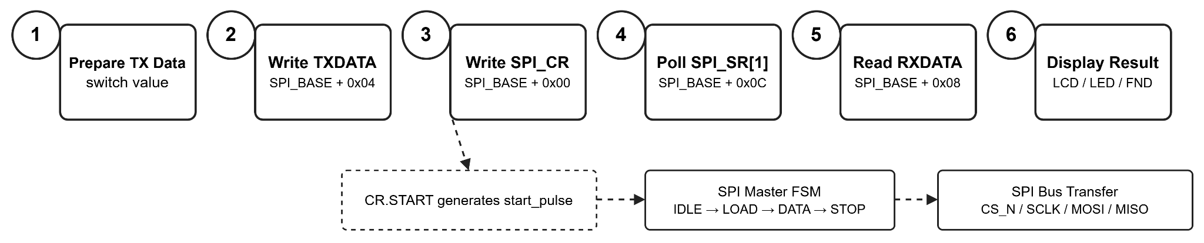
SPI Access Sequence

Slide 14
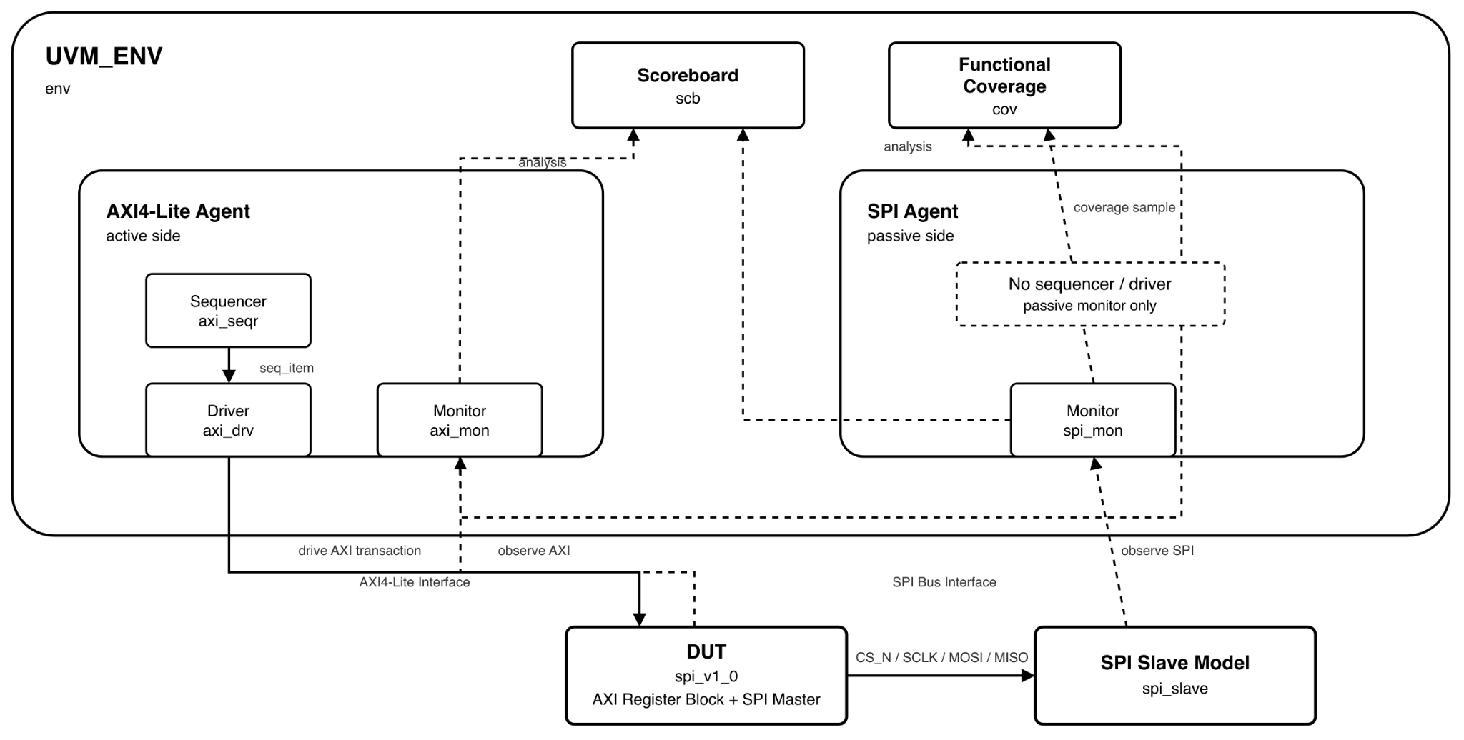
SPI UVM Architecture
Component | Main Role | Output
axi_lite_sequence | SPI 전송 시나리오 생성 | tx_data, slave_tx_data, clk_div
axi_lite_driver | AXI4-Lite register write/read 구동 | DUT AXI Interface
axi_lite_monitor | AXI write/read transaction 관찰 | Scoreboard / Coverage
spi_monitor | CS_N, SCLK, MOSI, MISO 관찰 | Scoreboard / Coverage
scoreboard | AXI 데이터와 SPI bus 데이터 비교 | Pass / Fail
coverage | 주요 기능 coverpoint 수집 | Coverage Report

Slide 15
SPI UVM Verification
Step | Action | Register / Signal | Expected Behavior
1 | Create transfer item | tx_data, slave_tx_data, clk_div | 전송 시나리오 생성
2 | Write TX data | SPI_TXDATA 0x04 | MOSI로 전송할 데이터 저장
3 | Set slave response | slave_tx_data | MISO 응답 데이터 준비
4 | Start transfer | SPI_CR 0x00 | START pulse 발생, SPI 전송 시작
5 | Poll done | SPI_SR 0x0C | DONE == 1까지 대기
6 | Read RX data | SPI_RXDATA 0x08 | MISO에서 수신한 데이터 확인
7 | Check result | Scoreboard | TX/MOSI, RX/MISO 비교

Slide 16
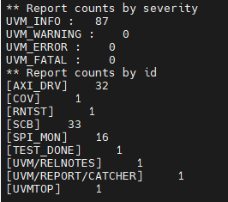
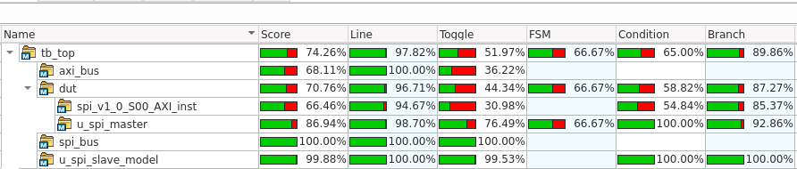
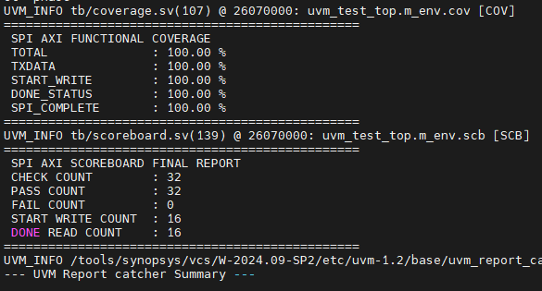
SPI UVM Verification
Functional Coverage: 100%
- TXDATA
- START_WRITE
- DONE_STATUS
- SPI_COMPLETE
Code Coverage:
- DUT: 70.76%
- SPI Master: 86.94%
- SPI Bus: 100%
Scoreboard:
- 32 Pass / 0 Fail

Slide 17
Board Validation Overview
Peripheral | Validation Target
GPIO | SW / BTN 입력, LED / FND 출력 확인
I2C LCD | LCD mode/data 표시 확인
Custom UART | Master → Slave board 데이터 전송 확인
SPI | Master → Slave board 데이터 전송 확인
Timer | Timer Counter

Slide 18
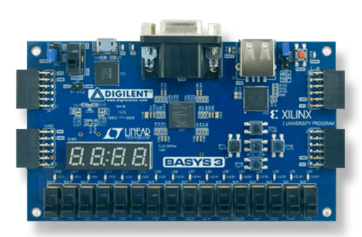
Board Validation
I/O | Function
SW[7:0] | 전송 데이터 입력
BTNU | Timer Mode
BTNL | SPI Send
BTNR | UART Send
BTND | Clear
BTNC | System Reset
LCD | Mode/Data 표시
LED/FND | Data/Debug 출력
Master Board
Slave Board

Slide 19
Board Validation
UART & SPI Board-to-Board Validation
Master Board
Slave Board

Slide 20
Board Validation
I2C
Master Board

Slide 21
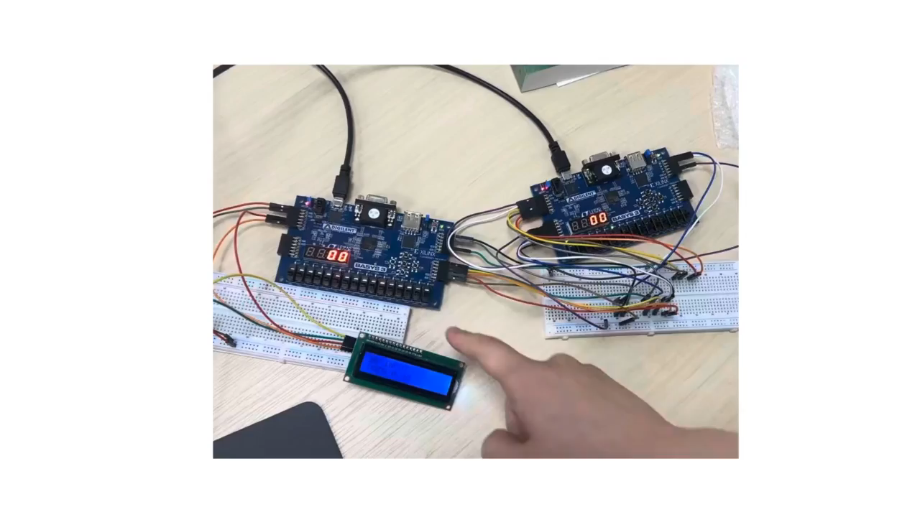
Implementation

Slide 22
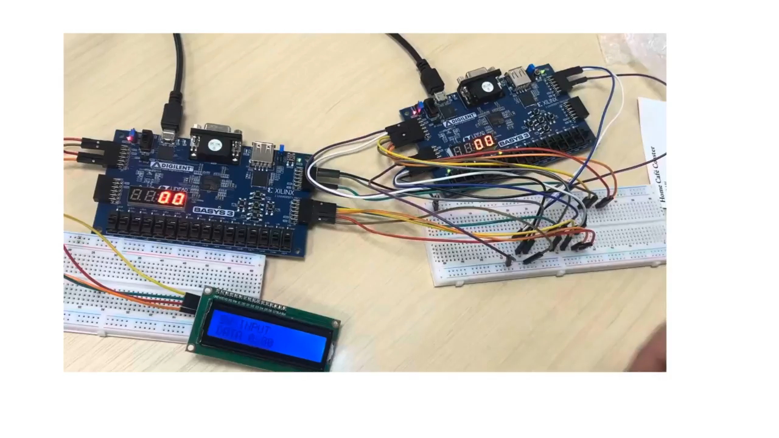
Implementation
Communitcation

Slide 23
Conclusion
Learning Outcomes
• MicroBlaze와 AXI4-Lite를 이용해 C Application에서 Hardware Register를 제어하는 구조를 이해하였다.
• Base Address + Register Offset 방식으로 GPIO, I2C LCD, UART, SPI, Timer Peripheral을 통합하는 방법을 학습하였다.
• SPI Peripheral을 통해 Register Map 설계, Access Sequence, Board-to-Board 통신, UVM 검증 흐름을 경험하였다.
Key Takeaways
• Peripheral 설계는 Register Map과 Software 제어 흐름이 중요함
• Board 검증에서는 배선, Reset, Status polling까지 고려해야 함
• Scoreboard / Coverage 기반 검증이 단순 파형 확인보다 체계적임

