Slide 1
3D Art Pipeline
Assessment - Game Art
Peter Donald
CUAANM313 Create 3D digital models

Slide 2
Introduction
Introduction:
This assessment will cover the process of planning, designing and creating simple and efficient 3D models, for use in a real-time engine.
The provided brief is designed to collect all the evidence of competency required for this subject. Following an alternative brief and/or presenting additional evidence of competency needs to be negotiated with your trainer. Further information on the assessment process and requirements can be found in the unit’s subject and assessment guide.
The assessment will include:
Basic rigging test.
Analysing a brief.
Gathering reference and developing simple concepts.
Referring to asset lists and using naming conventions.
Considering and selecting appropriate modelling methods.
Modelling, UV unwrapping and texturing simple objects.
Creating PBR texture maps.
Lighting and presenting your models.
Gathering and addressing feedback and conducting a post-mortem review.
Observing and maintaining healthy work practices.
The assessment instructions:
All sections marked in green must be edited/filled out by each student. Be sure to replace “Student Name” on the first slide and include your name in the document filename.

Slide 3
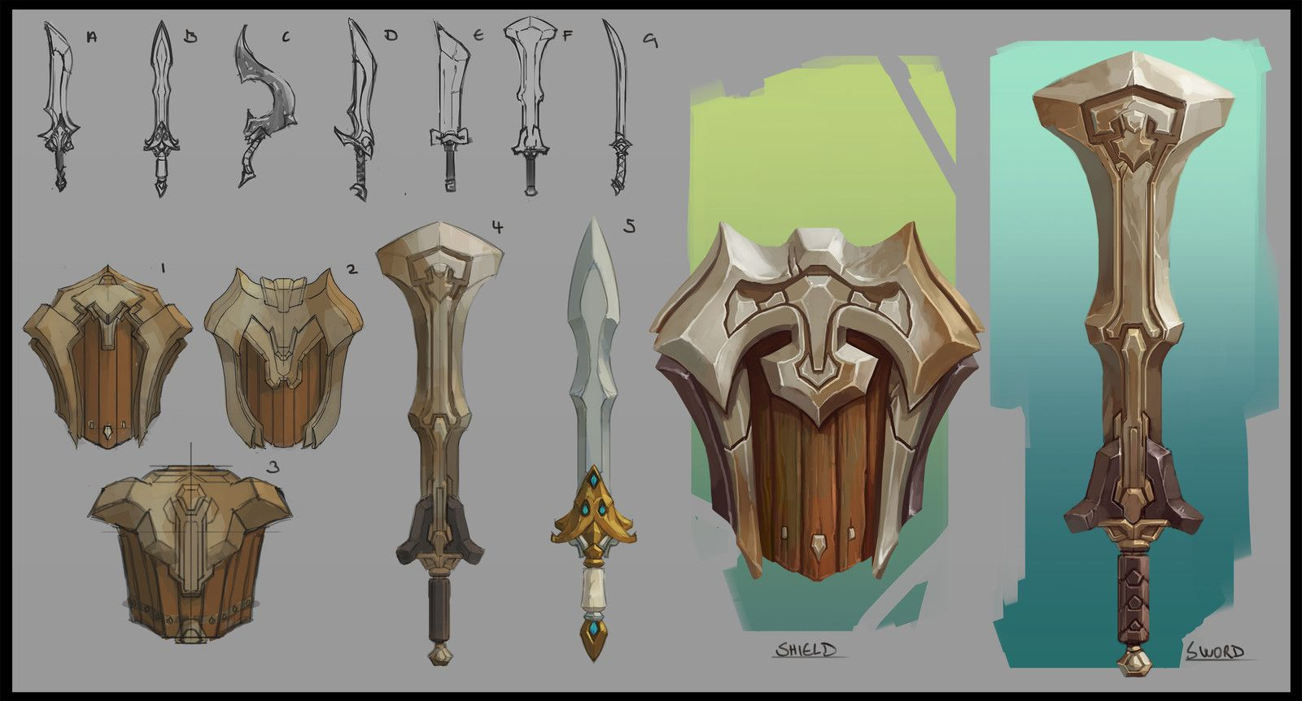
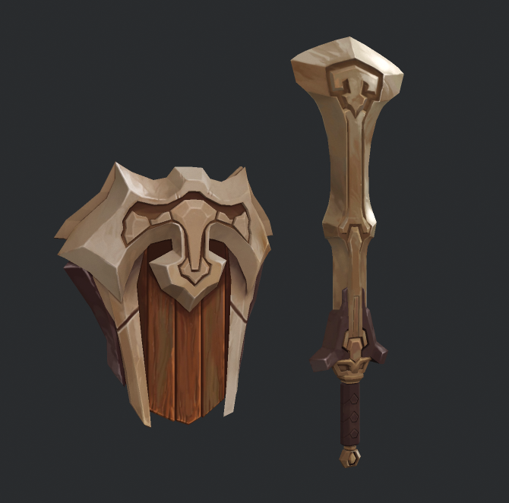
Brief | Overview
Overview:
Utilising different modelling methods and techniques create and present a bladed weapon and shield in a real-time engine.
The scene must contain:
A bladed weapon of your own design.
A shield of your own design.
Technical specifications:
Refer to asset list.
Sword and shield by Domen Kozelj

Slide 4
Brief | Requirements
Modelling:
Each mesh should not exceed the specified polycount (2000 tris).
Mesh topology must be clean and efficient.
Each stage of the project must be approved by your trainer before moving on to the next (Pre-production, Production).
Appropriate backups must be made throughout production (incremental saves).
Texturing:
Each asset must use a single material.
UV layouts must be clean and efficient.
Textures must use a non-destructive workflow utilising layers, masks and blend modes where appropriate.
All textures are to be exported in the resolution specified in the asset list (1024x1024) in .tga format.
Presentation:
The final assets must be uploaded to a single Sketchfab or Marmoset scene and lit appropriately.

Slide 5


Submission | Guidelines
The following files must be uploaded to Canvas for assessment. Ensure files are in appropriate folders and folders are zipped. All folders and submitted files must adhere to the provided naming conventions. Naming convention is SubjectName_AssetName_FirstNameLastName.
Example folder structure is below:
Submit the PowerPoint Workbook for the subject and any associated assessment files using the folder structure shown on this slide.
Within each folder, please submit relevant files:
Pre-Production Folder
        Rig test maya scene
        Production Folder
        Working model and texture source files
        Completed Production Folder
        Final high quality beauty render saved as a jpg
        Packaged final Marmoset Toolbag scene or sketchfab link
3DArtPipeline_FirstNameLastName
3DArtPipeline_Game_FirstNameLastName
Pre-Production
Production
CompletedProduction

Slide 6
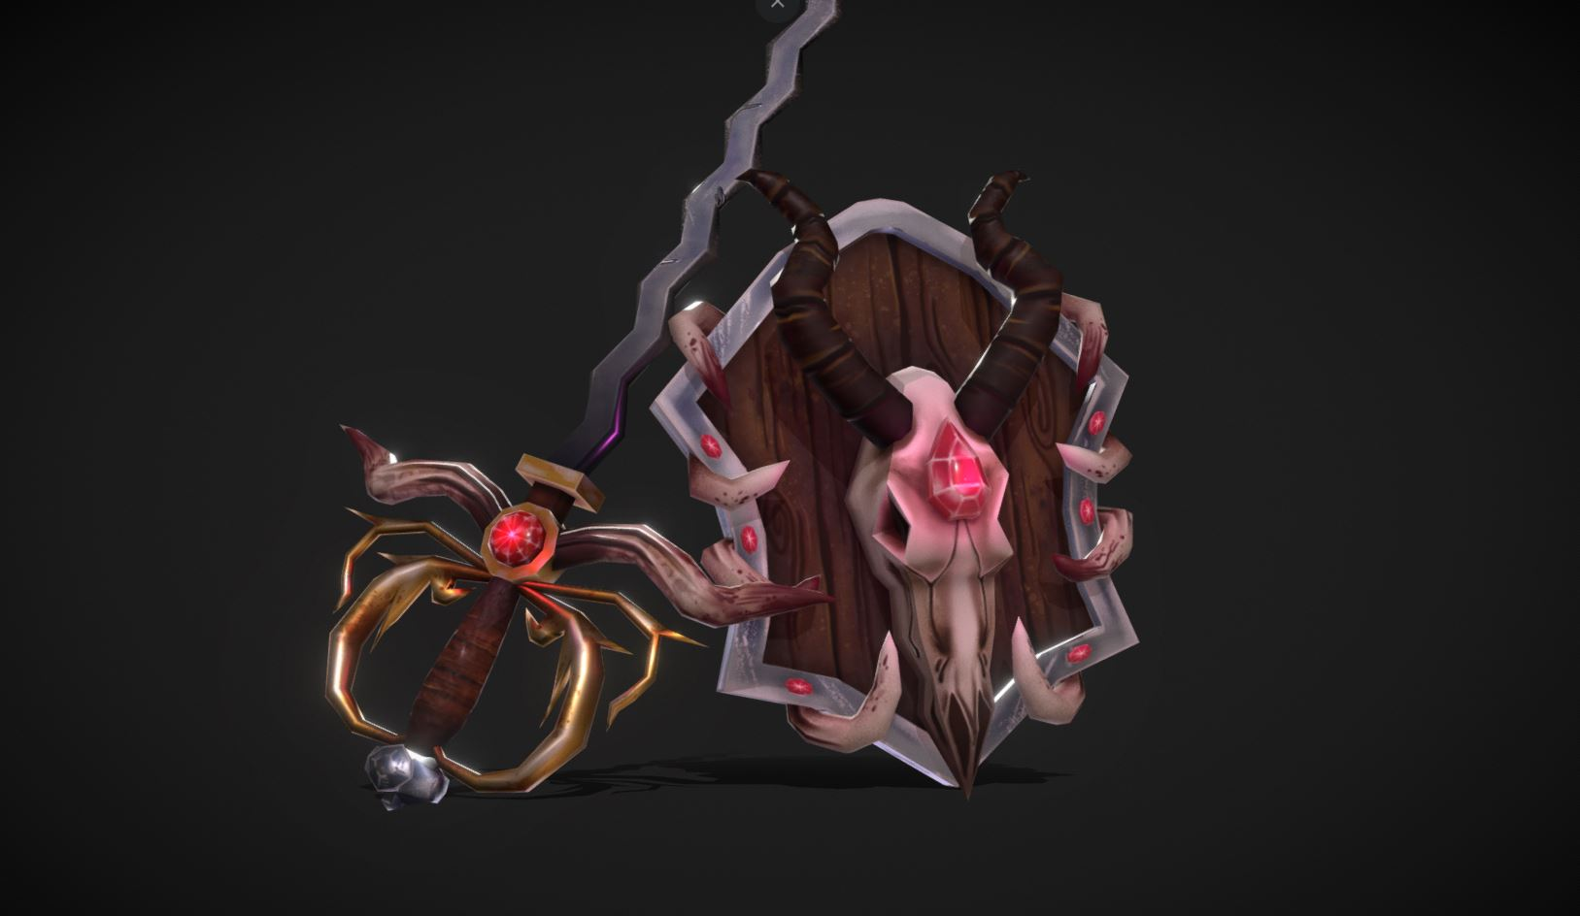
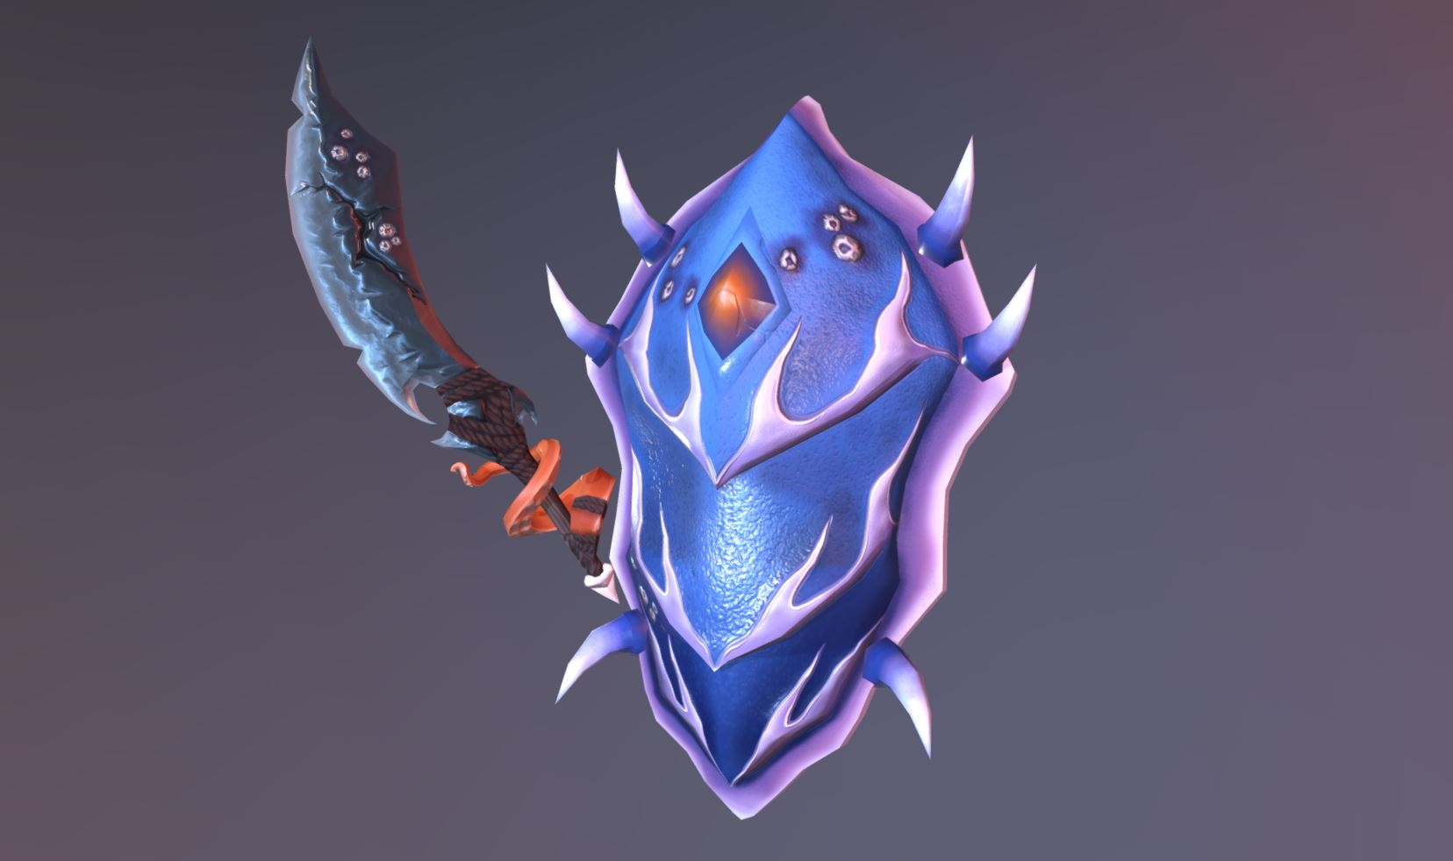
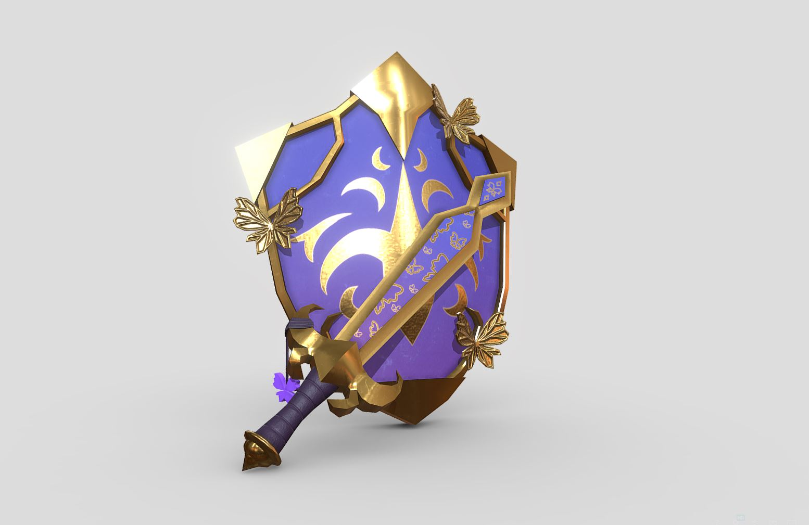
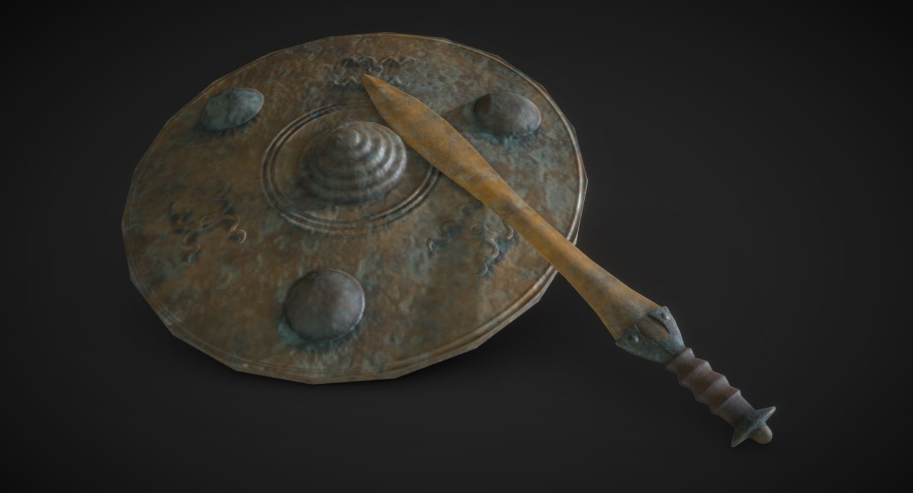
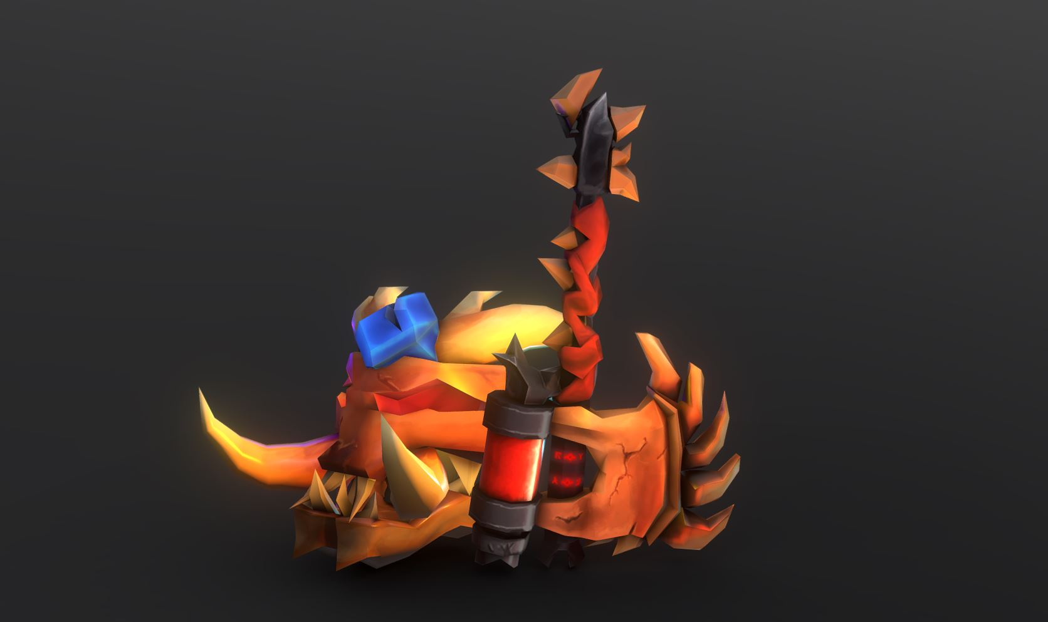
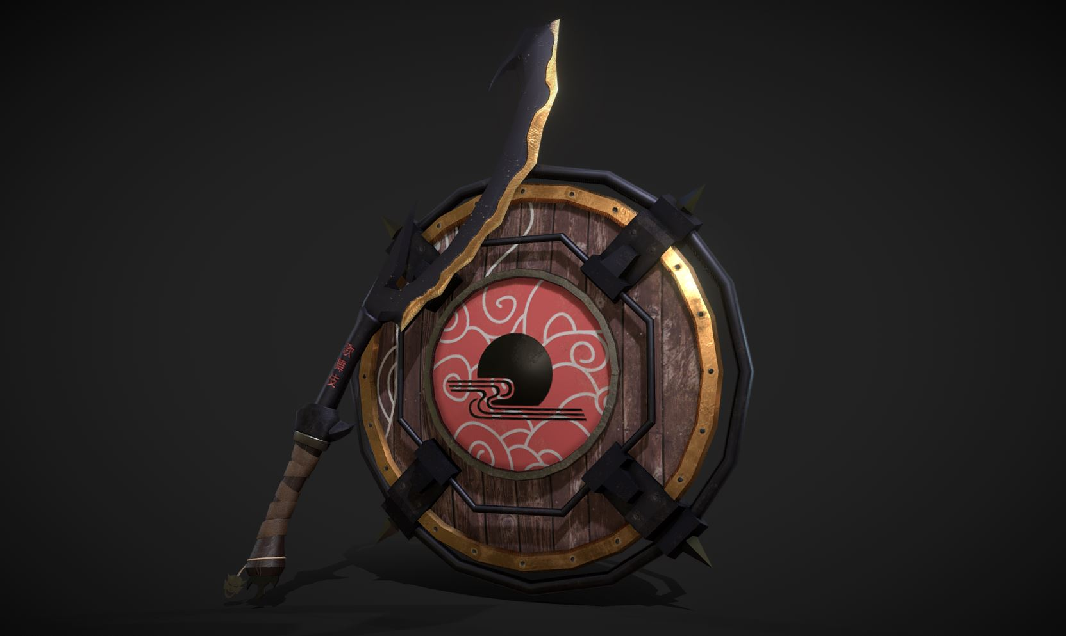
Examples | Student Work
Below are examples of high-quality submissions from ex-student for inspiration.
Alice Newhouse
Kaye Simonson
Ailish Worton
Luka Freiherr von Rechenberg
Harry Sherlock
Dylan Stuart

Slide 7
Maintain healthy work practice

Slide 8
Maintain Healthy Work Practice | WHS
When working in a studio environment it is important to maintain healthy and safe work practices. Before starting the assessment ensure that the following safe work practices are being maintained by evaluating your work environment using the checklist below.
✓
The workstation is setup ergonomically:
An ergonomic workstation requires that the position/height and angle of the monitors, chair, keyboard, mouse and desk can be adjusted to maintain a healthy posture and that there is an appropriate level of lighting in the room.
Regular breaks have been scheduled:
It is important to take regular breaks when working at a computer for any long period of time.
The work environment is free of hazards:
Hazards are potential sources of injury or ill-health which may include mechanical, physical, chemical, psychological and electrical hazards.
✓
✓
Outline the work health and safety requirements that must be considered when working in an office environment.
There are many work health and safety requirements that must be considered in an office environment but some more prominent considerations for a studio may include:
1. Ergonomics: Ensuring that office furniture and equipment, such as chairs, desks, and computer monitors, are set up in a way that minimizes the risk of injury or strain. This includes ensuring that the graphical tablet is at a comfortable height and angle if present in the work environment.
2. Avoid Eye strain: Working with a graphical tablet for extended periods can put a strain on the eyes, so it is important to take regular breaks and ensure that the workspace is adequately lit.
3. Repetitive strain injury (RSI): Working with a graphical tablet can involve repetitive motions, such as moving the pen across the tablet surface. This can increase the risk of RSI, so it is important to take regular breaks and stretch the hands and arms to prevent injury.
4. Mental health: Make sure you maintain a good work-life balance, take regular breaks and maintain an exercise regime. Communicate with your manager help to identify and address issues before they become problems. Take advantage of training opportunities provided by your employer.

Slide 9
Pre-Production

Slide 10

Pre-Production | Palm Tree Exercise
Insert a screenshot below of the palm tree exercise skinned and deformed
Coconut Tree Trunk 1
Coconut Tree Trunk 2
Coconut Tree Trunk 3
Describe the mesh and topology requirements necessary for optimal deformation.
Answer here

Slide 11
Pre-Production | Asset Description
Considering the brief, write a description of each asset below. Include the materials it is made from (wood, metal etc), its condition/age, where it was found, how it got there and any other relevant features.
E.g., A battered shield made of scarred wooden panels with rusty, studded metal banding. There is a large rusty shield boss with a skull motif in the center of the shield. The front of the shield is smattered with barnacles and its loosened panels warped from being half submerged in wet sand. Once owned by a great warrior the shield was washed up on a deserted beach many years ago and has remained undisturbed.
Bladed Weapon:
This polearm features an elegant asymmetrical crescent-shaped blade crafted from high-quality metal. The comfortable leather grip is complemented by a sturdy metal pommel that adds to the weapon's balance and weight. The metal banding along the blade is intricately engraved with mysterious runes that enhance the weapon's mystical properties. The blade and pommel are adorned with sparkling gems that further focus and amplify the weapon's power. Despite showing signs of wear and tear from extensive use, the weapon remains a formidable force to be reckoned with.
Shield:
This curved shield is the perfect complement to the polearm, providing vital protection during combat. The shield is expertly crafted, with a sturdy metal rim that offers exceptional durability and resilience. The center of the shield is crafted using the same high-quality metal as the polearm's blade, imbuing it with powerful mystical properties that enhance its defensive capabilities. In the center of the shield, a spherical gem glitters in the light, mounted on a shining metal plate that catches the eye. Despite bearing the scars of many battles, the shield remains a reliable and effective defense against enemy attacks.

Slide 12
Pre-Production | Modelling Methods
For each asset research and describe the modelling method/techniques that will be used to create the mesh (e.g. subdivision, NURBS, polygonal).
Object | Modelling Method/Techniques
Bladed Weapon | Polygonal techniques will be used to model the mesh. The pole can be constructed from a cylinder using extrusion, the move tool and scaling. The pommel and gem setting in the blade will be constructed from a cylinder using extrusion, scaling, move and vertex merge (for the gem). The blade will be constructed from a plane that will be shaped to represent the blade and then mirrored with bridging. The edge faces will then be extruded, and a loop-cut added to the face loop to make it possible to create an edge. If time permits, the model will be exported as FBX to perform sculpting in Blender to add wear, tear and runes.
Shield | Polygonal techniques will be used here. A plane will be shaped to match reference image and then mirrored with bridging. The edge faces will then be extruded with thickness and offset, extruded with thickness again to create the rim. The metal plate in the centre will be part of a cylinder, the gem will be part of a sphere. The leather padding on the back will be a cube and the front grip on the back will be an extruded cylinder and the back will be an extruded cube. If time permits, the model will be exported as FBX to perform sculpting in Blender to add wear, tear and runes.
Describe any intellectual property considerations you should consider when creating any assets.
The work should omit any trademarks, brands or labeling that are copyrighted and you have not sought permission to use (i.e. Everything in the assignment). For non-copyright material, likeness of real-world people or products should be avoided if consumers are likely to associate the asset with the product directly. Many jurisdictions have personality rights or likeness rights and thus using them in a commercial product requires an agreement. Likeness with an existing person or product that feels disparaged by the asset can also be problematic. If the asset is inspired by an existing asset, then the inspiration should not result in a direct copy but should add substantial new creative work (even if it is just inspiration aggregated from other assets).

Slide 13
Pre-Production | Schedule
With your trainer, negotiate a schedule covering each stage of development and include the milestone dates. Research and list the software required for each stage.
Task | Milestone Date | Software Required
Pre-production | Feb 17 | Adobe Photoshop, Autodesk Maya
Modelling & UV’s | Feb 23 | Autodesk Maya, (Possibly Blender for sculpting)
Texturing | Feb 27 | Substance Painter
Presentation | Mar 1 | Marmoset
Post-production | Mar 2 | N/A

Slide 14
Pre-Production | Asset List
Using consistent naming conventions, modify the asset names, list any additional textures and add relevant notes where required.
Asset | Polycount | Textures | Tex. Size | Texture Name
Bladed Weapon CrescentBladePolearm.fbx | 500-1500 Tris | Base Color Metallic Roughness Normal Emissive | 1024x1024 1024x1024 1024x1024 1024x1024 1024x1024 | CrescentBladePolearm_BaseColor.tga CrescentBladePolearm_Metallic.tga CrescentBladePolearm_Roughness.tga CrescentBladePolearm_Normal.tga CrescentBladePolearm_Emissive.tga
Shield CrescentShield.fbx | 500-1500 Tris | Base Color Metallic Roughness Normal Emissive | 1024x1024 1024x1024 1024x1024 1024x1024 1024x1024 | CrescentShield_BaseColor.tga CrescentShield_Metallic.tga CrescentShield_Roughness.tga CrescentShield_Normal.tga CrescentShield_Emissive.tga

Slide 15
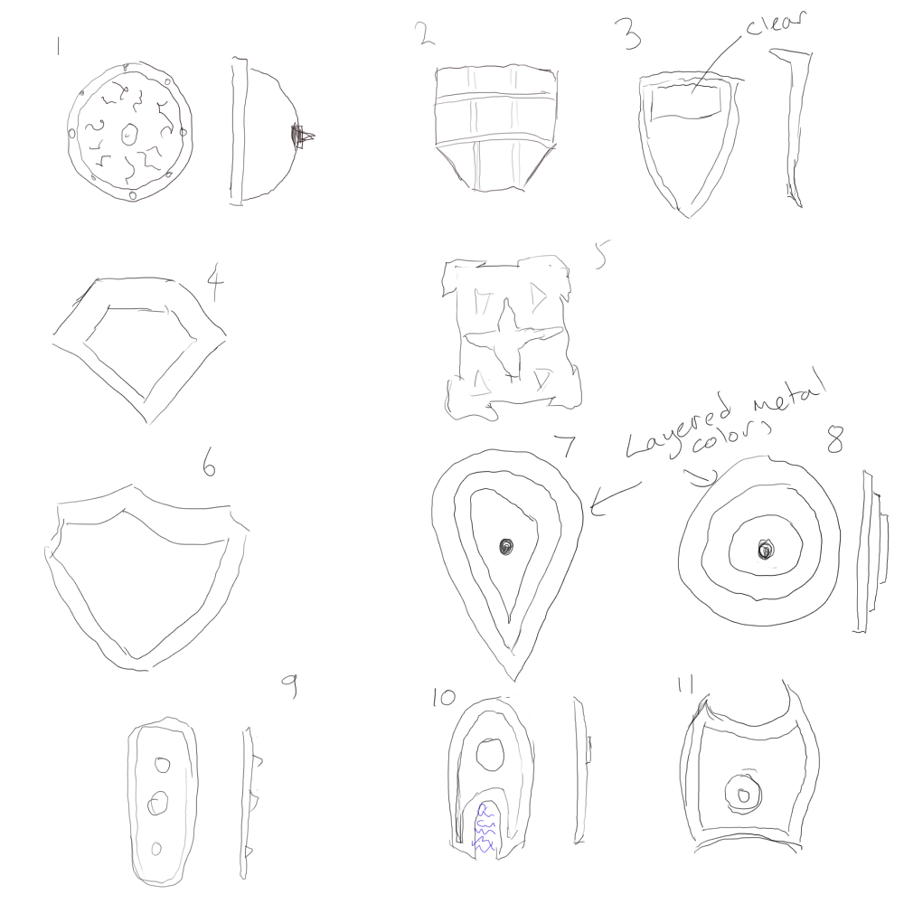
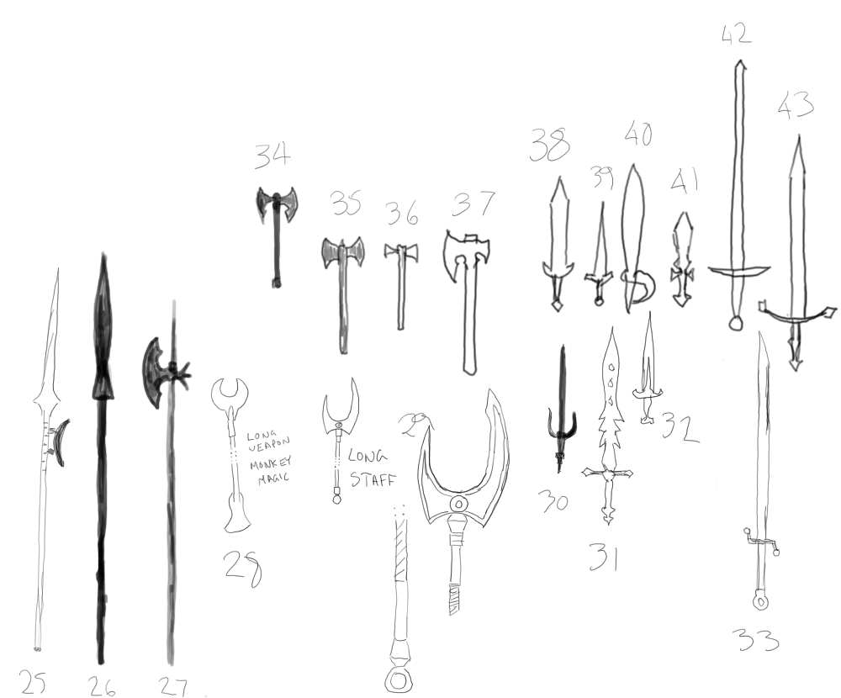
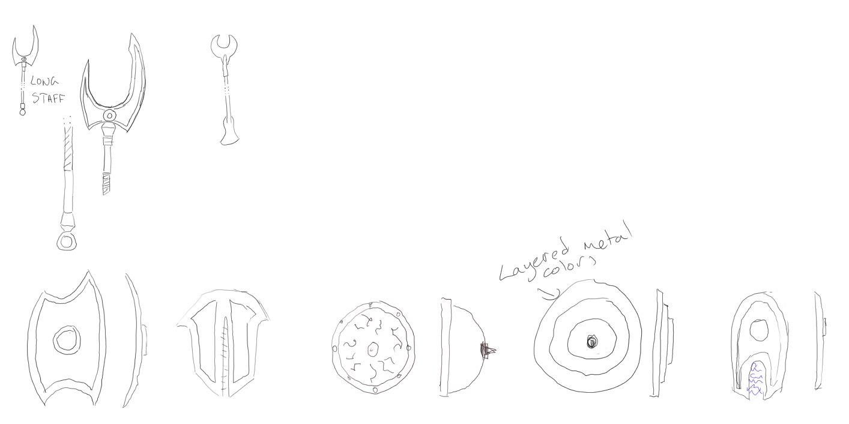
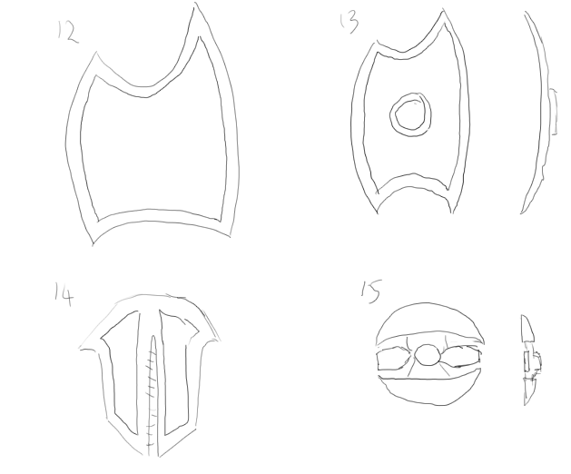
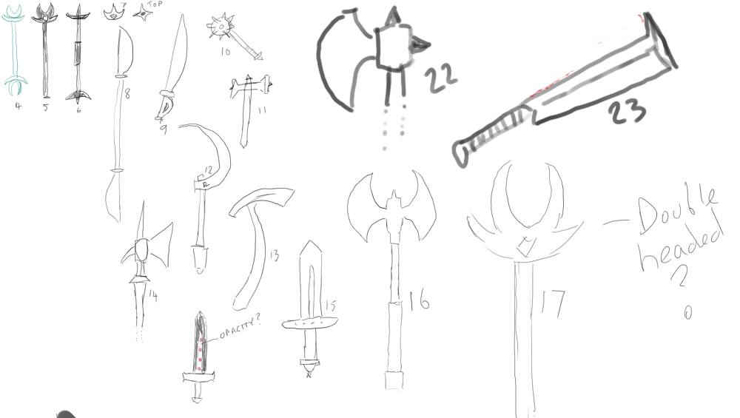
Pre-Production | Reference Sheet
Gather reference images and create a reference sheet for your proposed assets, insert the reference sheet below.

Slide 16
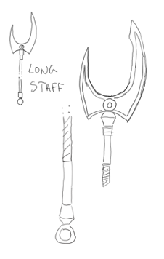

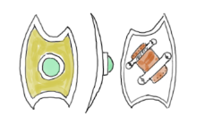
Pre-Production | Thumbnails
Create at least 3 thumbnail images for each asset (sketches or silhouettes). Thumbnails must include the overall form and major details. Each thumbnail should only take 1-2 minutes to complete. Insert the completed thumbnails below and obtain feedback from your peers/trainer.
Bladed Weapon
Shield

Slide 17
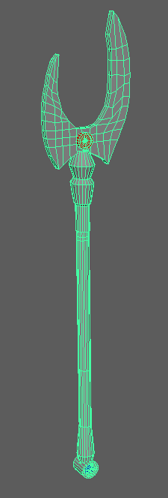
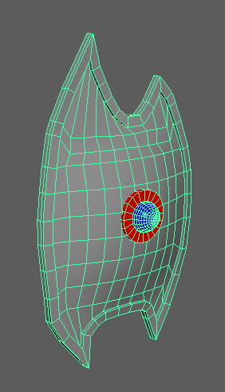
Pre-Production | Primitive Blockouts
Using 3D primitives create a primitive blockout for each of your assets based on the selected thumbnail. Screen capture the blockouts and insert them below.
Bladed Weapon
Shield

Slide 18
Pre-Production | Concept Feedback
You Must gather feedback and obtain approval for pre-production before modelling the assets. Feedback will be given verbally by your trainer, take notes below.
Feedback
Reduce the geometry around uniformly smooth surfaces so that the budget can be spent elsewhere. This includes the gem on the shield, the metal plate on the shield, the shaft and the pommel on the polearm. Spend the geometry budget freed up by previous action adding further depth to outline. Adding chinks and cuts in the blades and banding. Adding bumps in the grip. Apply soften edges to geometry and make sure the asset looks good when this is applied, and no visual anomalies are present. Rearrange some of the vertices so that the faces are convex and the mesh contains no concave faces. Rearrange the geometry so that the silhouette is smoother. This is applicable to both the blade and the shield outline. Merge pommel and banding meshes by editing components.

Slide 19
Pre-Production | Concept Approval
Describe how you have addressed the feedback received. Below insert an image of the adjustments made based off feedback.
Action Taken Based on Feedback | Approved
The initial block out models were created so that they had the correct shape and the required geometry to allow procedural texturing with minimal paint layers but little attention was paid to where the triangle budget was spent or how the flow of quads would respond to smoothing. As a result the decision was made to completely recreate the geometry from scratch with more attention paid to where the original feedback identified problems.
✓
I confirm that the concepts are my own or do not infringe copyright
Image demonstrating applied feedback

Slide 20
Production

Slide 21
Production | Bladed weapon
Create the bladed weapon mesh using the chosen modelling methods, ensuring that the mesh is clean with efficient topology. UV unwrap the mesh, ready for texturing and save a UV snapshot. Screen capture the finished mesh in shaded wireframe and checkered texture mode in Maya and insert the images below.
Perspective Shaded Wireframe
Checkered Texture
UV Unwrap

Slide 22
Production | Shield
Create the shield mesh using the chosen modelling methods, ensuring that the mesh is clean with efficient topology. UV unwrap the mesh, ready for texturing and save a UV snapshot. Screen capture the finished mesh in shaded wireframe and checkered texture mode in Maya and insert the images below.
Perspective Shaded Wireframe
Checkered Texture
UV Unwrap

Slide 23
Production | Mesh Clean Up
Before exporting your asset:
Check that the mesh scale is accurate.
Delete history (edit, delete all by type, history).
Run the cleanup tool and resolve any issues.
Move the object to the centre/origin of the world space (the grid is the ground).
Move the pivot to the centre/origin of world space (0 in XYZ).
Clean-up the outliner and rename the meshes in-line with the asset list.
Freeze transformations (modify, freeze transformations).
Save your work and ensure you have a backup.
List two mesh issues and describe why it's important to resolve them.
Answer here

Slide 24
Production | Mesh/UV Feedback
You Must gather feedback and obtain approval for the meshes and UV’s before texturing the assets. Feedback will be given verbally by your trainer, take notes below.
Feedback
Answer here

Slide 25
Production | Mesh/UV Approval
Describe how you have addressed the feedback received. Below insert an image of the adjustments made based off feedback.
Action Taken Based on Feedback | Approved
Answer here
Image demonstrating applied feedback

Slide 26
Production | Bladed Weapon Textures
Create the required texture maps for the bladed weapon, utilising a non-destructive workflow. The asset must use a single material, which has been named appropriately. Screen capture the textured asset, export each texture map and insert the images below.
Base Color
Metallic
Textured Mesh
Roughness
Normal

Slide 27
Production | Shield Textures
Create the required texture maps for the shield, utilising a non-destructive workflow. The asset must use a single material, which has been named appropriately. Screen capture the textured asset, export each texture map and insert the images below.
Base Color
Metallic
Textured Mesh
Roughness
Normal

Slide 28
Completed Production

Slide 29
Completed Production | Final Result
Compose both objects into a single scene and present it in a real-time engine. Apply all required textures, light the scene and add any post effects as required. Take a beauty render of the scene and insert the image.
Beauty Render

Slide 30
Evaluation

Slide 31
Evaluation | Post-Mortem
Did the assets turn out as you expected? If not, how are they different?
Answer here (~25 words)
What were the most challenging aspects of creating your assets?
Answer here (~25 words)
What aspect of your assets are you most proud of and why?
Answer here (~25 words)
If you were to create the assets again or had more time, what would you change or do differently?
Answer here (~25 words)
What new skills/techniques did you learn during the project?
Answer here (~25 words)

