Slide 1
Environment Pipeline
Assessment - Game Art
Peter Donald
CUADES412 Interpret and respond to a design brief
CUAPPR511 Realise a body of creative work
CUAANM512 Create 3D digital environments
CUAACD531 Refine drawing and other visual representation tools

Slide 2
Introduction
Introduction:
This assessment will go through the process of planning, designing and creating a small 3D environment using a modular asset set, suitable for a real time engine.
The provided brief is designed to collect all the evidence of competency required for this subject. Following an alternative brief and/or presenting additional evidence of competency needs to be negotiated with your trainer. Further information on the assessment process and requirements can be found in the unit’s subject and assessment guide.
The assessment will include:
Analysing briefs.
Industry research.
Gathering reference and resources, developing concept art and greyboxing environments.
Creating asset lists and using appropriate naming conventions.
Modelling, UV unwrapping and texturing objects.
Baking of high poly source mesh onto a low poly production model
Creating PBR texture maps.
Lighting and presenting environments.
Gathering and addressing feedback and conducting a post-mortem review.
Observing and maintaining healthy work practices.
The assessment instructions:
All sections marked in green must be edited/filled out by each student. Be sure to replace “Student Name” on the first slide and include your name in the document filename.

Slide 3
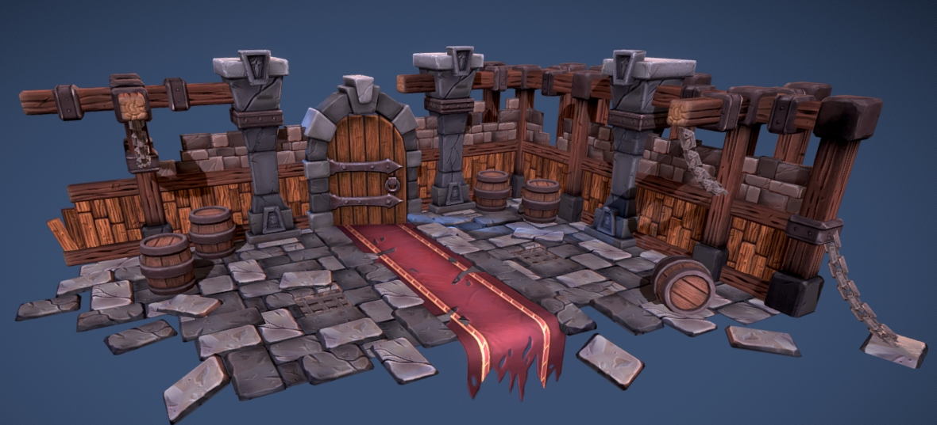
Brief | Environment
Overview:
Design and create a small environment with a consistent visual style and present the environment a in real-time engine.
The environments must:
Utilise modular asset sets where appropriate (minimum of 6 modular pieces and maximum of 14 pieces)
Include one hero asset
Stylized Dungeon Environment by Tobias Koepp

Slide 4
Brief | Requirements
Pre-production:
The thumbnails, greybox, lighting previsualisation and paint over must be in-line with the brief and your environment description.
Concepts and work created must adhere to copyright and intellectual property legislation.
Modelling:
Each mesh should have a polycount suitable for a real time engine.
Mesh topology must be clean and efficient.
Each stage of the project must be approved by your trainer before moving on to the next (Pre-production, Production).
Appropriate backups must be made throughout production (incremental saves).
Textures:
Where possible assets should share materials.
Texel density should be consistent across all assets.
UV layouts must be clean and efficient.
Must make use of at least one tiling texture.
Textures must use a non-destructive workflow utilising layers, masks and blend modes where appropriate.
All textures are to be exported in the resolution defined in the asset list in .tga format.
Presentation:
The final environments must be lit and presented in a real-time engine.

Slide 5


Submission | Guidelines
The following files must be uploaded to Canvas for assessment. Ensure files are in appropriate folders and folders are zipped. All folders and submitted files must adhere to the provided naming conventions. Naming convention is SubjectName_AssetName_FirstNameLastName.
Example folder structure is below:
Submit the PowerPoint Workbook for the subject and any associated assessment files using the folder structure shown on this slide.
Within each folder, please submit relevant files:
Pre-Production Folder
        Thumbnail concepts psd file
        Greybox maya scene
        Production Folder
        Model and texture source files
        Completed Production Folder
        Environment final high quality beauty render saved as a jpg
        Packaged final Marmoset Toolbag scene
EnvironmentPipeline_FirstNameLastName
EnvironmentPipeline_Game_FirstNameLastName
Pre-Production
Production
CompletedProduction

Slide 6
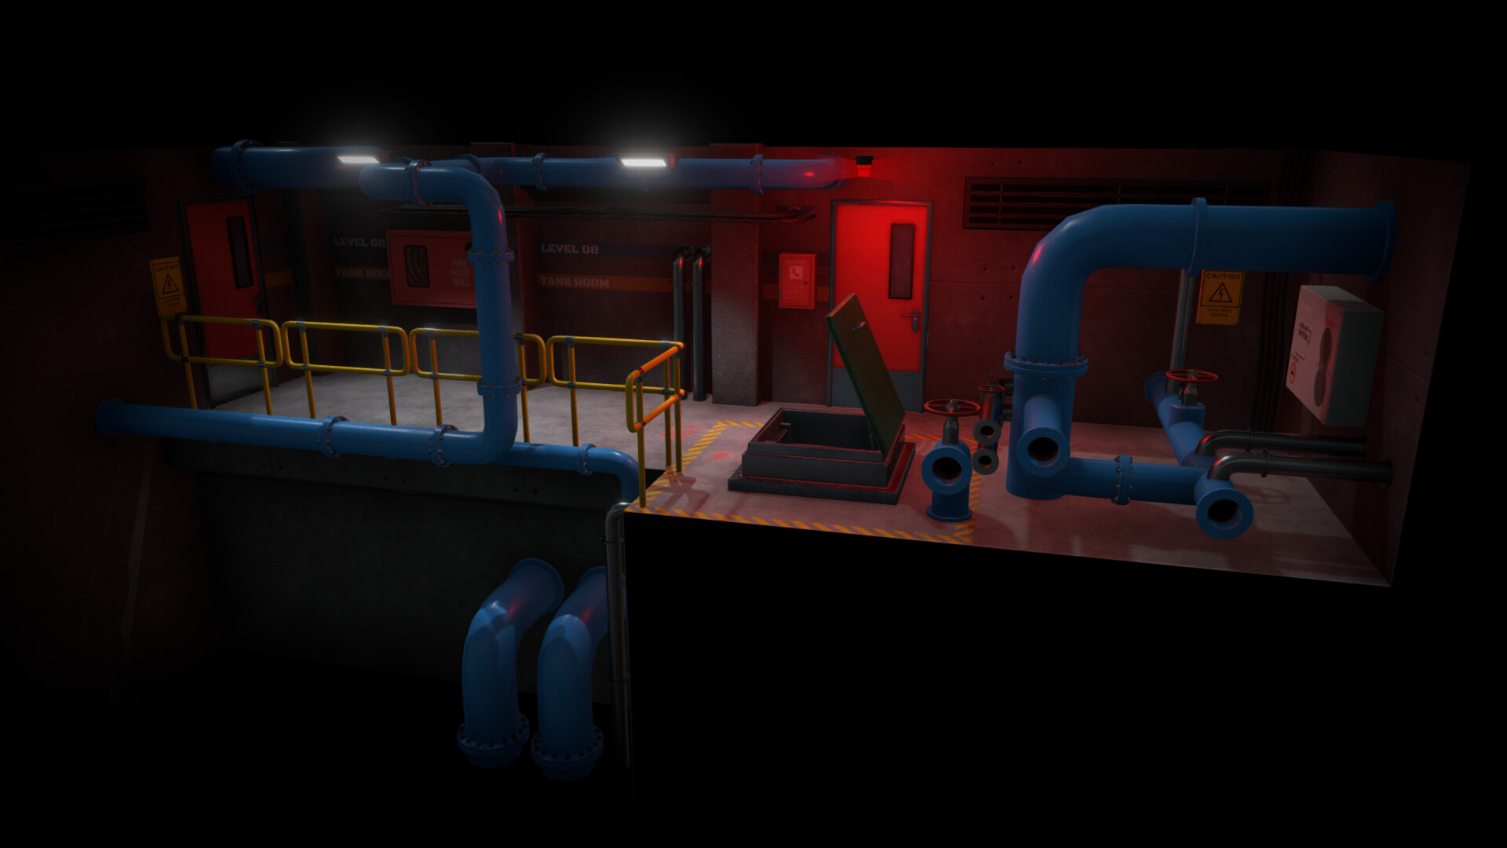
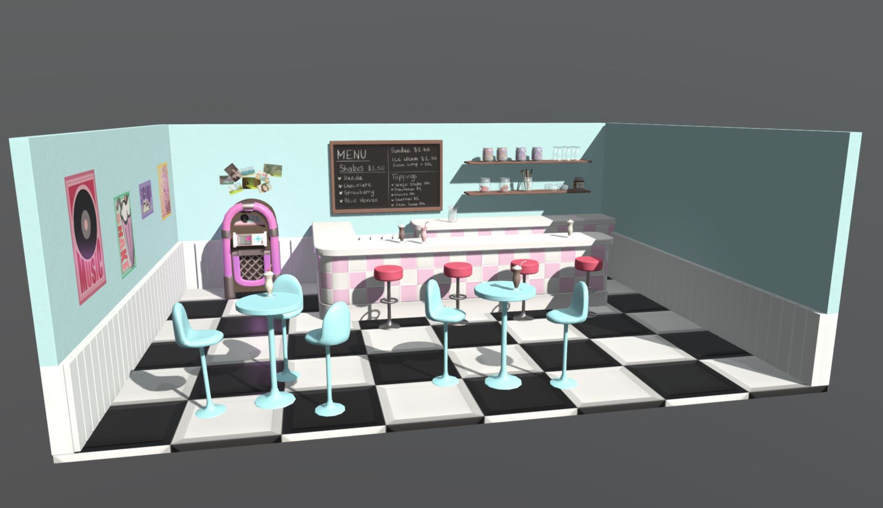
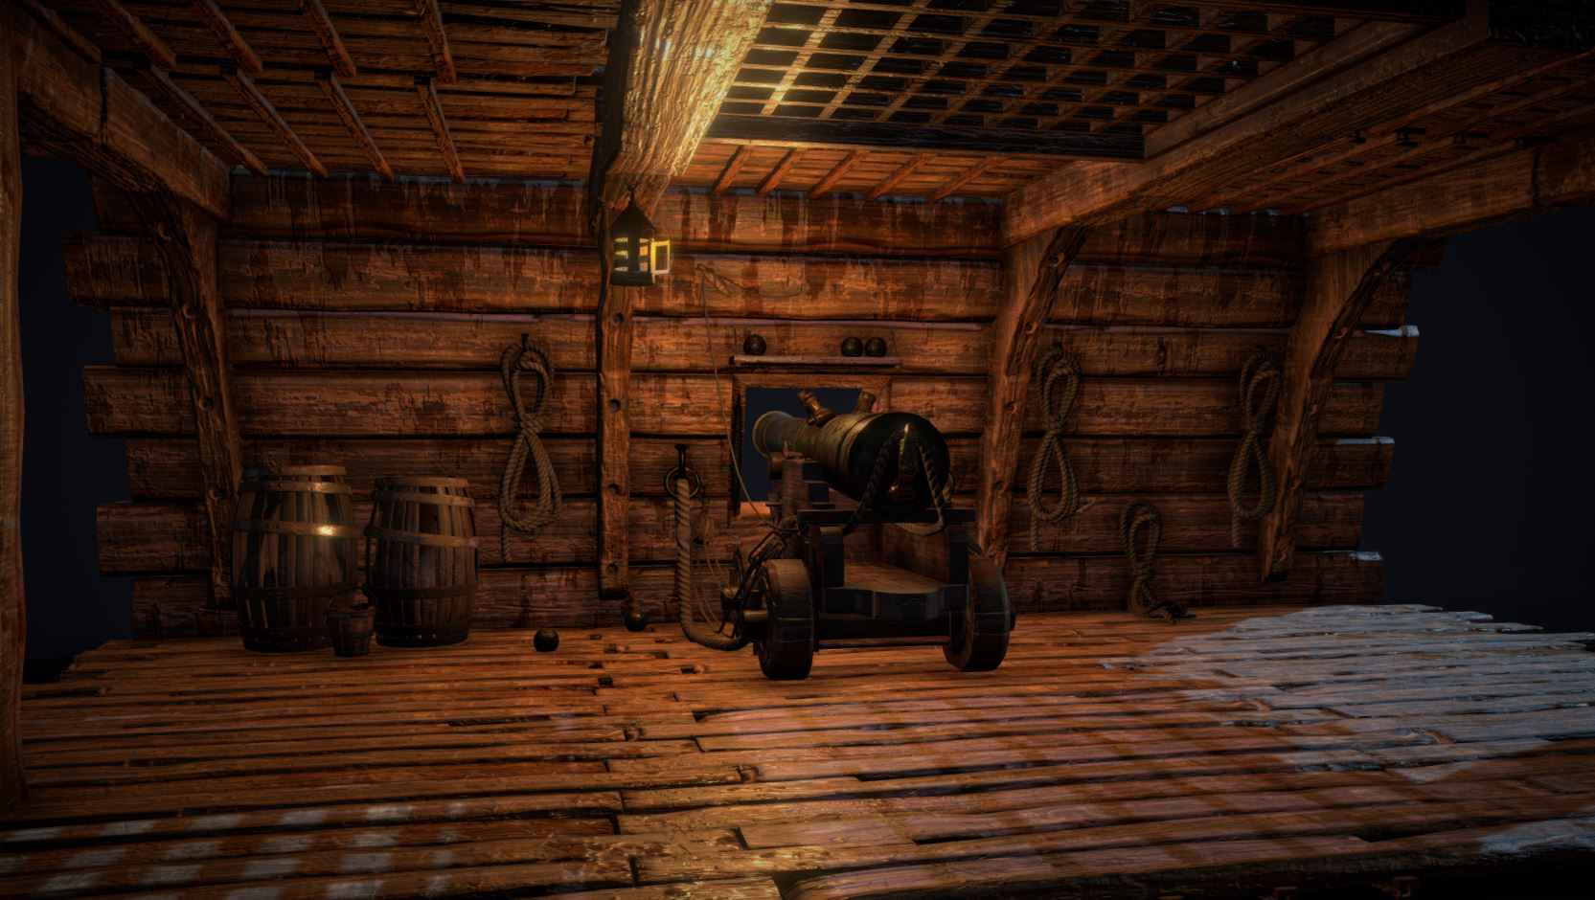
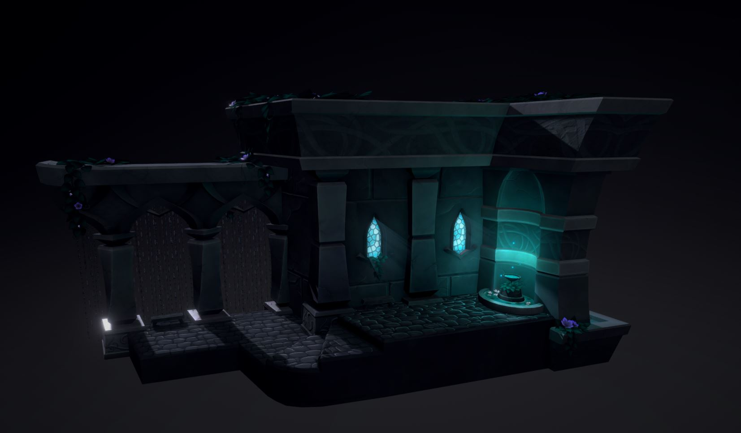
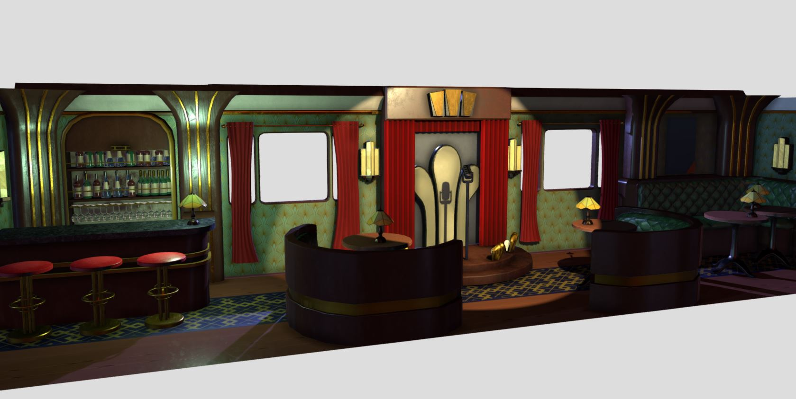
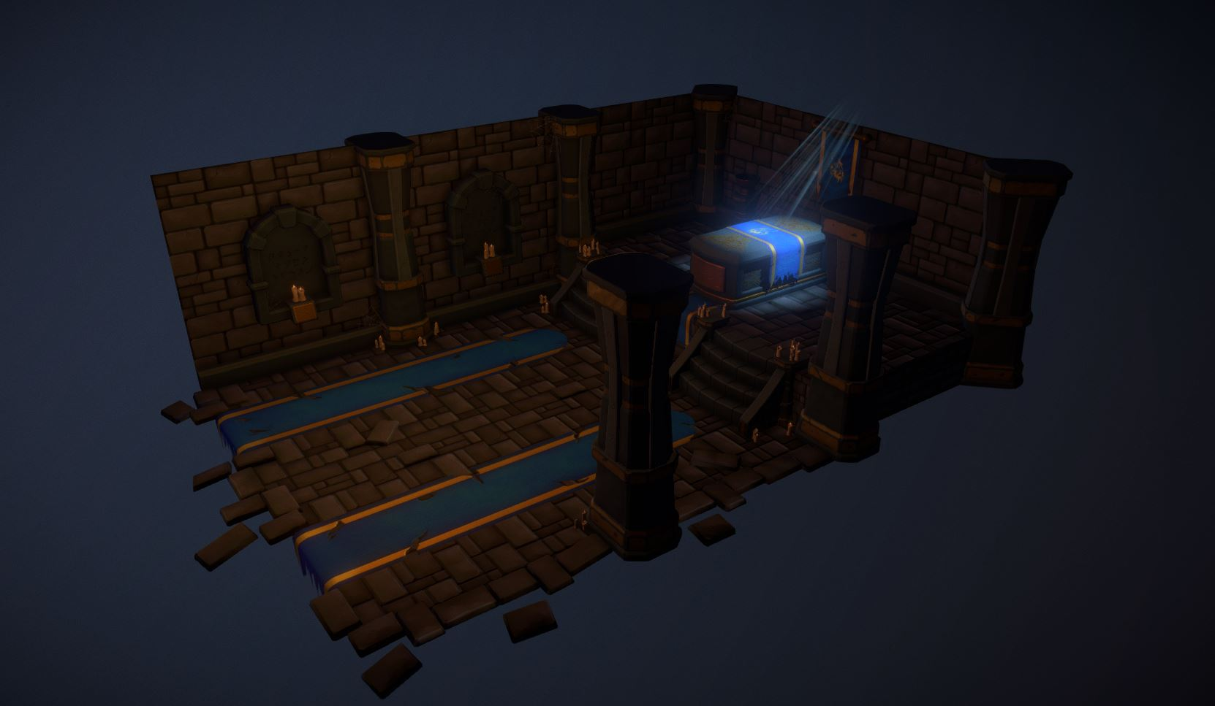
Examples | Student Work
Below are examples of high-quality submissions from ex-student for inspiration.
James Cocks
Alica Brown
Ben Lindridge
Jessica Murphy
Molly Broadstock
Brett Murphy

Slide 7
Maintain healthy work practice

Slide 8
Maintain Healthy Work Practices | WHS
When working in a studio environment it is important to maintain healthy and safe work practices. Before starting the assessment ensure that the following safe work practices are being maintained by evaluating your work environment using the checklist below.
✓
The workstation is setup ergonomically:
An ergonomic workstation requires that the position/height and angle of the monitors, chair, keyboard, mouse and desk can be adjusted to maintain a healthy posture and that there is an appropriate level of lighting in the room.
Regular breaks have been scheduled:
It is important to take regular breaks when working at a computer for any long period of time.
The work environment is free of hazards:
Hazards are potential sources of injury or ill-health which may include mechanical, physical, chemical, psychological and electrical hazards.
✓
✓
Outline the work health and safety requirements that must be considered when creating concepts in an office environment.
There are many work health and safety requirements that must be considered in an office environment but some more prominent considerations for a studio may include:
1. Ergonomics: Ensuring that office furniture and equipment, such as chairs, desks, and computer monitors, are set up in a way that minimizes the risk of injury or strain. This includes ensuring that the graphical tablet is at a comfortable height and angle if present in the work environment.
2. Avoid Eye strain: Working with a graphical tablet for extended periods can put a strain on the eyes, so it is important to take regular breaks and ensure that the workspace is adequately lit.
3. Repetitive strain injury (RSI): Working with a graphical tablet can involve repetitive motions, such as moving the pen across the tablet surface. This can increase the risk of RSI, so it is important to take regular breaks and stretch the hands and arms to prevent injury.
4. Mental health: Make sure you maintain a good work-life balance, take regular breaks and maintain an exercise regime. Communicate with your manager help to identify and address issues before they become problems. Take advantage of training opportunities provided by your employer.

Slide 9
Pre-Production

Slide 10
Pre-Production | Industry Research
Research and describe the role of an environment artist.
Answer here
Research and provide at least two links to environment concept art tutorials and describe what you learnt from each.
Answer here
List two emerging technologies that could be utilised by environment artists and describe the opportunities and challenges they represent.
Answer here

Slide 11
Pre-Production | Environment Description
Considering the brief, write a description of the environment below. Include the overall atmosphere, the hero object, all other objects in the environment and their condition, the primary light source as well as any other relevant information. The more detail you include in your description the easier it will be to convey the concept and to create an asset list.
E.g., The scene is the gloomy run-down interior of a pirate captain's quarters, cold blue moonlight streams through a large window onto a simple weathered and worn wooden table with four simple chairs. The table has a ragged treasure map spread across it upon which sits battered old chest full of gold coins which are also scattered around the table and floor. The hero object, a blood-stained cutlass rests beside the chest along with 3 pewter goblets and an empty bottle of rum. A simple candle stick flickers gently over the scene with a soft orange glow.
Environment:
Answer here (~50 words)

Slide 12

Pre-Production | Moodboard
Gather reference and other imagery and create a moodboard for your proposed environment, insert the moodboard below.

Slide 13
Pre-Production | Hero Asset Thumbnails
Create at least 3 different thumbnails of the hero asset, in-line with the environment description. Thumbnails must include the overall form and major details. Insert the completed thumbnails below and obtain feedback from your peers/trainer.​

Slide 14
Pre-Production | Asset List
Create an asset list for the environment. List each asset below, include the asset name, estimated polycount, texture size. Estimate the hours required to complete each asset and the total cost based on industry contract rates. Duplicate slides where required.
Asset | Polycount | Textures | Tex. Size | Texture Name | Time (Hrs) / Cost ($AUD)
AssetName.fbx | Polycount | BaseColor Metallic Roughness Normal | Texture Size Texture Size Texture Size Texture Size | AssetName_BaseColor.tga AssetName_Metallic.tga AssetName_Roughness.tga AssetName_Normal.tga | Time / Cost
AssetName.fbx | Polycount | BaseColor Metallic Roughness Normal | Texture Size Texture Size Texture Size Texture Size | AssetName_BaseColor.tga AssetName_Metallic.tga AssetName_Roughness.tga AssetName_Normal.tga | …
AssetName.fbx | Polycount | BaseColor Metallic Roughness Normal | Texture Size Texture Size Texture Size Texture Size | AssetName_BaseColor.tga AssetName_Metallic.tga AssetName_Roughness.tga AssetName_Normal.tga | …

Slide 15
Pre-Production | Schedule
With your trainer, negotiate a schedule covering each stage of development and include the milestone dates. Research and list the software required for each stage.
Task | Milestone Date | Software Required
Pre-production | 10/3 | Adobe Photoshop, Autodesk Maya
Modelling & UV’s | 27/3 | Autodesk Maya
Texturing | 31/3 | Substance Painter, Adobe Photoshop
Presentation | 14/4 | Unreal Engine
Post-production | 21/4 | N/A
Outline any production concerns or potential risks that may result in the project not being completed by the deadline:
Unreal Engine is not technology that is taught as part of the course (at this stage) and adopting it requires substantial independent learning. The primary advantage of moving to Unreal Engine is an improved lighting rigs and gaining experience in more realistic constraints of a modern real-time engine. The scene was designed with the capabilities of light present in engine.
To mitigate the risk, the learning and experimentation with Unreal will need to be experimented with before the presentation phase and the modelling should not be done assuming that Unreal specific features (i.e. nanite geometry engine) are present when doing modelling. To achieve a similar look in Mamoset will require substantially more work when arranging lights and avoiding the use of ray traced rendering.

Slide 16
Pre-Production | Greyboxing
Create a greybox of the environment, using simple primitive blockouts for all the assets in the scene. Clean up your scene and name all your assets in the outliner, in line with the asset list. Insert a screen capture of the completed environment greybox below.

Slide 17
Pre-Production | Lighting Previsualisation
Add lighting to your greybox scene to convey the intended mood of the environment. List and describe each light below, including the light source, type of light and the colour.
Lights:
1. Source
Type
Colour
2. Source
Type
Colour
3. Source
Type
Colour
Lighting Previs

Slide 18
Pre-Production | Paint Over
Using Photoshop or an equivalent, paint details and textures over the screen capture of your lighting previsualisation to create a piece of key art, ensure that it captures the look and feel of your final environment and include colour palette in-line with the environment colour scheme on the image.
Paint over

Slide 19
Pre-Production | Peer Feedback
You Must gather peer feedback on your pre-production of your environment.
Feedback | Actions Taken Based on Feedback
Answer here | Answer here

Slide 20
Pre-Production | Trainer Feedback
You Must gather feedback and obtain approval for pre-production before modelling the assets. Feedback will be given verbally by your trainer, take notes below and describe how you will address the feedback.
Feedback | Actions Taken Based on Feedback | Approved
Answer here | Answer here
I confirm that the concept is my own or does not infringe copyright

Slide 21
Production

Slide 22
Production | Modelling
Create each model, ensuring that the mesh is clean with efficient topology. Screen capture all the objects in shaded wireframe mode and insert the images below.

Slide 23
Production | Mesh Clean Up
Before exporting your asset:
Check that the mesh scale is accurate.
Delete history (edit, delete all by type, history).
Run the clean-up tool and resolve any issues.
Move the object to the centre/origin of the world space (the grid is the ground).
Move the pivot to the centre/origin of world space (0 in XYZ).
Clean-up the outliner and rename the meshes in-line with the asset list.
Freeze transformations (modify, freeze transformations).
Save your work and ensure you have a backup.

Slide 24
Production | UV Unwrapping
UV unwrap all the meshes ready for texturing, ensure that the texel density is consistent and that there is minimal distortion. Screen capture all the objects in checkered texture mode and insert the images below.

Slide 25
Production | Modelling/UV Feedback
You Must gather feedback and obtain approval for the meshes and UV’s before texturing the assets. Feedback will be given verbally by your trainer, take notes below.
Feedback
Answer here

Slide 26
Production | Modelling/UV Approval
Describe how you have addressed the feedback received. Below insert an image of the adjustments made based off feedback.
Action Taken Based on Feedback | Approved
Answer here
Image demonstrating applied feedback

Slide 27
Production | Texturing
Create the required texture maps for each asset, utilising a non-destructive workflow. Screen capture the textured assets and insert the images below.

Slide 28
Completed Production

Slide 29
Completed Production | Presentation
Import the modular textured environment into a real-time engine for presentation. Light the scene and add any desired post effects. Take a beauty render of the scene and insert the image below.
Environment Beauty Render

Slide 30
Evaluation

Slide 31
Evaluation | Post-Mortem
Did the environment turn out as you expected? If not, how is it different?
Answer here (~25 words)
What were the most challenging aspects of creating your environment?
Answer here (~25 words)
What aspect of your environment are you most proud of and why?
Answer here (~25 words)
If you were to create the environment again or had more time, what would you change or do differently?
Answer here (~25 words)
What new skills/techniques did you learn during the project?
Answer here (~25 words)

