Slide 1

Whirlwind:
Overload protection, fault-tolerance and self-tuning in an Internet services platform
Peter Donald <peter@realityforge.org>
La Trobe University, Melbourne, Australia

Slide 2
Incident Resource Information System
  Used during emergency situations
  Tracks movement of resources
  Generates payments for personnel

Slide 3
Dramatic load increase during emergencies
  Resources organized into a hierarchical tree modeling geographic regions
  Clients listen to and update specific sub-trees
  Emergencies cluster geographically
  Resource movements increase during emergencies

Slide 4
Load increase lead to...
  Response time spikes
  Throughput loss
  Unpredictable behavior
  Crashing

Slide 5
Requirements
  Load management strategies:
    Admission control
    Service degradation
    Throttling
    Adaptive scheduling policy
  Fault tolerance
  Self-Tuning
  Future hardware upgrade path

Slide 6
Design Elements
  Processes
  Messages
  Groups
  Principals
  Message Predicates
  Schedulers
  Adaptive Concurrency Level

Slide 7
Processes
  Isolated
  Sequential
  Cleanup on termination via onTerminate() method
  Normal or non-normal termination
  Monitor other processes

Slide 8
Messages
  Asynchronous
  Post operation can fail
  Post failure typically indicates overload
  Sender handles failure

Slide 9
Groups
  Contains processes with similar;
    resource,
    computational and
    concurrency requirements
  Share a;
    message predicate,
    thread pool and
    scheduler
  Cohort scheduling

Slide 10
Principals
  Single Unit of Work
  Single Unit of Load
  Associated with multiple processes

Slide 11
Message Predicates
  Queried before message queued
  Rejection typically signals the group is overloaded
  Rejection decision based on;
    message cost
    class or priority of principal associated with target process
  Rejection allows sender to determine response
    Admission control
    Service degradation

Slide 12
Schedulers
  Determine order that worker threads handle processes
  FIFO by default
  "Request Aware Scheduler" driven by the associated Principal
  "Resource Aware Scheduler" driven by the estimated change in available resources after scheduling a process

Slide 13
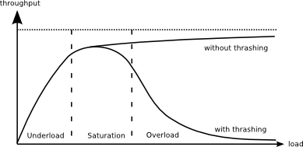
Adaptive Concurrency Level
  Adjust pool size to maximize throughput based on feedback
  Controller based on heuristics or control algorithms such as method of incremental steps

Slide 14
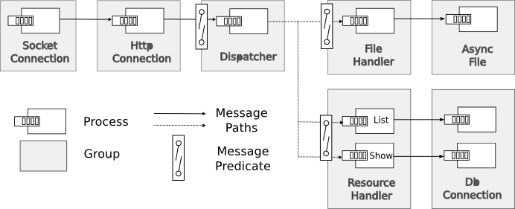
Example

Slide 15
Evaluation
  Actively used over a period of 5 years
    Evolution rate slowed down and moved to convenience rather than correctness or performance
  Survived February 2009 Fires.
    Worst fire recorded in Australia's history
    Extreme load for long periods of time

Slide 16
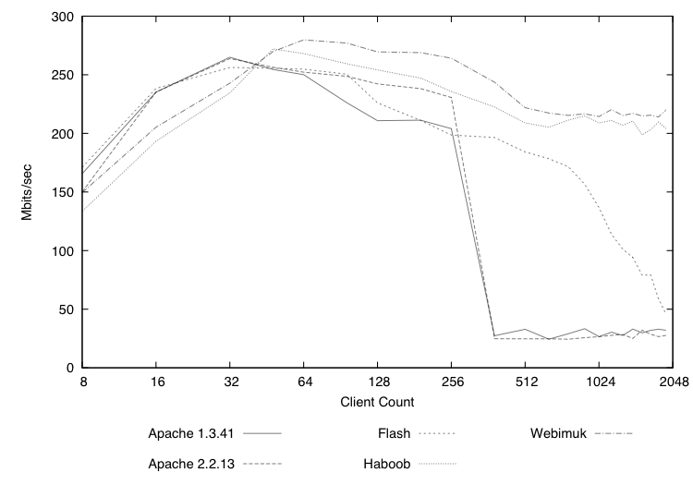
Performance

Slide 17
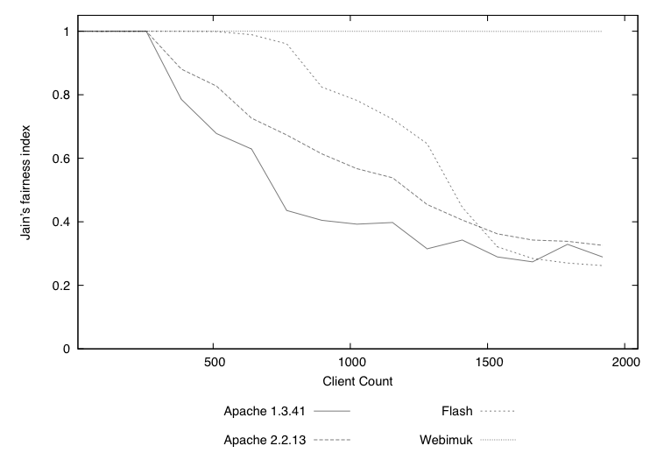
Performance (2)

Slide 18
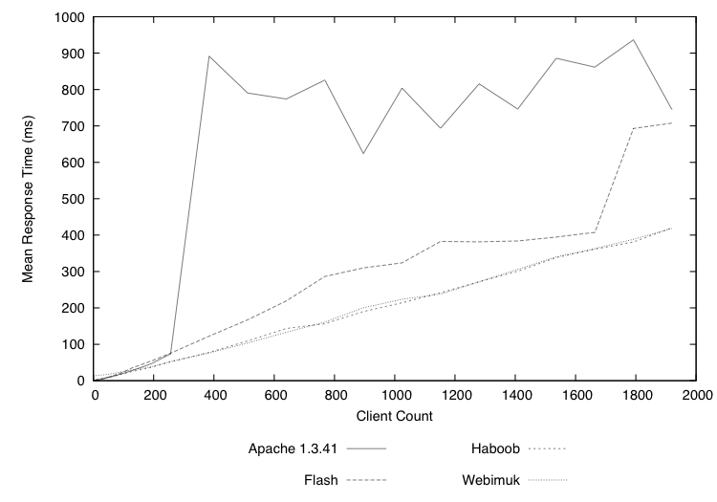
Performance (3)

Slide 19
Questions?

