Slide 1
A General Purpose Software Architecture for Scalable, Well-Conditioned Internet Services
Peter Donald <peter@realityforge.org>

Slide 2
Internet Services Today
Internet Services are increasingly part of our lives
  E-Commerce: e-Bay, Amazon.com
  E-Mail: Gmail, Hotmail
  E-Banking: B-Pay, Net Banking
  VOIP: Skype
  Instant Messaging: ICQ, AIM, SMS
  Game Servers: World Of Warcraft
  Other: Google, Dictionary.com
How many of these do you use a day?

Slide 3
Today's Demands
Internet Services are highly concurrent
  Yahoo: 1.2 billion page views / day
  AOL Web Caches: 10 billion hits / day
  Google: 290 million searches / day
Internet Services must be resilient to load
  Extreme load spikes occur, usually when the service is most valuable
  Downtime is not acceptable in many cases.
Internet Services must be easy to create and deploy
  Static websites, PHP, Java Servlets

Slide 4
Tomorrows Demands
ITUs visions for the future of communications
  Location aware
  Broader range of devices connected to network
    Set-top boxen, phones, PDAs, PCs, gaming devices etc
  Operation in times of crisis
    Emergency broadcast
    911 phone service
  More secure, robust networks
    Less susceptible to spam, phishing, adware etc
  Everything has a presence in cyberspace
    Pay for goods at vending machine electronically

Slide 5
Scalable, Well-Conditioned Services
Scalable
  The software will be capable of handling 10,000’s of simultaneous connections.
Well-Conditioned
  The software will gracefully degrade service when load increases
  The software must not “meltdown” when extreme load peaks occur.

Slide 6
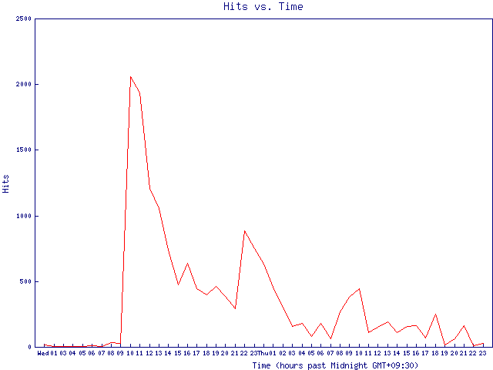
Mild Slashdot Effect (load x 40)
Mild Slashdot Effect for http://slash.dotat.org on July 26 2000
http://slash.dotat.org/~newton/installpics/slashdot-effect.html

Slide 7
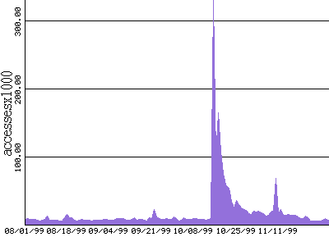
USGS Pasadena Office Traffic
October 16, 1999 Hector Mine Earthquake
http://pasadena.wr.usgs.gov/office/stans/slashdot.html

Slide 8
Expect Overload
Flash crowds occur because there is often a large correlation in user demand
  “Slashdot Effect” can suddenly increase interest in web site.
  Earth quake dramatically increased demand for USGS Pasadena Office web site.
  Launch of World of Warcraft placed a huge demand on the game servers.
  CNN received 30,000 hits / sec on Sept. 11th causing 2.5 hours downtime.
Peak load can be several orders of magnitude greater than the average.
  This makes over provisioning infeasible.

Slide 9
Software Architecture
Applications with high concurrency are hard to write
  We need to make it easier
The Software Toolkit chosen will often define the level of scalability that can be achieved
  “PHP” vs “Servlets and JDBC” vs “EJB and Presentation Layer”.
  Existing Software Toolkits are usually limited to specific application domains or models.

Slide 10
Software Architecture
Operating systems virtualize resources to provide maximum resource transparency
  Does not give the application feedback about the cost of operations. (i.e. page faults, access speeds for disks etc).
  May support static resource containment. (i.e.. CPU or memory limits).
  Does not allow application to participate in resource allocation and scheduling
Thread/process–based concurrency or event-based concurrency

Slide 11
Thread/Process-based Concurrency
High resource usage makes it inappropriate for massive scalability
  Context switch overhead
  Per-thread stack space
  Synchronization primitives such as contended locks
  Even light-weight user-land thread implementations do not usually scale to more than 8000 threads.
Designed for time-sharing systems.
  OS multiplexes “virtual machines” on hardware.
  Does not allow applications to participate in scheduling.

Slide 12
Thread/Process-based Concurrency
Consider a simple HTTP server
Single-Process Server
  Can not handle simultaneous requests
Multi-Process Server
  Can handle multiple requests
  A slow modem user can tie up a single process.
  The number of processes must be limited or thrashing occurs.
  The maximum number of processes is usually an estimate by the administrator. This estimate is difficult to get right.
  i.e. Apache Web Server uses this model and has a limit of 150 processes out of the box.

Slide 13
Event-based Concurrency
Requires a limited number of threads to process events.
  No longer limited by the OS support for threads.
  There is much less overhead per connection.
    Each connection requires a simple data structure rather than the thread stack and associated thread local values.
A slow connection does not tie up the system.
Due to reduced resource usage, an event-based system can usually handle larger number of simultaneous connections.
Applications can participate in scheduling. With application specific knowledge this can increase performance (i.e. Shortest Remaining Processing Time).

Slide 14
Event-based Concurrency
Software support for event-based is limited.
  Limited OS support.
  Limited language support.
Debugging is difficult.
Resource Management is more complex
  Can not rely on the OS to clean up any “dangling” resources
Software is often developed in an ad-hoc manner.
  Modular, reusable code is rarely present.
Must never block.
  This is difficult when you consider page faults or garbage collection in managed runtimes.
Difficult to distinguish between multiple flows

Slide 15
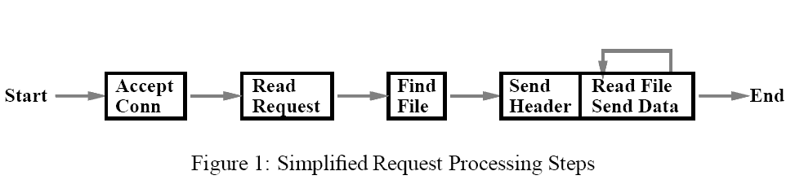
Flash Web Server
Many event-based servers use FSMs
image from “Flash: An Efficient and Portable Web Server”
by Vivek S. Pai, Peter Druschel, and Willy Zwaenepoel

Slide 16
SEDA
The “Staged Event-Driven Architecture” by Matt Walsh
Breaks the application down into “stages” separated by queues
Each stage has an EventHandler that is responsible for implementing the stage-specific logic.
The application becomes a directed graph of stages.

Slide 17
SEDA
SEDA is a combination of both thread-based and event-based programming styles. Each stage has a pool of threads and each thread retrieves events from the queue and passes the events to the EventHandler.
This means that the EventHandler need not be completely non-blocking which simplifies development.

Slide 18
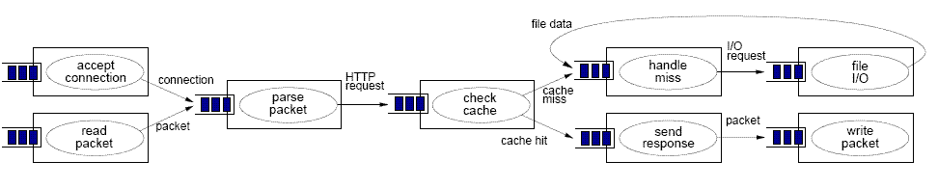
SEDA Web Server
Sandstorm was a SEDA implementation in java
Haboob was a Web server built using Sandstorm
Haboob significantly outperformed Apache and Flash http servers under load.
Image from http://www.cs.berkeley.edu/~mdw/proj/seda

Slide 19
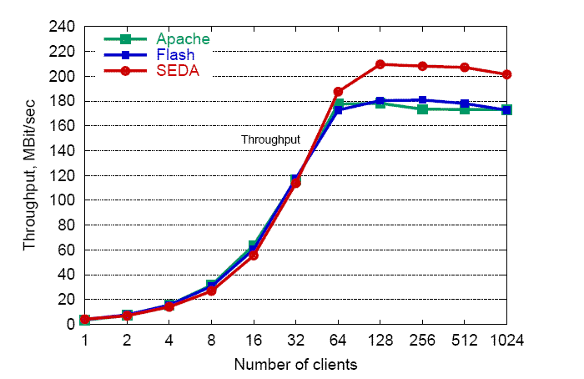
Throughput
Image from http://www.cs.berkeley.edu/~mdw/proj/seda

Slide 20
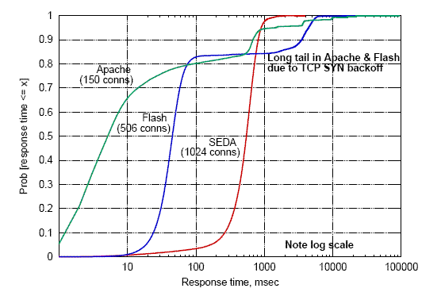
Response Time Distribution
 | SEDA | Flash | Apache
Mean RT | 547 ms | 665 ms | 475 ms
Max RT | 3.8 sec | 37 sec | 1.7 minutes
Image from http://www.cs.berkeley.edu/~mdw/proj/seda

Slide 21
Stage Parameters
Each stage has a number of parameters that effect performance. E.g.
  Batch size: the number of events passed to each thread
    Large batch size → increases throughput by increasing locality
    Small batch size → reduces response time
  Thread Count: the number of threads per stage
    A larger thread count can increase the throughput of stage but too many threads will cause thrashing.
  Queue Size: The maximum number of events in queue
    A large queue can increase response time but a small queue can cause events to be rejected that could be handled.

Slide 22
Feedback System
The parameters are dynamically adjusted by the runtime to achieve desired performance goals.
  Admins can specify performance goals rather than guestimating the static resource allocations that can achieve goal. i.e. the admin may specify “response time < 5 seconds”
The performance characteristics of a stage are often related to the distribution of requests that the stage receives. Using dynamic control allows the application to adjust to new request distributions without admin intervention.

Slide 23
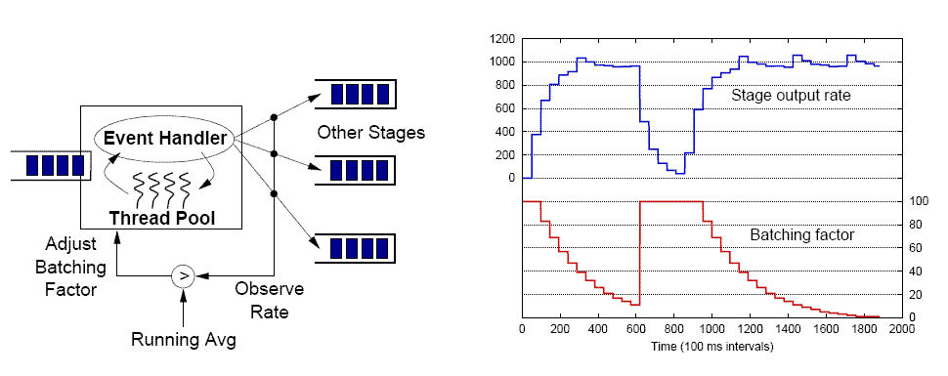
Batch Controller
Image from http://www.cs.berkeley.edu/~mdw/proj/seda

Slide 24
Overload Response
An enqueue operation on a queue can throw an exception to indicate the stage will not handle event.
Events can be rejected if accepting the event would mean that the stage fails to meet its performance requirements.
The application can then choose how to respond to overload.
  “The server is busy. Please try again later”
  Degrade the service in some manner.
    Reduce the fidelity of images transmitted.

Slide 25
SEDA Summary
Pros:
  Decoupled load management.
  Enabled code reuse.
  Dynamic control makes it possible for application to “self-heal” and attempt to meet its performance goals.
Cons:
  Sandstorm code base evolved with several authors, styles and lots of baggage.
  Writing a Sandstorm application is still too complex:
    Application needs to handle with re-ordering of events
    Application needs to ensure appropriate synchronization primitives are in place as events for same flow can be executed from different threads in the same stage.
  Queues introduce latency.
  Controllers are limited.

Slide 26
Whirlwind
Whirlwind started out as a “improved” SEDA implementation
  Consistent design approach
  No more global variables
  Use JMX standard for management
  Remove complexity where possible. Sandstorms API consisted of 5 interfaces (totalling 11 methods), 4 exceptions and several classes. Whirlwinds API consists of a single interface;
public interface EventHandler
{
void handleEvents( Object[] events )
throws Exception;
}

Slide 27
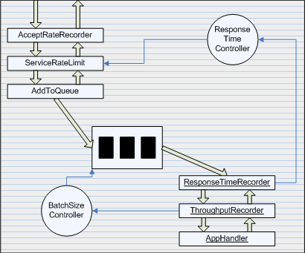
Whirlwind
Whirlwind stages do not have “fixed” pipeline like Sandstorm.
  Application developers can choose the structure of stage according to their particular needs. (i.e. No queue, or many)
Sandstorm stage implemented
using Whirlwind primitives

Slide 28
Whirlwind
Per-flow and per-request resource management.
  Use a generic mechanism for recording resource consumption.
  Expose the resource accounting so that generic load management controllers can take into account these factors when scheduling events.
    Under load the system may prioritize low “cost” requests or requests that will reduce the load on the stage.
Ensure that each flow has events executing in at most one thread per stage.
  Reduce need for synchronization primitives.
  Events are not re-ordered by runtime.
Per-path and per-resource instrumentation and resource management.

Slide 29
Validation
Deployed as part of resource management application in the Department of Sustainability and Environment.
  Only need to sustain ~500 simultaneous clients but it gives the codebase a good workout.
Get the code into the hands of other developers to get feedback from their experience.
Develop a network server and experiment with different resource management approaches and controllers.
  Contemplating a standard server such as HTTP, LDAP, SMTP, IMAP etc
Analyze the code size and complexity of a Whirlwind application to what degree the framework aided software development

Slide 30
Future Work
Develop a cluster or grid enabled version where stages can be replicated across nodes.
Look further into control theory and how it can be used to manage resources across stages as well as within a stage.

Slide 31
Related Work
Staged server (Microsoft Research).
Click modular router.
Scout OS.
Adaptive middleware.
IBMs Autonomic Computing/ “Self Healing” initiative.

Slide 32
Thankyou
And goodbye…

