Slide 1
ALPACA OPTIONS ALPHA · $100,000 PAPER MANDATE
CaiSheng
财神
Autonomous options-volatility allocation
with audited Alpaca paper execution
LANGGRAPH DEBATE → DETERMINISTIC RISK → LEVEL-3 MLEG → BROKER RECEIPT
Paper only · Replay is never presented as competition P&L
Notes:
[Sources]
- https://alpaca.markets/learn/building-a-multi-agent-ai-trading-system-on-alpaca
- /Users/yanjunjie/Documents/Alpaca/docs/ONE_PAGE_WRITEUP.md

Slide 2
STRATEGY
02
The agent trades volatility mispricing—not direction
Will realized movement exceed or undershoot the move priced by executable option quotes?
forecast edge = expected |return| − executable straddle-implied move − costs
LONG STRADDLE
SHORT IRON BUTTERFLY
NO TRADE
Buy movement when the lower confidence bound survives spread, fees, and slippage.
Sell overpriced movement only with defined wings and a verified maximum loss.
Abstain on stale data, weak edge, poor liquidity, OOD inputs, or any risk veto.
Notes:
[Sources]
- /Users/yanjunjie/Documents/Alpaca/README.md
- /Users/yanjunjie/Documents/Alpaca/src/volagent/quant/forecast.py
- /Users/yanjunjie/Documents/Alpaca/src/volagent/quant/strategy_selector.py

Slide 3
CREATIVITY & ORIGINALITY
03
Parallel specialists debate; deterministic code owns authority
LOCKED MARKET
SNAPSHOT
EVENT + VOL
SPECIALISTS
LONG vs SHORT
ADVOCATES
MODEL-RISK
CRITIC
20-POINT
RISK GATE
ALPACA
EXECUTION
Language-model participation is recorded per role. Pricing, EV, sizing, risk, execution, monitoring, and reconciliation remain deterministic.
The Alpaca article inspired specialist isolation and a critic layer; CaiSheng adds options-native math, durable intents, and a non-bypassable risk boundary.
Notes:
[Sources]
- https://alpaca.markets/learn/building-a-multi-agent-ai-trading-system-on-alpaca
- /Users/yanjunjie/Documents/Alpaca/docs/ALPACA_MULTI_AGENT_ALIGNMENT_RESEARCH.md
- /Users/yanjunjie/Documents/Alpaca/src/volagent/graph/nodes.py

Slide 4
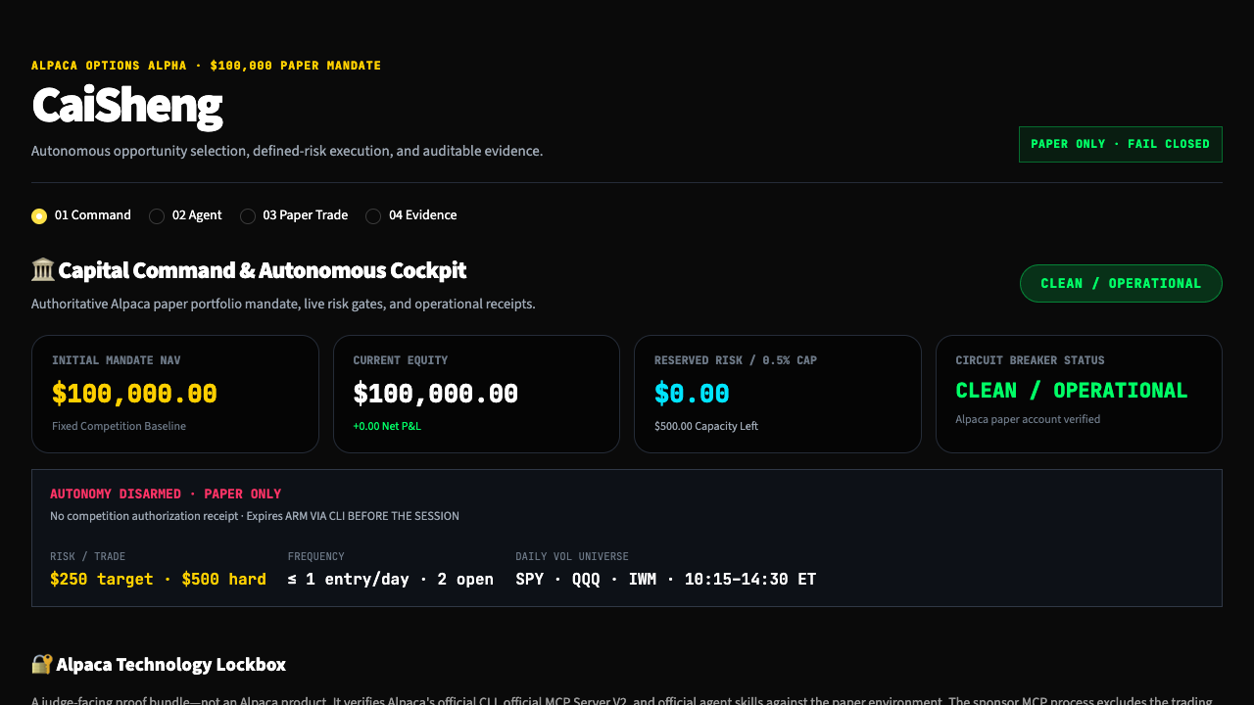
TECHNOLOGY IMPLEMENTATION
04
Alpaca is the operating system—not a logo
TRADING API
Fresh account, positions, orders, option chains, Level-3 multi-leg limits, cancellations, and reconciliation.
MCP
Official MCP V2 is dynamically verified read-only; CaiSheng FastMCP writes accept only approved canonical order tokens.
CLI + SKILLS
Official CLI doctor/account/clock checks plus four fingerprinted Alpaca skills create sanitized proof receipts.
Notes:
[Sources]
- https://github.com/alpacahq/alpaca-mcp-server
- https://github.com/alpacahq/alpaca-skills
- https://docs.alpaca.markets/docs/options-level-3-trading
- /Users/yanjunjie/Documents/Alpaca/docs/ALPACA_TECHNOLOGY_LOCKBOX.md

Slide 5
P&L GOVERNANCE
05
The risk envelope decides whether the agent may trade
0.5%
$250
1 / day
target risk per trade
new-entry throttle
hard maximum loss per strategy
$500 on the $100,000 mandate
2 open
−$500
maximum strategies
daily-loss halt
1%
0 orphan
high-water drawdown halt
required broker lineage
If quotes are stale, contracts mismatch, edge disappears after costs, or broker state cannot be reconciled, CaiSheng returns NO_TRADE or LIQUIDATE_ONLY.
Notes:
[Sources]
- /Users/yanjunjie/Documents/Alpaca/config/competition.yaml
- /Users/yanjunjie/Documents/Alpaca/src/volagent/execution/broker_risk.py
- /Users/yanjunjie/Documents/Alpaca/src/volagent/quant/risk_gate.py

Slide 6
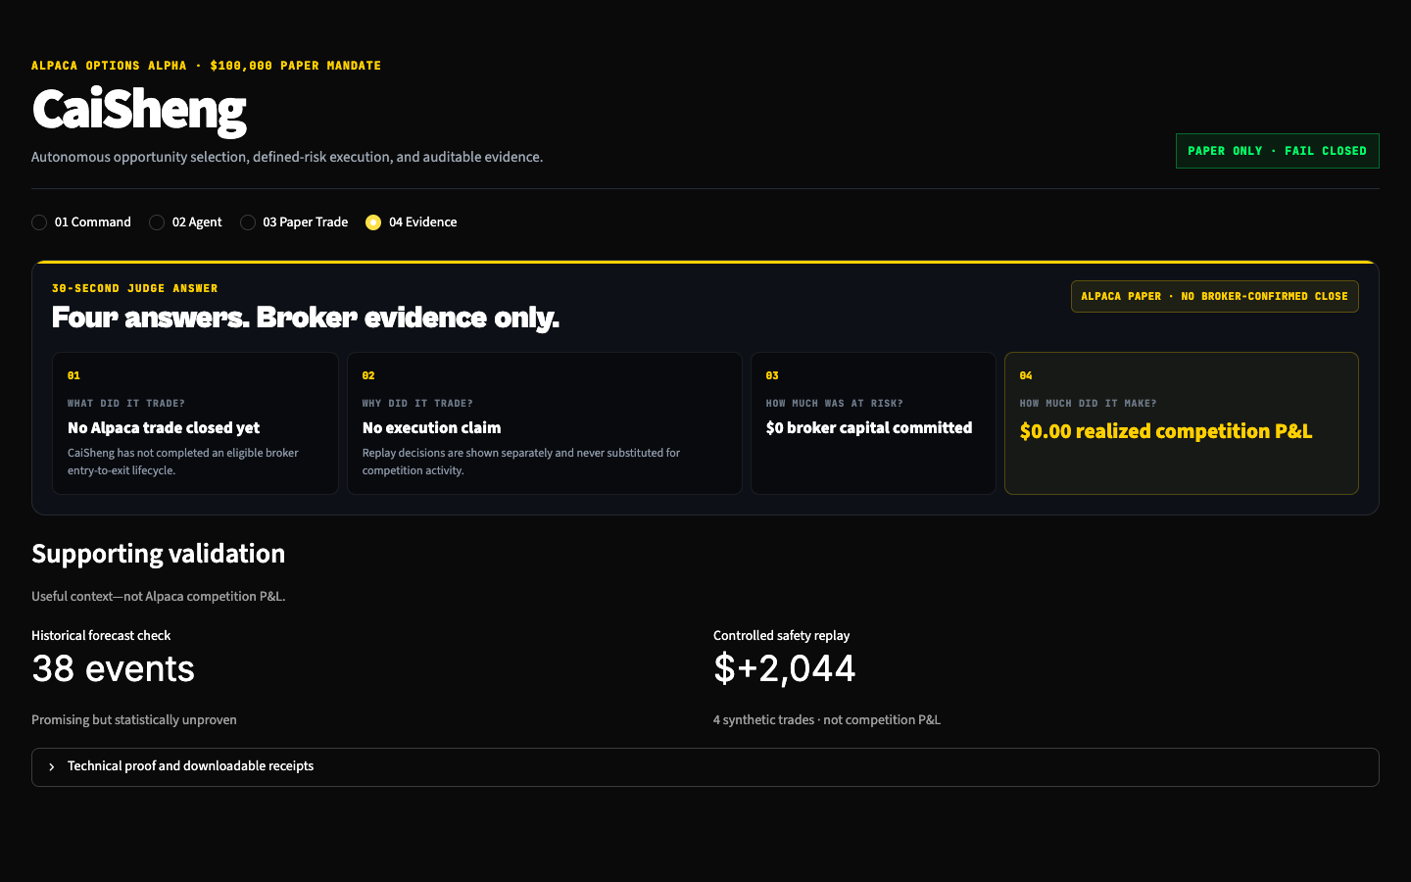
P&L PERFORMANCE
06
Replay never masquerades as competition P&L
ALPACA PAPER
$0
0 governed closed trades
No realized-alpha claim
CONTROLLED SYNTHETIC REPLAY
+$2,044
4 synthetic trades · functional evidence only
38-event forecast study: promising, statistically unproven
Notes:
[Sources]
- /Users/yanjunjie/Documents/Alpaca/data/evaluation/economic_evidence_receipt.json
- /Users/yanjunjie/Documents/Alpaca/data/evaluation/oos_evaluation_results.json

Slide 7
PRESENTATION & EXECUTION
07
A judge can verify the complete system in under 90 seconds
01
AGENT
Run sealed long-vol, short-vol, and NO_TRADE scenarios; inspect role runtime and feed identity.
02
RISK
Show the 20-point gate, exact contracts, maximum loss, payoff, and rejection reasons.
03
ALPACA
Show CLI/MCP/skills Lockbox, canonical MLEG payload, ledger fingerprint, and reconciliation receipt.
04
P&L
Read the live paper-account result from Alpaca; keep synthetic and historical evidence visibly separate.
CaiSheng turns agent reasoning into a bounded, auditable Alpaca paper-trading lifecycle.
Notes:
[Sources]
- /Users/yanjunjie/Documents/Alpaca/docs/JUDGE_LIVE_DEMO_SCRIPT.md
- /Users/yanjunjie/Documents/Alpaca/docs/ONE_PAGE_WRITEUP.md

