Slide 1
Parking Lot Occupancy Detector
Classical Computer Vision — No Machine Learning
Kyle Hale & Jingyi Zhong
University of Washington — Computer Vision — Spring 2026

Slide 2
Problem Statement
• Parking lots are a significant urban resource — knowing occupancy in real time has direct practical value
• Goal: given an overhead image, determine which parking spaces are OCCUPIED and which are EMPTY
• Constraints: classical OpenCV only (no ML), static images, manual ROI definition per lot
• Dataset: PKLot (PUCPR + UFPR04) plus a third lot (ANG) — overhead images under varied lighting and occupancy conditions
• Output: annotated image with red (occupied) / green (empty) polygons + count overlay

Slide 3
Detection Pipeline
Input Image
640×640 overhead JPEG
Grayscale
cv::cvtColor
Gaussian Blur
5×5 kernel, σ=1.5
ROI Extraction
Polygon mask per space
Canny Edge Count
low=50, high=150
Intensity Variance
cv::meanStdDev
Threshold + Label
edge > T OR σ > T
Save & Display
output/ + imshow
Highlighted stages are the two dual-signal classifiers

Slide 4
Key Techniques
• Canny Edge Detection — counts edge pixels within each parking space polygon
• cv::Canny(roi, edges, 50, 150) → edgeCount = cv::countNonZero(edges)
• Intensity Variance — measures pixel uniformity (empty pavement is spectrally uniform)
• cv::meanStdDev(roi, mean, stddev, mask) → σ = stddev[0]
• Dual-Signal Classification — OCCUPIED if edgeCount > T₁ OR σ > T₂
• Per-Lot Threshold Calibration — run empty reference image, set T = max + 10
• Polygon ROI Masking — cv::fillConvexPoly isolates exact space interior from surroundings

Slide 5
ROI Definition — All Three Lots
• Each space defined as a quadrilateral polygon — four corner points clicked interactively
• Custom OpenCV label tool: click 4 corners → auto-completes polygon → press S to export code
• Polygon mask (cv::fillConvexPoly) ensures classification uses only interior pixels
• ROIs placed inside painted lines to avoid line-marking edges inflating edge counts
• PUCPR: 43 spaces | UFPR04: 257 spaces | ANG: 34 spaces
• Calibration: PUCPR3.jpg, UFPR1.jpg, ANG1.jpg (empty references) — zero false positives on all

Slide 6
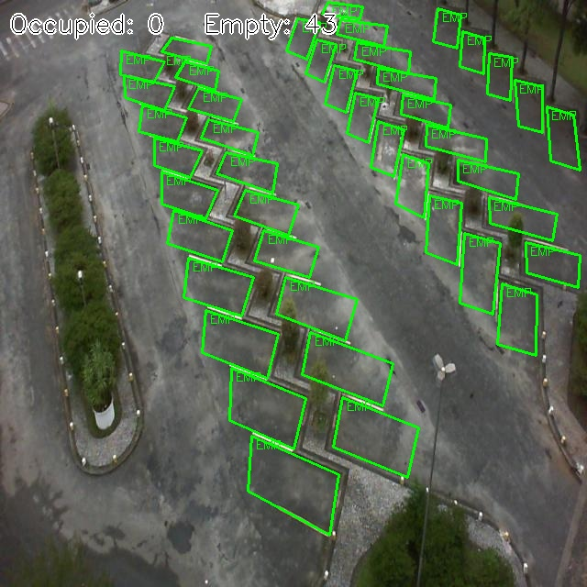
Result — PUCPR (Empty Lot)
PUCPR3.jpg | Detected: 0 Occupied / 43 Empty | Zero false positives on calibration image

Slide 7
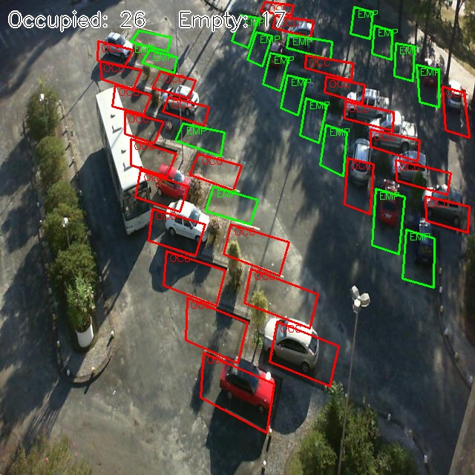
Result — PUCPR (Partially Occupied)
PUCPR1.jpg | Detected: 26 Occupied / 17 Empty | Total spaces: 43

Slide 8
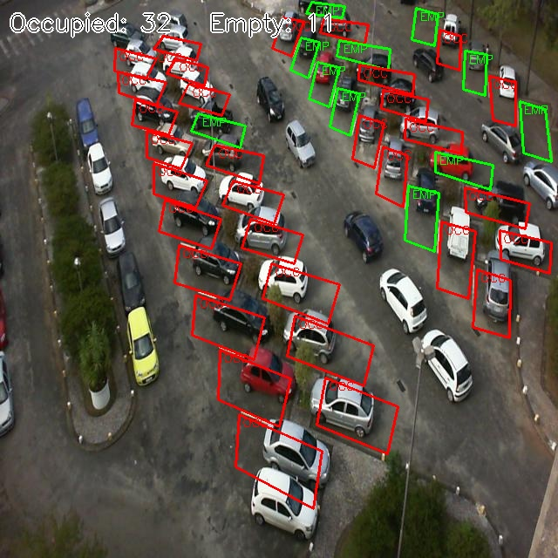
Result — PUCPR (Heavily Occupied)
PUCPR2.jpg | Detected: 32 Occupied / 11 Empty | Total spaces: 43

Slide 9
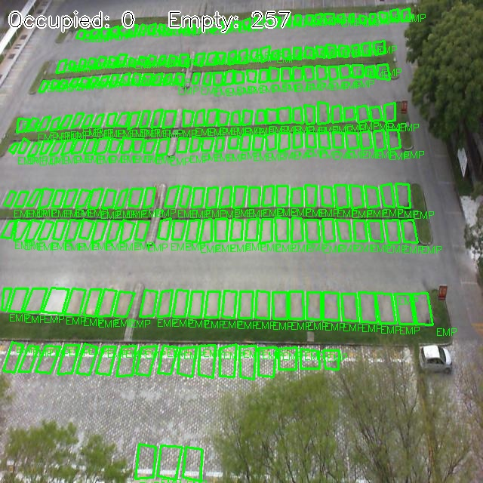
Result — UFPR04 (Empty Lot)
UFPR1.jpg | Detected: 0 Occupied / 257 Empty | Zero false positives on calibration image

Slide 10
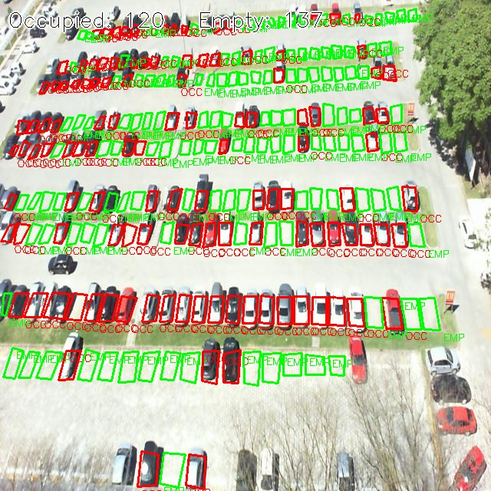
Result — UFPR04 (Partially Occupied)
UFPR2.jpg | Detected: 120 Occupied / 137 Empty | Total spaces: 257

Slide 11
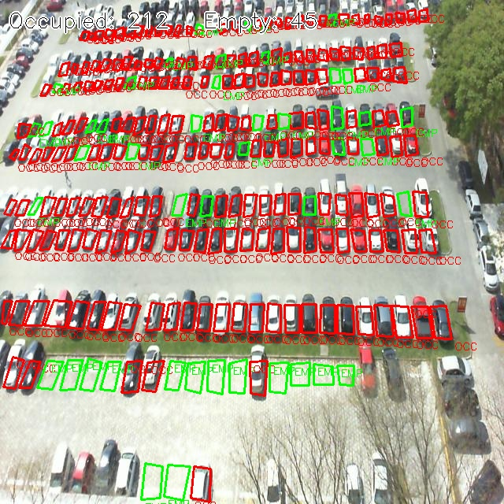
Result — UFPR04 (Heavily Occupied)
UFPR3.jpg | Detected: 212 Occupied / 45 Empty | Total spaces: 257

Slide 12
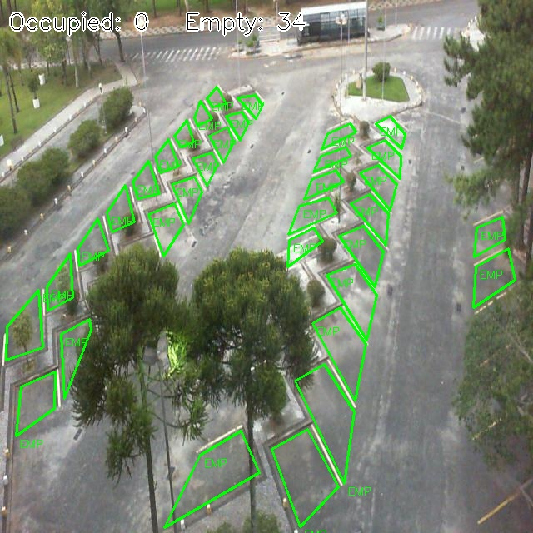
Result — ANG (Empty Lot)
ANG1.jpg | Detected: 0 Occupied / 34 Empty | Zero false positives on calibration image

Slide 13
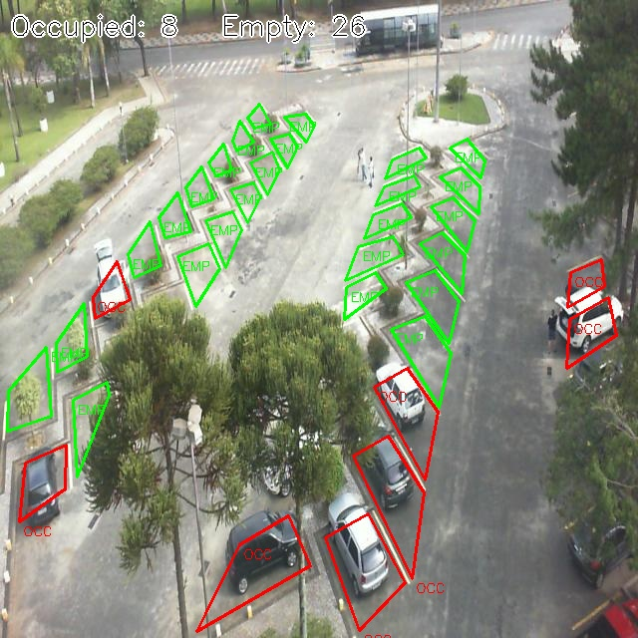
Result — ANG (Partially Occupied)
ANG2.jpg | Detected: 8 Occupied / 26 Empty | Total spaces: 34

Slide 14
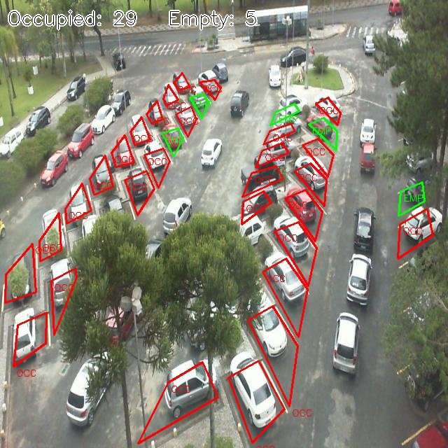
Result — ANG (Heavily Occupied)
ANG3.jpg | Detected: 29 Occupied / 5 Empty | Total spaces: 34

Slide 15
Accuracy Summary & Challenges
Image
Lot
Condition
Occ
Emp
Total
PUCPR3
PUCPR
Empty ref
0
43
43
PUCPR1
PUCPR
Partial
26
17
43
PUCPR2
PUCPR
Heavy
32
11
43
UFPR1
UFPR04
Empty ref
0
257
257
UFPR2
UFPR04
Partial
120
137
257
UFPR3
UFPR04
Heavy
212
45
257
ANG1
ANG
Empty ref
0
34
34
ANG2
ANG
Partial
8
26
34
ANG3
ANG
Heavy
29
5
34
• Fundamental challenge: edge/σ distributions of empty textured spaces and low-contrast cars overlap
• Canny(30,90) tested — empty-space max rose from 127→234, requiring threshold 244 (too high)
• Dual-signal OR logic improves recall without increasing false positives on calibration image
• Remaining errors are irreducible without a background reference or learned classifier

Slide 16
Future Work
• Automatic ROI detection via Hough line transform — no manual tracing for new lots
• Background subtraction using registered empty-lot reference — eliminate shadow false positives
• Live video mode using cv::VideoCapture — real-time occupancy monitoring with FPS display
• Lightweight ML classifier (SVM + HOG features) — higher accuracy ceiling than threshold-based approach

