Slide 1
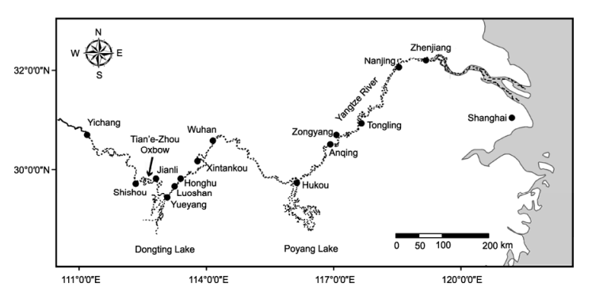
Anqing Xijiang Reserve(20)
Swan Island Reserve(100)
Wuhan Baiji Dolphin Museum (6)
Anhui Tongling Reserve(10)
Hewang Temple Reserve(20)

Slide 2
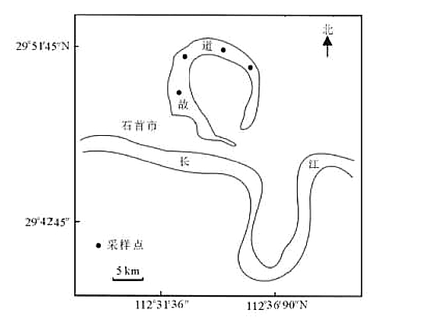
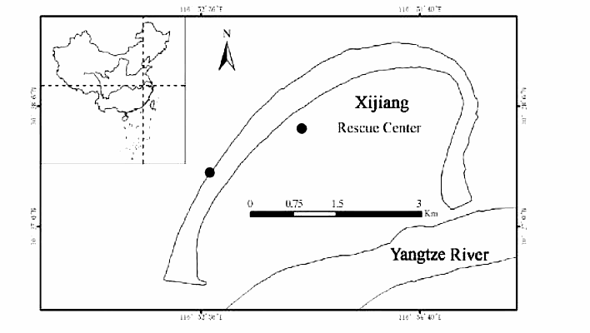
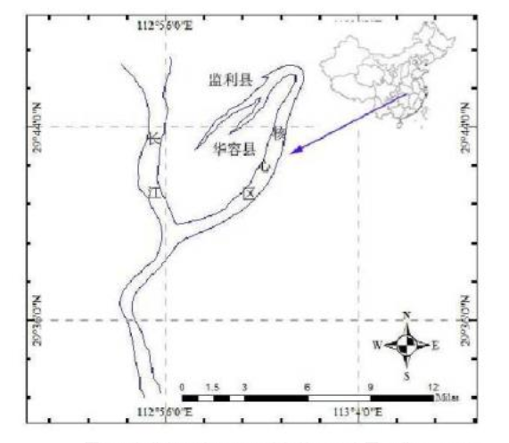
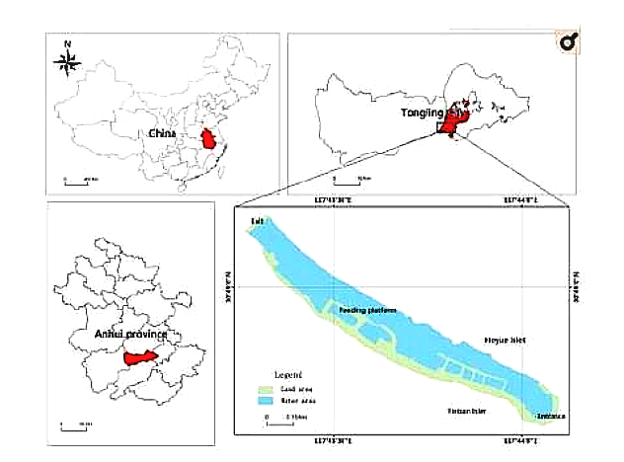
Swan Island Reserve(100)
Anqing Xijiang Reserve(20)
Honghu Lake Reserve (6)
Anhui Tongling Reserve(10)
Hewang Temple Reserve(20)

Slide 4
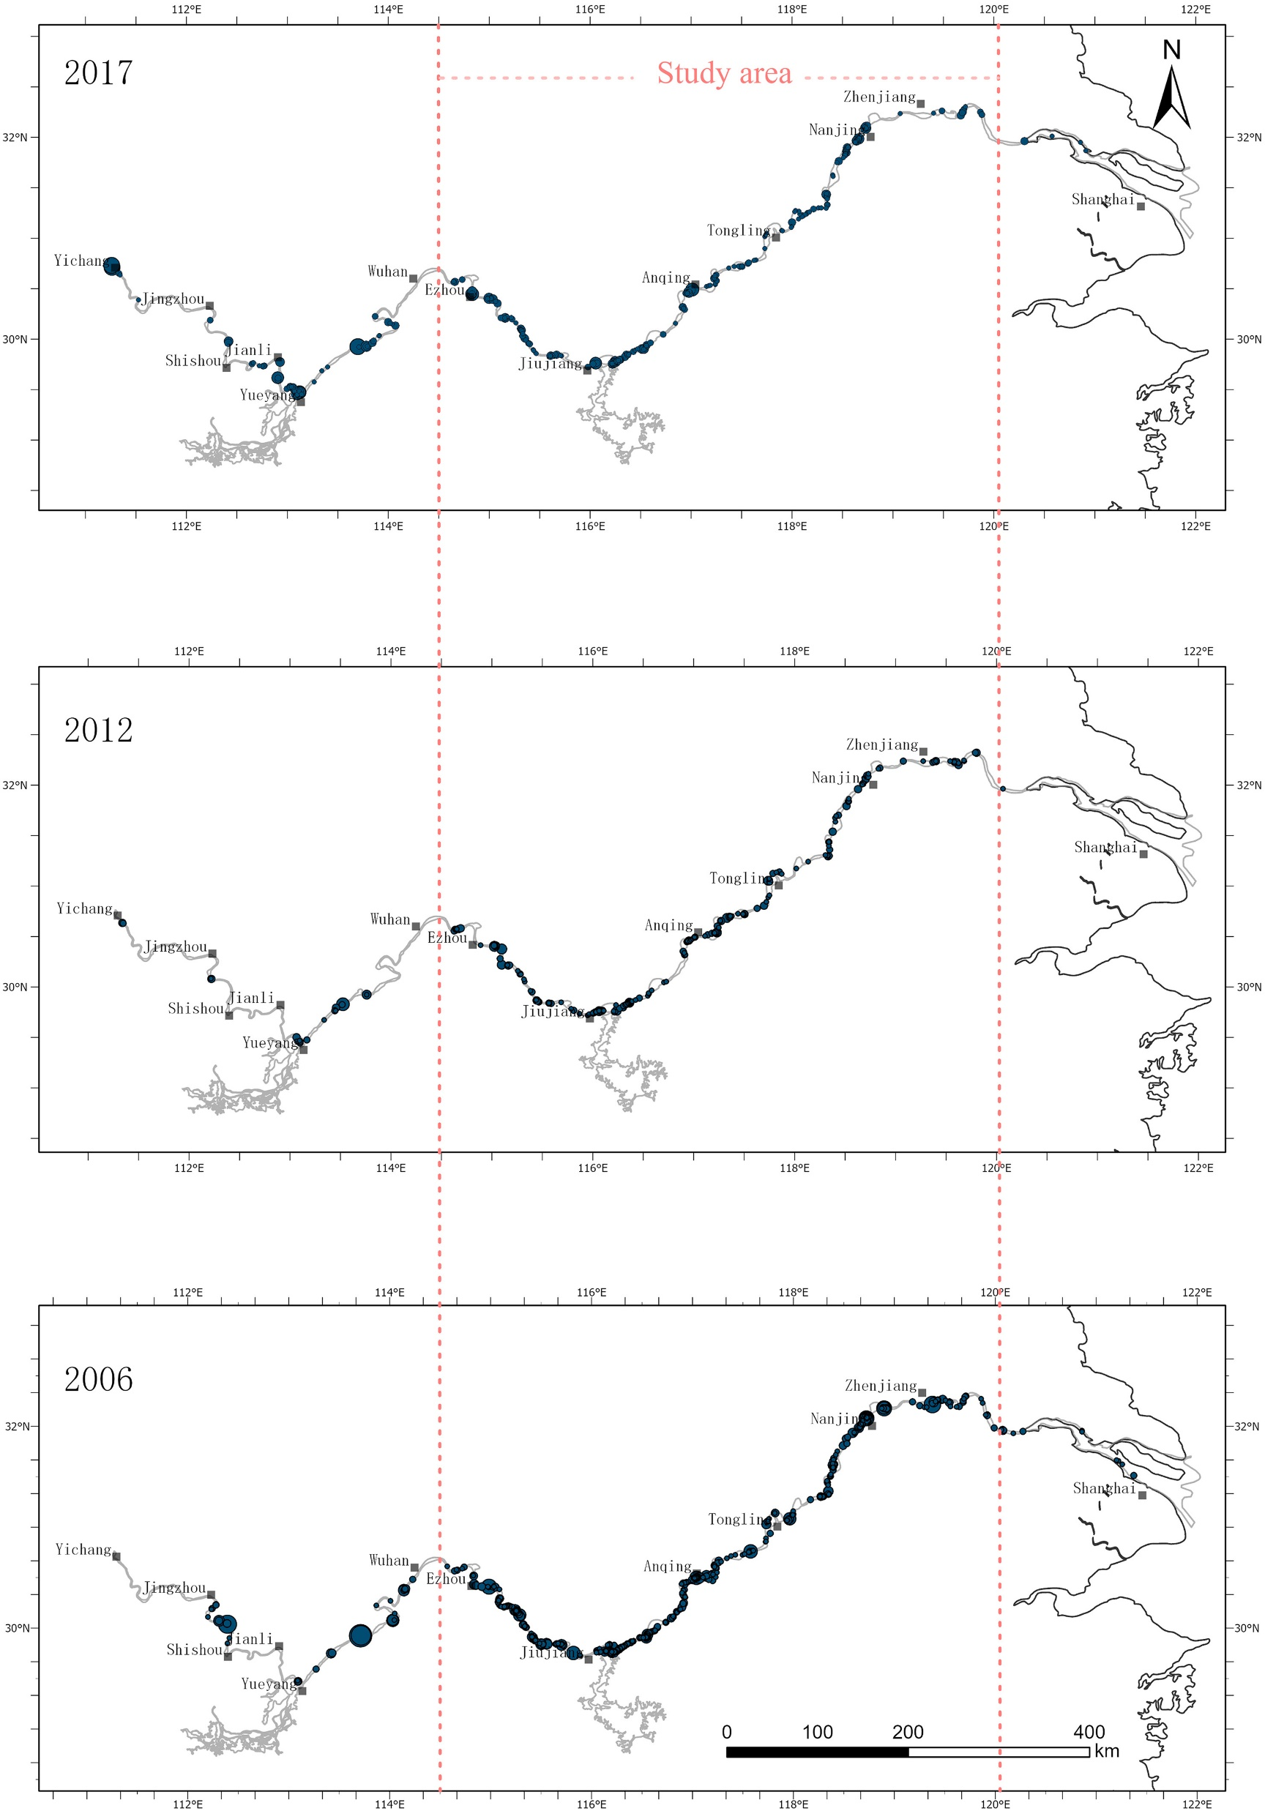

Slide 5
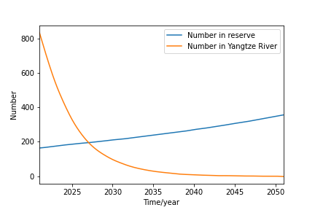
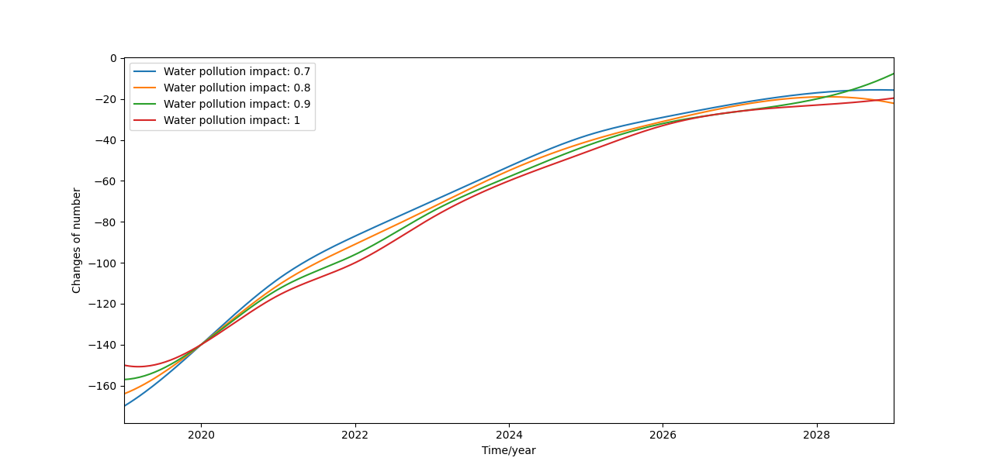

Slide 6
