Slide 1
- night
+ night
- clouds
+ clouds
- fog
+ fog
- winter
+ winter
- sunny
+ sunny

Slide 2
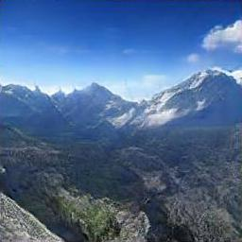
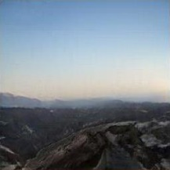
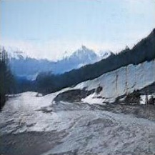
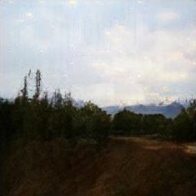
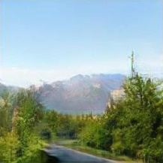
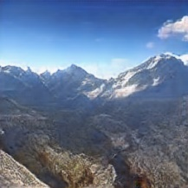
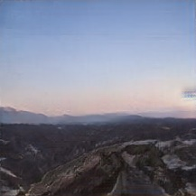
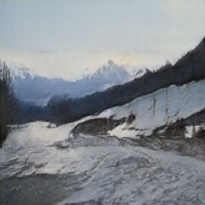
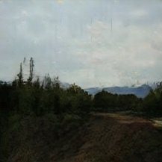
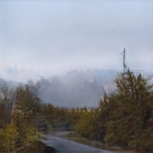
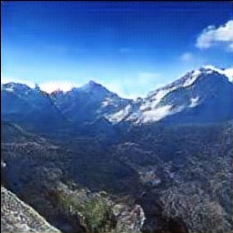
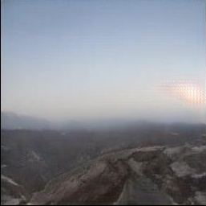
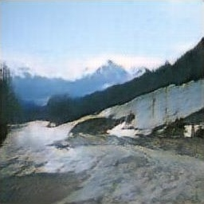
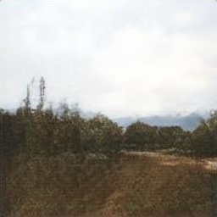
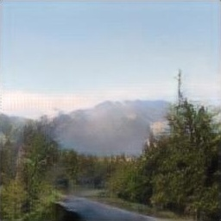
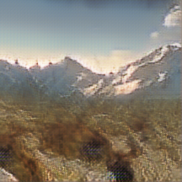
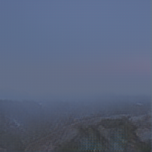
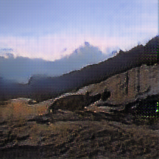
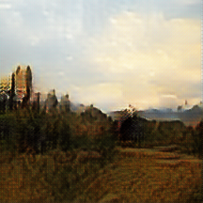
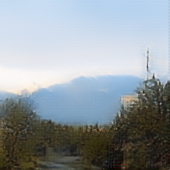
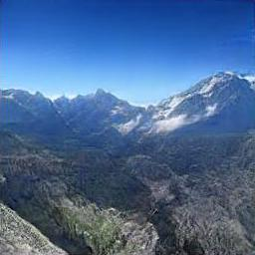
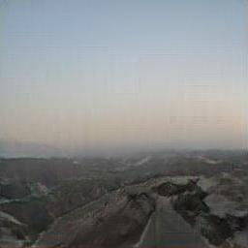
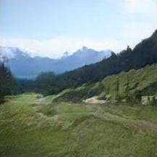
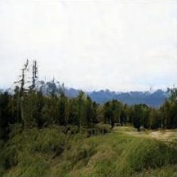
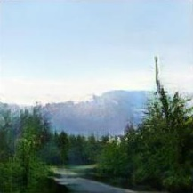
- Clouds
+ Fog
- Winter
- Night
- Sunny
Original
CycleGAN
RelGAN
DRIT++
Ours
(a)
(b)
(c)
(d)
(e)

Slide 3
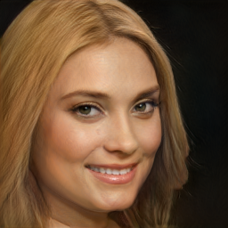
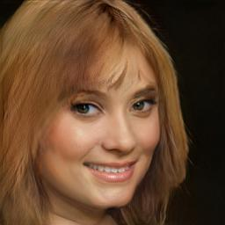
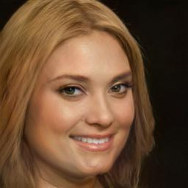
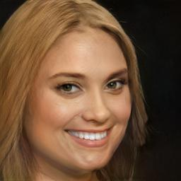
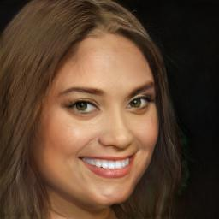
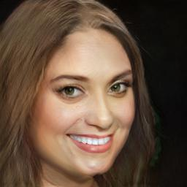
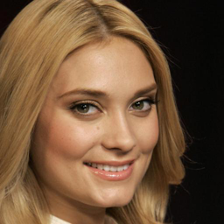
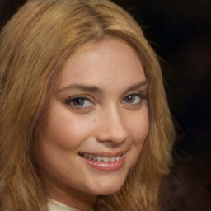
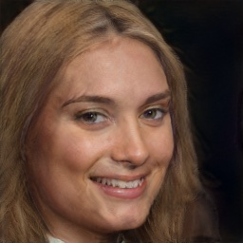
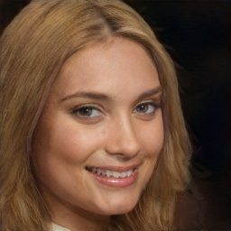
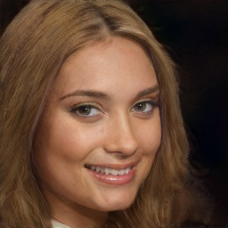
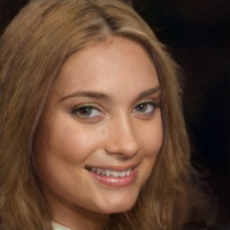
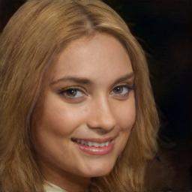
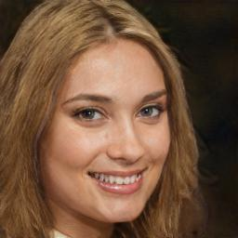
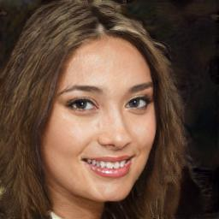
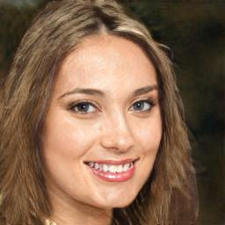
Ours
InterfaceGAN
EnjoyEditing
+ Smiling,
+ Chubby
+ Smiling, + Chubby
+ Black Hair, -Blond Hair,
+ Lip Stick
+ Smiling, + Chubby,
+ Black Hair, -Blond Hair,
+ Lip Stick, + Big Nose,
+ Pale Skin
Original
Inversion
+ Bangs
+ Chubby

Slide 4
(a)
(b)
(c)
(d)
(e)
Ours
InterfaceGAN
EnjoyEditing
+ 笑容,
+ 胖
+ 笑容, + 胖
+ 黑头发, -棕头发,
+ 口红
+ 笑容, + 胖,
+黑头发, -棕头发,
+口红, + 大鼻子,
+ 白皮肤
原图
Inversion
+ 刘海
+ 胖

Slide 5
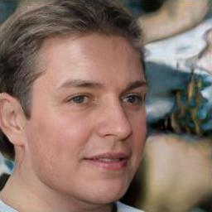
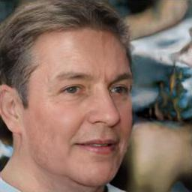
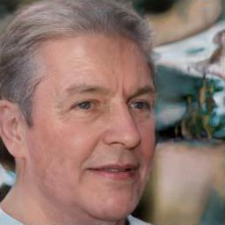
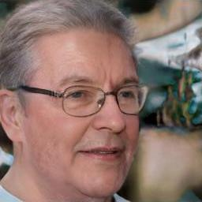
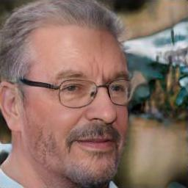
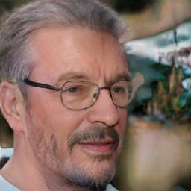
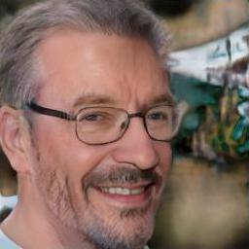
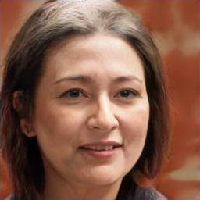
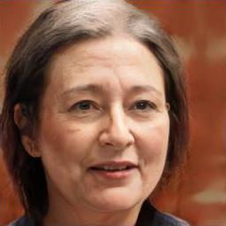





Original
+ Age
+ White Hair
+ Eyeglasses
+ Beard
+ Thin
+ Smiling
Original
+ Age
+ White Hair
+ Eyeglasses
+ Makeup
+ Thin
+ Smiling

Slide 6
原图
+年龄
+白头发
+眼镜
+胡子
+瘦
+笑容
原图
+年龄
+白头发
+眼镜
+化妆
+瘦
+笑容

Slide 7









































5 o'clock shadow
Arched eyebrows
Attractive
Bags under eyes
Bald
Bangs
Big lips
Big nose
Black hair
Blond hair
Blurry
Brown hair
Bushy eyebrows
Chubby
Double chin
Eyeglasses
Goatee
Gray hair
Heavy makeup
High cheekbones
Original
Male
Mouth slightly open
Mustache
Narrow eyes
No beard
Oval face
Pale skin
Pointy nose
Receding hairline
Rosy cheeks
Sideburns
Smiling
Straight hair
Wavy hair
Wearing earrings
Wearing hat
Wearing lipstick
Wearing necklace
Wearing necktie
Young

Slide 8
短胡子
柳叶眉
迷人的
眼袋
野性
刘海
厚嘴唇
大鼻子
黑发
金发
模糊
棕发
浓眉
胖
双下巴
眼镜
山羊胡
灰发
浓妆
高颧骨
原图
男性
嘴微张
八字胡
皱眉
没胡子
圆脸
白皮肤
尖鼻子
秃顶
脸红
鬓角
笑
直发
卷发
戴耳环
戴帽子
涂口红
戴项链
戴领带
年轻

