Slide 1







自表示网络
$$真实x_{4}$$
Encoder
Encoder
$$\text{重建}的x_{4}$$
转换网络
判别器
$$真实x_{4}$$
Conv
weight
Conv
$$x_{1}$$
X
+
模态内注意力
真/假
Conv
weight
$$x_{2}$$
+
Up
-
Conv
$$\text{生成}的x_{4}$$
X
模态间注意力
模态内注意力
Conv
weight
$$x_{3}$$
X
+
特征图
模态内注意力

Slide 2
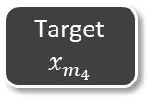

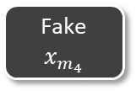



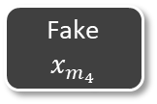
Framework 1
Fake
$$x_{m_{4}}$$
Target
$$x_{m_{4}}$$
Fake
$$x_{m_{4}}$$
Fake
$$x_{m_{4}}$$
Target
$$x_{m_{4}}$$
$$x_{m_{4}}$$
(1)
(2)
Decoder
Discriminator
Discriminator
Latent
(1), (2)
(2)
Modal
Attention
GAN
branch
Uncertainty
branch
GAN
branch
Uncertainty
branch
Encoders
Real/Fake
Uncertainty
estimation
Input images
$x_{m_{1}}$, $x_{m_{2}}$, $x_{m_{3}}$
Real/Fake
Uncertainty
estimation
Train the Discriminator
Train the Generator

Slide 3
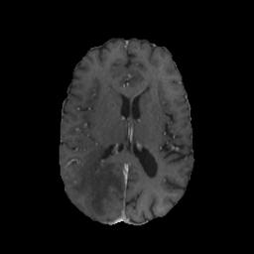
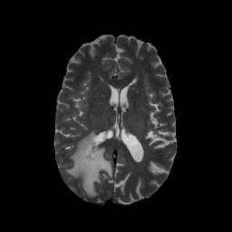
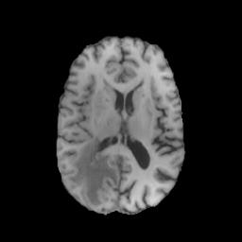
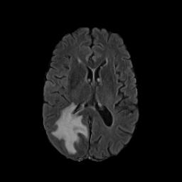
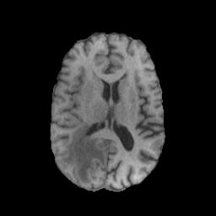





Framework 2
E₁
Conv
$$x_{m_{1}}$$
Real/Fake
Fake
$$x_{m_{4}}$$
E₂
Modal
Attention
D
Discriminator
$$x_{m_{2}}$$
DUQ
Uncertainty
E₃
$$x_{m_{3}}$$
Target
$$x_{m_{4}}$$

Slide 4
Framework 3
Real Image
Fake Image
Real Image
Fake Image
Discriminator
Discriminator
D_{gan}
D_{clsf}
D_{gan}
D_{unc}
Real/Fake
Domain
Classification
Real/Fake
Uncertainty
Estimation
(a)
(b)
(c)
a. Ordinary Discriminator b. Ours c.

Slide 5





Framework 3
D_{gan}
D_{gan}
D
Real/Fake
D
Real/Fake
$$y/\hat{y}$$
$$y/\hat{y}$$
x₁
E₁
D_{cls}
Domain
Classification
D_{unc}
Uncertainty
Estimation
x₂
E₂
Modal
Attention
D
$$\hat{y}$$
c₁
0.6
D
D
Softmax
$$y/\hat{y}$$
Uncertainty=RBF( f )
$$y/\hat{y}$$
f
0.3
f
x₃
E₃
0.1
c₂
c₃
(a)
(b)
(c)
a. Ordinary Discriminator b. Ours c. Multi-head Generator and Modal Attention

Slide 6



InterAttention原图
$$f_{x_{m_{1}}}$$
$$f_{x_{m_{2}}}$$
$$f_{x_{m_{3}}}$$

Slide 7



$$f_{x_{1}}$$
$$f_{x_{2}}$$
$$f_{x_{3}}$$

Slide 8
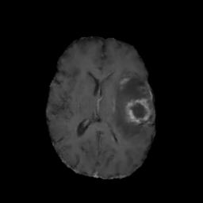
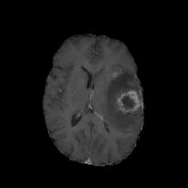
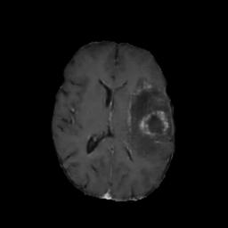
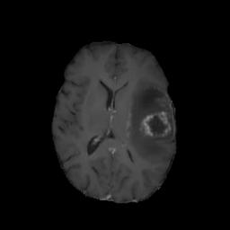
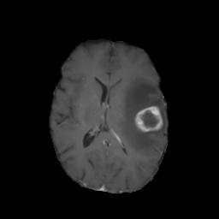




Ablation study原图
(a)
(b)
(c)
(d)
(e)
a无MA，Unc，cls；b有MA，无Unc，cls；c无MA有Unc；d有MA有Unc；e原图

Slide 9
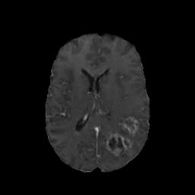
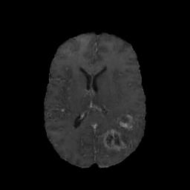
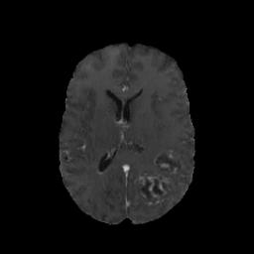
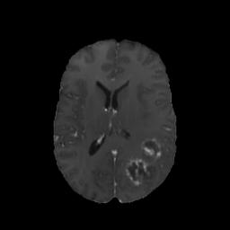
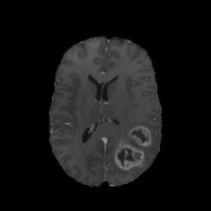













Ablation study新图
0.8877,0.9491
0.9071,0.9520
0.8981,0.9514
0.9286,0.9616
(a)
(b)
(c)
(d)
(e)
0.9227,0.9636
0.9317,0.9651
0.9378,0.9684
0.9536,0.9741
(a)
(b)
(c)
(d)
(e)
a无MA，Unc，cls；b有MA，无Unc，cls；c无MA有Unc；d有MA有Unc；e原图

Slide 10
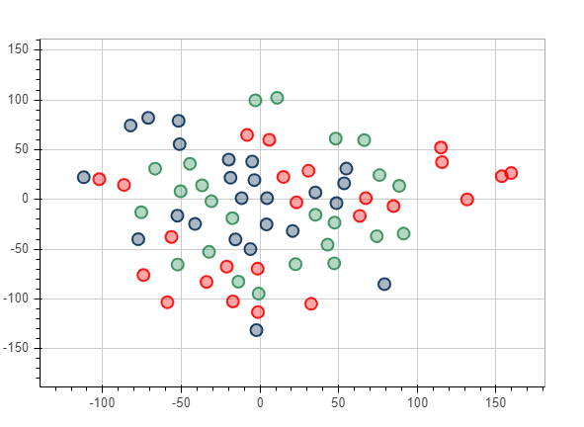
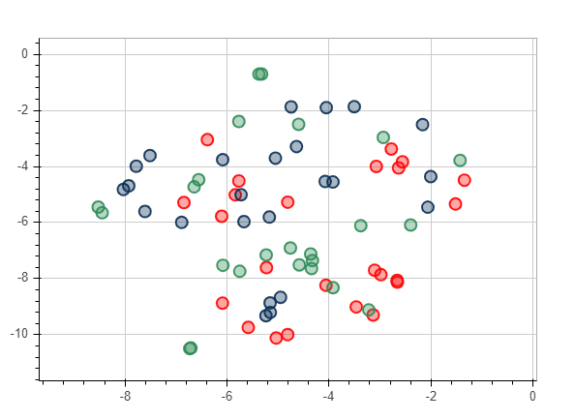
visualization of feature maps 原图
确认该图均为验证集中6号图片四种模态提取的特征
(a)
(b)
a无MA，无cls；b有MA，有unc

Slide 11
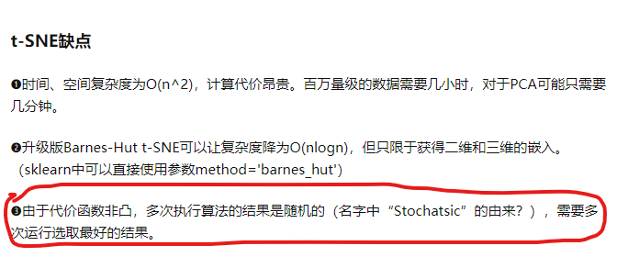

Slide 12
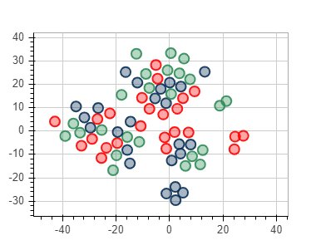
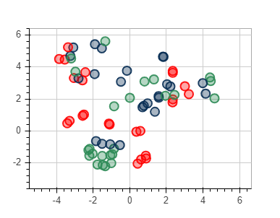
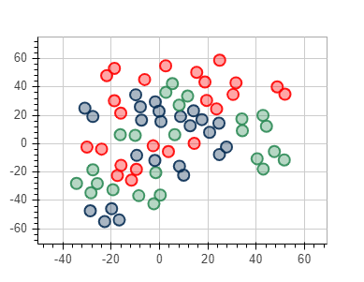
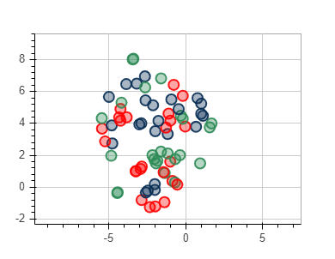
visualization of feature maps
验证集6
(a)
(b)
(c)
(d)
a无MA，有cls；b有MA，有cls
c无MA，有uc；d有MA，有uc

Slide 13
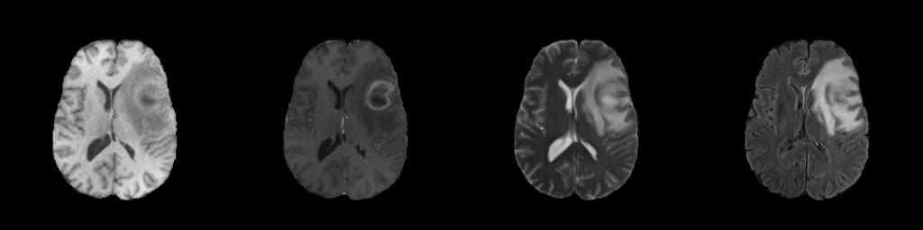
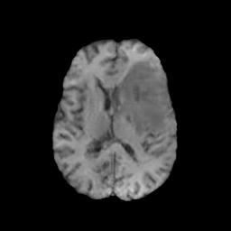
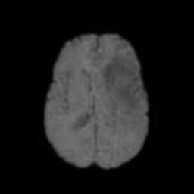
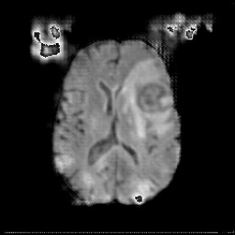
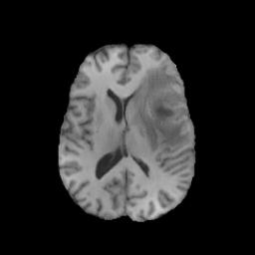
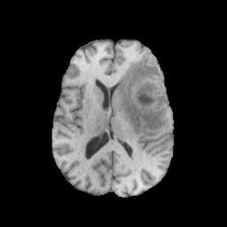

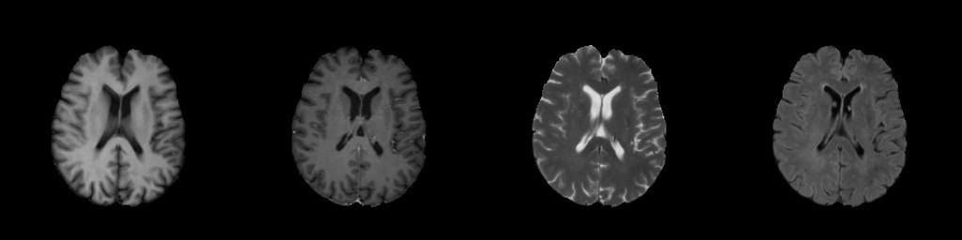
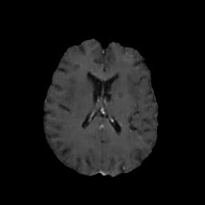
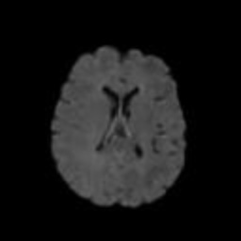
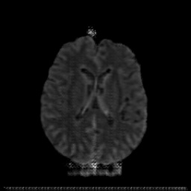
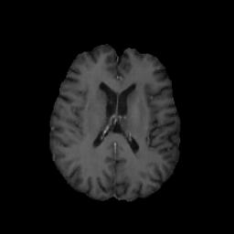
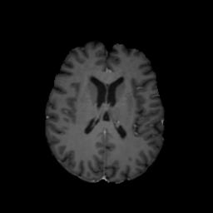

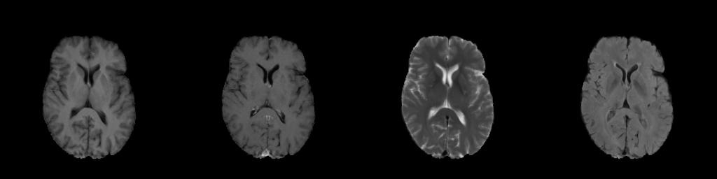
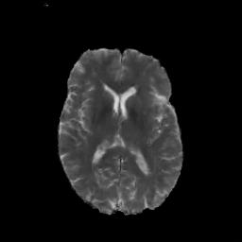
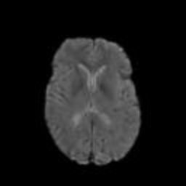
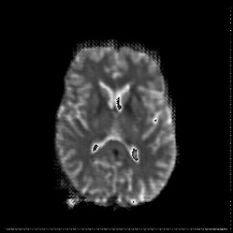
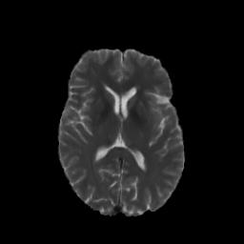


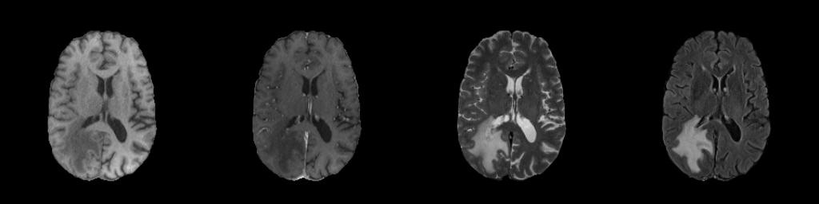
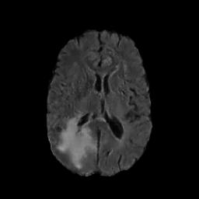
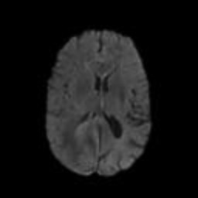
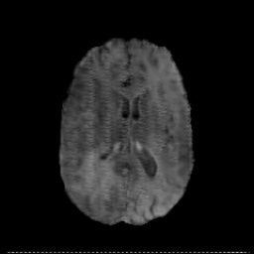
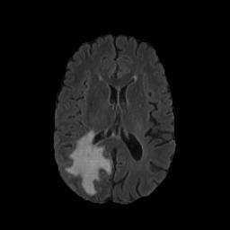

T1
T1Gd
T2
T2-FLAIR
Pix2pix
StarGAN
CollaGAN
我们的方法
目标
?
0.8965,0.9527
0.8589/0.9334
0.7101/0.7566
0.9338/0.9681
?
0.8895,0.9520
0.8589/0.9403
0.7851/0.8187
0.9288/0.9690
?
0.8830,0.9485
0.8315/0.9279
0.7881/0.7662
0.9210/0.9630
?
0.8653,0.9463
0.8385/0.9308
0.8081/0.8661
0.9053/0.9608

Slide 14

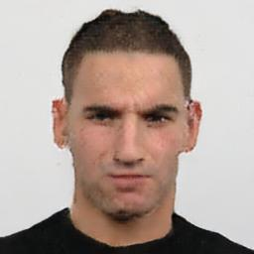



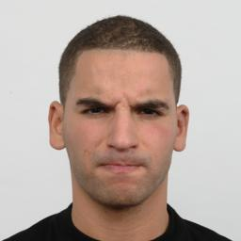
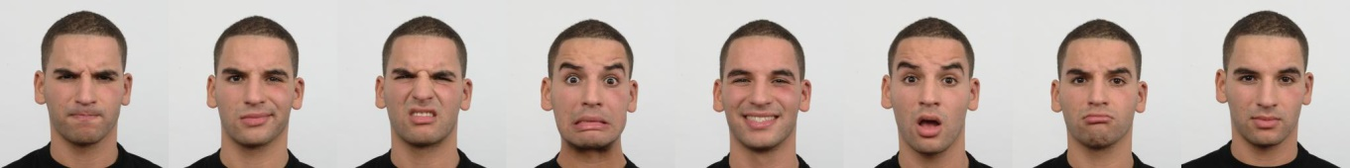


















Angry
Contemptuous
Disgusted
Fearful
Happy
Surprised
Sad
Neutral
Pix2pix
StarGAN
CollaGAN
Ours
Target
129.95
94.65
129.95
32.38
108.91
100.18
130.30
30.18
89.70
109.73
135.18
27.07
93.27
97.36
130.31
33.76
没有相应的pix2pix等结果，无法扩展；附录中只有自己方法的生成结果与原图对比

Slide 15


loss
(a)
(b)
a. cls loss b. unc loss

