Slide 1
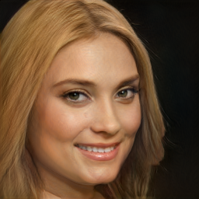

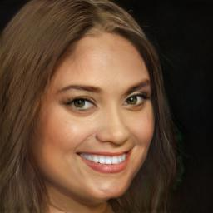
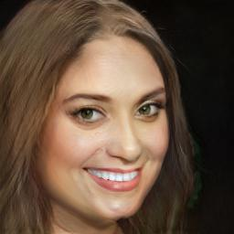
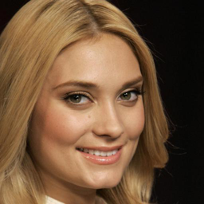
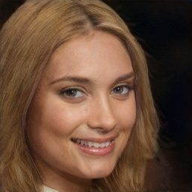
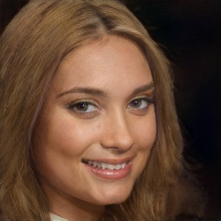
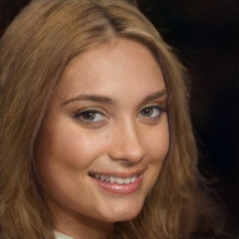
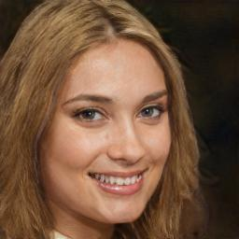
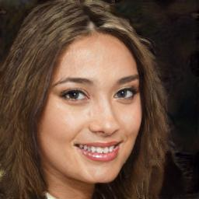
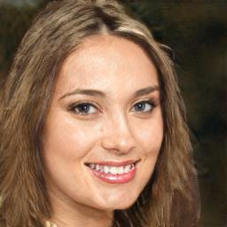
Inversion
+ Smiling, + Chubby
+ Black Hair, -Blond Hair,
+ Lip Stick
+ Smiling, + Chubby,
+ Black Hair, -Blond Hair, + Lip Stick, + Big Nose, + Pale Skin
Original
+ Smiling, + Chubby
Ours
InterfaceGAN
EnjoyEditing
(a)
(b)
(c)
(d)

