Slide 1
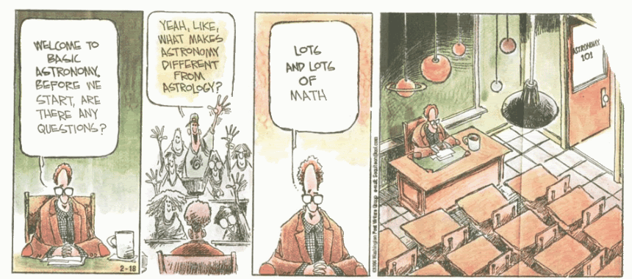
PHYS 275
Planets
Fall 2017
Lecture 4
More Orbits

Slide 2
Today’s Class
Complex motions with simple physics – but more complex math!
Kepler’s First Law
From Newton’s Law of Gravity
Two (~equal mass) body orbits are also ellipses
Time dependence of orbits
small aside: periapsis is closest approach of orbiting bodies
e.g. perihelion – closest approach to Sun
periastron – closest approach to a star
perigee – closest approach to Earth

Slide 3

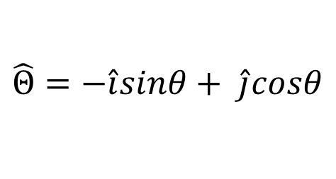
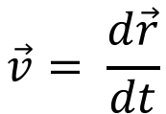
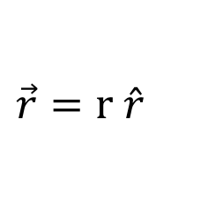
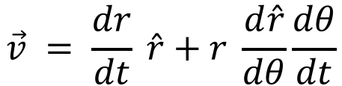
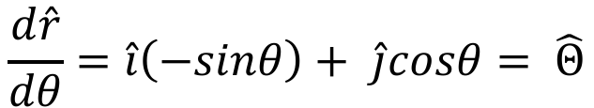
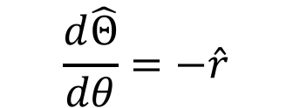










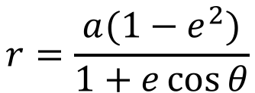
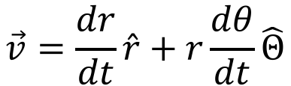


Equation of ellipse
$$r=\frac{a(1−e^{2})}{1+e\cos{θ}}$$
What is the acceleration in polar coordinates???
$$\vec{r}=r \hat{r}$$
$$v_{θ}=r\frac{dθ}{dt}$$
$$y$$
$$\hat{Θ}$$
$$\vec{v}$$
$$\hat{r}$$
$$v_{r}=\frac{dr}{dt}$$
$$\vec{v}= \frac{d\vec{r}}{dt}$$
$$\hat{j}$$
$$\vec{r}$$
$$\vec{r}$$
$$θ$$
$$x$$
$$\vec{v} = \frac{dr}{dt} \hat{r}+r \frac{d\hat{r}}{dθ}\frac{dθ}{dt}$$
$$\hat{i}$$
$$\hat{r}=\hat{i}cosθ+ \hat{j}sinθ$$
$$\frac{d\hat{r}}{dθ}=\hat{i}\left(−sinθ\right)+ \hat{j}cosθ= \hat{Θ}$$
$$\vec{v}=\frac{dr}{dt}\hat{r}+r\frac{dθ}{dt}\hat{Θ}$$
$$\hat{Θ}=−\hat{i}sinθ+ \hat{j}cosθ$$
$$\frac{d\hat{Θ}}{dθ}=−\hat{r}$$

Slide 4
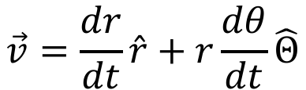
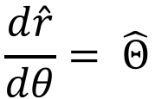

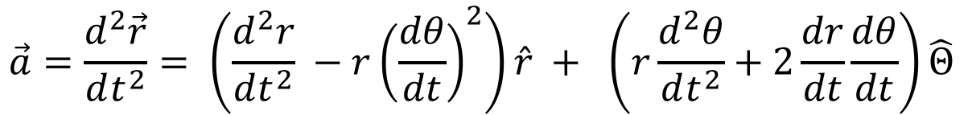
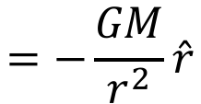
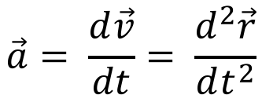
Acceleration?
$$\vec{v}=\frac{dr}{dt}\hat{r}+r\frac{dθ}{dt}\hat{Θ}$$
$$\vec{a}= \frac{d\vec{v}}{dt}= \frac{d^{2}\vec{r}}{dt^{2}}$$
$$\frac{d\hat{r}}{dθ}= \hat{Θ}$$
$$\frac{d\hat{Θ}}{dθ}=−\hat{r}$$
$$\vec{a}=\frac{d^{2}\vec{r}}{dt^{2}}= \frac{d^{2}r}{dt^{2}}\hat{r}+ \frac{dr}{dt}\frac{d\hat{r}}{dθ}\frac{dθ}{dt} + \frac{dr}{dt}\frac{dθ}{dt}\hat{Θ}+r\frac{d^{2}θ}{dt^{2}}\hat{Θ}+r\frac{dθ}{dt}\frac{d\hat{Θ}}{dθ}\frac{dθ}{dt}$$
$$\vec{a}=\frac{d^{2}\vec{r}}{dt^{2}}= \left(\frac{d^{2}r}{dt^{2}} −r{\left(\frac{dθ}{dt}\right)}^{2}\right)\hat{r} + \left(r\frac{d^{2}θ}{dt^{2}}+2\frac{dr}{dt}\frac{dθ}{dt}\right)\hat{Θ}$$
$$=−\frac{GM}{r^{2}}\hat{r}$$

Slide 5
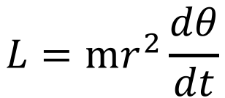
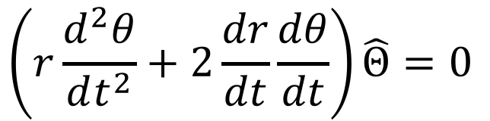
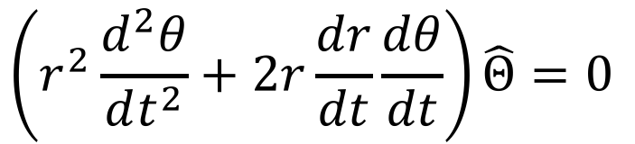
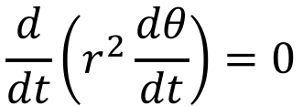
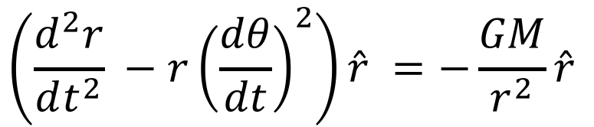
Kepler’s First Law.... (cont’d)
$$\left(r\frac{d^{2}θ}{dt^{2}}+2\frac{dr}{dt}\frac{dθ}{dt}\right)\hat{Θ}=0$$
$$\left(\frac{d^{2}r}{dt^{2}} −r{\left(\frac{dθ}{dt}\right)}^{2}\right)\hat{r} =−\frac{GM}{r^{2}}\hat{r}$$
Multiply by r
$$\left(r^{2}\frac{d^{2}θ}{dt^{2}}+2r\frac{dr}{dt}\frac{dθ}{dt}\right)\hat{Θ}=0$$
$$\frac{d}{dt}\left(r^{2}\frac{dθ}{dt}\right)=0$$
$$L=mr^{2}\frac{dθ}{dt}$$

Slide 6



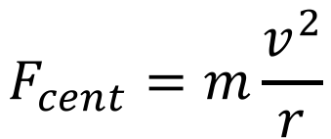

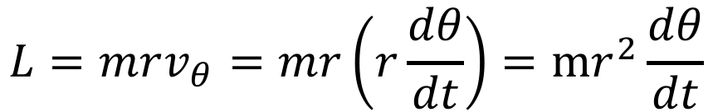
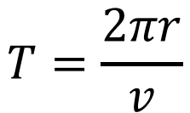
Uniform Circular Motion
“Uniform” means “at constant speed”
v
$$\vec{v}$$
Centripetal Force
r
$$\vec{F}$$
$$F_{cent}=m\frac{v^{2}}{r}$$
Period of motion
Angular momentum
$$r$$
$$T=\frac{2πr}{v}$$
$$\vec{L}=m\vec{r}×\vec{v}$$
$$L=mrv_{θ}=mr\left(r\frac{dθ}{dt}\right)=mr^{2}\frac{dθ}{dt}$$

Slide 7
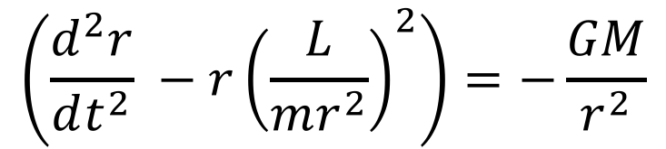
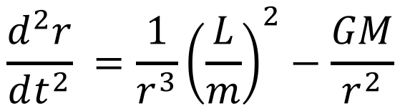
Kepler’s First Law.... (cont’d)
$$\left(r\frac{d^{2}θ}{dt^{2}}+2\frac{dr}{dt}\frac{dθ}{dt}\right)\hat{Θ}=0$$
$$\left(\frac{d^{2}r}{dt^{2}} −r{\left(\frac{dθ}{dt}\right)}^{2}\right)\hat{r} =−\frac{GM}{r^{2}}\hat{r}$$
Multiply by r
$$\left(r^{2}\frac{d^{2}θ}{dt^{2}}+2r\frac{dr}{dt}\frac{dθ}{dt}\right)\hat{Θ}=0$$
$$\left(\frac{d^{2}r}{dt^{2}} −r{\left(\frac{L}{mr^{2}}\right)}^{2}\right)=−\frac{GM}{r^{2}}$$
$$\frac{d}{dt}\left(r^{2}\frac{dθ}{dt}\right)=0$$
$$\frac{d^{2}r}{dt^{2}} =\frac{1}{r^{3}}{\left(\frac{L}{m}\right)}^{2}−\frac{GM}{r^{2}}$$
$$L=mr^{2}\frac{dθ}{dt}$$

Slide 8
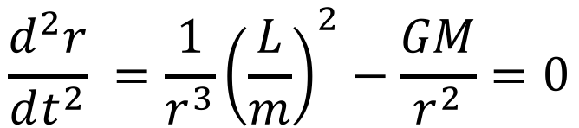
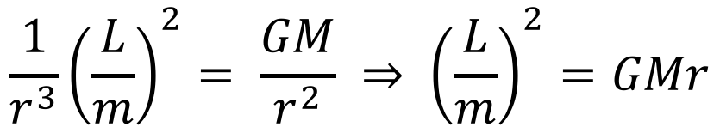
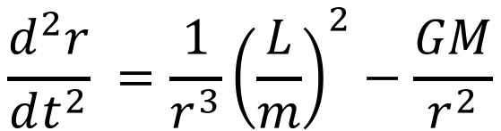
Kepler’s First Law.... (cont’d)
$$\frac{d^{2}r}{dt^{2}} =\frac{1}{r^{3}}{\left(\frac{L}{m}\right)}^{2}−\frac{GM}{r^{2}}$$
Need to solve this differential equation
Cannot be solved in closed form…. Can not write out r(t) !!!
$$\frac{d^{2}r}{dt^{2}} =\frac{1}{r^{3}}{\left(\frac{L}{m}\right)}^{2}−\frac{GM}{r^{2}}=0$$
Can solve numerically. Note:
$$\frac{1}{r^{3}}{\left(\frac{L}{m}\right)}^{2}= \frac{GM}{r^{2}} ⇒ {\left(\frac{L}{m}\right)}^{2}=GMr$$
IF

Slide 9
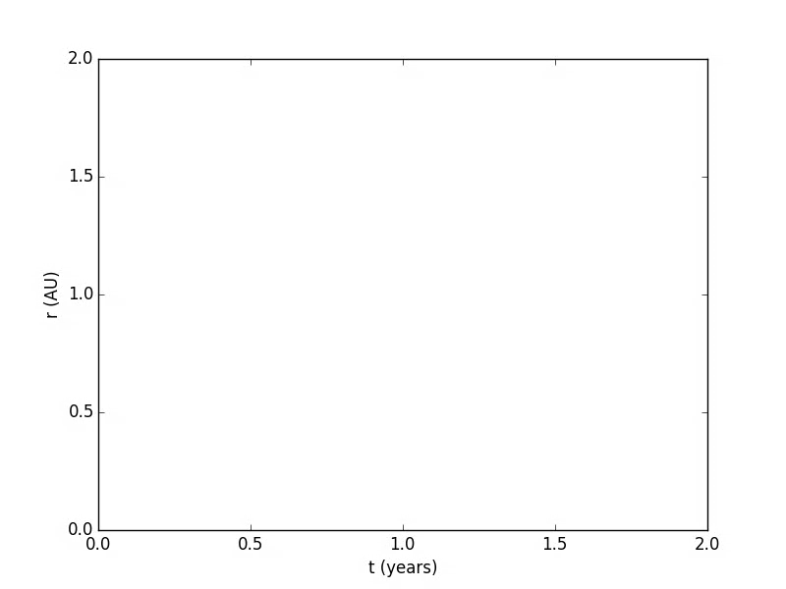
Earth’s Orbit

Slide 10
Earth’s orbit with 25% more angular momentum
Bigger orbit –> longer period

Slide 11
Earth’s orbit with initial velocity of -1.0 km/s

Slide 12
Earth’s orbit with initial velocity of -10 km/s
Bigger orbit –> longer period

Slide 13
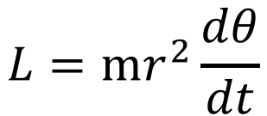
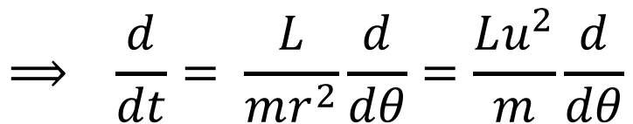
Kepler’s First Law.... (cont’d)
$$\frac{d^{2}r}{dt^{2}} =\frac{1}{r^{3}}{\left(\frac{L}{m}\right)}^{2}−\frac{GM}{r^{2}}$$
Need to solve this differential equation
Cannot be solved in closed form…. Can not write out r(t) !!!
Tricks to solving this: (1) write time derivative as angle derivative (angle 𝜃 )
(2) change variable to u = 1/r
$$L=mr^{2}\frac{dθ}{dt}$$
$$⟹ \frac{d}{dt}= \frac{L}{mr^{2}}\frac{d}{dθ}=\frac{Lu^{2}}{m}\frac{d}{dθ}$$

Slide 14
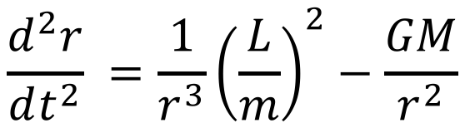
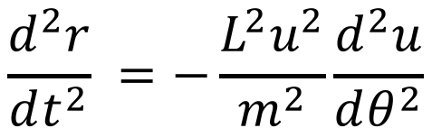
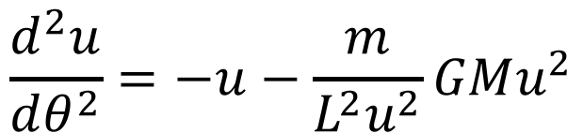
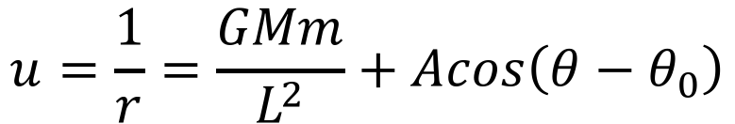
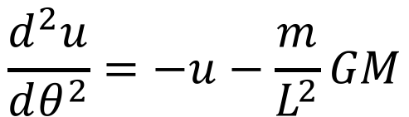
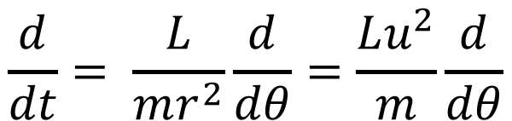
Kepler’s First Law…
$$\frac{d^{2}r}{dt^{2}} =\frac{1}{r^{3}}{\left(\frac{L}{m}\right)}^{2}−\frac{GM}{r^{2}}$$
$$\frac{d}{dt}= \frac{L}{mr^{2}}\frac{d}{dθ}=\frac{Lu^{2}}{m}\frac{d}{dθ}$$
$$\frac{d^{2}r}{dt^{2}} =−\frac{L^{2}u^{2}}{m^{2}}\frac{d^{2}u}{dθ^{2}}$$
$$\frac{d^{2}u}{dθ^{2}}=−u−\frac{m}{L^{2}u^{2}}GMu^{2}$$
$$u=\frac{1}{r}=\frac{GMm}{L^{2}}+Acos\left(θ−θ_{0}\right)$$
$$\frac{d^{2}u}{dθ^{2}}=−u−\frac{m}{L^{2}}GM$$
What does this look like?

Slide 15
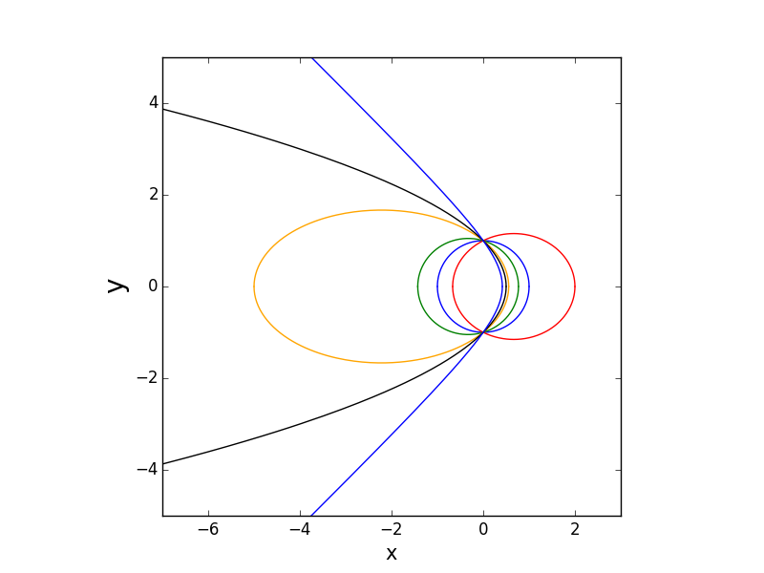
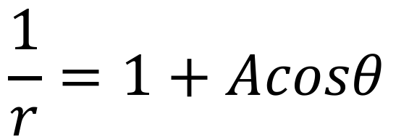
Plots of Kepler’ First Law solution
1.0
1.4
$$\frac{1}{r}=1+Acosθ$$
0.8
-0.5
0.3
0.0

Slide 16


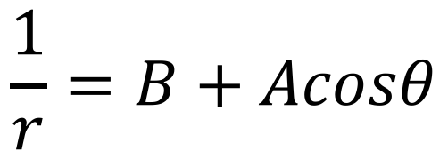
“Conic Sections”
The “standard form” for conic sections in polar coordinates is
If B > A ellipse
If B = A parabola
If 0 < B < A hyperbola + branch
If –A < B < 0 hyperbola − branch
$$\frac{1}{r}=B+Acosθ$$
For arbitrary orientations replace with
$$θ$$
$$θ − θ_{0}$$

Slide 17
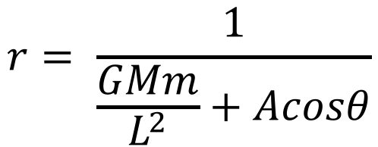
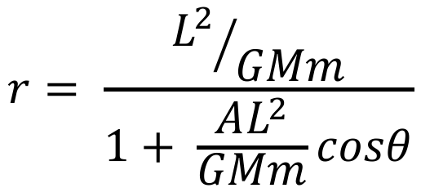
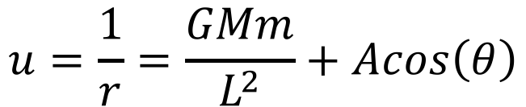
Kepler’s First Law in a more standard form
$$u=\frac{1}{r}=\frac{GMm}{L^{2}}+Acos\left(θ\right)$$
$$r= \frac{1}{\frac{GMm}{L^{2}}+Acosθ}$$
$$r= \frac{{L^{2}}/{GMm}}{1+ \frac{AL^{2}}{GMm}cosθ}$$

Slide 18






A little more on vectors
$$\vec{r_{12}}$$
$\vec{r_{1}}+ \vec{r_{12}}= \vec{r_{2}}$
$$\vec{r_{2}}$$
$$\vec{r_{12}}= \vec{r_{2}} −\vec{r_{1}}$$
$$\vec{r_{1}}$$
$\vec{r_{12}}=−\vec{r_{21}}=− \left(\vec{r_{1}} −\vec{r_{2}}\right)$

Slide 19




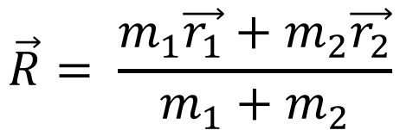
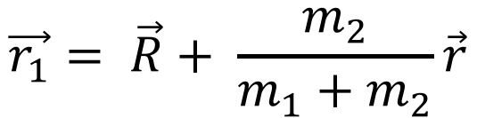
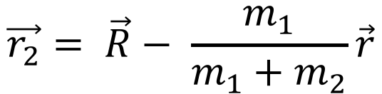

Centre of Mass frame
$$\vec{r_{21}}= \vec{r}$$
$$\vec{r}=\vec{r_{21}}= \vec{r_{1}} −\vec{r_{2}}$$
m₁
CoM
$$\vec{R}= \frac{m_{1}\vec{r_{1}}+m_{2}\vec{r_{2}}}{m_{1}+m_{2}}$$
m₂
$$\vec{R}$$
$$\vec{r_{2}}$$
$$\vec{r_{1}}= \vec{R}+ \frac{m_{2}}{m_{1}+m_{2}}\vec{r}$$
$$\vec{r_{1}}$$
$$\vec{r_{2}}= \vec{R}− \frac{m_{1}}{m_{1}+m_{2}}\vec{r}$$
O

Slide 20


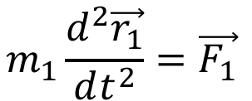
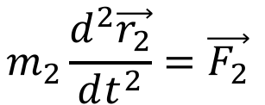
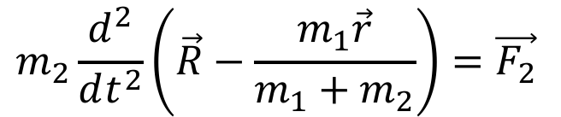
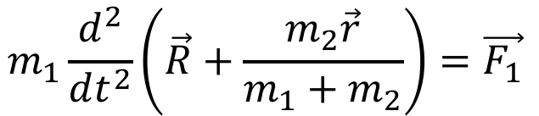



Two-body Problem
$$\vec{F_{1}}=−\vec{F_{2}}=−\frac{Gm_{1}m_{2}}{r^{2}}\hat{r}$$
$$\vec{r}$$
m₁
CoM
m₂
$$m_{1}\frac{d^{2}\vec{r_{1}}}{dt^{2}}=\vec{F_{1}}$$
$$m_{2}\frac{d^{2}\vec{r_{2}}}{dt^{2}}=\vec{F_{2}}$$
$$\vec{R}$$
$$m_{1}\frac{d^{2}}{dt^{2}}\left(\vec{R}+\frac{m_{2}\vec{r}}{m_{1}+m_{2}}\right)=\vec{F_{1}}$$
$$m_{2}\frac{d^{2}}{dt^{2}}\left(\vec{R}−\frac{m_{1}\vec{r}}{m_{1}+m_{2}}\right)=\vec{F_{2}}$$
$$\left(m_{1}+m_{2}\right)\frac{d^{2}\vec{R}}{dt^{2}}= \vec{F_{1}}+\vec{F_{2}}=0$$
$$⟹ \frac{d^{2}\vec{R}}{dt^{2}}=0$$
O

Slide 21





Two-body Problem
$$\vec{F_{1}}=−\vec{F_{2}}=−\frac{Gm_{1}m_{2}}{r^{2}}\hat{r}$$
$$\vec{r}$$
m₁
CoM
m₂
$$m_{1}\frac{d^{2}}{dt^{2}}\left(\frac{m_{2}\vec{r}}{m_{1}+m_{2}}\right)=\vec{F_{1}}$$
$$\vec{R}$$
$$\left(\frac{m_{1}m_{2}}{m_{1}+m_{2}}\right)\frac{d^{2}\vec{r}}{dt^{2}}=\vec{F_{1}}$$
$$\left(\frac{m_{1}m_{2}}{m_{1}+m_{2}}\right)\frac{d^{2}\vec{r}}{dt^{2}}=\vec{F_{1}}$$
$$⟹ μ\frac{d^{2}\vec{r}}{dt^{2}}=\vec{F_{1}}$$
$$μ=\left(\frac{m_{1}m_{2}}{m_{1}+m_{2}}\right)$$
O

Slide 22




Two-body problem (cont’d)
From slide titled Acceleration?
$$\vec{a}=\frac{d^{2}\vec{r}}{dt^{2}}= \left(\frac{d^{2}r}{dt^{2}} −r{\left(\frac{dθ}{dt}\right)}^{2}\right)\hat{r} + \left(r\frac{d^{2}θ}{dt^{2}}+2\frac{dr}{dt}\frac{dθ}{dt}\right)\hat{Θ}$$
$$=−\frac{GM}{r^{2}}\hat{r}$$
$$μ\frac{d^{2}\vec{r}}{dt^{2}}=\vec{F_{1}}$$
We have already solved this equation!
We have, in the CoM frame:
The only difference is the “constants”, in particular the masses
Orbit around Sun version:
$$\left(\frac{Mm_{}}{M+m_{}}\right)\frac{d^{2}\vec{r}}{dt^{2}}=−\frac{GMm}{r^{2}}\hat{r}$$

Slide 23



Two-body problem (cont’d)
$$\left(\frac{Mm_{}}{M+m_{}}\right)\frac{d^{2}\vec{r}}{dt^{2}}=−\frac{GMm}{r^{2}}\hat{r}$$
$$⟹ \frac{d^{2}\vec{r}}{dt^{2}}=−\frac{G\left(M+m\right)}{r^{2}}\hat{r}$$
Solution is an ellipse, angular momentum still conserved, Kepler’s 3rd Law becomes:
$$P^{2}=\frac{4π^{2}}{G\left(M+m\right)}a^{3}$$

Slide 24
Two-body problem (cont’d)
We have solved the two body problem for any pair of masses!
But what about solving position as a function of time?
This is called “Kepler’s Problem”.
He solved it, but….

Slide 25

Kepler’s Problem
”Auxilary Circle”
𝜃 = “true anomaly”
E = “eccentric anomaly”
M = “mean anomaly”
= 2𝝅t/P
a
b
$$\vec{r}$$
E
𝜃
Focus
The Auxilary Circle is a “stretched” version of the ellipse, by a/b

Slide 26
Kepler’s Problem
Time problem is an area problem…
”Auxilary Circle”
a
b
$$\vec{r}$$
E
𝜃
Focus

Slide 27
Kepler’s Problem
Time problem is an area problem…
”Auxilary Circle”
a
b
$$\vec{r}$$
E
𝜃
Focus

Slide 28
Kepler’s Problem
Time problem is an area problem…
”Auxilary Circle”
a
b
$$\vec{r}$$
E
𝜃
Focus

Slide 29

Kepler’s Problem
”Auxilary Circle”
The bigger area is exactly a/b larger than the swept out area (which increases linearly with time)
a
b
$$\vec{r}$$
E
𝜃
Focus
$$\frac{πa^{2}}{P}t$$

Slide 30




Kepler’s Problem
The shaded area is given by:
”Auxilary Circle”
$$\frac{E}{2π}πa^{2} − \frac{1}{2}ae×asinE$$
a
asinE
$$⟹ \frac{1}{2}a^{2}\left(E−esinE\right)$$
b
$$\vec{r}$$
E
𝜃
ae
Focus
$$⇒ \frac{πa^{2}}{P}t=\frac{1}{2}a^{2}\left(E−esinE\right)$$
$⇒ \frac{2π}{P}t=E−esinE=M$

Slide 31



Kepler’s Problem
$E−esinE=M$
”Auxilary Circle”
Can solve for position because geometry is easy… ????
a
$$r=a\left(1−ecosE\right)$$
b
$$\vec{r}$$
E
𝜃
$$tan\frac{θ}{2}= \sqrt{\frac{1+e}{1−e}} tan\frac{E}{2}$$
Focus

Slide 32



Kepler’s Problem
$E−esinE=M$
But perhaps not so easy… This is a ”transcendental” equation.
There is no “closed” solution... It must be solved numerically!
But you can “reverse it”: When is planet at E=0.1 ? (5.72 degrees) for e.g. e=0.2
$$M=\frac{2π}{P}t=0.1 −0.2 sin 0.1=0.08$$
$$t=0.0127 P$$

Slide 33
Lecture Summary
We now know how to do many useful things with two body orbits:
Closed orbits are ellipses (or circles)
Period related to the size of the orbit (semi-major axis)
Speed at any point in orbit
Non-closed orbits are parabolas or hyperbolas
Time (since periapsis) at any point in orbit
BUT
“standard form” of elliptical orbit equation was incomplete (how are a and e related to basic things like energy and angular momentum)
What happens where there are more than two bodies?

