Slide 1

Date: 23 December 2018
Student Name: Andzelika Balyseviene
Udacity Data Foundation Nanodegree Program
Music SQL Database Project

Slide 2
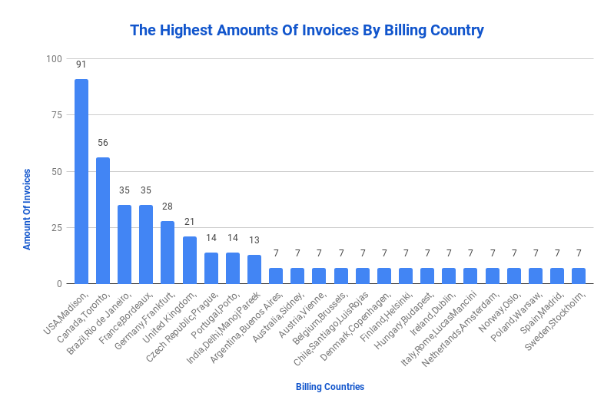

Notes:
USA has 91, the highest amount of invoices.
Canada has 56,the second largest amount of invoices.
Both numbers suggest the highest volume of trade.

Slide 3
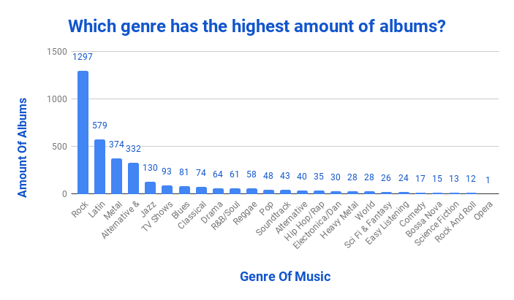

Notes:
It appears that the highest amount of music albums, 1297, belongs to Rock,
And the second highest number, 579 belongs to Latin music.
The fewest amount of music albums belongs to Opera.

Slide 4
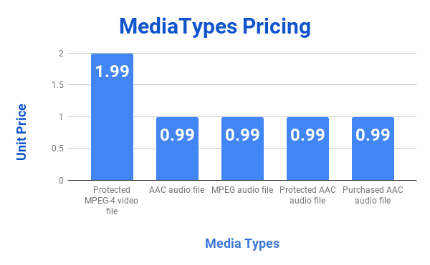
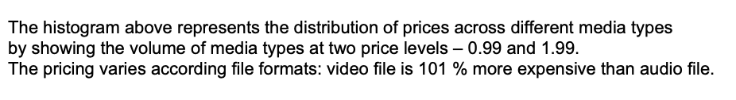
Notes:
The histogram above represents the distribution of prices across different media types
by showing the volume of media types at two price levels – 0.99 and 1.99.
The pricing varies according file formats: video file is 101 % more expensive than audio file.

Slide 5
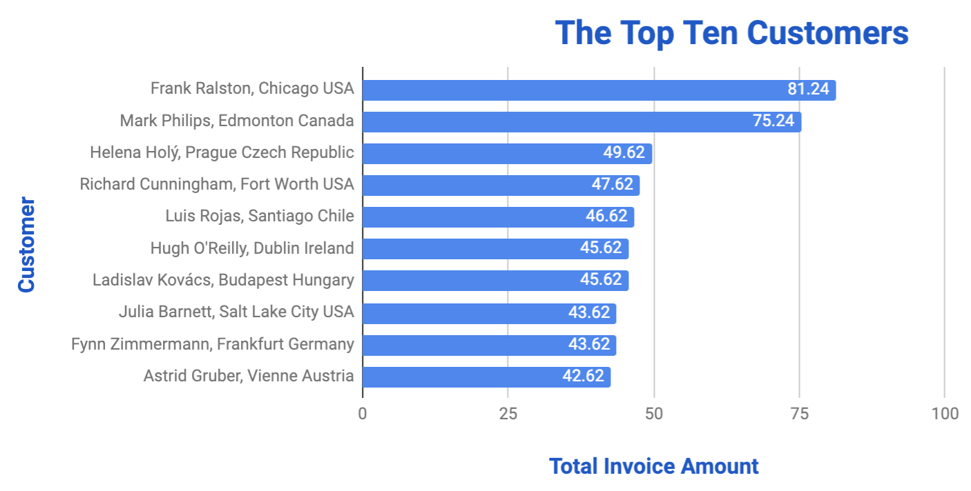

Notes:
The best customer is Frank with 81.24 in purchases.
The second best customer is Mark with 75.24 in purchases.

Slide 6
Query 1 "Amount Of Invoices":
SELECT BillingCountry, BillingCity, c.FirstName, c.LastName, COUNT (*) AS amount_of_invoices
FROM Invoice i
JOIN Customer c
ON i.CustomerId = c.CustomerId
GROUP BY BillingCountry
ORDER BY amount_of_invoices desc;

Slide 7
Query 2 "Genre Frequency":
SELECT g.Name, Count(*) AS frequency
FROM Genre g
INNER JOIN Track t
ON g.GenreId = t.GenreId
group BY g.Name
order BY 2 desc;

Slide 8
Query 3 "Exploring Media Types Pricing":
SELECT t.UnitPrice,t.MediaTypeId,m.Name, COUNT(t.MediaTypeId) AS amount_of_files, group_concat(t.Name) AS list_of_songs
FROM Track t
JOIN MediaType m
ON t.MediaTypeId = m.MediaTypeId
GROUP BY m.Name
ORDER BY UnitPrice desc;

Slide 9
Query 4 "The Top Ten Customers":
SELECT BillingCity, BillingCountry, c.FirstName, c.LastName, sum(total) AS sum_of_totals
FROM Invoice i
JOIN Customer c
ON i.CustomerId = c.CustomerId
GROUP BY c.FirstName
order BY 5 desc
limit 10;

