Slide 1
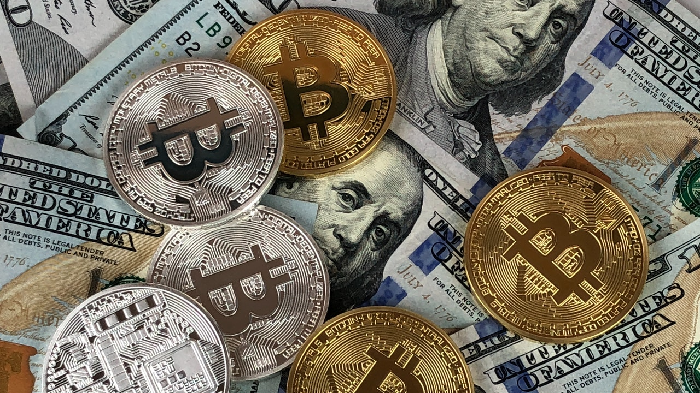
Analyzing Cryptocurrency Price Fluctuation Through
News and Social Media

Slide 2
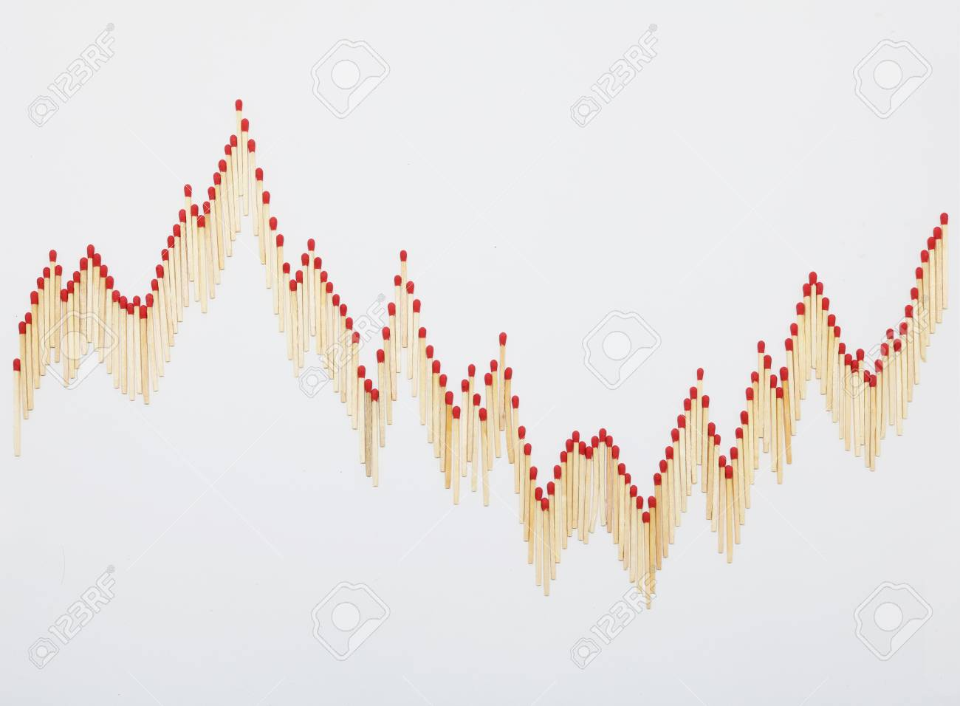



Market volatility
Nascent market
All cryptocurrencies combined accounted for less than 0.7% of the world's money.
Limited liquidity i.e. inherently volatile
Certain events can spark huge changes in price e.g. Elon Musk’s tweets, Tesla buying Bitcoin, Paypal allowing users to buy/sell crypto

Slide 3
Goal
Identifying and Visualizing correlation of specific events or sentiment with price spikes in cryptocurrency using a Knowledge Graph.
Price
Increase
Event
?
Price
Decrease

Slide 4
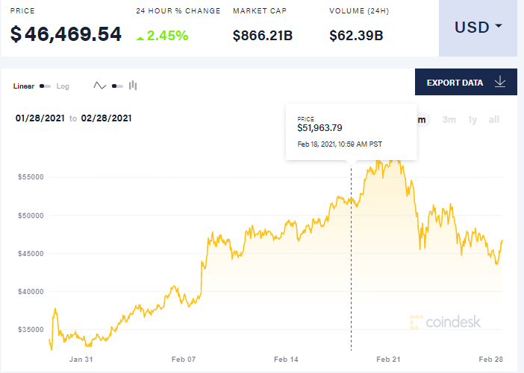
Data Sources
Structured
List of Cryptocurrencies and their Details
Price History
- APIs like CoinBase, CoinMarketCap

Slide 5
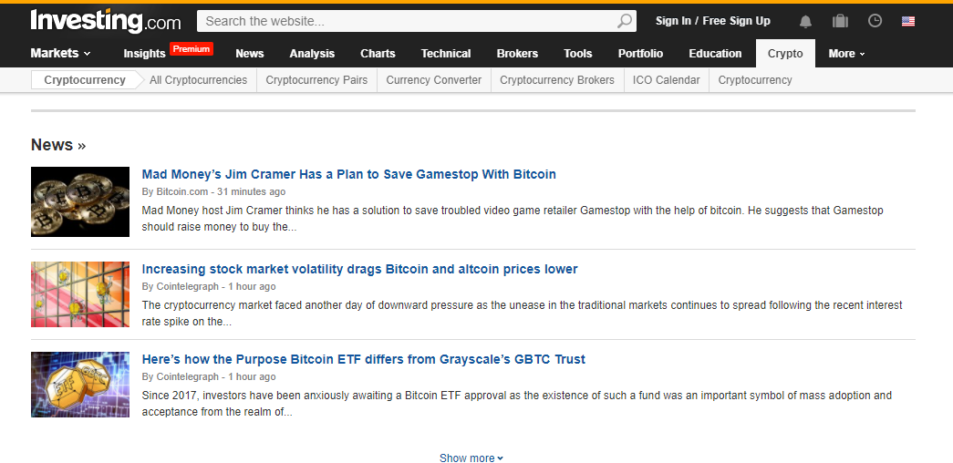
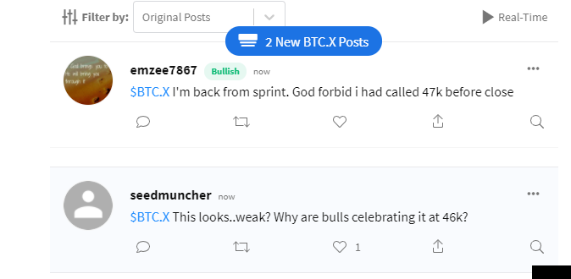
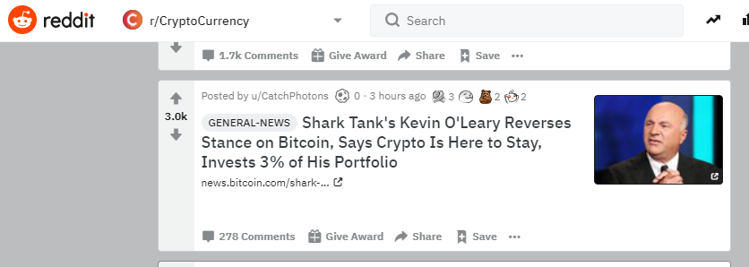
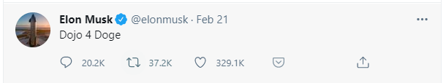
Data Sources
Unstructured
Twitter
- popular Crypto accounts like Elon Musk, John McAfee, Vitalik Buterin
StockTwits
- A microblogging community for traders and investors
News
- Investing.com, CryptoNews.com
Reddit
- popular crypto subreddits like r/CryptoCurrency

Slide 6
Questions to answer
What provoked a change in price of a major cryptocurrency?
How much time did it take for a tweet like Elon Musk to have a significant impact on the price of Dogecoin? Was the tweet the only instigator or did his tweet caused the news hype that led to the increase (i.e. a delay in the impact)
Can news and social media be a useful predictor in predicting cryptocurrency flunctuations?

Slide 7
Technical challenges
Information extraction from unstructured social media posts
Designing scrapers for a wide range of news sources
Storing all the data, structured as well as unstructured, in an RDF model so it can be easily queried using SPARQL

