Slide 3



Auto-Click Skip Intro Button

Slide 4

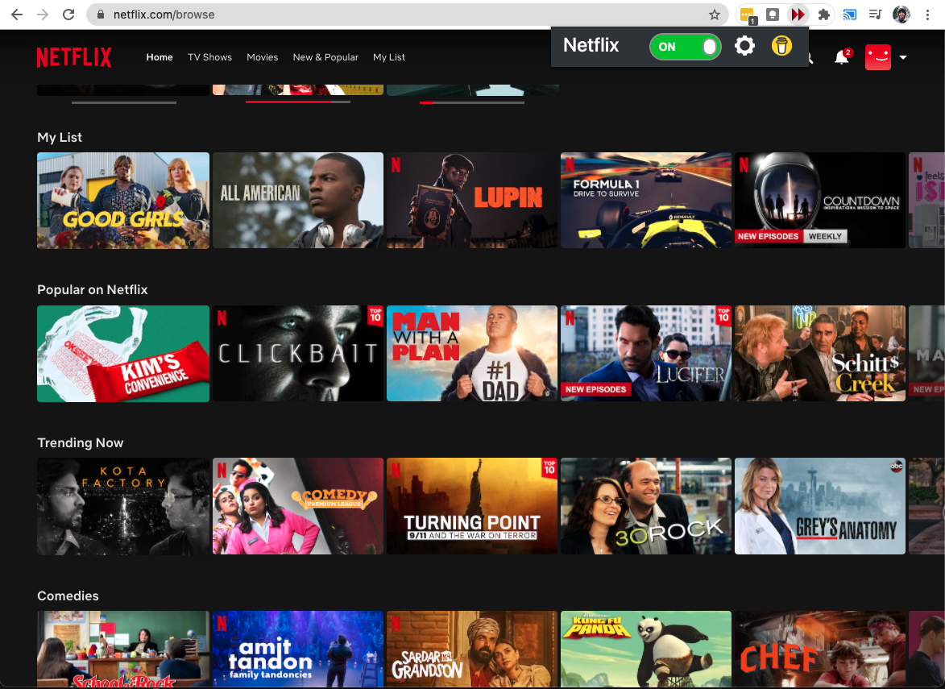
Easily Turn On Auto-Skip Intro

Slide 5
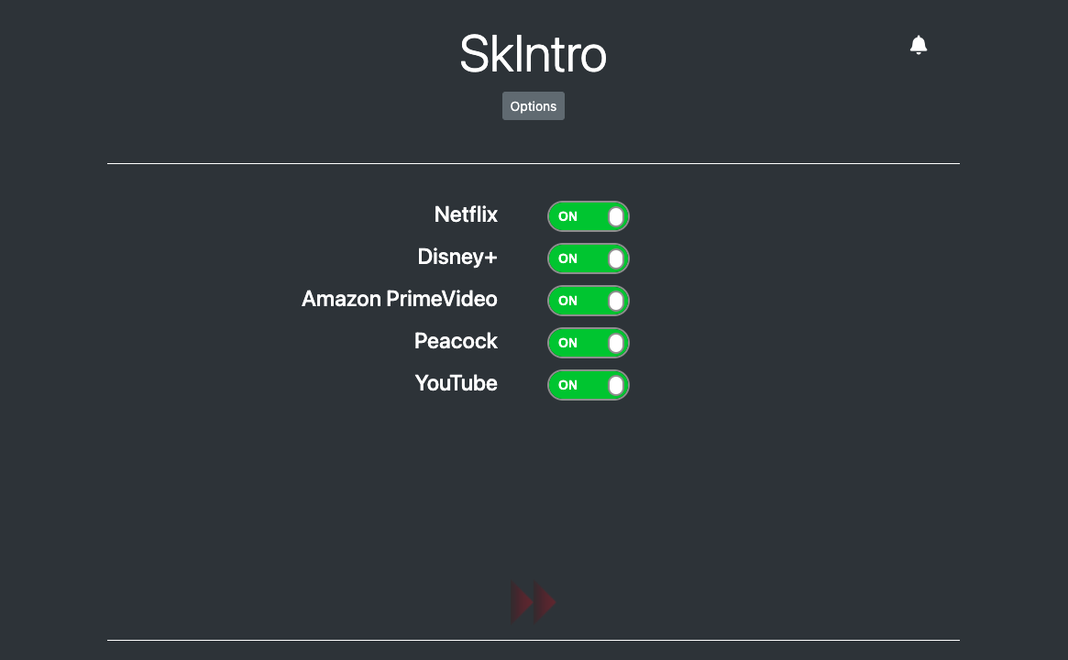
Support for Multiple Streaming Services

Slide 6

Skip Intro

