Slide 1

Cue
Not sure how to reply?
Cue has a suggestion.
An AI keyboard that combines conversation context,
what you want to say, and your writing style.
Undefined · Mikołaj Piech · Marcel Chudyba
HackYeah 2026 · Artificial Intelligence
Notes:
Sources: docs/PRODUCT.md and the team’s declaration. Artwork: existing assets/mascots/cue-write.png, an AI-assisted Cue asset.

Slide 2
When finding the words is hard
What should I say?
What am I missing?
You want to offer support, clear up a misunderstanding, or flirt a little. Finding the right words and tone can be hard.
Important events, preferences, and promises get buried in the chat history.
“finally done 😮‍💨”
Do you remember the exam they were so stressed about?
Notes:
The user need and target audience are product hypotheses, not research findings. The exam example is a fictional situation illustrating lost context. It is not a user-study result.

Slide 3
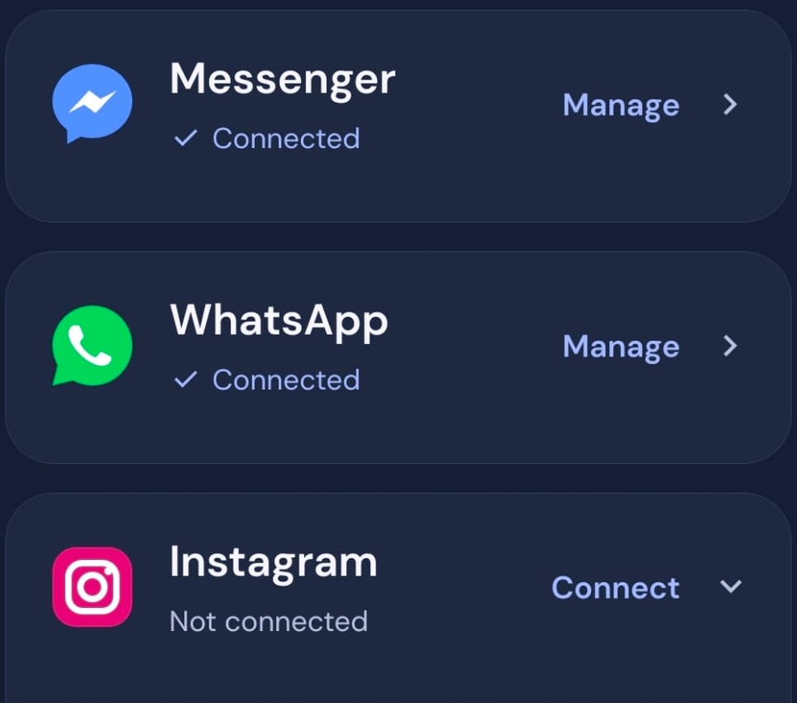
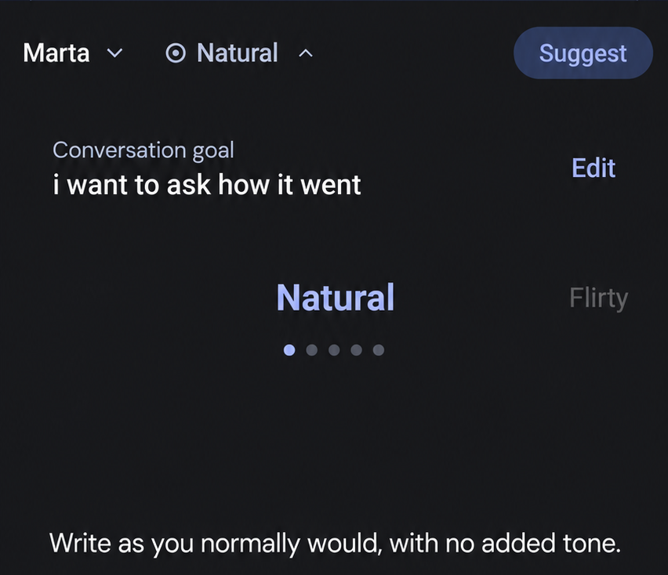
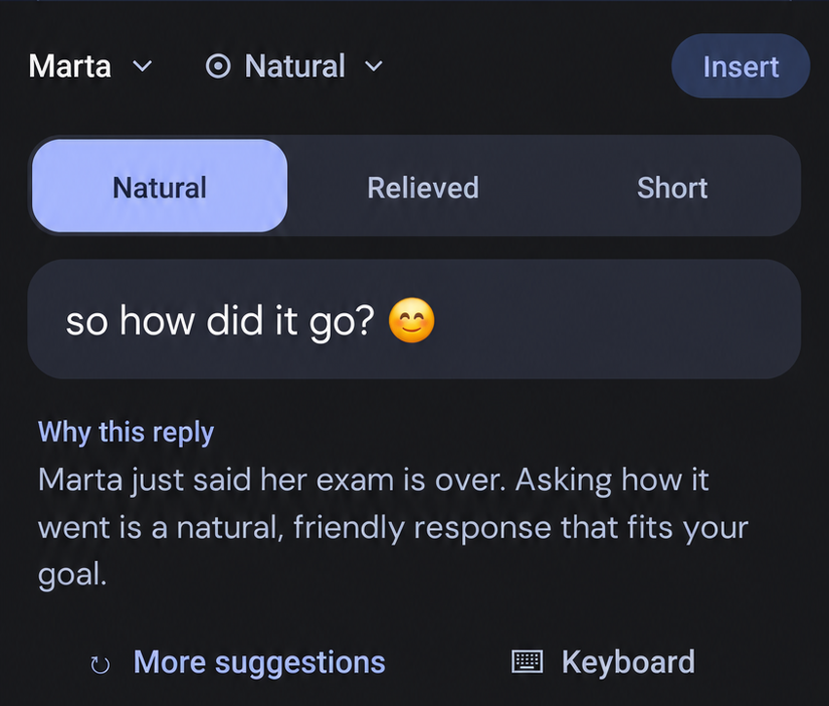
Cue, right where you type
01 Connect an account
02 Set your intention
03 Get a suggestion
Messenger or WhatsApp.
Context from your chosen chat.
Say what you want to express.
Choose a tone.
A reply in your own voice,
right in your keyboard.
You review, edit, and send.
Notes:
Section 01 uses a new English screenshot supplied by the user, cropped to the account rows. Messenger and WhatsApp show Connected; Instagram shows Not connected. Source: artifacts/cue/screenshots/en/01-connected-accounts-user.png. Sections 02 and 03 show Cue’s native keyboard on a Samsung Galaxy S22. Marta is a fictional conversation with 21 messages and 10 outgoing replies used as writing samples. The goal, translated into English, is “i want to ask how it went”, with a natural tone. The suggestion, translated as “so how did it go? 😊”, and its explanation came from a real model call in Polish. The keyboard was open in Cue’s test field. For sections 02 and 03 in this English deck, screenshot text, including the goal, reply, and explanation, was translated using image editing. These are localized presentation images, not captures of an English native keyboard or a new English model run. No behavior, connection status, or features were added. The user reviews, edits, and sends the reply. Sources: artifacts/cue/screenshots/01-connections-full.png, 02-intention-full.png, 03-reply-full.png, artifacts/cue/demo/exam-conversation.json, and exam-result.json. English assets: artifacts/cue/screenshots/en/.

Slide 4
Memory keeps up with the conversation
Marta · demo conversation
Cue remembers
thanks for the ticket! i owe you 50 zł.
i’ll pay you back tomorrow.
Amount owed
Remaining
50 zł
→
30 zł
actually, the day after tomorrow,
is that okay?
Settled in full
sent 20 zł out of the 50 zł.
i’ll send the rest the day after tomorrow.
Tomorrow → day after tomorrow
Cue’s saved note
sent the remaining 30 zł too.
“Marta paid you back the full 50 zł
for the ticket.”
got it, we’re all settled :)
Notes:
This slide translates selected Polish messages from a fictional demo conversation in CueDemo.kt into English, preserving their chronological order and meaning. The 50 zł to 30 zł progression illustrates the arithmetic implied by a partial repayment of 20 zł; it is not an independently measured intermediate model result. The saved note is an English translation of the preserved real Polish AI output: “Marta oddała Ci 50 zł za bilet — rozliczone w całości.” Its recorded status is done. No new English inference or benchmark was run for this slide. The completion is supported by the user confirming receipt. Source: artifacts/cue/demo/debt-memory-result.json.

Slide 5
A reply that sounds like you
Incoming message · Marta
Want to meet up tomorrow?
Without your style context
With your style context
Sure, I’d love to meet up.
What time works for you?
yeah sure, what time?
More formal
Short messages · lowercase
Notes:
Source: benchmarks/cue/report.json and cases.json, personal-voice case. Incoming message is translated from “Masz ochotę spotkać się jutro?”. The displayed replies are faithful English translations of the preserved Polish model outputs, not new English inference. Both variants used the same incoming message and intention: accept the meeting and ask for the time. The intention is omitted from the visual for brevity, not removed from the original test input. The memory variant supplied style context including lowercase, short messages, frequent phrases and writing examples. The no-memory variant omitted that context. One illustrative synthetic case, not a claim of general superiority or a controlled isolation of writing samples alone.

Slide 6
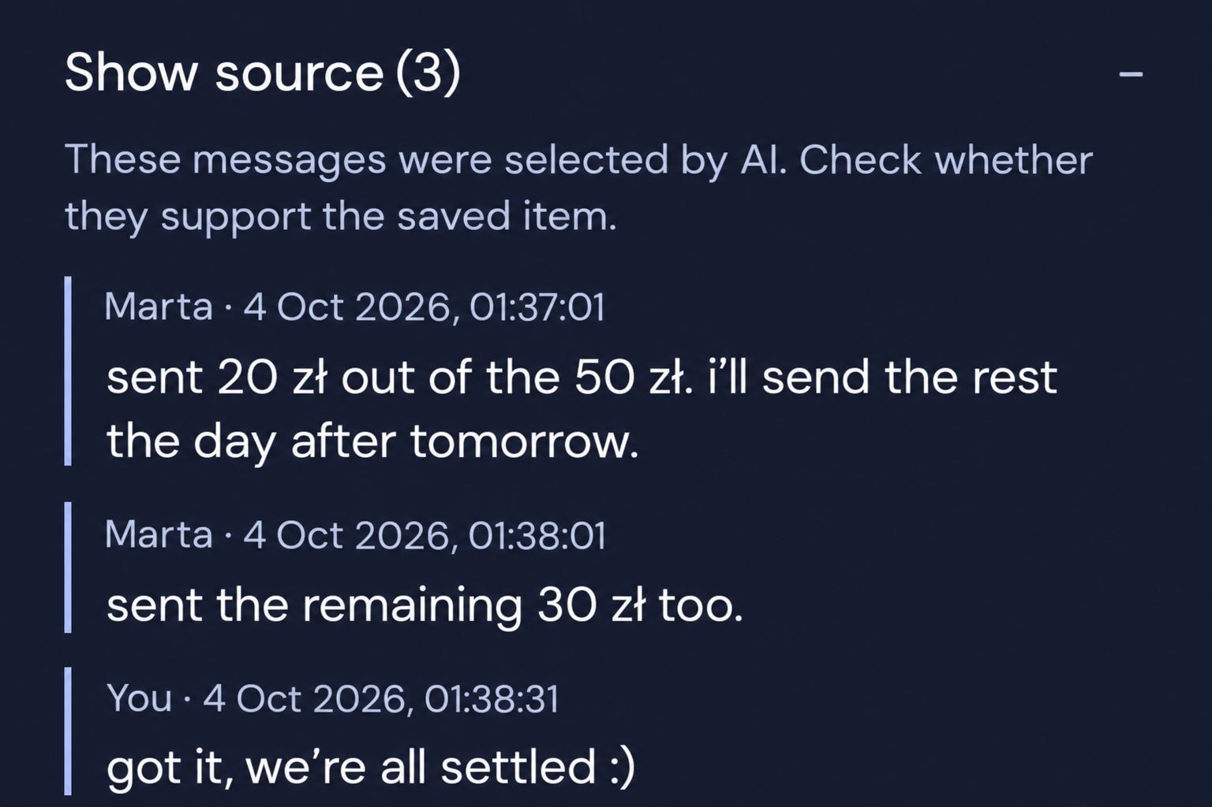
See the messages behind the memory
Check the source
Original message, sender,
and date.
Correct the memory
Edit, delete, or mark
it as done.
Notes:
Sources: src/features/subtext/EvidenceSources.tsx, ConversationReminders.tsx, and artifacts/cue/demo/debt-memory-result.json. The right-hand panel comes from an actual capture of the connected Android phone, with the isolated fictional ticket repayment demo open and its three stored source messages expanded in the reminder editor. Original capture: artifacts/cue/screenshots/05-debt-sources-full.png. English excerpt: artifacts/cue/screenshots/en/05-debt-sources-localized.png, cropped and translated with image editing; not a new English-native capture or fresh model inference. Message amounts, authors, order, dates and times are preserved. The user can view source messages, edit or delete reminders and mark open commitments as done; this completed example also supports reopening. Source availability can vary for older entries. No private conversation is shown and no reminder was saved, edited or deleted while capturing.

Slide 7
How Cue works
On your phone
In the cloud
Messenger · WhatsApp · Instagram
01 Build context
Selected context
02 Secure the request
History, memory & writing style
+ your intention
Supabase · auth & rate limits
04 Back to your keyboard
AI result
03 Generate with AI
Validate, review, edit, send
DeepSeek · memory & replies
Notes:
Sources: docs/ARCHITECTURE.md, SubtextRuntime.kt, SubtextKeyboard.kt, and supabase/functions/deepseek-analyze. This editable diagram simplifies the reply-request path: local conversation history, separate memory and per-chat writing features provide selected context and the user intention; Supabase validates the session and applies request limits while retaining the model key on the server; DeepSeek returns a result; the phone validates and presents suggestions in the keyboard for user review, editing and manual sending. Memory analysis also uses this backend, and eligible chats may update automatically when AI is enabled; replies are generated on request. Up to 80 recent messages, memory and style examples can be included; available recent images may accompany reply analysis. The diagram does not claim that all processing is local or that code verifies semantic truth. Instagram is present in the current integration code; its inclusion is not a claim of successful end-to-end verification for every service.

Slide 8
Prototype scope and next steps
Today
Next
Android prototype
Test usefulness with users
Cloud AI requires internet
and review.
Improve factual accuracy
and reliability
History depends on the
service and session.
Validate the iOS experience
Notes:
Sources: docs/ARCHITECTURE.md, docs/PRODUCT.md, docs/RESOURCES.md, benchmarks/cue/report.json and review.json. Android is the verified prototype path; iOS validation is a next step, not a claim of equivalent tested behavior. Cloud AI requires internet and sends selected conversation messages, memory, style context and intention for processing. Up to 80 recent messages can be included; reply requests may include up to 3 available recent images. Memory updates automatically for eligible chats after AI consent, and individual chats can be excluded; reply suggestions are on demand and users send manually. Unofficial integrations depend on the service, session and available history. Next steps are plans, not completed outcomes: usefulness testing with users, broader grounding evaluation and reliability improvements, and iOS validation. Evaluation details: 24 synthetic conversation cases, 33 live calls across the main memory-enabled run and nine no-memory comparisons. Main run: 23 of 24 successful requests with valid basic JSON structure; p50 2.573 seconds and p95 3.688 seconds for successful endpoint requests. These are infrastructure/format measurements, not semantic accuracy, user usefulness or complete phone/keyboard latency. The synthetic suite is a regression set, not a held-out benchmark, and there were no independent human participants. Assistant review identified invented details, disputed-debt attribution issues and one HTTP 502. The evaluation predates the local prompt clarification; deployed prompt equality and provider model identity were not verified. Detailed reports are provided with the project.

Slide 9

Cue
Not sure how to reply?
Cue has a suggestion.
Undefined
Mikołaj Piech · Marcel Chudyba
Both 18 · Built from scratch during HackYeah.
Open-source foundations · DeepSeek AI · Codex-assisted development
Notes:
Team declaration: Undefined consists of Mikołaj Piech and Marcel Chudyba, both 18; Cue was created from scratch during HackYeah using existing external tools and general-purpose open-source components. Application work includes integration of native messaging bridges and the Cue interface, per-chat memory, style/intention/tone flow, reminder lifecycle and source inspection, native keyboard integration, backend request validation, demonstrator and evaluation. External resources: Expo SDK 57, React Native, Expo Router and Expo Modules (https://docs.expo.dev/); React, TanStack Query, Zustand, Zod, AsyncStorage, FlashList and Reanimated, with versions and notices in package-lock.json; messaging bridges adapted from Arie, MirrorMsg, mautrix-meta/messagix and whatsmeow, with repositories, commits, modifications and licenses in modules/subtext/NOTICE.md; HeliBoard 4.0 keyboard engine, dictionaries and related upstream functionality, documented in vendor/heliboard/INTEGRATION.md; Supabase Auth and Edge Functions (https://supabase.com/docs); DeepSeek API for interpretation and generation (https://api-docs.deepseek.com/), using the configured alias deepseek-flash, not a team-trained foundation model. App fonts DM Sans and Manrope have licenses in assets/fonts. Full resource disclosure: docs/RESOURCES.md. Codex substantially supported implementation, analysis, debugging, tests, synthetic examples, documentation and presentation materials. Selected screenshot excerpts were translated using AI image editing and are identified in their slide notes. Artwork: assets/mascots/cue-wave.png; brand mascot prompts are documented in assets/mascots/prompts.json. No claim is made of authoring the external engines or model.

