Slide 1
OpenMC : the People’s Monte Carlo

Slide 2
How Monte Carlo Particle Simulations Work

Slide 3
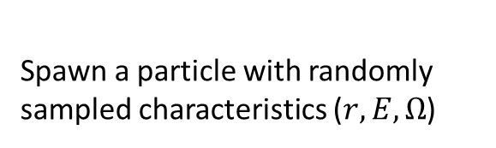
How Monte Carlo Particle Simulations Work
Spawn a particle with randomly sampled characteristics ($r,E,Ω$)

Slide 4
How Monte Carlo Particle Simulations Work
Spawn a particle with randomly sampled characteristics ($r,E,Ω$)
Choose a random distance to collision

Slide 5
How Monte Carlo Particle Simulations Work
Spawn a particle with randomly sampled characteristics ($r,E,Ω$)
Sample a random reaction
Choose a random distance to collision

Slide 6
How Monte Carlo Particle Simulations Work
Spawn a particle with randomly sampled characteristics ($r,E,Ω$)
Sample a random reaction
Choose a random distance to collision

Slide 7
How Monte Carlo Particle Simulations Work
Spawn a particle with randomly sampled characteristics ($r,E,Ω$)
Choose a random distance to collision
Sample a random reaction

Slide 8
How Monte Carlo Particle Simulations Work
Spawn a particle with randomly sampled characteristics ($r,E,Ω$)
Run for 1,000’s to 1,000,000,000’s of particles!
Choose a random distance to collision
Sample a random reaction

Slide 9

Material Definitions
OpenMC Materials require 2-3 things

Slide 10
Material Definitions
OpenMC Materials require 2-3 things
Atomic content

Slide 11
Material Definitions
OpenMC Materials require 2-3 things
Atomic content
Density

Slide 12
Material Definitions
OpenMC Materials require 2-3 things
Atomic content
Density
Thermal Scattering Data (if necessary)

Slide 13
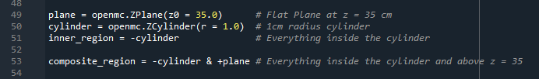
Geometry Definitions

Slide 14
Geometry Definitions
OpenMC geometry is generated with Constructive Solid Geometry (CSG)

Slide 15
Geometry Definitions
OpenMC geometry is generated with Constructive Solid Geometry (CSG)
Built from basic shapes and surfaces

Slide 16
Geometry Definitions
OpenMC geometry is generated with Constructive Solid Geometry (CSG)
Built from basic shapes and surfaces
Regions defined from inside/outside a given surface

Slide 17
Geometry Definitions
OpenMC geometry is generated with Constructive Solid Geometry (CSG)
Built from basic shapes and surfaces
Regions defined from inside/outside a given surface
Cells are built from a material filler and a defining region

Slide 18
Geometry Definitions
OpenMC geometry is generated with Constructive Solid Geometry (CSG)
Built from basic shapes and surfaces
Regions defined from inside/outside a given surface
Cells are built from a material filler and a defining region
Universes are built from a collection of cells

Slide 19
Geometry Definitions
OpenMC geometry is generated with Constructive Solid Geometry (CSG)
Built from basic shapes and surfaces
Regions defined from inside/outside a given surface
Cells are built from a material filler and a defining region
Universes are built from a collection of cells
Lattices are built from a collection of universes

Slide 20

Tallies for When It Needs to Count

Slide 21
Tallies for When It Needs to Count
Tallies collect data when the simulation is running

Slide 22
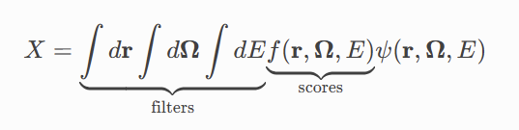
Tallies for When It Needs to Count
Tallies collect data when the simulation is running
From the OpenMC website

Slide 23
Tallies for When It Needs to Count
Tallies collect data when the simulation is running
From the OpenMC website
Filters govern where the tally is collected (in space, energy, angle, etc.)

Slide 24
Tallies for When It Needs to Count
Tallies collect data when the simulation is running
From the OpenMC website
Filters govern where the tally is collected (in space, energy, angle, etc.)
Scores govern what is collected (fission rate, flux, decay rate)

Slide 25
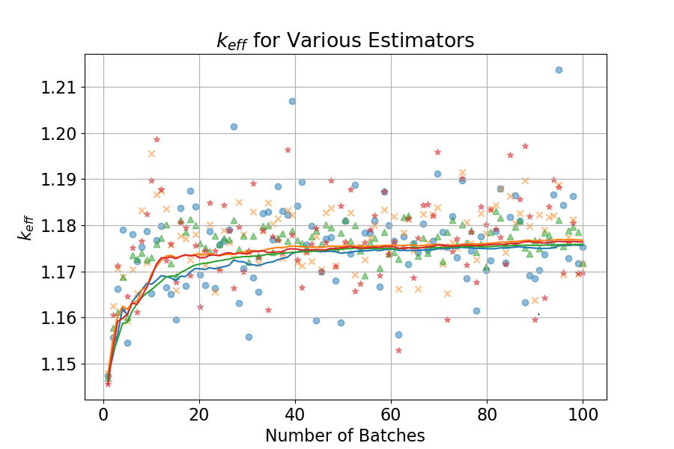
Simulation Settings

Slide 26
Simulation Settings
Particles per batch

Slide 27
Simulation Settings
Particles per batch
Number of total batches

Slide 28
Simulation Settings
Particles per batch
Number of total batches
Number of inactive batches

Slide 29
Simulation Settings
Particles per batch
Number of total batches
Number of inactive batches
Converge the fission source before counting tallies

Slide 30
Simulation Settings
Particles per batch
Number of total batches
Number of inactive batches
Converge the fission source before counting tallies
Shannon Entropy can be used to find ideal inactive batch number

Slide 31
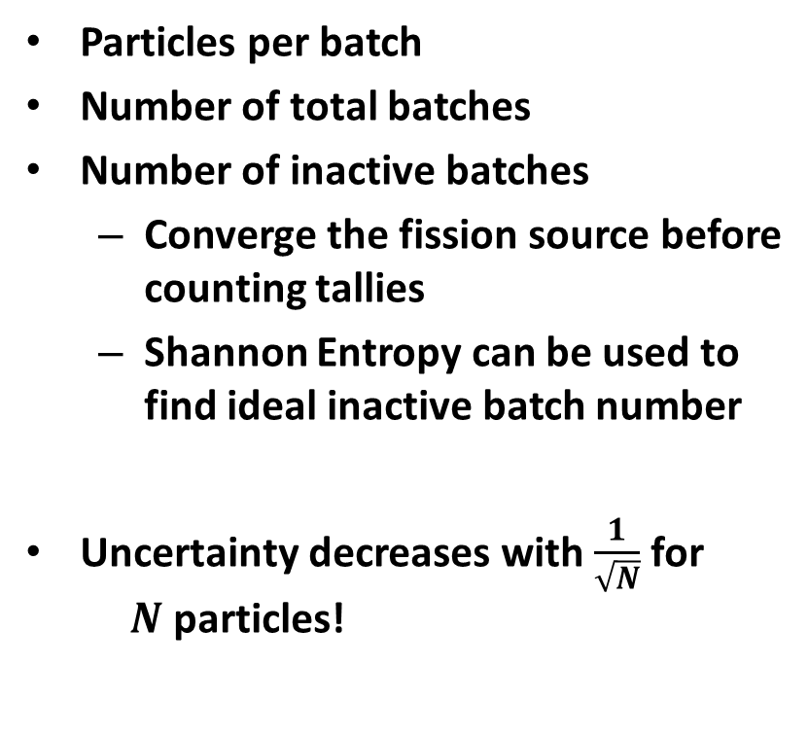
Simulation Settings
Particles per batch
Number of total batches
Number of inactive batches
Converge the fission source before counting tallies
Shannon Entropy can be used to find ideal inactive batch number
Uncertainty decreases with $\frac{1}{\sqrt{N}}$ for $N$ particles!

Slide 32

OpenMC Documentation and Examples

