Slide 1
UPES | C PROGRAMMING MINI HACKATHON 2026
TEAM 11 • BATCH 10
BitNet-C
A Bitwise Optimized Binary Neural Network
for Ultra Low Memory Activation
TEAM AMATEURS
TEAM NUMBER 11 | BATCH 10
Nimit
Pranav Bhasin
SAP ID: 590033868
SAP ID: 590032768
Abhimanyu Jakhar
Aasma Sharda
SAP ID: 590032062
SAP ID: 590032474
Faculty: Prof. Subhranil Das | UPES, Dehradun

Slide 2
Problem Statement & Objectives
The engineering challenge: reduce model storage while preserving correct binary inference
ASSIGNED PROBLEM STATEMENT
BitNet-C — A Bitwise Optimized Binary Neural Network for Ultra Low Memory Activation
CONVENTIONAL APPROACH
TECHNICAL CHALLENGE
BITNET-C OBJECTIVES
Float32 representation
Compact, correct inference
Pure C proof of concept
• 32 bits for each neural weight
• Represent weights using binary bits
• Implement an 8 → 4 → 1 network
• 32 bits per hidden activation
• Replace multiplications with bitwise matching
• Use XNOR + population counting
• 36 weights occupy 144 bytes
• Pack neuron outputs efficiently
• Optimize weights with bit-flip search
• 4 activations occupy 16 bytes
• Verify agreement with float32 reference
• Test all 256 possible input patterns
Higher storage cost even for a tiny network.
Optimize storage without changing inference semantics.
Add benchmarking, visualization and file persistence.
SCOPE: an 8-bit educational classifier; savings describe weight and activation storage, not total process RAM.
BITNET-C | TEAM AMATEURS | TEAM 11 | BATCH 10
02 / 09

Slide 3
Proposed Solution & Network Architecture
Pure C implementation • 8 input bits → 4 hidden neurons → 1 output neuron
INPUT LAYER
HIDDEN LAYER
OUTPUT LAYER
8
4
1
8-bit pattern
4 sign activations
Class 0 / 1
uint8_t input
Packed in 1 byte
Binary sign output
36 binary weights
5 bytes of weights
Inference engine
32 hidden + 4 output weights
4 hidden bytes + 1 output byte
XNOR → Popcount → Sign
BITNET-C | TEAM AMATEURS | TEAM 11 | BATCH 10
03 / 09

Slide 4
Core Algorithm & C Implementation
The binary dot product replaces multiplication with bitwise matching
WORKED EXAMPLE (8-bit neuron)
Core C functions
count_bits()
binary_dot_product()
binary_activation()
binary_network()
Input A
10110110
Weight B
10100110
XNOR(A,B)
11101111
Programming concepts
Matching bits
7 of 8
uint8_t / uint32_t • arrays
Functions • loops • conditions
XOR, NOT, AND, bit shifting
String validation • pointers
Dot product
2 × 7 − 8 = +6
Sign activation
+1
Dot(A,B) = 2 × Popcount(XNOR(A,B)) − N
BITNET-C | TEAM AMATEURS | TEAM 11 | BATCH 10
04 / 09

Slide 5
Training, Classification & Evaluation
Discrete bit-flip hill climbing with reproducible stratified holdout
256 TOTAL BINARY PATTERNS
192 TRAINING / 64 TESTING
Class 0: 93 patterns | Class 1: 163 patterns
75:25 stratified split; test inputs excluded from training
01
02
03
04
Initialize
Flip one bit
Keep improvement
Restart
Original / random weights
Evaluate training score
Otherwise revert flip
Retain best model
REFERENCE LABEL
Class 0: fewer than four 1-bits | Class 1: at least four 1-bits
BITNET-C | TEAM AMATEURS | TEAM 11 | BATCH 10
05 / 09

Slide 6
Memory Optimization & Performance Analysis
Storage calculations are for model representations, not total process RAM
WEIGHT STORAGE
HIDDEN ACTIVATION STORAGE
Float32 — 144 bytes
Float32 — 16 bytes
Binary — 5 bytes
Binary — 1 byte
96.53% LESS STORAGE
93.75% LESS STORAGE
BENCHMARK METHOD
1,000,000 inferences per network • CPU timing via clock() • Speed varies by hardware and compiler.
BITNET-C | TEAM AMATEURS | TEAM 11 | BATCH 10
06 / 09

Slide 7
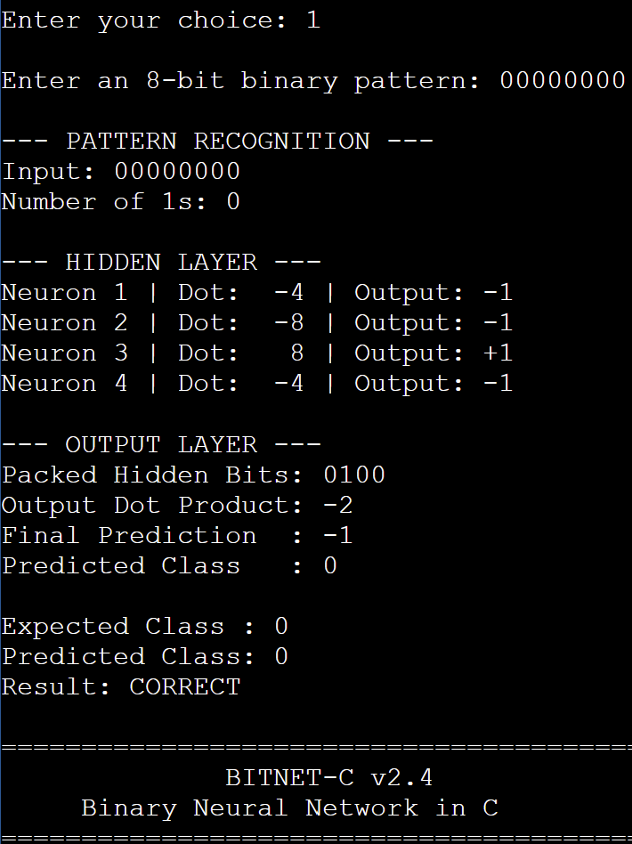
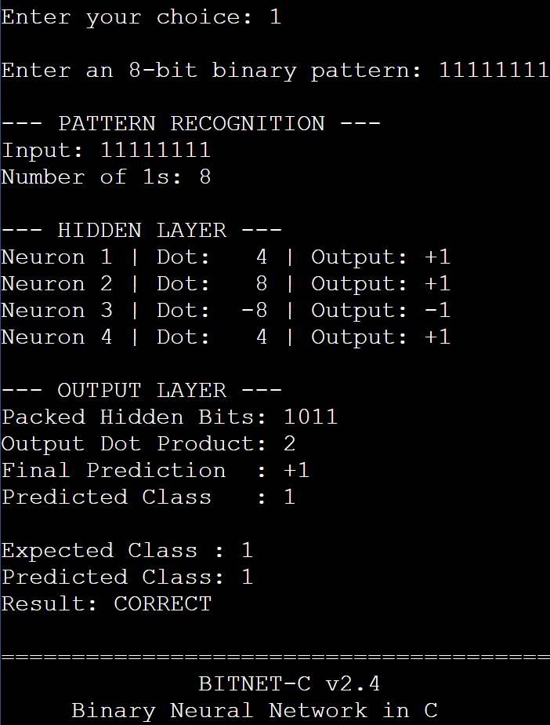
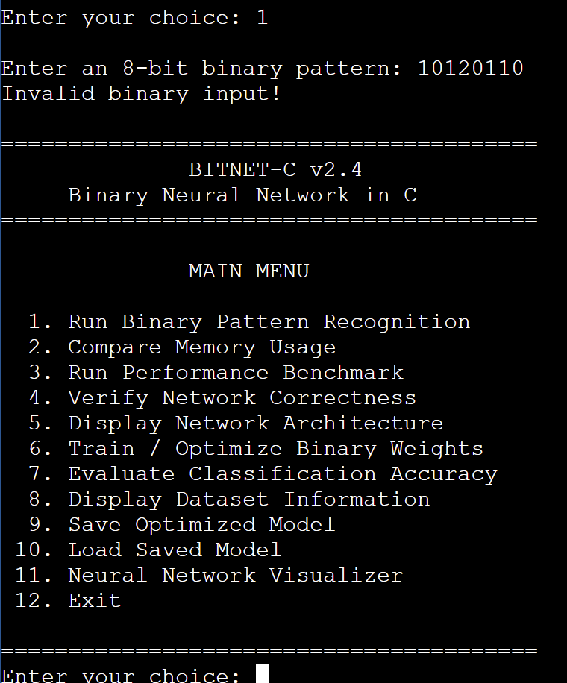
Testing, Validation & Observed Results
Actual OnlineGDB evidence • Class predictions • Computational correctness
TC-01 | 00000000 → Class 0
TC-02 | 11111111 → Class 1
TC-06 | Invalid input rejected
4 / 4 shown valid classification tests passed
v2.2 observed: 256/256 correct after training
Final v2.4 full-run accuracy requires reconfirmation.
BITNET-C | TEAM AMATEURS | TEAM 11 | BATCH 10
07 / 09

Slide 8
Working Prototype & Live Demonstration
Interactive C terminal • 12 menu operations • Reproducible technical walkthrough
BITNET-C v2.4 | MAIN MENU
LIVE DEMONSTRATION SEQUENCE
01 Binary pattern recognition
06
Train binary weights
02 Memory comparison
07
Evaluate 192 train / 64 test
03 Performance benchmark
01
Predict from an 8-bit input
04 Correctness verification
11
Inspect XNOR and activations
05 Network architecture
06 Train / optimize weights
07 Classification accuracy
MODEL PERSISTENCE & VALIDATION
08 Dataset information
09 SAVE
Write BNC1 signature + 5 weight bytes
09 Save optimized model
10 Load saved model
10 LOAD
Validate file and restore optimized weights
11 Neural network visualizer
04 VERIFY
Compare binary and float32 over 256 inputs
12 Exit
Saved model file: 9 bytes | Weight payload: 5 bytes
BITNET-C | TEAM AMATEURS | TEAM 11 | BATCH 10
08 / 09

Slide 9
Conclusion, Future Scope & Team Contributions
BitNet-C is a compact, testable C-based binary neural-network prototype
PROJECT OUTCOMES
LIMITATIONS & NEXT STEPS
• 8 → 4 → 1 binary inference in C
• 96.53% less weight storage
• 93.75% less hidden-activation storage
• Training, validation, save/load and visualizer
• Small, fully enumerable 8-bit task
• Benchmark speed is environment-dependent
• Future: wider inputs, larger networks, hardware popcount and memory profiling
TEAM AMATEURS | TEAM 11 | BATCH 10
Nimit
Team Lead & Lead Developer
Pranav Bhasin
Testing & Validation
Abhimanyu Jakhar
Research & Analysis
Aasma Sharda
Documentation & Presentation
Faculty: Prof. Subhranil Das | github.com/realnimit1-byte/Batch10_Team11_BitNet-C
BITNET-C | TEAM AMATEURS | TEAM 11 | BATCH 10
09 / 09

