Slide 1
PWM-Based DC Motor
CT 321 — Project
Speed Control System
GROUP NO 10
NAMES | REG NO | COURSE
NISAGURWE S AGOSTINO | T23-03-14465 | BSc.CE
DAVID DANIEL DAVID | T23-03-15326 | BSc.CE
DENNIS MARIWA | T23-03-19910 | BSc.CE
EMMANUEL N FULUGE | T23-03-15286 | BSc.CE

Slide 2
Project Overview
Objective
Key Specifications
Design and implement a PWM-based DC motor speed control system using the ATmega32, with push-button speed control and LED level indicators.
PWM output: Timer0 / OC0 / PB3
5 speed levels: 0%, 25%, 50%, 75%, 100%
External 8 MHz crystal clock source
Push Buttons
ATmega32
MOSFET Driver
DC Motor
PA0 PA1 PA2
Timer0 PWM
Gate via 220Ω
Flyback diode
LED Speed Indicators (PB0, PB1, PB2)
Level 0
0% — Stopped
Level 1
25% — Low
Level 2
50% — Medium
Level 3
75% — High
Level 4
100% — Full
Notes:
Introduce the system: buttons → ATmega32 → MOSFET → motor. Explain the LED indicators show current speed level.

Slide 3
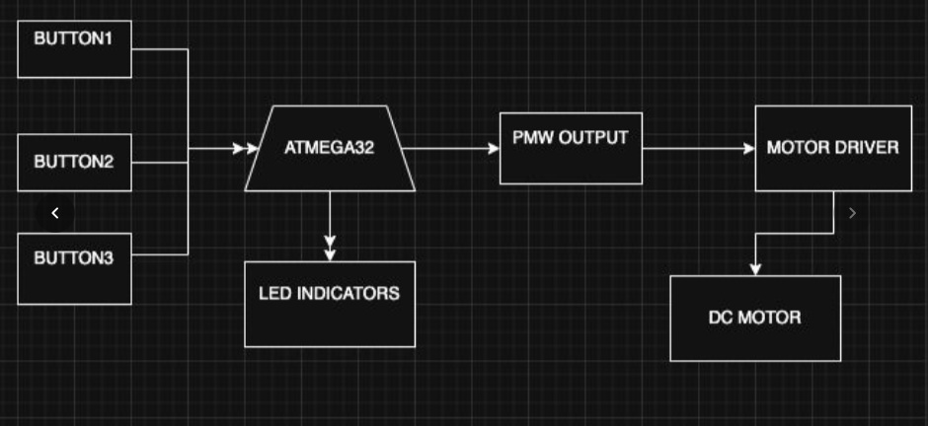
System Block Diagram
Notes:
Show the full system block diagram here. Explain the signal flow from push buttons through the ATmega32 to the motor driver and DC motor. Mention the feedback path via LED indicators.

Slide 4
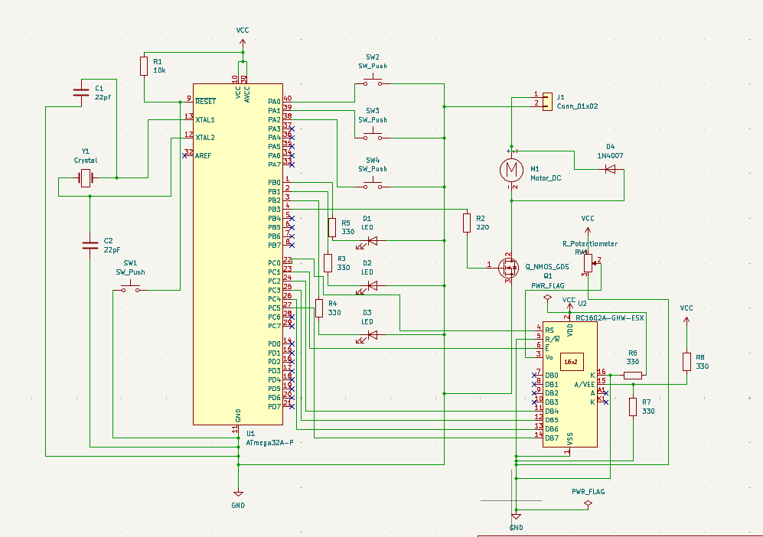
KiCad Schematic Design
Notes:
Walk through the schematic. Point out: PB3 PWM signal path through 220Ω to MOSFET gate. PA0-PA2 button inputs with internal pull-ups. PB0-PB2 LED outputs. Crystal oscillator circuit. Flyback diode across motor.

Slide 5
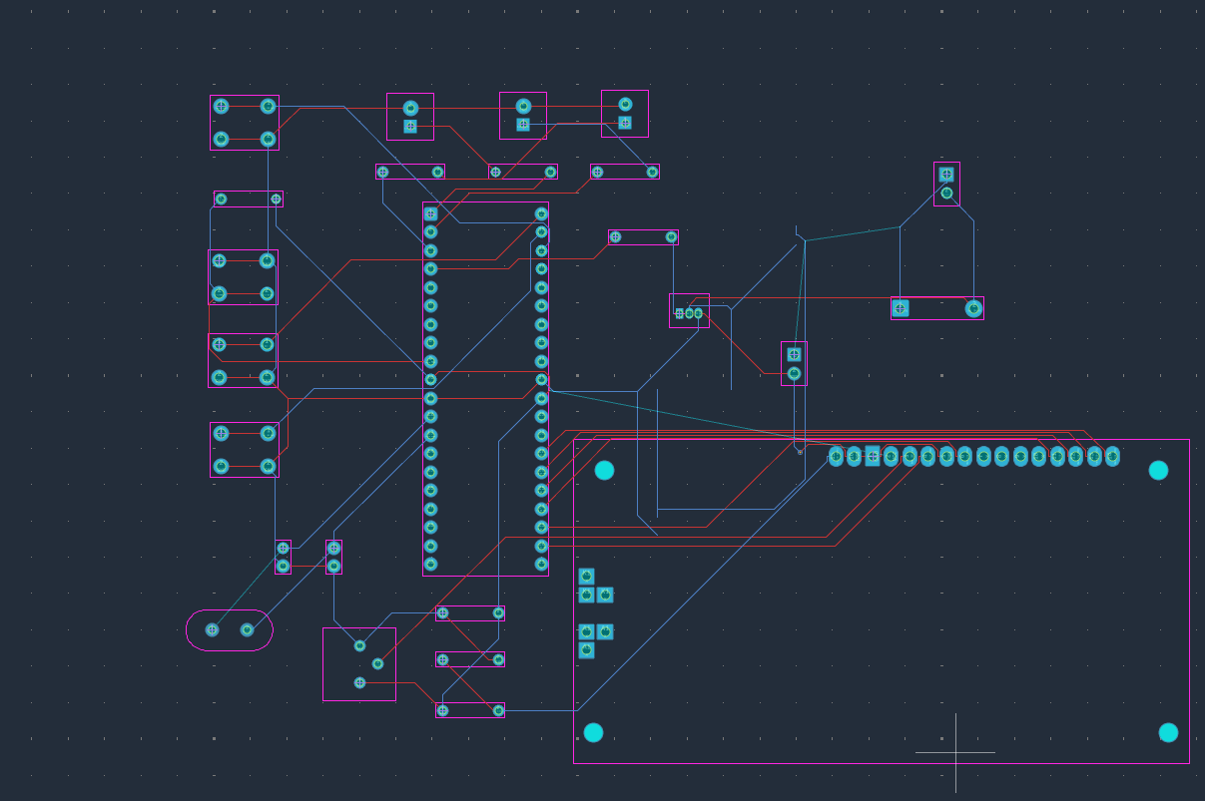
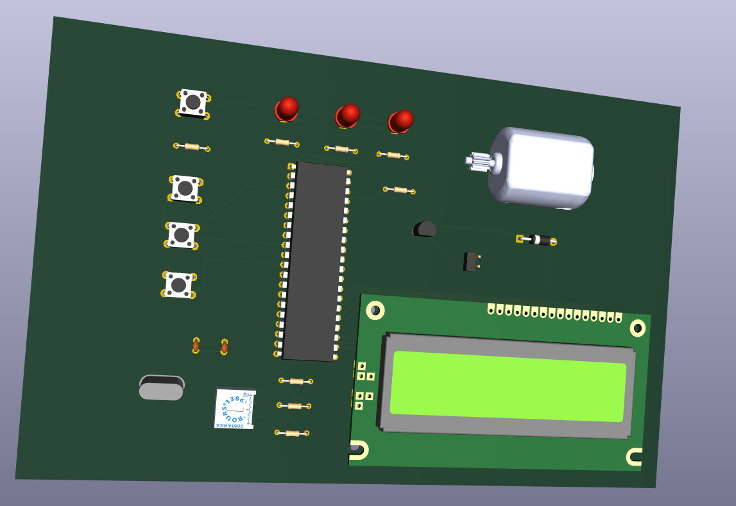
PCB Layout (KiCad)
Notes:
Show the PCB layout. Point out: motor driver section placed away from crystal to reduce noise. Wider traces for motor power path. DRC and ERC were run and passed before Gerber export.

Slide 6
PWM Theory & Configuration
Duty Cycle Formula
Timer0 Fast PWM Setup
D = (OCR0 / 255) × 100%
WGM01:WGM00
= 1:1
Fast PWM mode
Speed Levels
COM01:COM00
= 1:0
Level | OCR0 | Duty Cycle | Motor
0 | 0 | 0% | Stopped
1 | 64 | 25% | Low
2 | 128 | 50% | Medium
3 | 191 | 75% | High
4 | 255 | 100% | Full
Non-inverting output
CS02:CS00
= 001
No prescaler (CLK/1)
Frequency Calculation
f = 8,000,000 / (1 × 256) = 31.25 kHz
Fixed frequency — only duty cycle changes with OCR0
Notes:
Explain PWM formula, OCR0 values for each level, and Timer0 TCCR0 register settings. Frequency is fixed at 31.25 kHz — only duty cycle changes.

Slide 7
Firmware Implementation
Main Program Structure
Button Logic
main()
{
initialize_gpio();
initialize_pwm();
while(1)
{
read_buttons();
update_duty_cycle();
update_speed_indicators();
}
}
Increase (PA0)
OCR0 += 64 (max: 255)
Decrease (PA1)
OCR0 -= 64 (min: 0)
Stop (PA2)
OCR0 = 0 (immediate stop)
Safety & Features
Upper limit: OCR0 capped at 255
Lower limit: OCR0 floored at 0
Software debounce on all buttons
Safe startup: motor stopped at power-on
Internal pull-ups on PA0–PA2
Notes:
Walk through the main firmware loop. Show button logic and safety limits. Mention software debounce and safe startup.

Slide 8
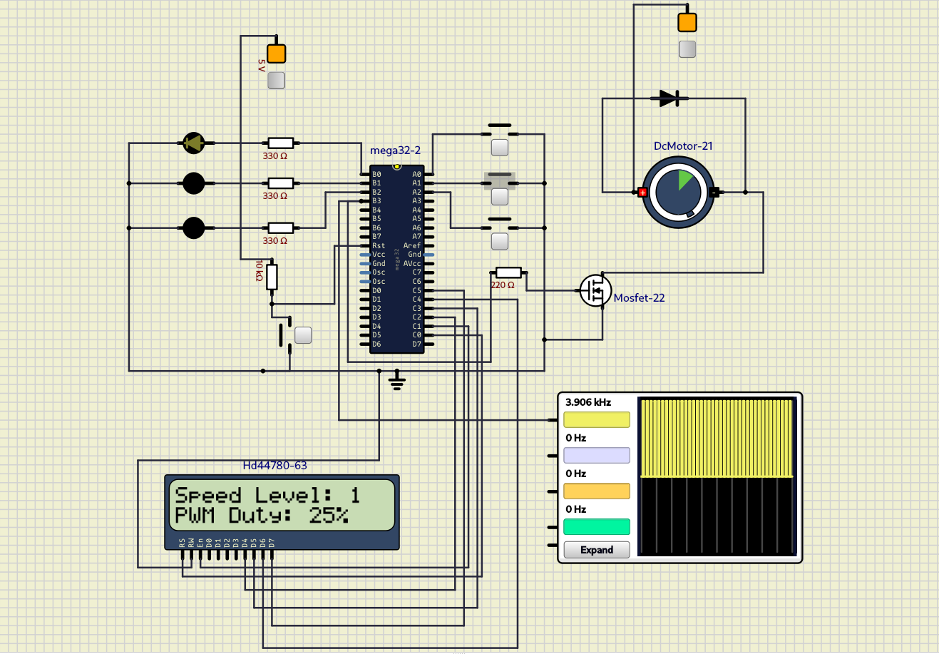
SimulIDE Simulation
Notes:
Show the SimulIDE simulation running. Point to the oscilloscope PWM waveform. Walk through all 6 tests that passed.

Slide 9
GitHub Repository
firmware/
src/, include/, hex/ — source code and compiled .hex
kicad/
schematic/, pcb/, gerber/ — KiCad design files
simulide/
circuit/, screenshots/ — simulation files
documentation/
pwm_config, duty_calc, pin_mapping, test_results .md files
media/
demonstration_video_link.txt
Repository: ATmega32_PWM_DC_Motor_Control
Notes:
Show the GitHub repository structure. Explain what is in each folder: firmware source and hex, KiCad design files, SimulIDE simulation, documentation markdown files, and demo video link.

Slide 10
Conclusion
✓
PWM Generation
✓
Speed Control
Timer0 Fast PWM at 31.25 kHz on PB3/OC0 — confirmed by oscilloscope
5 discrete levels (0–100%) via push buttons with safety limits
✓
Motor Driver
✓
LED Indication
MOSFET stage + flyback diode protects MCU from back-EMF
Speed level shown clearly on PB0, PB1, PB2 LEDs
✓
KiCad Design
✓
Simulation Verified
Full schematic + PCB layout with DRC/ERC compliance
All 6 functional tests passed in SimulIDE
Notes:
Summarize all 6 achievements. Mention the extension possibility.

Slide 11
Thank You
GitHub: https://github.com/realnissa/ATmega32_PWM_DC_Motor_Control
Notes:
Open for questions. Be ready to show SimulIDE simulation live and walk through any section.

